Slide 1
YALA – Yet Another List App
Evan Berryman, Jake Allen, Sam Hobbs

Slide 2
Purpose
Make shopping lists easier to manage
Only add items from a particular store inventory
Create and save multiple lists

Slide 3
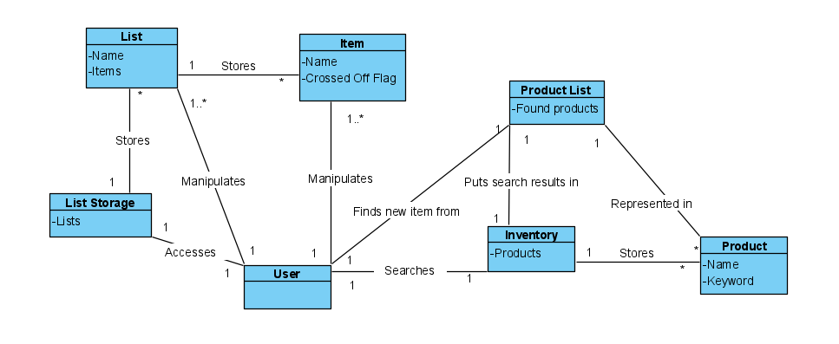
Domain model

Slide 4
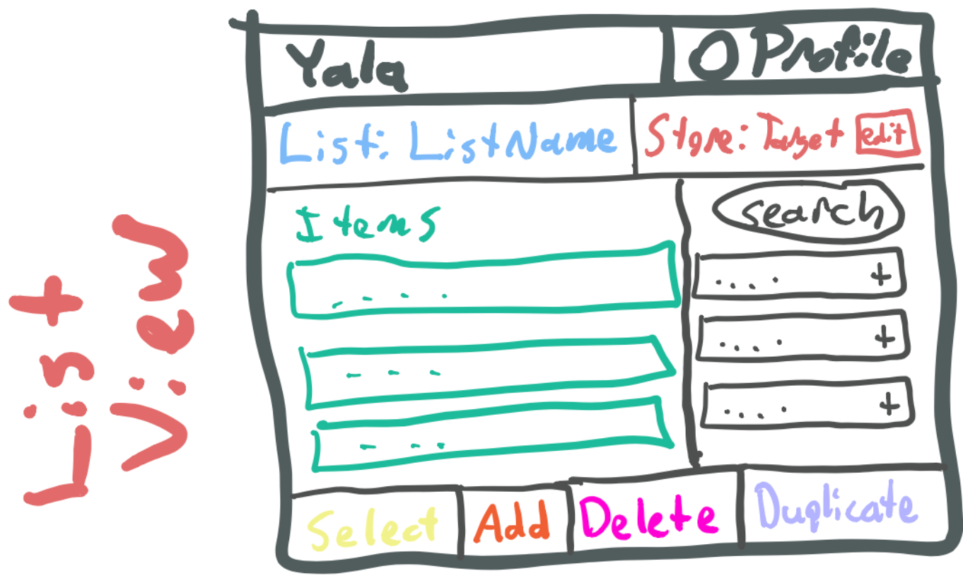
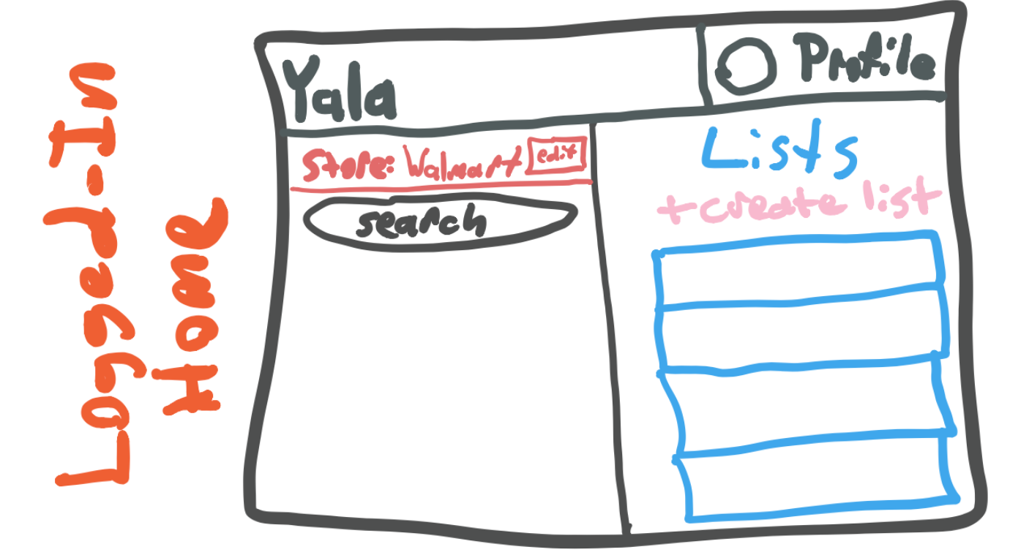
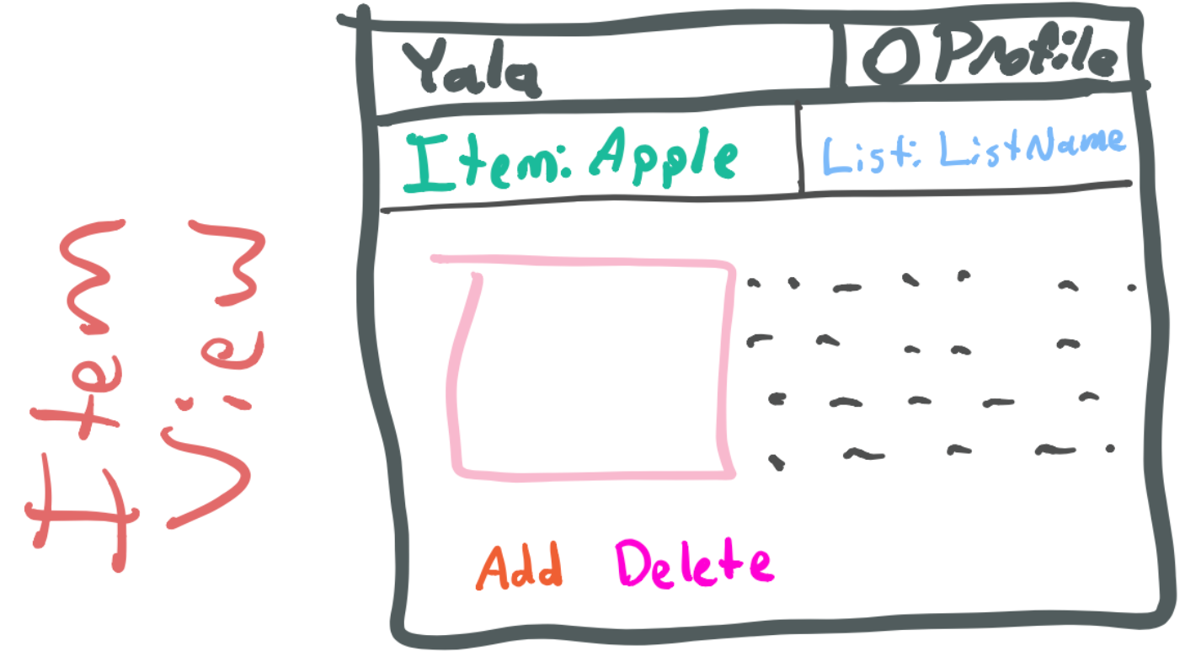
UI Layout

Slide 5
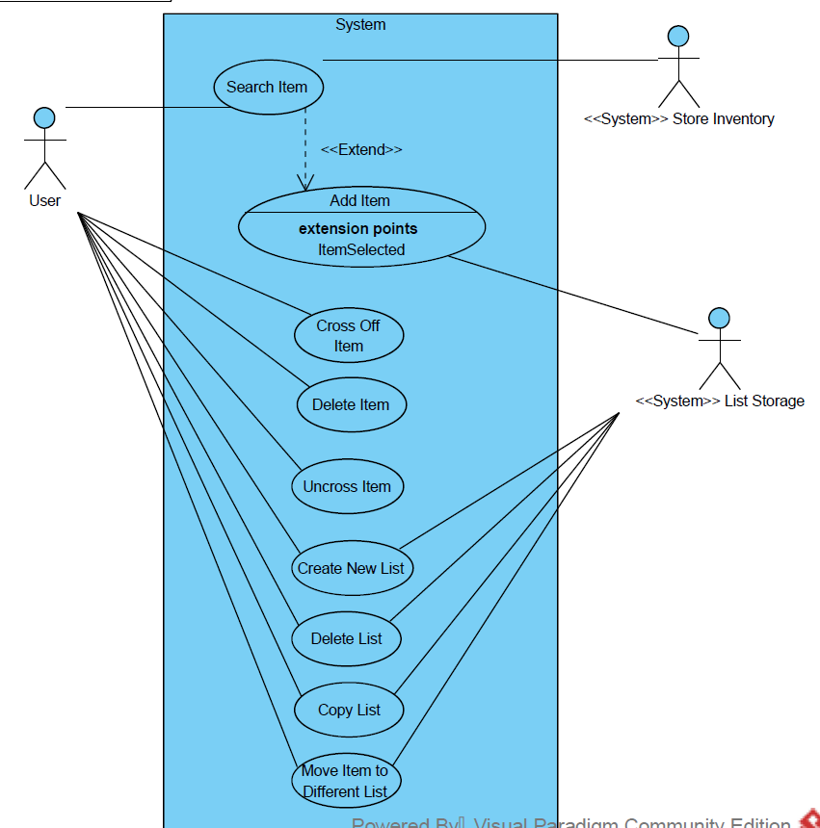
Use cases

Slide 6
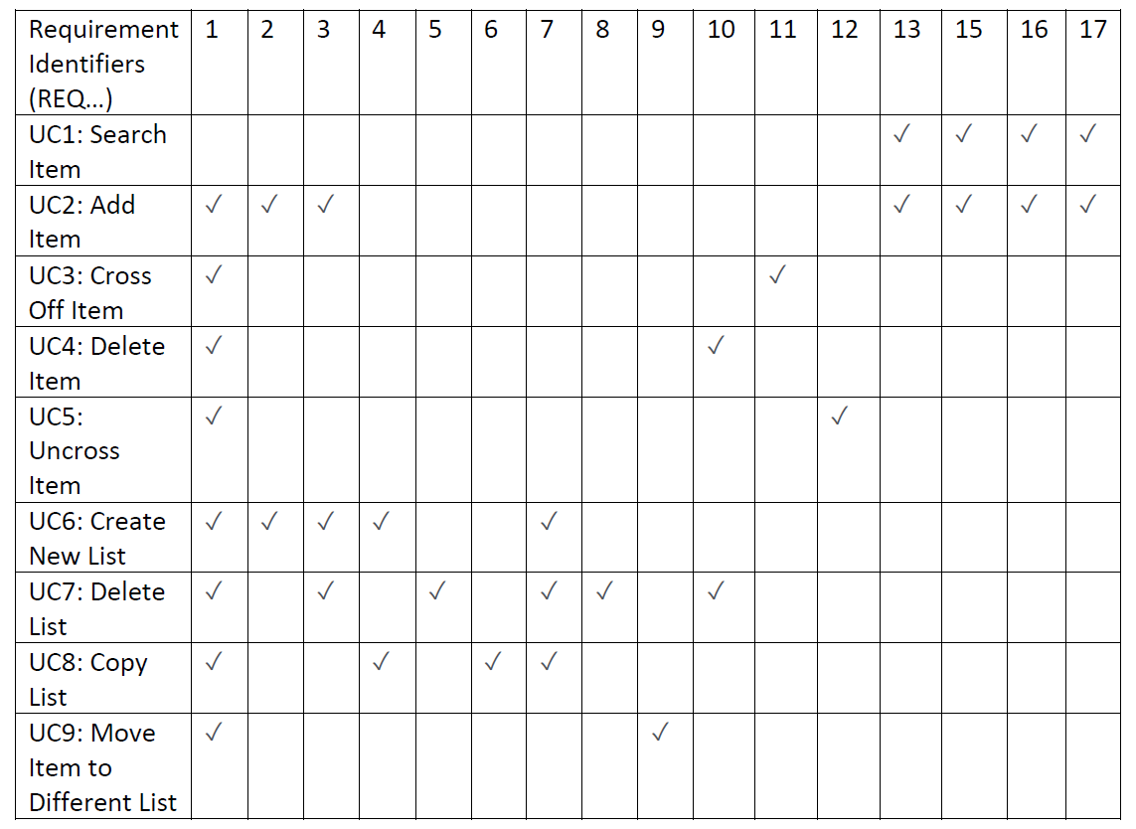
Traceability Matrix

Slide 7
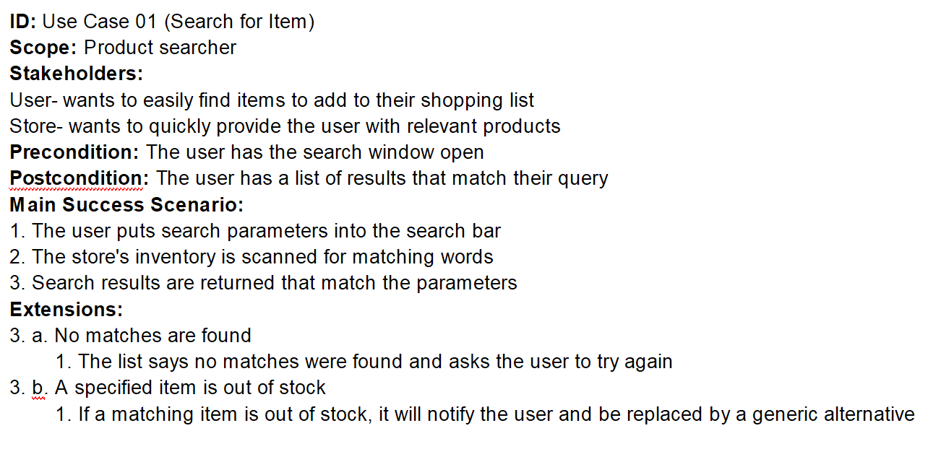
Use Case example

Slide 8
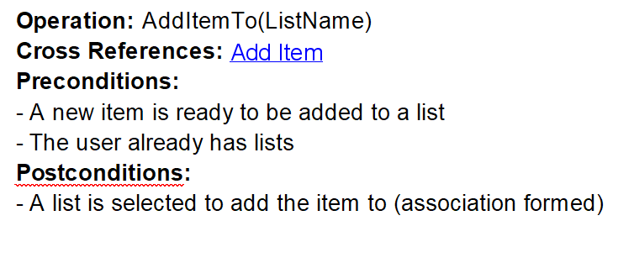
Operation example

Slide 9
Conclusion
Make shopping lists quickly
Only include items you can get
Robustly manage multiple lists

