Slide 1





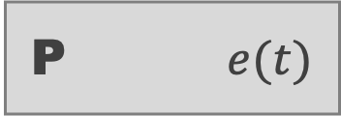
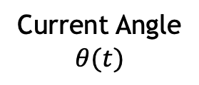


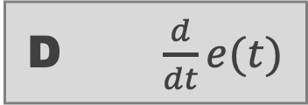


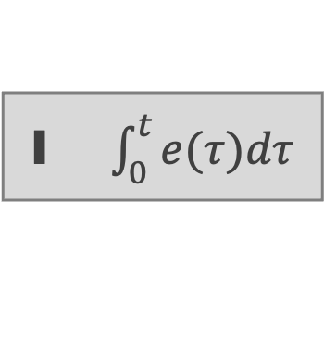


$$K_{p}$$
P $e(t)$
Target Angle $0°$
Error
$$e(t)$$
$$+$$
Controller Output
Current Angle
$$θ(t)$$
$$+$$
$$K_{i}$$
$$+$$
I $\int_{0}^{t}{e(τ)dτ}$
Motors
$$–$$
$$+$$
$$K_{d}$$
D $\frac{d}{dt}e(t)$
Measured Angle
$$\hat{θ}(t)$$
Sensors
Feedback

Slide 2
$$K_{p}$$
P $e(t)$
Target Angle $0°$
Error
$$e(t)$$
$$+$$
Controller Output
Current Angle
$$θ(t)$$
$$+$$
$$K_{i}$$
$$+$$
I $\int_{0}^{t}{e(τ)dτ}$
Motors
$$–$$
$$+$$
$$K_{d}$$
D $\frac{d}{dt}e(t)$
Measured Angle
$$\hat{θ}(t)$$
Sensors
Feedback

Slide 3











$$K_{p}$$
P $e(t)$
Target Angle $0°$
Error
$$e(t)$$
$$+$$
Controller Output
Current Angle
$$θ(t)$$
$$+$$
$$K_{i}$$
$$+$$
I $\int_{0}^{t}{e(τ)dτ}$
Motors
$$–$$
$$+$$
$$K_{d}$$
D $\frac{d}{dt}e(t)$
Measured Angle
$$\hat{θ}(t)$$
Sensors
Feedback

Slide 4
