Slide 1
Tissue optical path (finger)
MATLAB
LED drive commands
Arduino
PWM LED drive voltage
Photodiode current
USB Serial: Host Tx
USB Serial: Device Rx
Nellcor Probe
Transimpedance Amplifier
PWM
Amplified PPG voltage
RC Low-Pass Filter
HPF’d + offset PPG voltage
Digitalized PPG
Conditioned PPG voltage
LPF’d PPG voltage
USB Serial: Host Rx
USB Serial: Device Tx
Active Gain
RC High-Pass Filter + DC Bias
ADC

Slide 2
Sections
Hardware Front-End
Schematic & explanations
Filter and amplification calculations (cutoff frequencies, etc.)
Oscilloscope waveforms
MCU Acquisition & Serial Protocol
LED drive command packets (MATLAB -> Arduino) and decoding
PPG data packets (Arduino -> MATLAB) and decoding
Digital Signal Processing
Butterworth filtering, DC baseline estimation, AC amplitude estimation, R calculation, SpO2 estimate
Graphical User Interface
Live data visualization, customizable parameters, DSP visualization, live R and SpO2 estimates, console

Slide 3
Complete Schematic

Slide 4
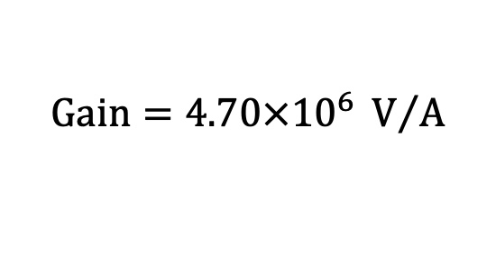
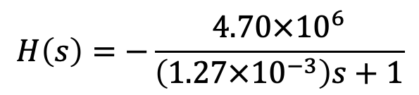

Transimpedance Amplifier + Light Low-Pass Filter
$$H\left(s\right)=−\frac{4.70×{10}^{6}}{\left(1.27×{10}^{−3}\right)s+1}$$
$$Gain=4.70×{10}^{6} V/A$$
$$LPF f_{c}=135 Hz$$

Slide 5

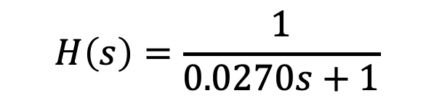
Passive Low-Pass Filter
$$H\left(s\right)=\frac{1}{0.0270s+1}$$
$$LPF f_{c}=5.89 Hz$$

Slide 6

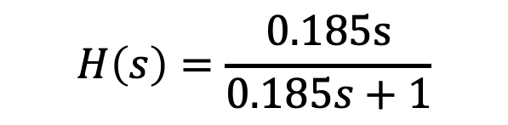
Passive High-Pass Filter + DC Bias
$$H\left(s\right)=\frac{0.185s}{0.185s+1}$$
$$HPF f_{c}=0.86 Hz$$
After filtering, the output will be centered around VBIAS

Slide 7
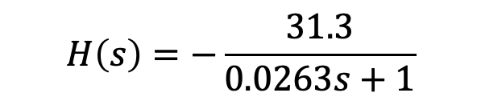


Active Gain + Low-Pass Filter
$$H\left(s\right)=−\frac{31.3}{0.0263s+1}$$
$$Gain=31.3$$
$$LPF f_{c}=6.05 Hz$$

Slide 8
MATLAB → Arduino Serial Communication Protocol
MATLAB
Arduino
LED drive command packets
USB Serial: Host Tx
USB Serial: Device Rx
packet = [0xAA, 0x01, 0x06, 0x01, 0xB8, 0x0B, 0xE8, 0x03, 0x46, 0xF5, 0x55]
Start Byte
ID
Payload Length
LSB
MSB
LSB
MSB
Checksum
End Byte
LED
Duration
Deadtime
Intensity
Payload
“Turn on the red LED for a duration of 3000 ms using a deadtime of 1000 ms and intensity 70”

Slide 9
MATLAB → Arduino Serial Communication Protocol
function packet = buildPacket(command, whichLed, duration, deadtime, intensity)
% buildLedPacket Constructs a command packet for the Nellcor probe LED.
%
% Inputs:
% duration - Duration in milliseconds (0–65535)
% whichLed - 0: OFF, 1: RED ON, 2: IR ON
% intensity - LED intensity (0–255)
%
% Output:
% packet - 1x11 uint8 array ready to send via serial
startByte = uint8(170); % 0xAA
endByte = uint8(85); % 0x55
durationBytes = typecast(uint16(duration), 'uint8'); % little-endian
deadtimeBytes = typecast(uint16(deadtime), 'uint8’); % little-endian
payload = [uint8(whichLed), durationBytes, deadtimeBytes, uint8(intensity)];
lengthPayload = uint8(numel(payload));
checksum = uint8(mod(sum(payload), 256));
packet = [startByte, command, lengthPayload, payload, checksum, endByte];
end

Slide 10
MATLAB ← Arduino Serial Communication Protocol
MATLAB
Arduino
Digitalized PPG packets
USB Serial: Host Rx
USB Serial: Device Tx
packet = [0xAA, 0x02, 0xF4, 0x01, 0xF1, 0x07, 0x00, 0x00, 0xEE, 0x55]
Start Byte
LSB
MSB
LSB
MSB
Checksum
End Byte
LED
Value
Timestamp
Payload
“The IR LED produced a value of 500 at a timestamp of 2033 ms”

Slide 11
MATLAB ← Arduino Serial Communication Protocol
void sendPacket(uint8_t encoding, uint16_t value, uint32_t timestamp) {
uint8_t start = 0xAA, end = 0x55;
uint8_t vBytes[2]; // initialize value array
uint8_t tBytes[4]; // initialize time array
memcpy(vBytes, &value, 2); // pull from memory + bitshift (little-endian style)
memcpy(tBytes, &timestamp, 4); // pull from memory + bitshift
uint8_t checksum = (encoding + vBytes[0] + vBytes[1] +
tBytes[0] + tBytes[1] + tBytes[2] + tBytes[3]) % 256;
Serial.write(start);
Serial.write(encoding);
Serial.write(vBytes, 2);
Serial.write(tBytes, 4);
Serial.write(checksum);
Serial.write(end);
}

Slide 12
Hardware Front-End
MCU Acquisition
ADC
LED Drive Command Packets
Digitalized PPG Packets

Slide 13
Hardware Front-End
MCU Acquisition
ADC
LED Drive Command Packets
Digitalized PPG Packets

Slide 14
Hardware Front-End
MCU Acquisition
ADC
LED Drive Command Packets
Digitalized PPG Packets

Slide 15
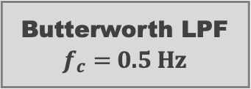


Pulsatile (AC) Component
Peak-Trough Detection
Max
AC
Digitalized PPG
Digitally-filtered PPG
AC
Butterworth LPF
$$f_{c}=4 Hz$$
$$÷$$
AC/DC ratio
Constant (DC) Component
DC
Butterworth LPF
$f_{c}=$0.5 Hz
Median

