Slide 1
Raw EGM
Detection
Threshold
Frog Heart
Differential Amplifier
RC High-Pass Filter
RC Low-Pass Filter
Active Gain
Comparator
Potentiometer
Conditioned EGM
QRS Detection
Arduino
ADC
ADC
Capacitive Discharge Stimulation Circuit
I2C
OLED Display
Digital
Out
Digital
Out

Slide 2
Raw EGM
Detection
Threshold
Frog Heart
Differential Amplifier
RC High-Pass Filter
RC Low-Pass Filter
Active Gain
Comparator
Potentiometer
Conditioned EGM
QRS Detection
Arduino
ADC
ADC
Capacitive Discharge Stimulation Circuit
I2C
OLED Display
Digital
Out
Digital
Out

Slide 5
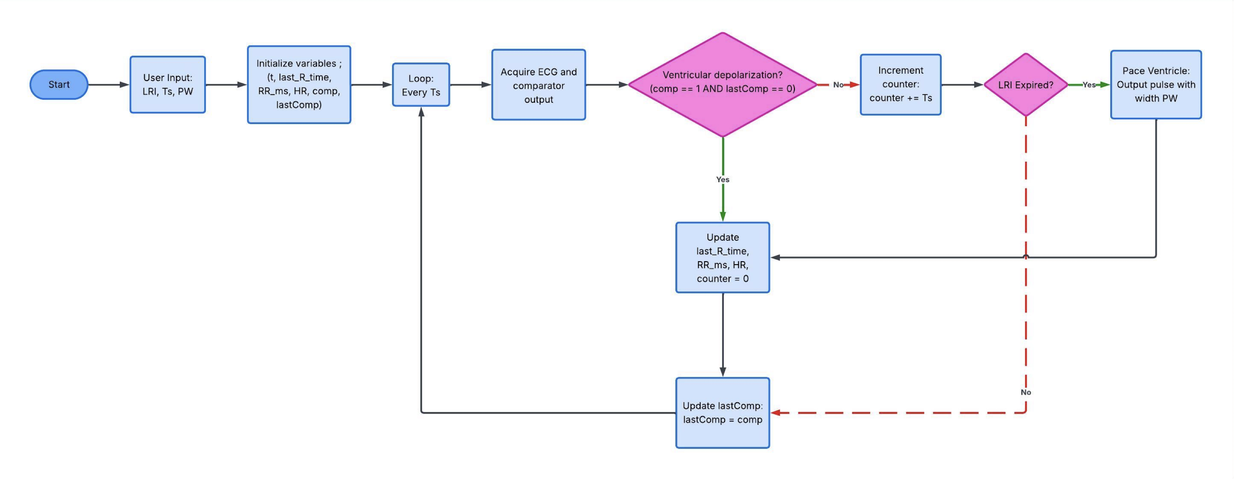

Slide 7
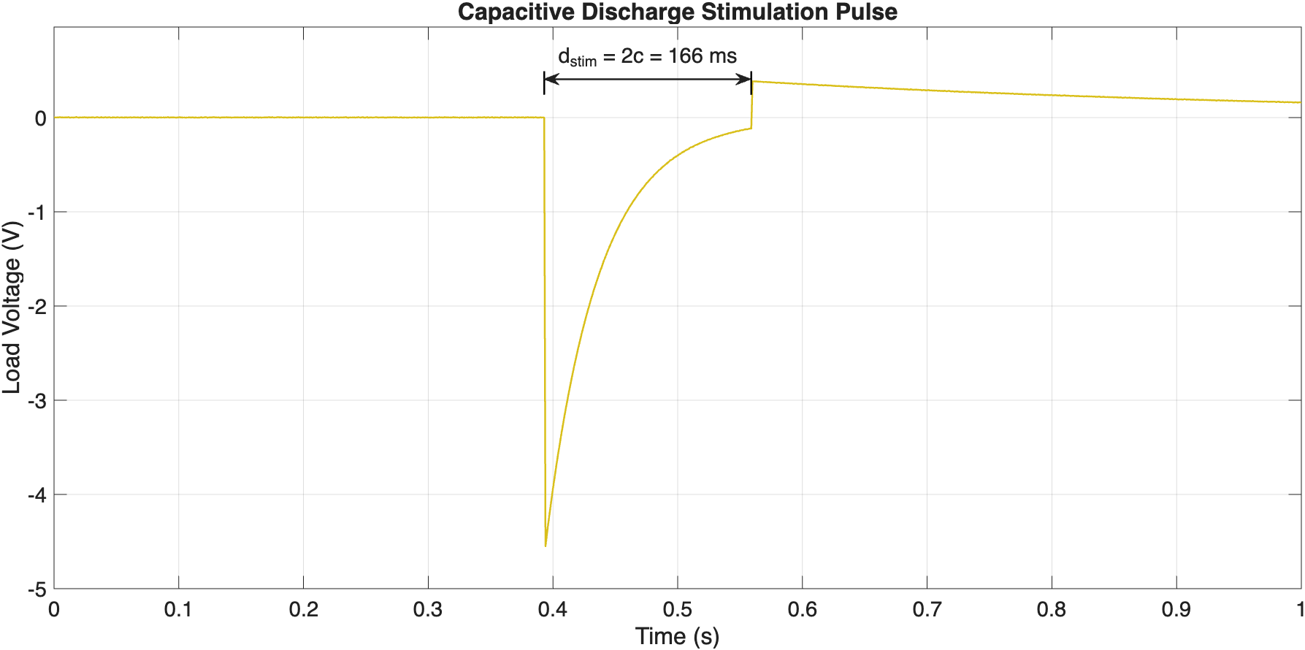

Slide 8
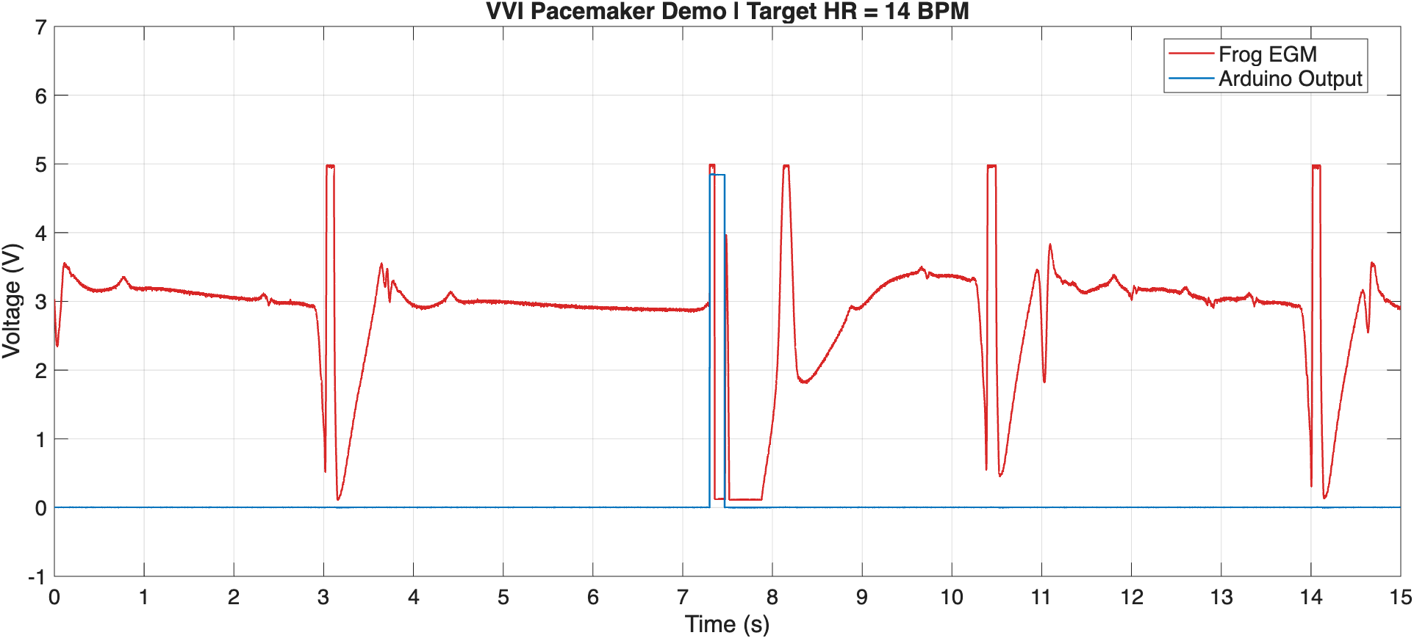
LRI expired!

