Slide 1
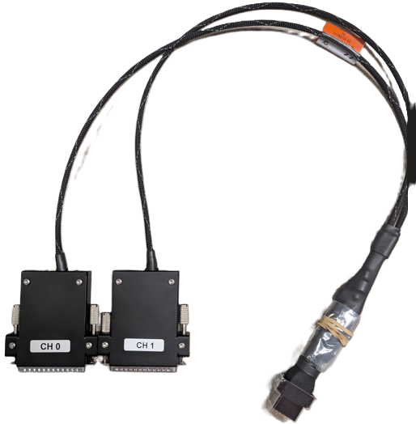
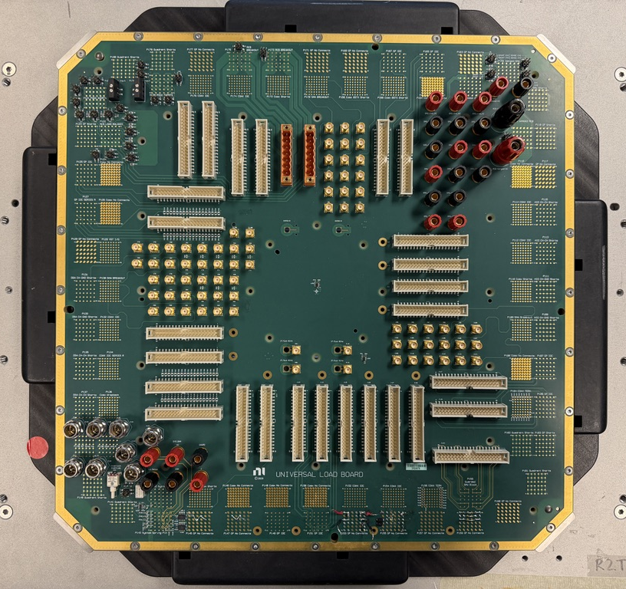
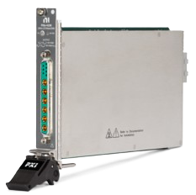
Signal Flow
Module
Cable
Device Interface Board (DIB)

Slide 2
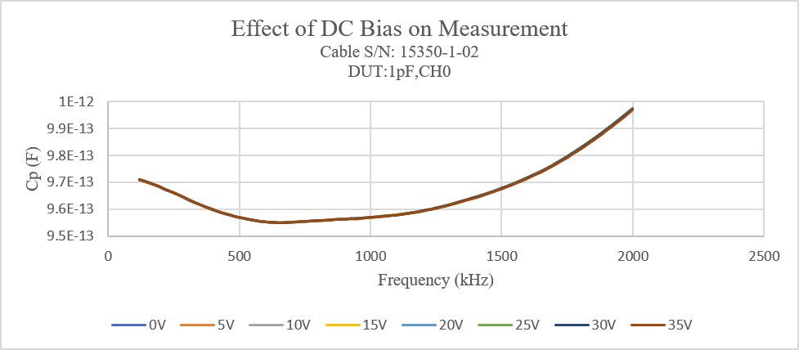
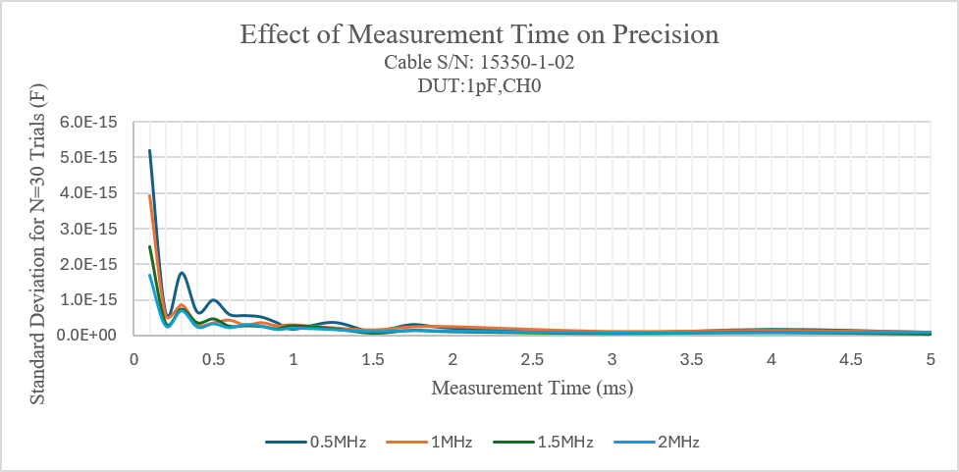

Slide 3
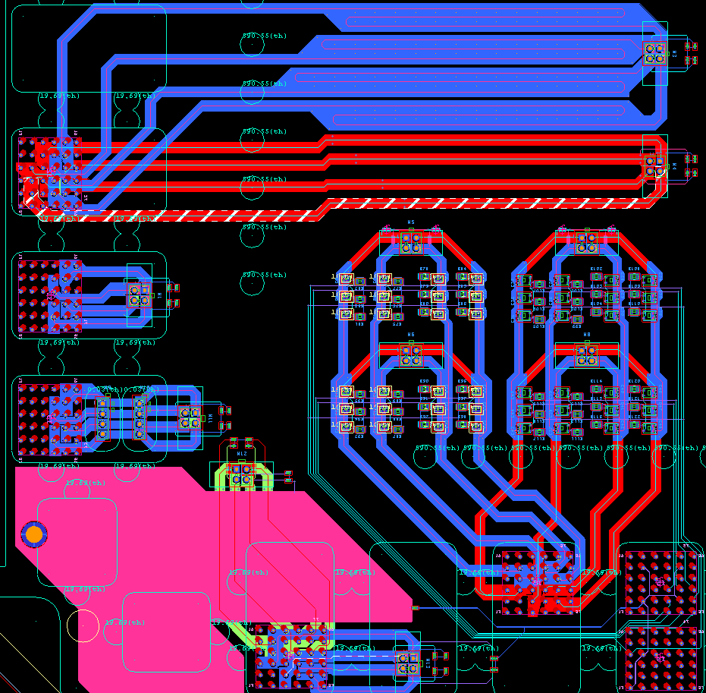

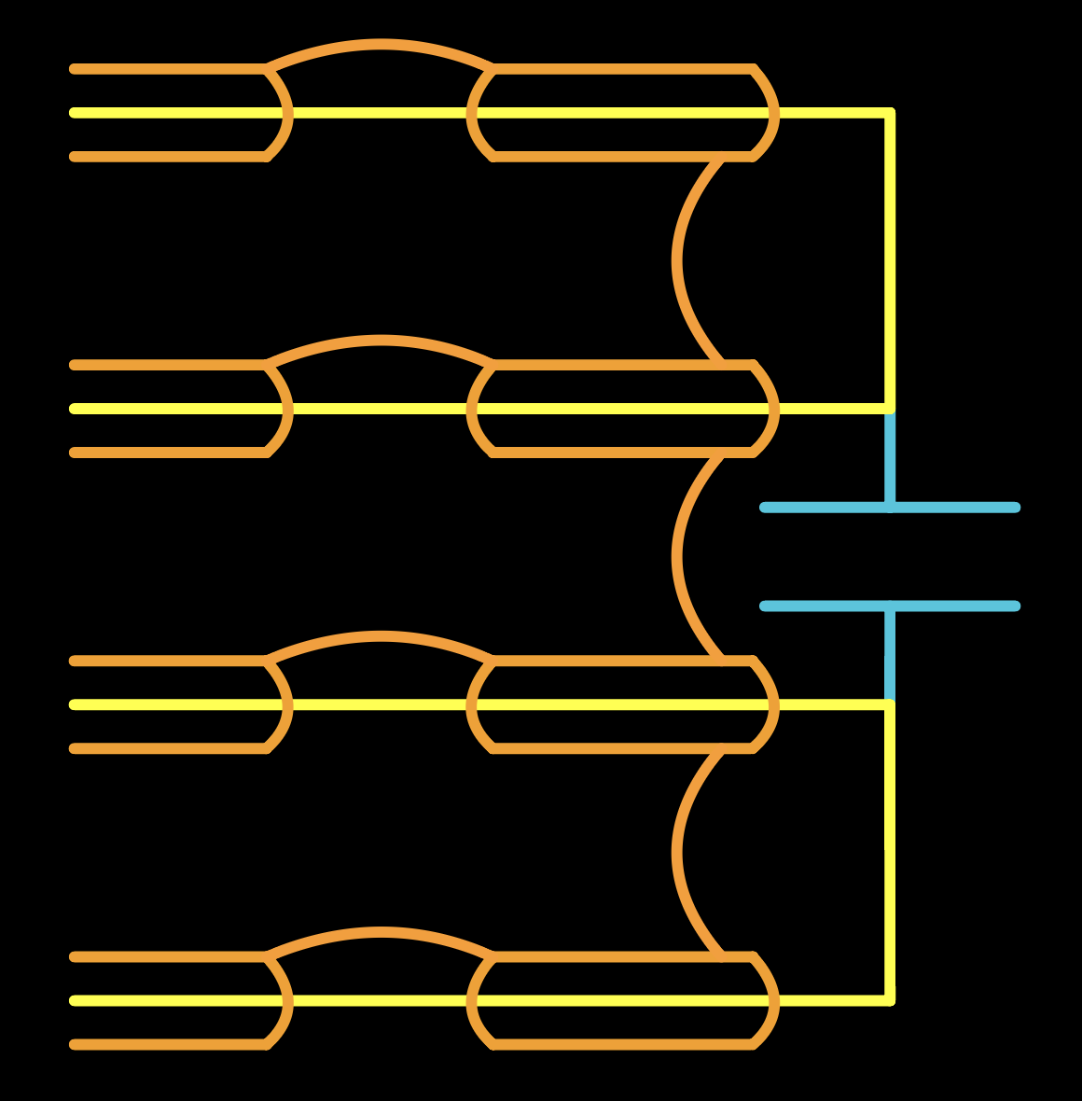
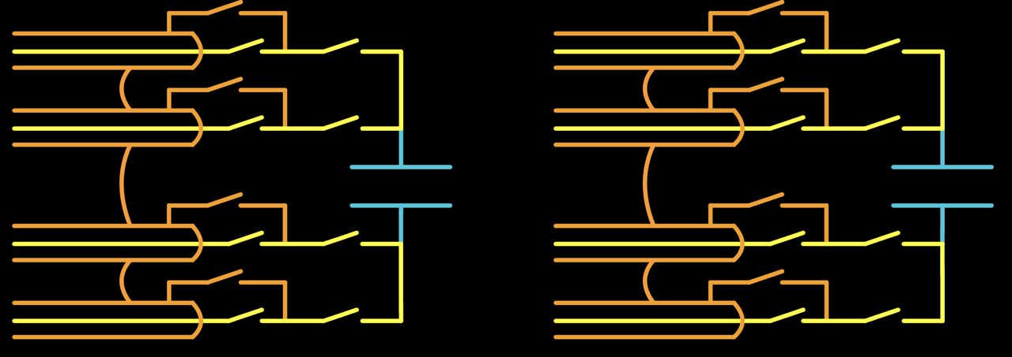
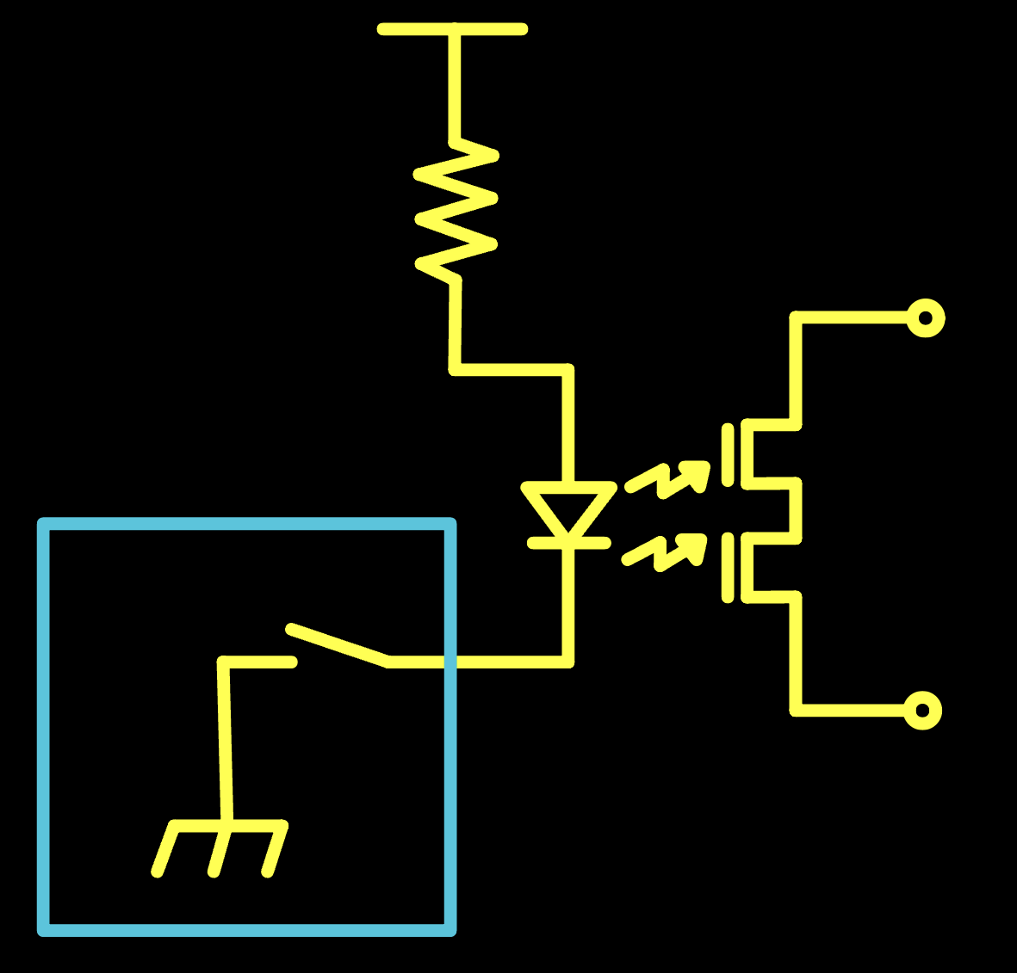
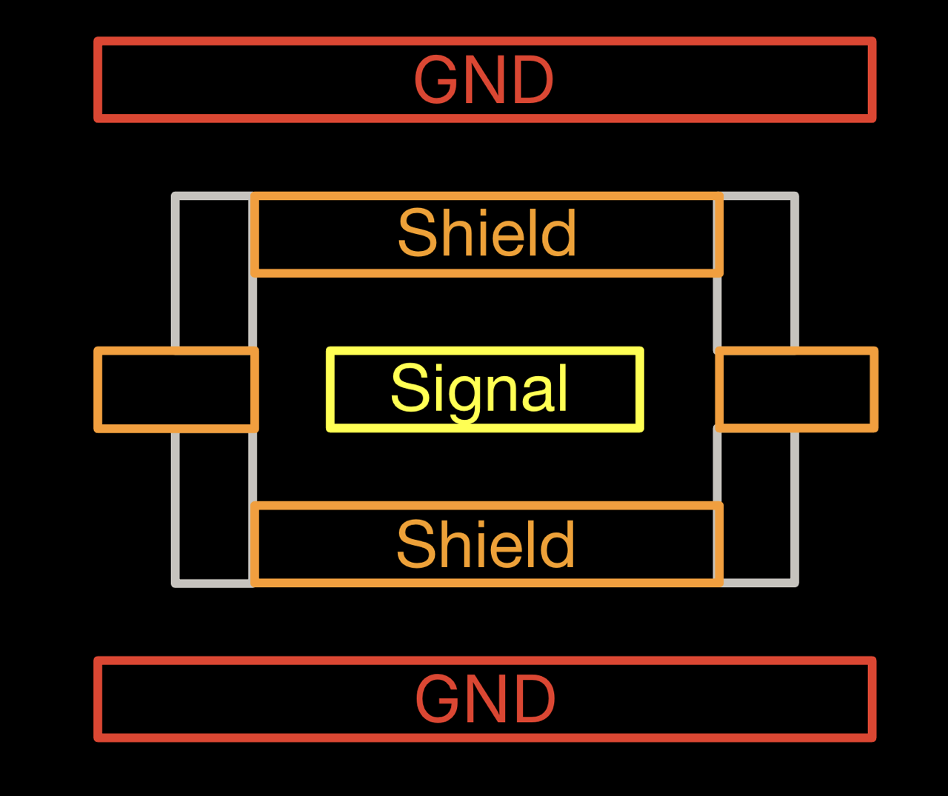
DIB Non-Ideality Tests: Board Layout
Long PCB Traces
Board-to-Board Connection
Switching Parasitics
(PhotoMOS Switches)
Adjacent GND Floods

Slide 4
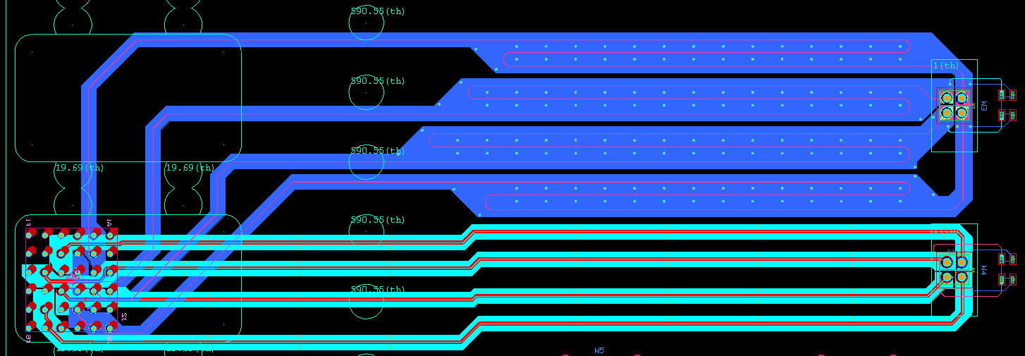
Test Case: Long PCB Traces

Slide 5
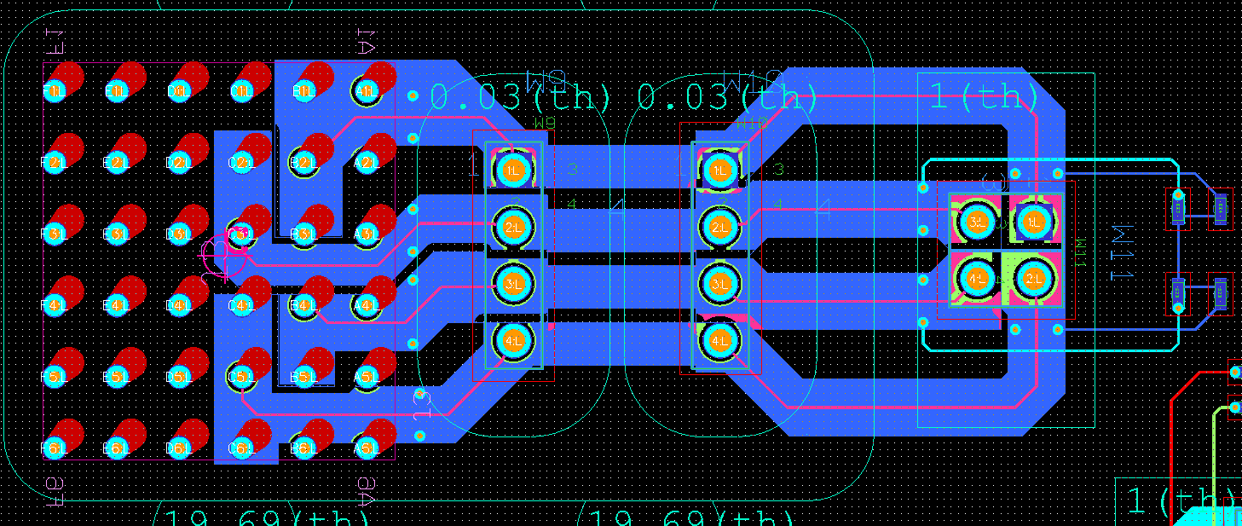
Test Case: Board-to-Board Connection
Break in 4TP Guarding

Slide 6
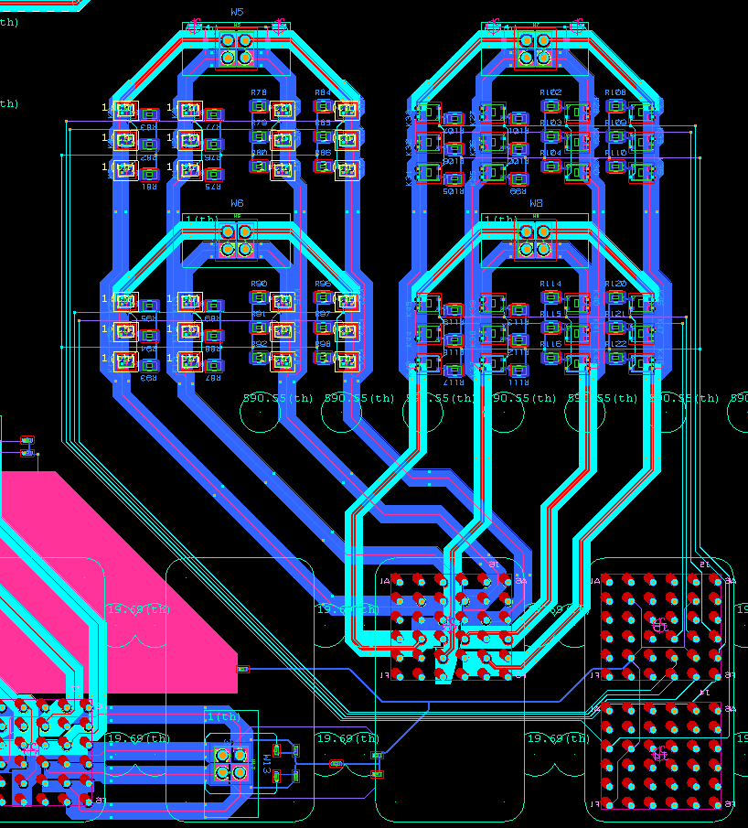
Test Case: Switching Parasitics
Guarded PhotoMOS Switch Topology

Slide 7
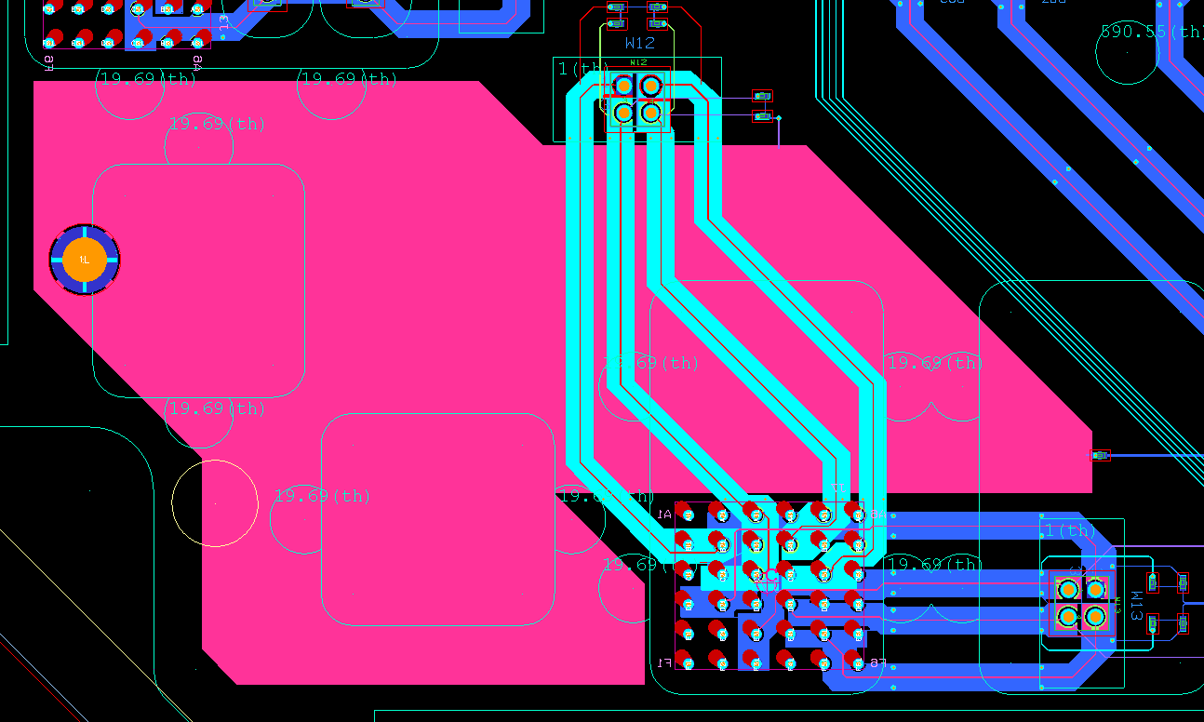
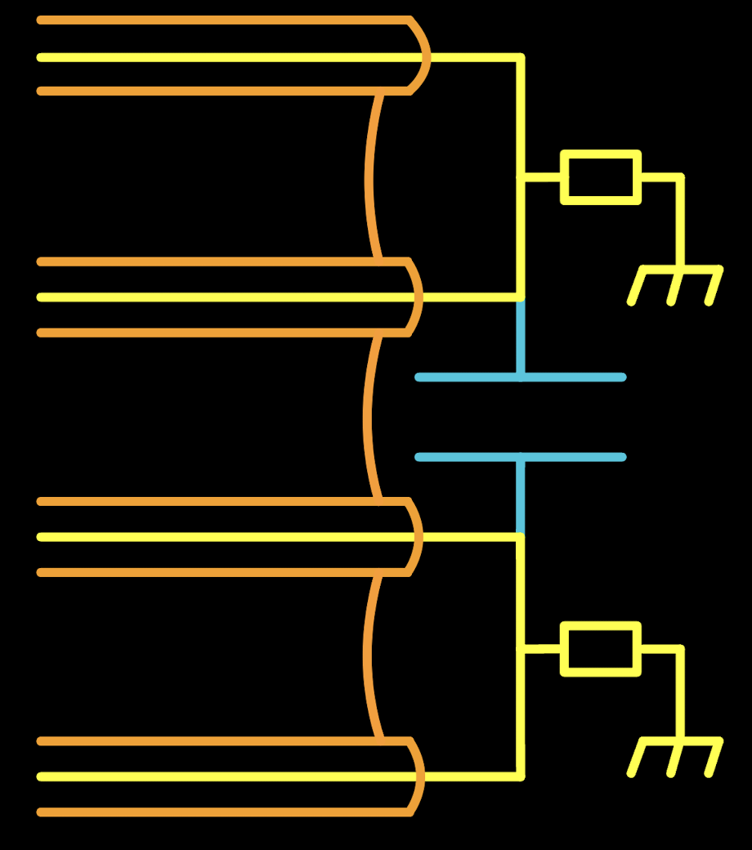
Test Case: Grounding Topologies
Adjacent GND Floods
Impedance to GND

Slide 8
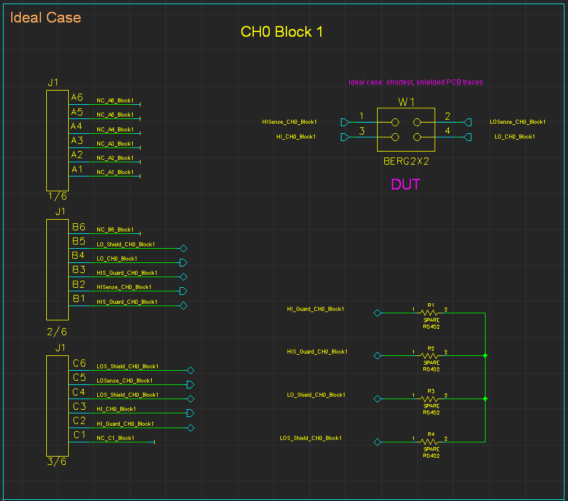
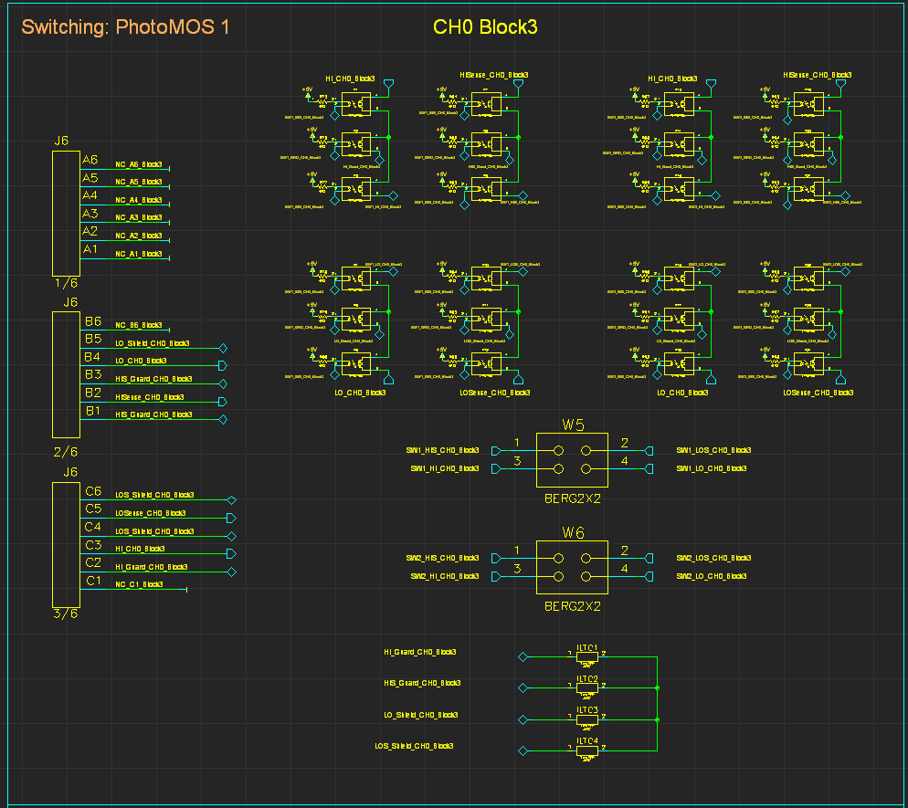
Schematic Design

