Slide 1

Machine Learning Classification to Predict NFL Bets
Jacob Lukasik & Michael Jenks

Slide 2
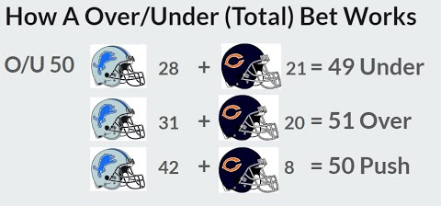
Project Description and Goals
Predict over/under bets using classification algorithms
What is an O/U bet?
Simplify input parameters for new predictions
Achieve accuracy > 52.4%
https://www.youtube.com/watch?v=2c3VuqJbezE

Slide 3
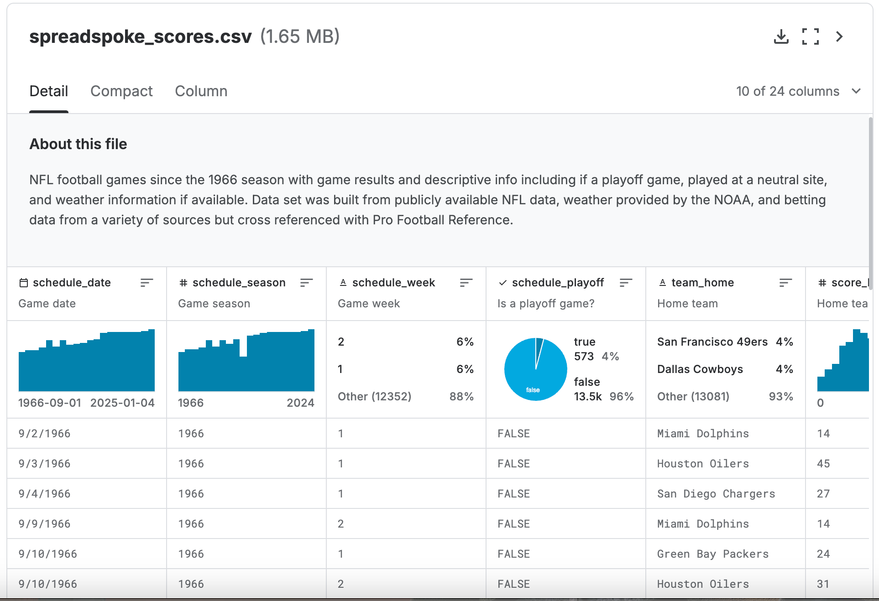
Our Data
Kaggle football betting dataset
NFL offensive and defensive team stats
https://www.kaggle.com/datasets/tobycrabtree/nfl-scores-and-betting-data?select=spreadspoke_scores.csv

Slide 4
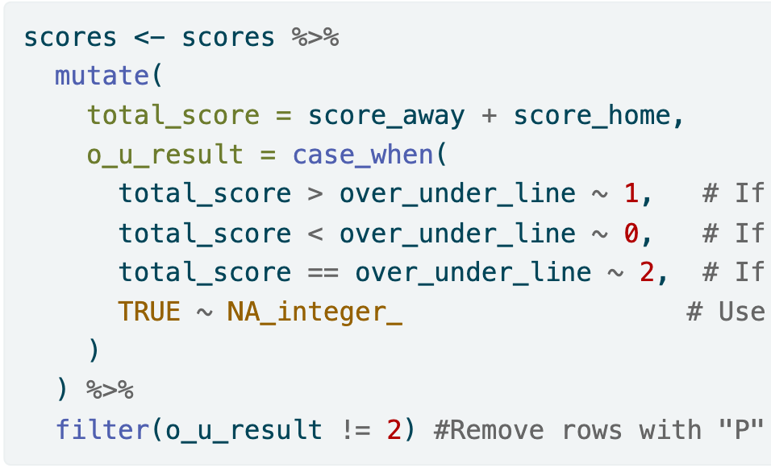

Pre-Processing & Feature Engineering
Had to filter out some unnecessary and sparse features
Removed N/A rows
Joined offensive and defensive stats to betting data
Only examined games with season $≥$ 2014
Engineered binary feature if over or under hit

Slide 5
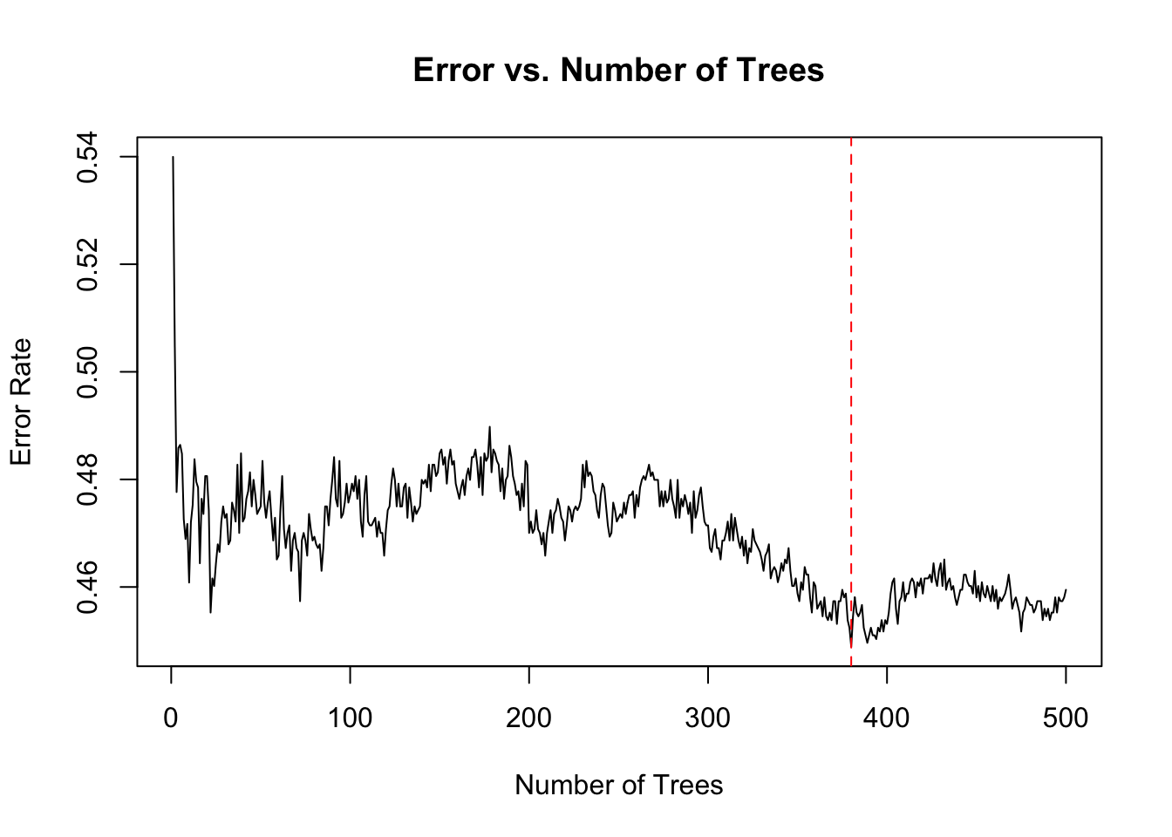
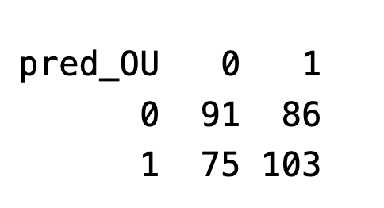
Model 1: Random Forest Classifier
Split into a training and testing set randomly
Trained a model using CV to find optimal ntrees
Reached an accuracy of 54.65% on testing set, better than the 52.4% criteria we shot for
Ran the model on all Sunday matchups for week 12:

Slide 6
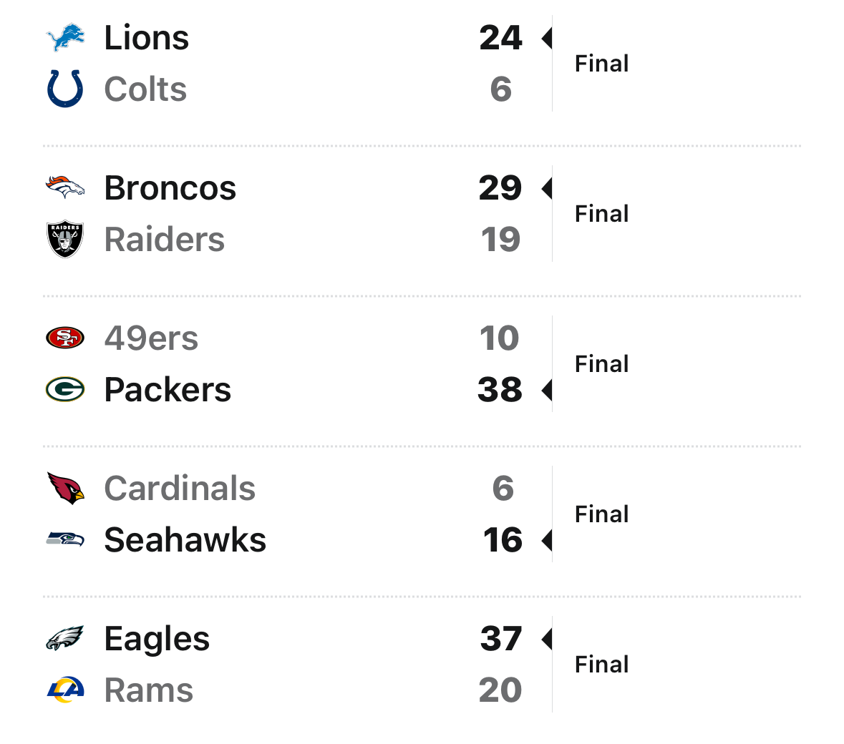
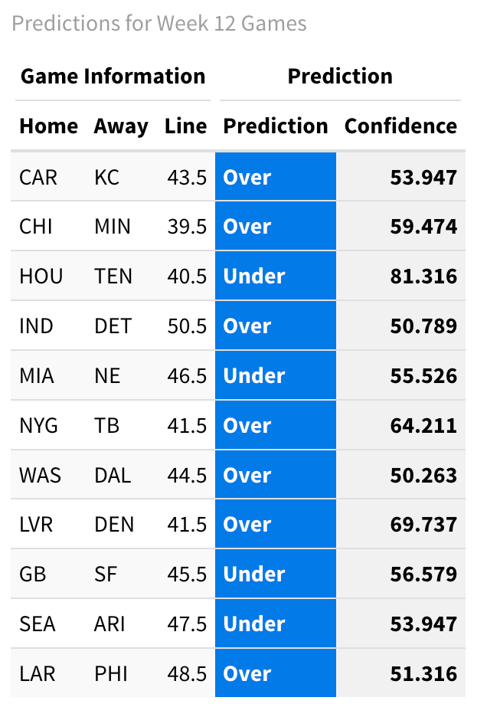
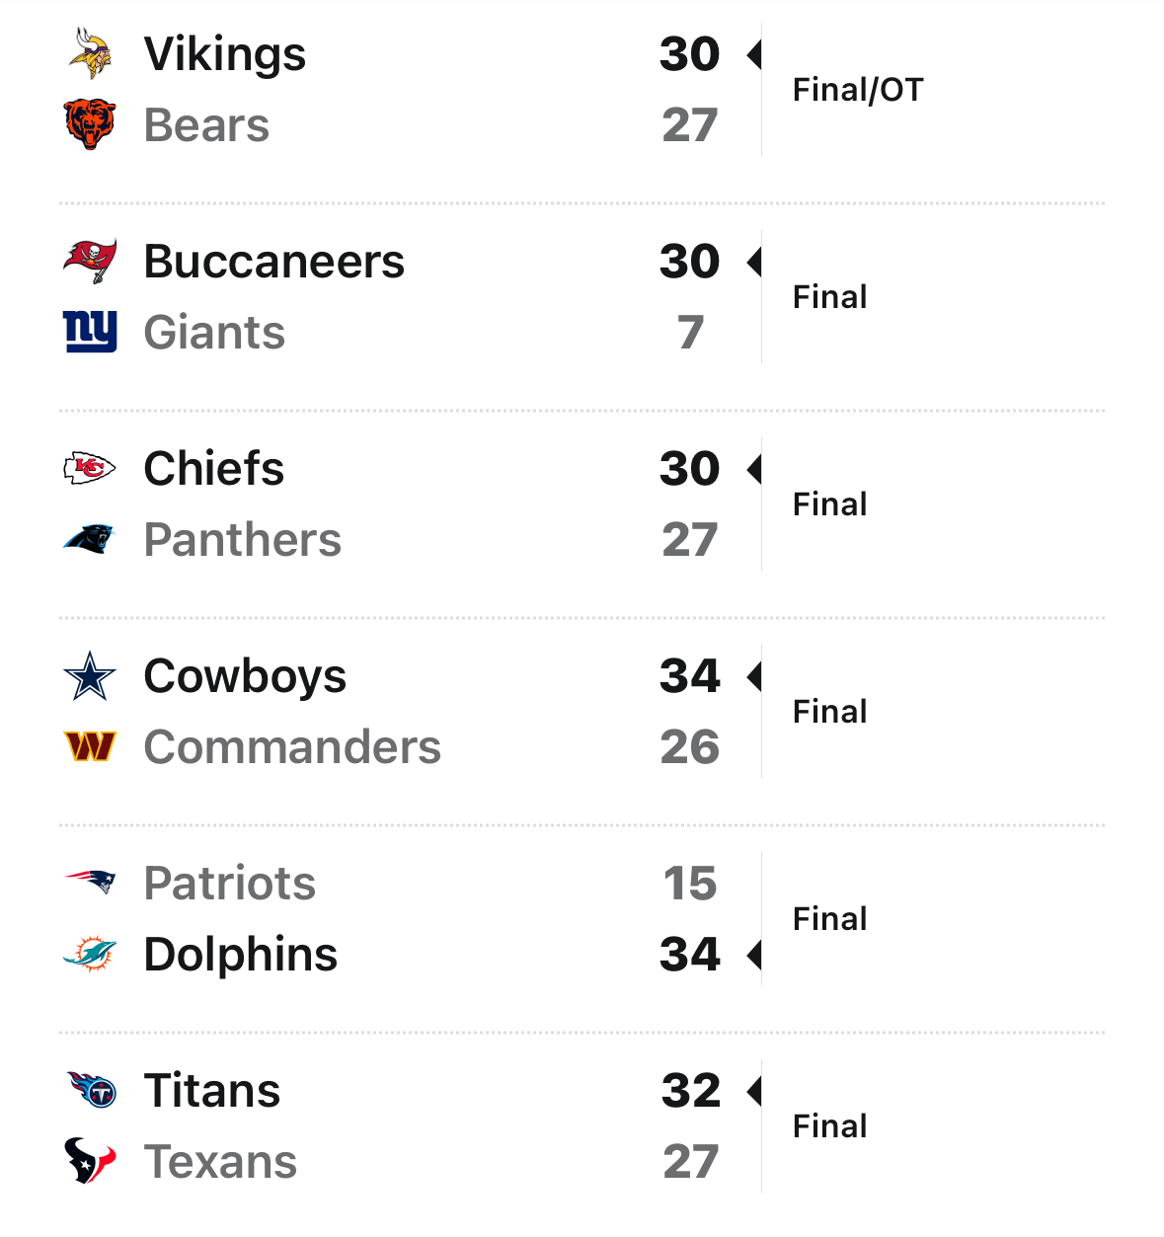
Model 1: Week 12 Predictions
6/11 on Sunday Week 12 Matchups – Accuracy of 54.55%

Slide 7
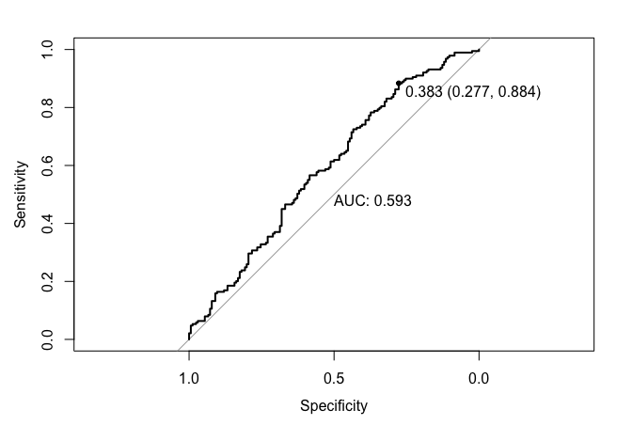
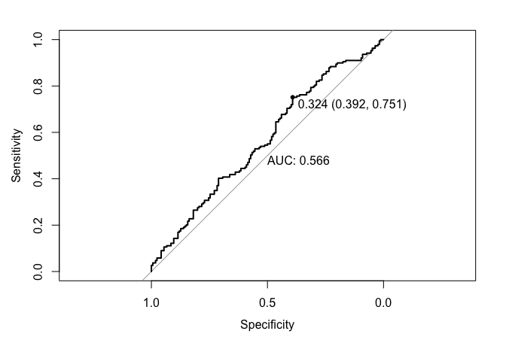
Model 2: XGBoost
Model 2a was trained without parameter tuning – 58.3% Prediction Accuracy
Model 2b – Use parameter tuning with 5-fold cross validation – 60% Prediction Accuracy
2B
2A

Slide 8
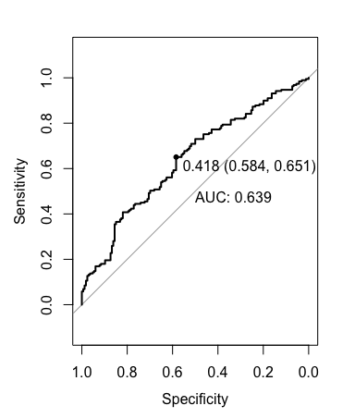
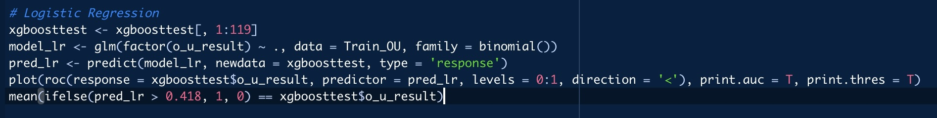
Model 3: Logistic Regression
Test simplest model and compare performance
Accuracy – 62%

Slide 9
Results, Implications, Limitations
Logistic regression performed the best in terms of prediction accuracy
NFL results and betting odds are often unpredictable due to parity across the league and an element of randomness
Prediction also relies on data such as momentum, injuries, schedule difficulty
Potential to improve accuracy and prediction
All models eclipse the "profit" benchmark of 52.4% -> profit potential across models

