Slide 1
Planning Mod Thumbnails
For the steam workshop.

Slide 2
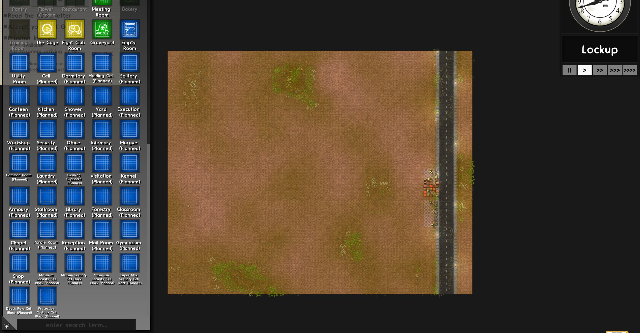
The Planning Mod
Base Game

Slide 3
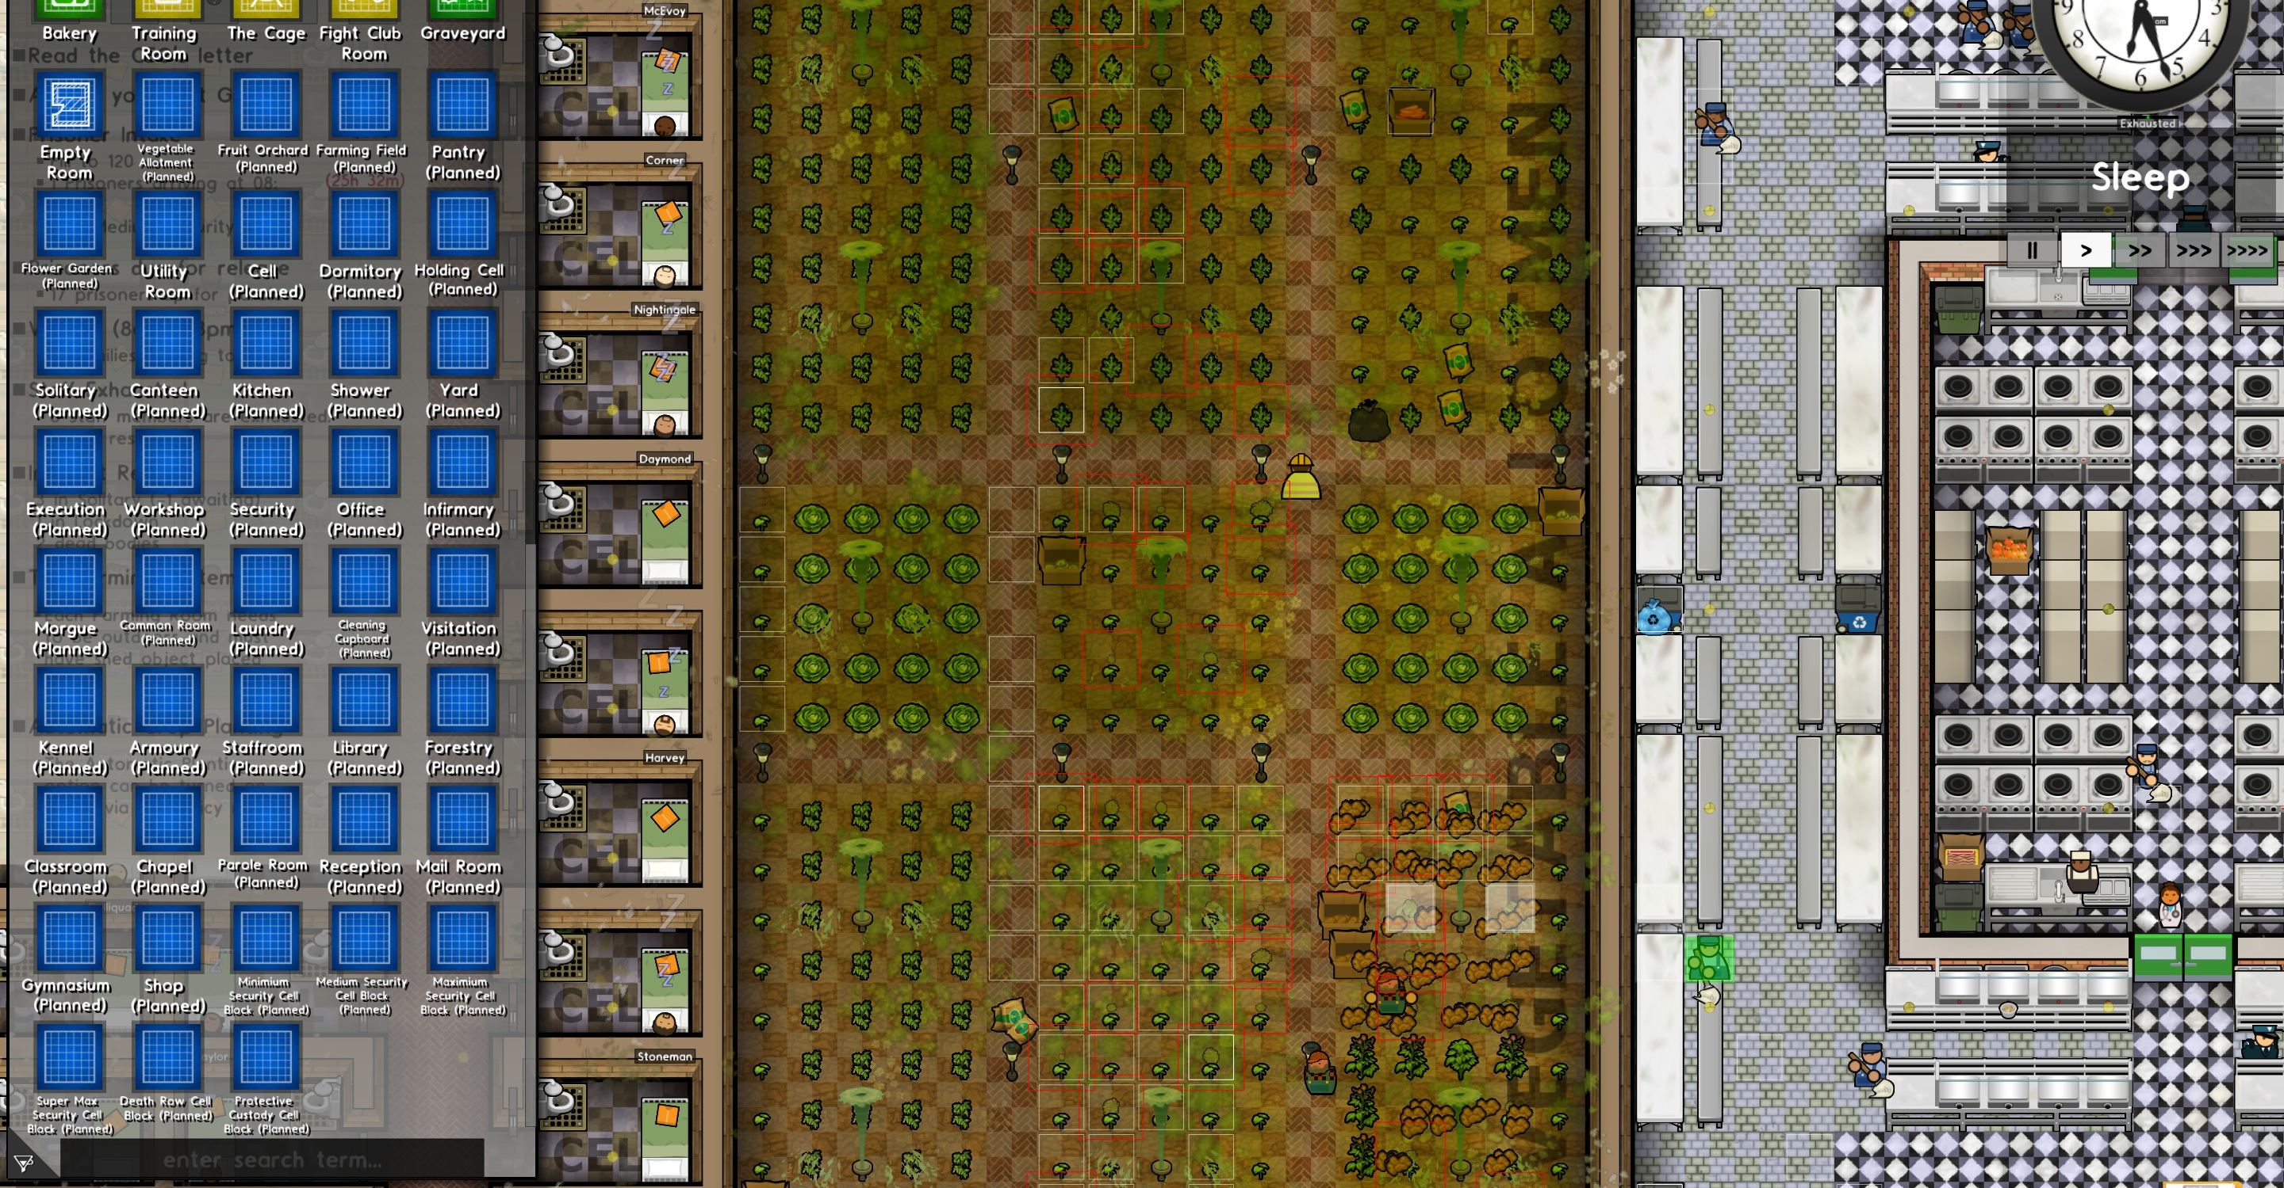
Going Green DLC – Drop-in
The Planning Mod

Slide 4
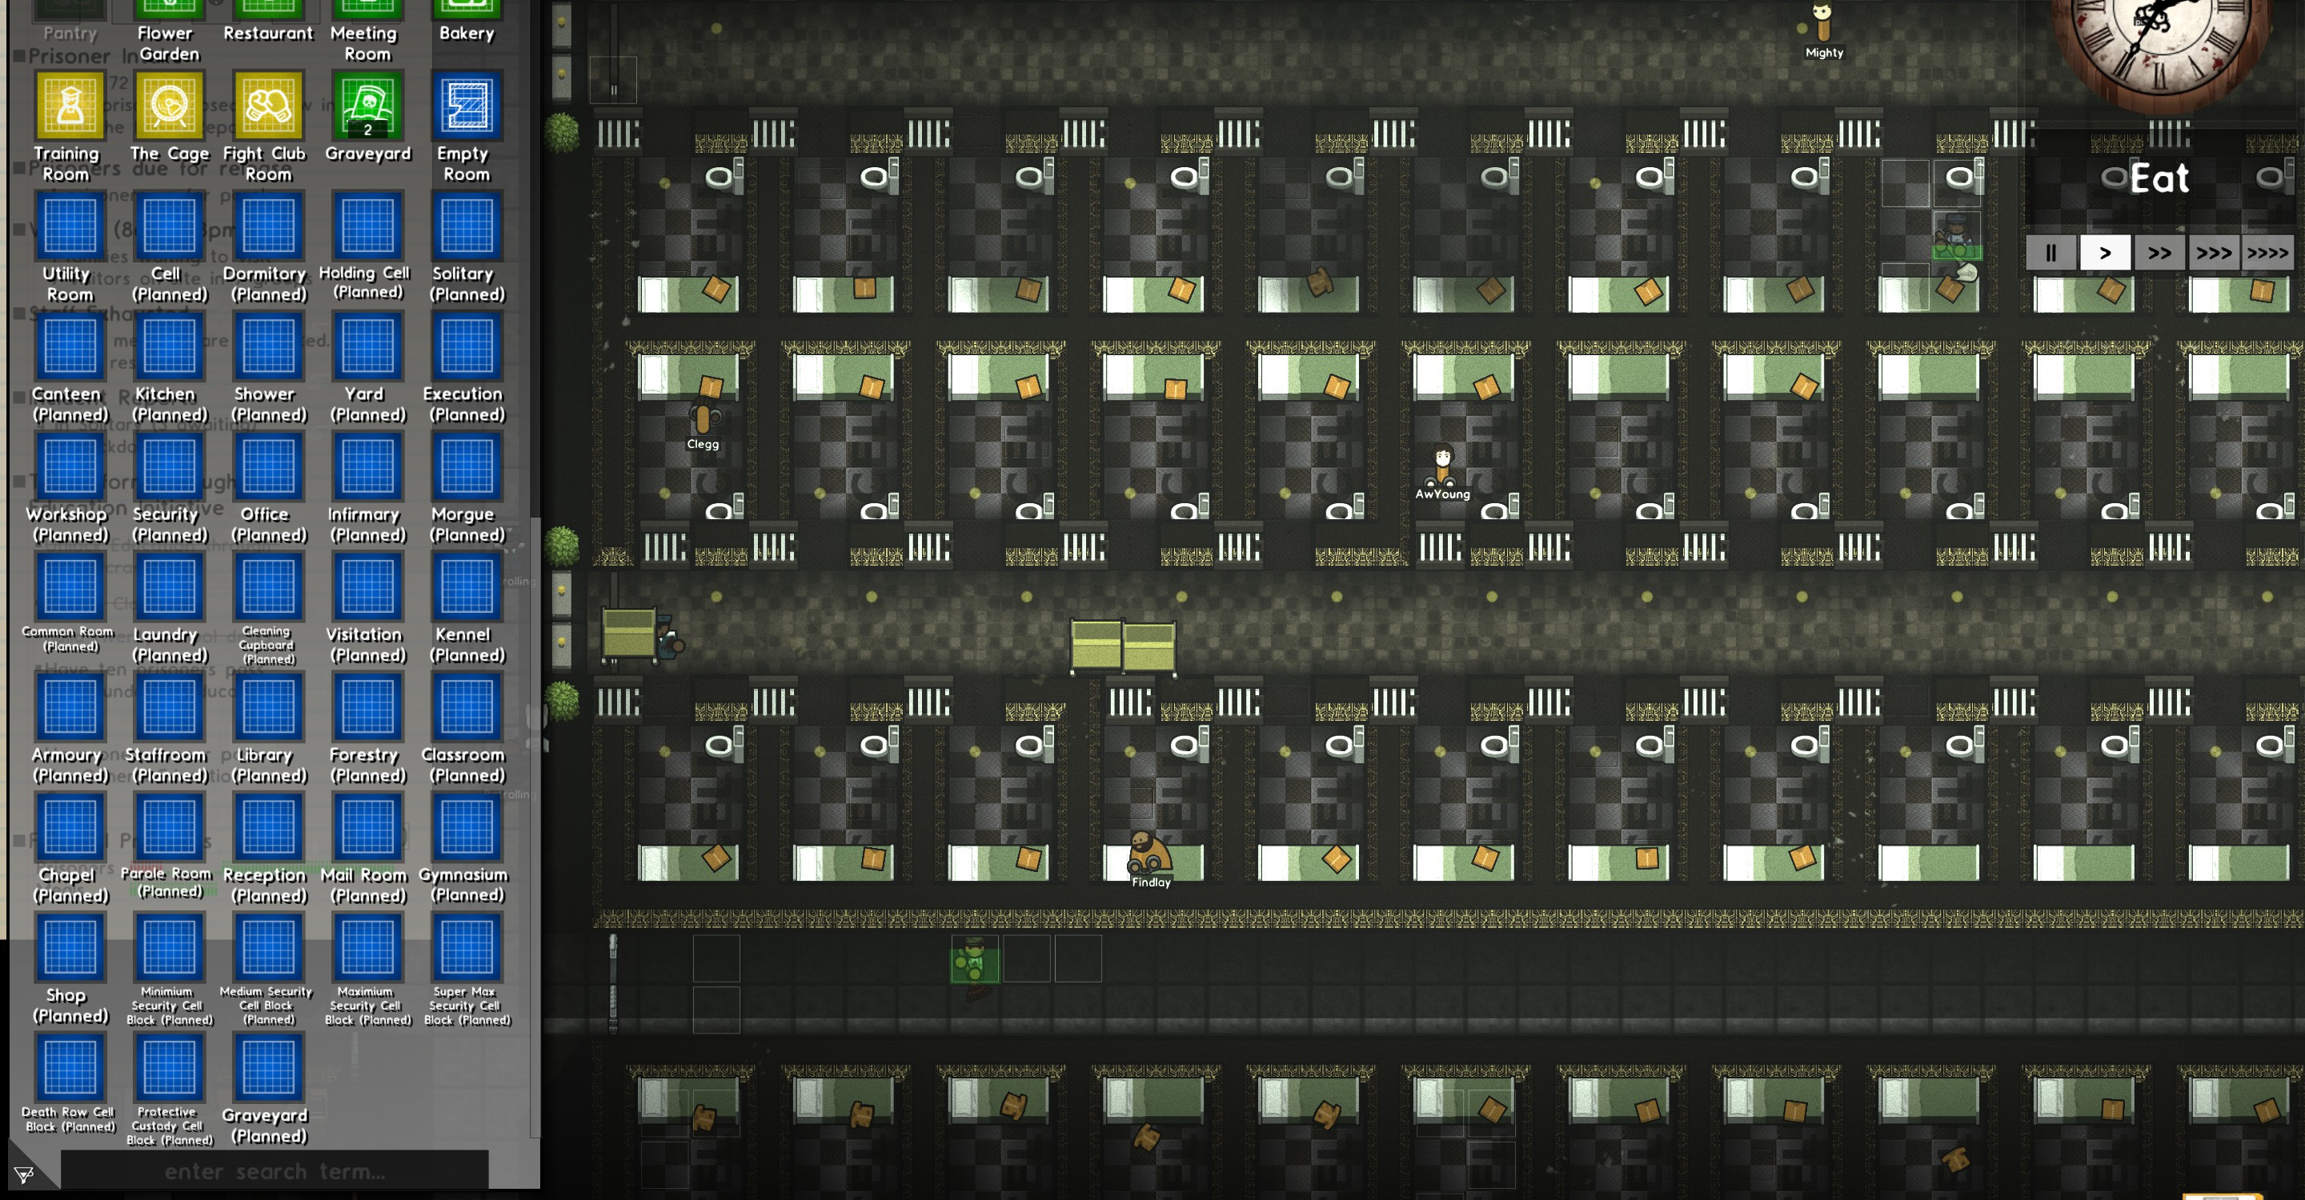
Undead DLC – Drop-in
The Planning Mod

