Slide 1
Parallel Processing in Object Detection using YOLOv5
Jie Gao

Slide 2
Object Detection in Computer Vision
Object detection is a fundamental task in computer vision that involves identifying and locating objects within an image or video frame.
It has numerous applications, including autonomous vehicles, robotics, image recognition, and augmented reality.

Slide 3
The YOLOv5 Model:
YOLO (You Only Look Once) is a popular family of deep learning models designed for real-time object detection.
YOLOv5 is the latest version of the YOLO model and boasts significant improvements over its predecessors in terms of accuracy and speed.

Slide 4
Problem Statement
Need for Faster Processing:
In many real-world applications, object detection needs to be performed on large datasets or continuous video streams.
Faster processing can greatly improve the efficiency of these tasks, making it possible to process more images in less time, ultimately leading to quicker decision-making or improved user experience.

Slide 5
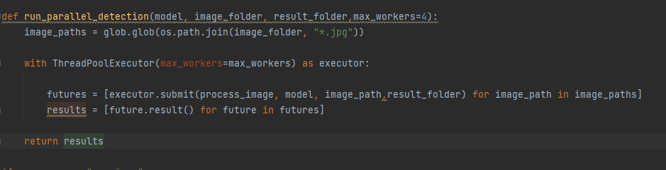
Method Used
The project used concurrent.futures module to achieve the parallele coding

Slide 6
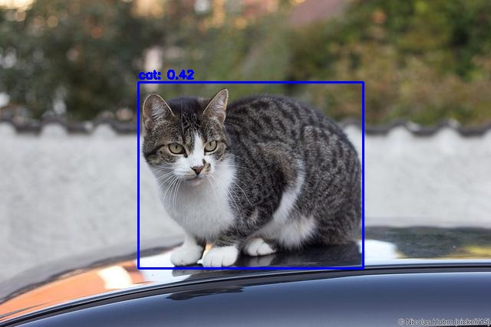
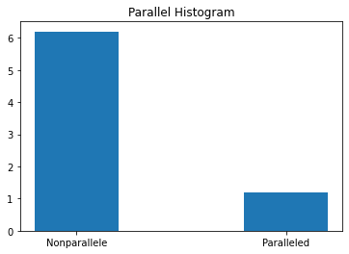
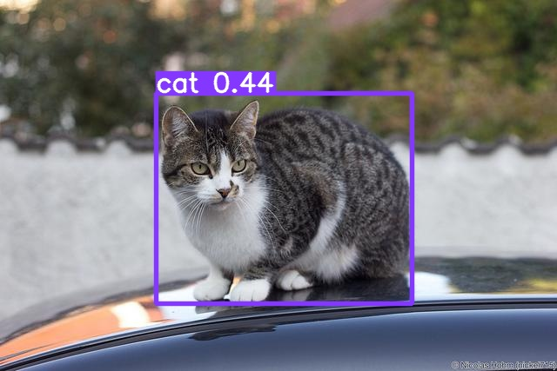
Result

