Slide 1
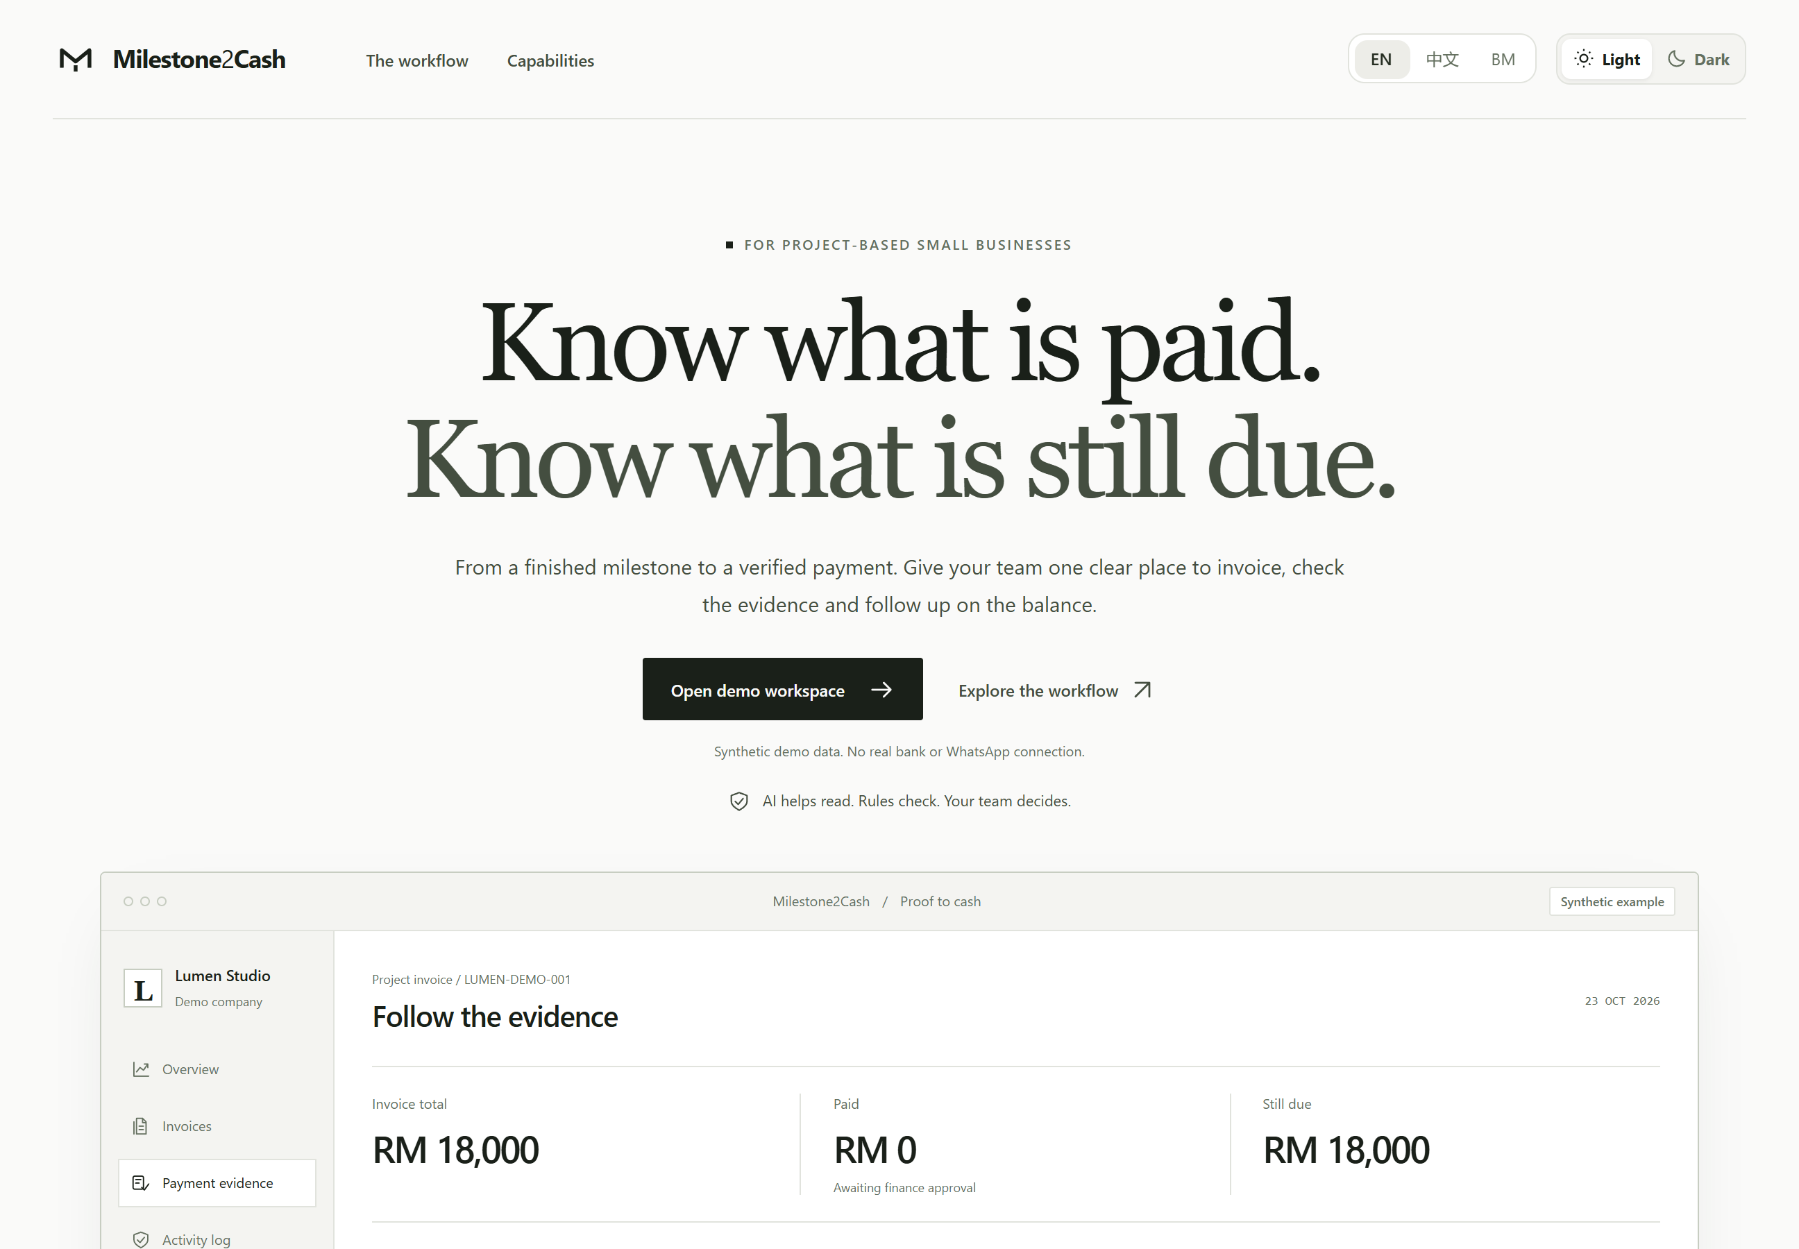
SDC HACKATHON 2026 · DOMAIN 2 · ORBYTE SMART SME CHALLENGE
Milestone2Cash
Proof-to-Cash
Know what is paid.
Know what is still due.
We check a customer's “dah bayar” claim against the bank before it counts, then keep the rest of the invoice in view.
Live on Replit: milestone-2-cash-proof-to-cash.replit.app
Team Lets go
Jiazhong Yang (team leader) · Low Li Xin · Jieheng Li · Lingchen Wu
Monash University Malaysia · Universiti Malaya
Notes:
[0:00–0:15] Presenter: ____
We are team Lets go. This is Milestone2Cash Proof-to-Cash, for small service businesses that bill by project milestone and get paid by bank transfer — usually with nothing but a WhatsApp message as proof.
Our promise: know what is paid, and know what is still due.

Slide 2
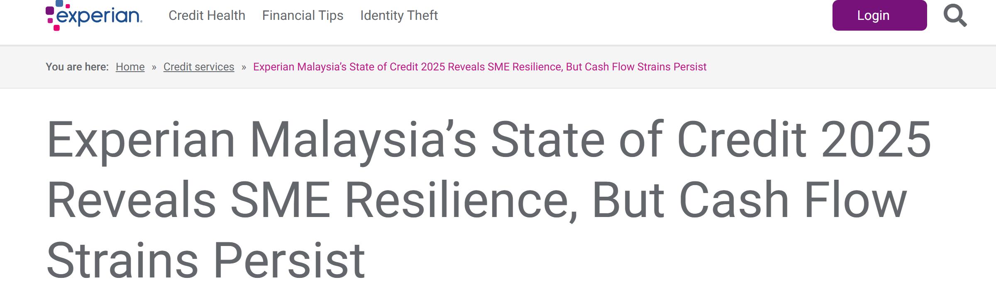
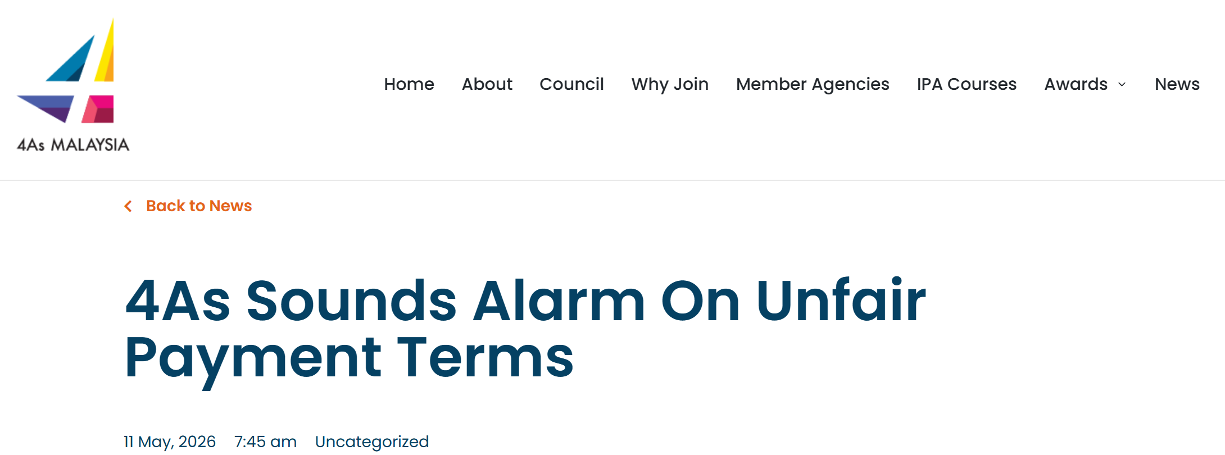
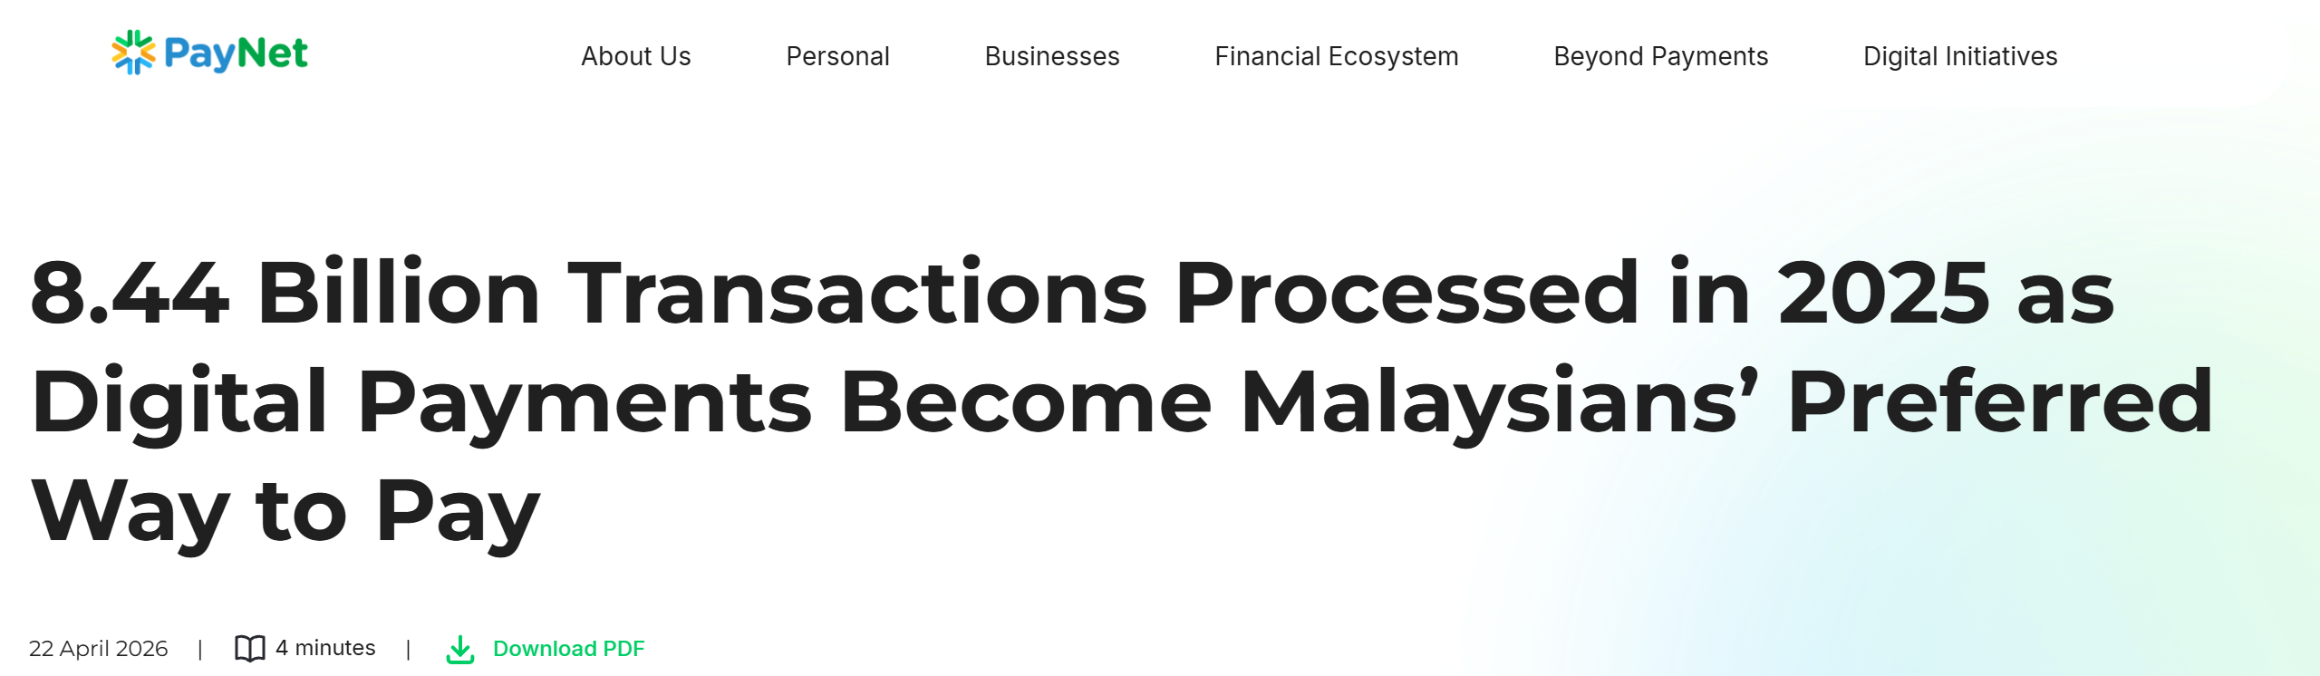
02 · THE PROBLEM
Small firms finish the work, then wait months to be paid
Who feels it most: project-based micro-firms (design, renovation, events, IT) with 5–20 staff
64 days
Average time Malaysian SMEs wait to be paid, versus 58 days for large firms.
THE DAILY BURDEN
Experian Malaysia, State of Credit 2025 (21 May 2025)
Remember to invoice every finished milestone
Chase each client, one by one, on WhatsApp
Open the bank app to check whether a “dah bayar” screenshot is real
Track what is still due in a spreadsheet
90–120+
Days in the payment cycle advertising agencies now face, stretched from 30.
4As Malaysia statement (11 May 2026)
Delayed client payments
Named by Bank Negara as a cause of repayment stress in some micro and small firms.
Bank Negara Malaysia, Financial Stability Review 2H 2025, via Malay Mail (31 Mar 2026)
IN THE NEWS
Why now: Malaysia processed 8.44 billion digital payment transactions in 2025, so more payments arrive as transfers with a screenshot as proof (PayNet, Apr 2026).
Sources: experian.com.my · aaaa.org.my · malaymail.com · paynet.my (links in the speaker notes)
Milestone2Cash · 2/14
Notes:
[0:15–0:45]
Malaysian SMEs wait about sixty-four days to be paid, longer than big companies. Advertising agencies say thirty-day terms have stretched to ninety or a hundred and twenty days. Bank Negara names delayed client payments among the causes of stress in some micro and small firms.
For a small studio, getting paid is manual: invoice each milestone, chase every client on WhatsApp, and check the bank whenever someone says “dah bayar”.
Sources:
- Experian Malaysia, State of Credit 2025: https://www.experian.com.my/2025/05/21/experian-malaysias-state-of-credit-2025-reveals-sme-resilience-but-cash-flow-strains-persist/
- 4As Malaysia, 11 May 2026: https://aaaa.org.my/4as-sounds-alarm-on-unfair-payment-terms/
- Bank Negara FSR 2H 2025 via Malay Mail, 31 Mar 2026: https://www.malaymail.com/news/money/2026/03/31/bnm-reports-stronger-credit-quality-for-business-sector-in-second-half-of-2025/214528
- PayNet, 8.44 billion transactions in 2025: https://paynet.my/about-us/media-centre/press-release/8-44-billion-transactions-processed-in-2025-as-digital-payments-become-malaysians-preferred-way-to-pay.html

Slide 3
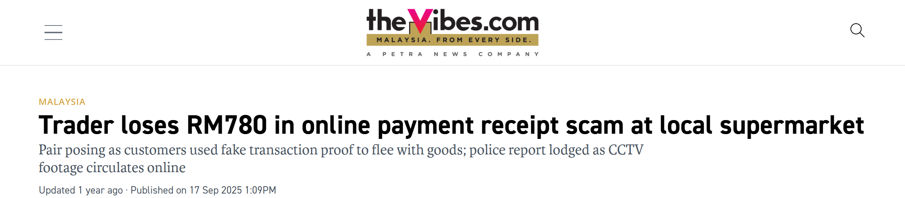
03 · WHERE IT GOES WRONG
A screenshot is a claim, not a receipt
Our demo scenario (synthetic): Studio Lumen's RM18,000 invoice, and the client says “dah bayar”
CLAIM
BANK
STILL DUE
IT ALREADY HAPPENS
On WhatsApp
Imported bank credit
Invoice LUMEN-DEMO-001
RM780
“Dah bayar boss, RM9,000.”
RM9,000 received
RM9,000 outstanding
of goods lost by a Port Dickson trader to a fake online-transfer receipt. The account later showed no credit.
+ a transfer screenshot
ref LMN-231026-001
keep collecting
✕ Mark it paid
The other RM9,000 drops out of collection.
✕ Count “I'll pay 28 Oct” as cash
Available funds look higher than they are.
The Vibes, 17 Sep 2025
Finance must know: is the money in the bank, is it counted once, and what is still due?
Scenario data is synthetic. Incident: thevibes.com (Sept 2025).
Milestone2Cash · 3/14
Notes:
[0:45–1:10]
Here is the moment we built for. An RM18,000 invoice is overdue. The client sends “dah bayar boss, RM9,000” with a screenshot.
The bank shows nine thousand arrived, so nine thousand is still due. Two easy mistakes: mark the invoice paid and stop chasing the rest, or treat a promise to pay later as money already received.
And screenshots can be fake: a Port Dickson trader lost seven hundred and eighty ringgit of goods to a fake transfer receipt.
Source: https://www.thevibes.com/articles/news/112870/trader-loses-rm780-in-online-payment-receipt-scam-at-local-supermarket

Slide 4
04 · THE GAP
Today's tools start after the money is clean
Small firms' payment evidence arrives as WhatsApp messages and screenshots, not bank feeds and email
Manual today
Existing finance tools
Milestone2Cash
Bank app + spreadsheet
Strong on invoices and prediction
Starts where the evidence arrives
Someone checks each screenshot by eye
Partial payments are easy to mark as fully paid
Promises get mixed with real cash
No record of who decided what
QuickBooks predicts when customers will pay, from their history (Intuit)
Chaser's AI reads debtor email replies and drafts answers (Chaser)
Built around bank feeds and email inboxes
Reads the WhatsApp reply and transfer screenshot (EN, 中文, BM)
Checks the claim against bank credits before it counts
Keeps the remainder and promises separate from cash
Every decision logged
QuickBooks: Intuit Cash Flow Planner help page · Chaser: chaserhq.com AI email generator. We do not claim other tools lack features we have not verified.
Milestone2Cash · 4/14
Notes:
[1:10–1:25]
Good tools exist. QuickBooks predicts when customers will pay; Chaser uses AI to read debtor email replies. But they work from bank feeds and email.
Our users' evidence is a WhatsApp message and a screenshot. Milestone2Cash starts exactly there: it reads the claim, checks it against the bank, and keeps the rest of the invoice in view.
Sources: https://quickbooks.intuit.com/learn-support/en-global/help-article/money-movement/cash-flow-planner/L8kvVEdNC_ROW_en · https://www.chaserhq.com/features/ai-email-generator

Slide 5
05 · OUR SOLUTION
One reviewed path from finished work to cash
Every step names who acts. Nothing that touches money happens without a person approving it.
01
02
03
04
Milestone done
Follow up
Read the evidence
Check and record
Invoice draft from the payment schedule
Reminder drafted in the client's language
Local OCR + AI read the reply and screenshot
Rules match the claim to bank credits
WHO DECIDES
WHO DECIDES
WHO DECIDES
WHO DECIDES
Owner approves
Finance confirms the send (simulated)
Unsure? It goes to a person
Finance approves the payment
AI helps read. Rules check. Your team decides.
Then: partial payments keep the remainder collectible, promises move expected dates, every action is logged.
Milestone2Cash · 5/14
Notes:
[1:25–1:45]
Milestone2Cash connects four steps. A finished milestone becomes an invoice draft that the Owner approves. Finance sends a reminder in the client's language — sending is simulated in our demo.
When the client replies or sends a screenshot, local OCR and AI read it. Rules check it against bank credits, and Finance approves the payment.
AI helps read. Rules check. Your team decides.

Slide 6
06 · WHAT THE BUSINESS GETS
Safer decisions, less manual work, clearer cash
Three outcomes for the owner and Finance, each backed by a feature in the live app
1
Safer decisions
2
Less manual work
3
Clearer cash
A screenshot or a promise is not money received.
The app does the reading and matching.
Received, still due and expected stay separate.
Every claim is checked against bank records
Finance approves before anything is recorded
One bank credit can be used once
Every action is in the activity log
Amount, reference and time read from the screenshot
Bank CSV import, then automatic matching
AI drafts reminders and picks up promised dates
Less retyping and switching between apps
Partial payments keep the balance collectible
Promises move expected dates, never cash
Late-payment scenarios in the 30-day forecast
Lowest balance and safety line at a glance
We have not measured time savings yet. Minutes per payment check (manual vs tool) is the first pilot measure.
Features shown in the live app at milestone-2-cash-proof-to-cash.replit.app; all data synthetic.
Milestone2Cash · 6/14
Notes:
[1:45–2:00]
What does the business get? First, safer decisions: a screenshot or a promise is never treated as money received; it is checked against the bank and approved by Finance, and everything is logged.
Second, less manual work: the app reads the screenshot, imports the bank CSV and matches it, and drafts reminders. We have not measured the time saved yet — that is the first thing our pilot will measure.
Third, clearer cash: received, still due and expected are kept separate, and late-payment scenarios show up in the forecast.

Slide 7
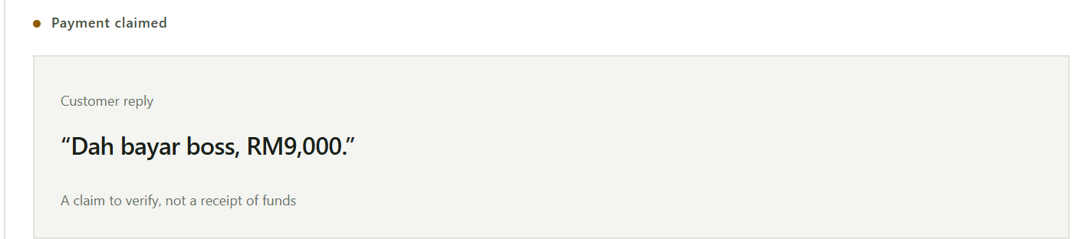
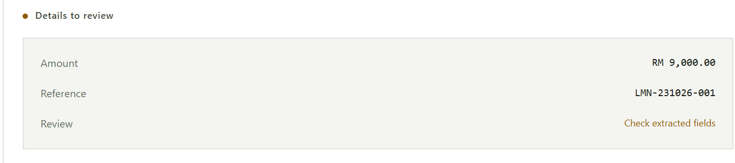
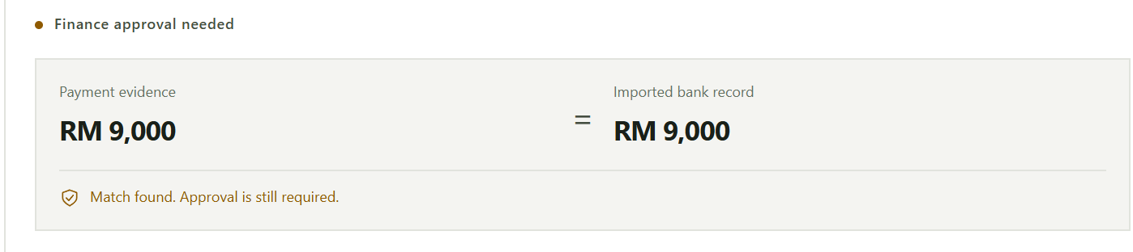
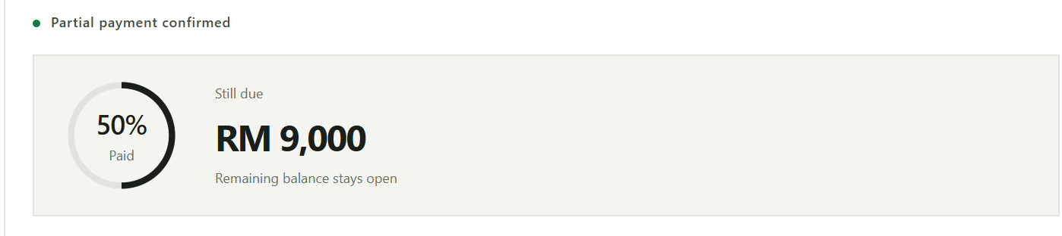
07 · HOW IT WORKS
From “dah bayar” to a verified partial payment
Four screens from our app's built-in walkthrough (synthetic example; no transaction is created)
1 The claim arrives A reply or screenshot starts a review. It is not proof.
2 AI reads the details OCR + AI extract amount and reference; Finance can correct.
3 Rules check the bank Claim matches the bank credit, but a person still approves.
4 Finance confirms RM9,000 recorded; RM9,000 stays due; every step logged.
Screens: milestone-2-cash-proof-to-cash.replit.app (landing-page walkthrough). The live workflow is shown in the demo video.
Milestone2Cash · 7/14
Notes:
[2:00–2:20]
This is the flow in four screens. The claim arrives and starts a review — it is not proof. OCR and AI read the amount and reference, and Finance can correct them.
Rules compare the claim with the imported bank credit: nine thousand claimed, nine thousand received — but a person still approves.
After approval only nine thousand is recorded; the other nine thousand stays due and every action is logged.

Slide 8
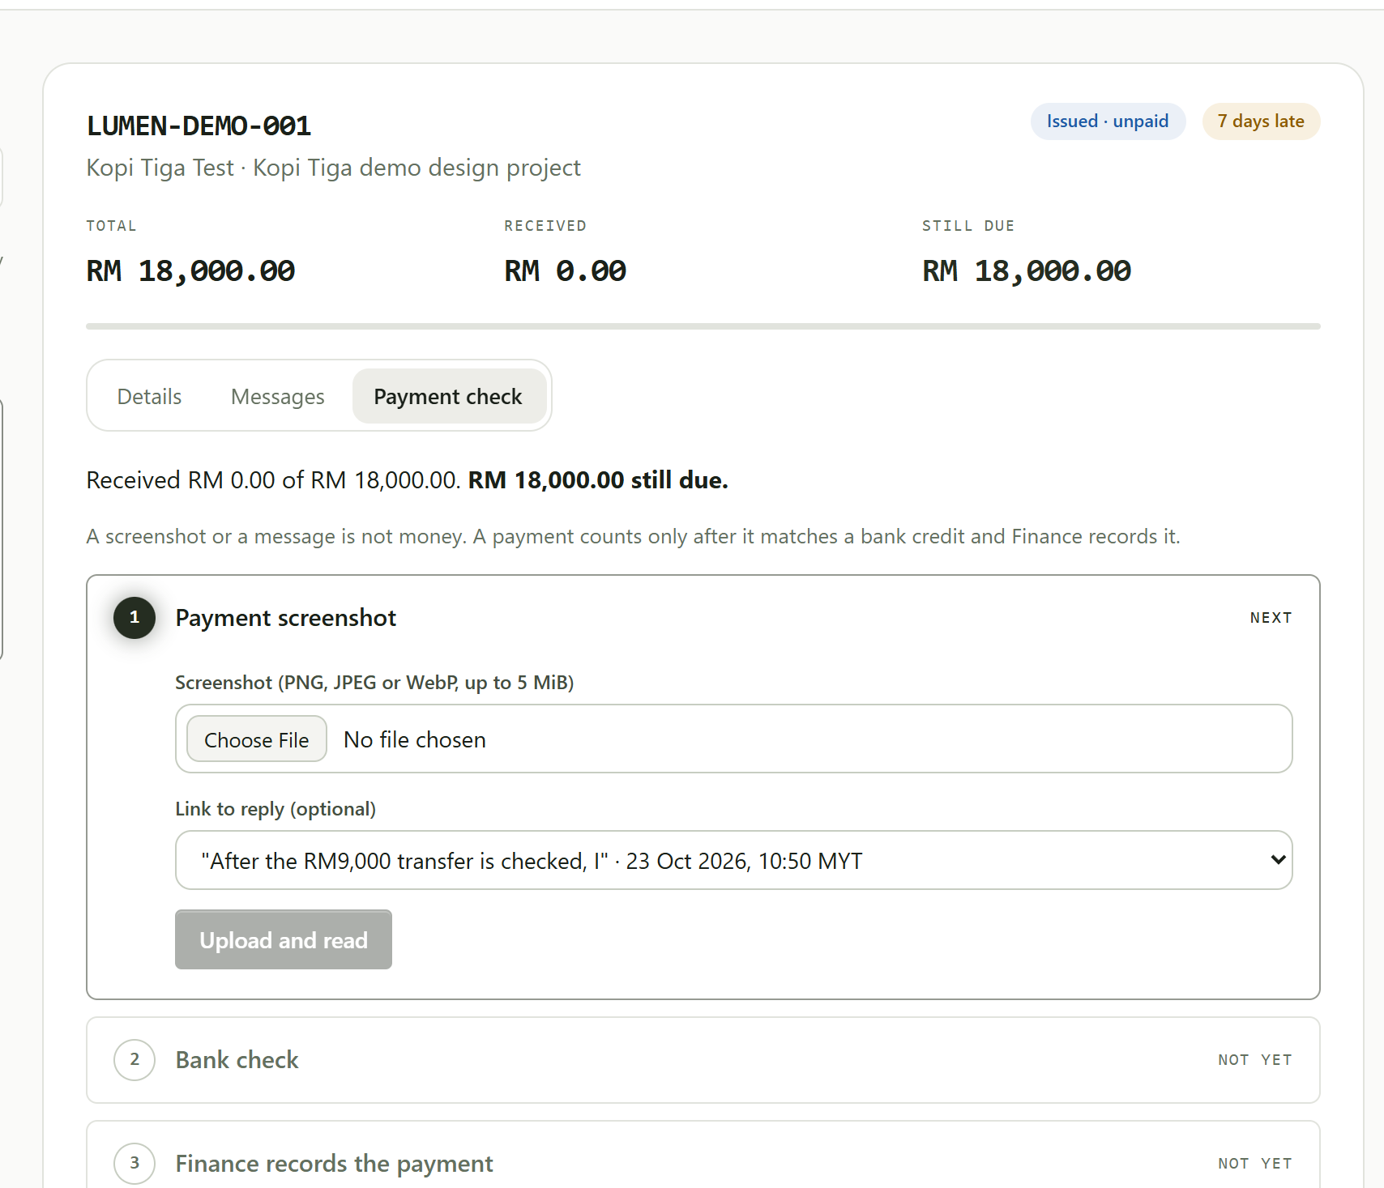
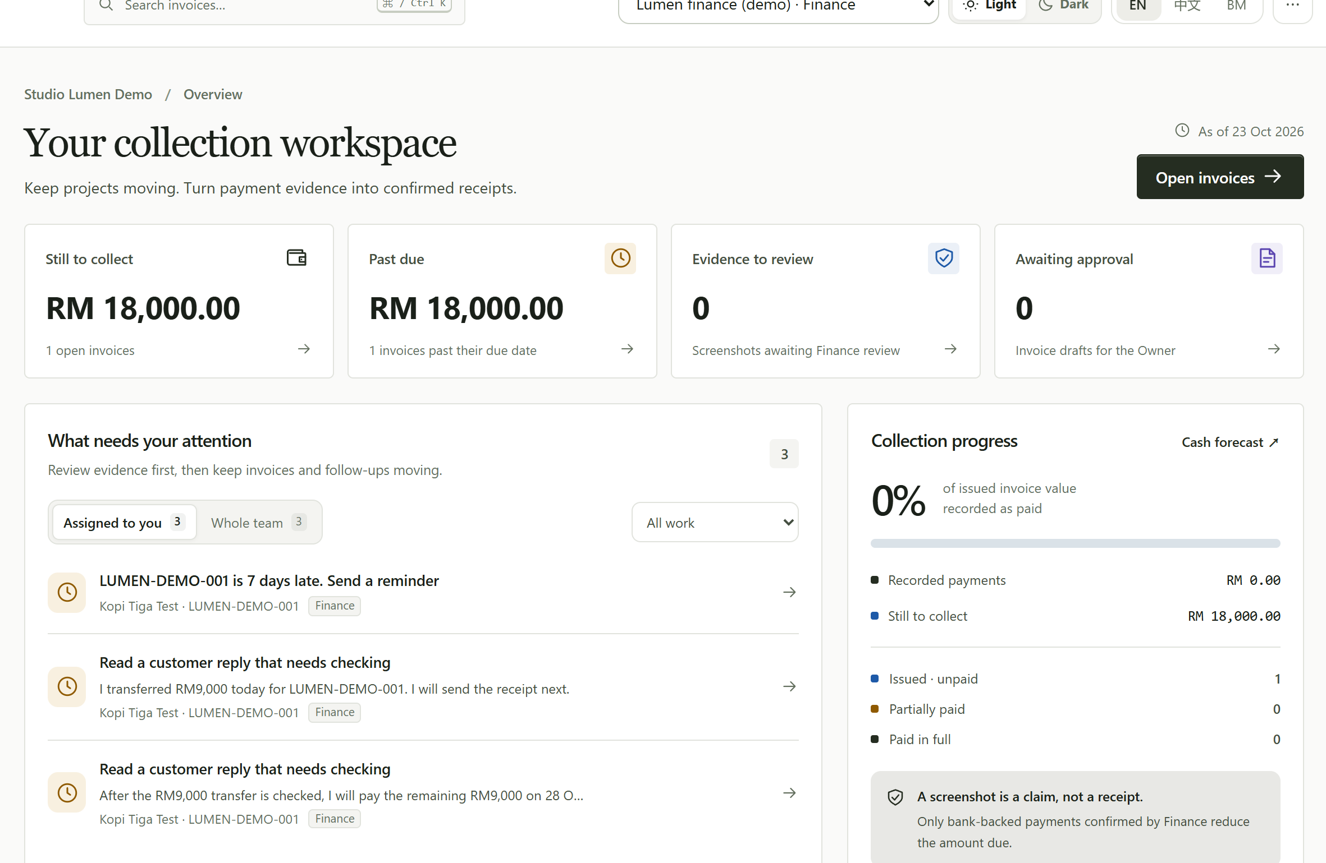
08 · LIVE DEMO
A working product, live on Replit
Live: milestone-2-cash-proof-to-cash.replit.app · synthetic demo company “Studio Lumen”
Works on mobile
English · 中文 · BM
Light and dark themes
Bank CSV import
Duplicate-payment protection
Demo path: milestone done → Owner approves invoice → reminder sent (simulated) → RM9,000 screenshot read → bank check → partial payment recorded
Screenshots: live app, seeded synthetic state on 24 Oct 2026. Demo roles; sending is simulated; no real bank or WhatsApp link; redeploying resets the demo data.
Milestone2Cash · 8/14
Notes:
[2:20–3:50] SWITCH TO THE LIVE APP (about 90 seconds).
1. As Project manager, complete the milestone; as Owner, approve the invoice draft.
2. As Finance, open the overdue invoice, draft the reminder, confirm the simulated send.
3. Payment check: upload data/demo/receipts/lumen-partial.png, show the original next to the extracted fields.
4. Run the bank check and read the verdict. Tick the review and record the partial payment: RM9,000 paid, RM9,000 still due.
Say: “A screenshot alone cannot record a payment, and a retry cannot use the same bank credit twice.”
If the AI is slow or unavailable, use the labelled manual fallback and say so.

Slide 9
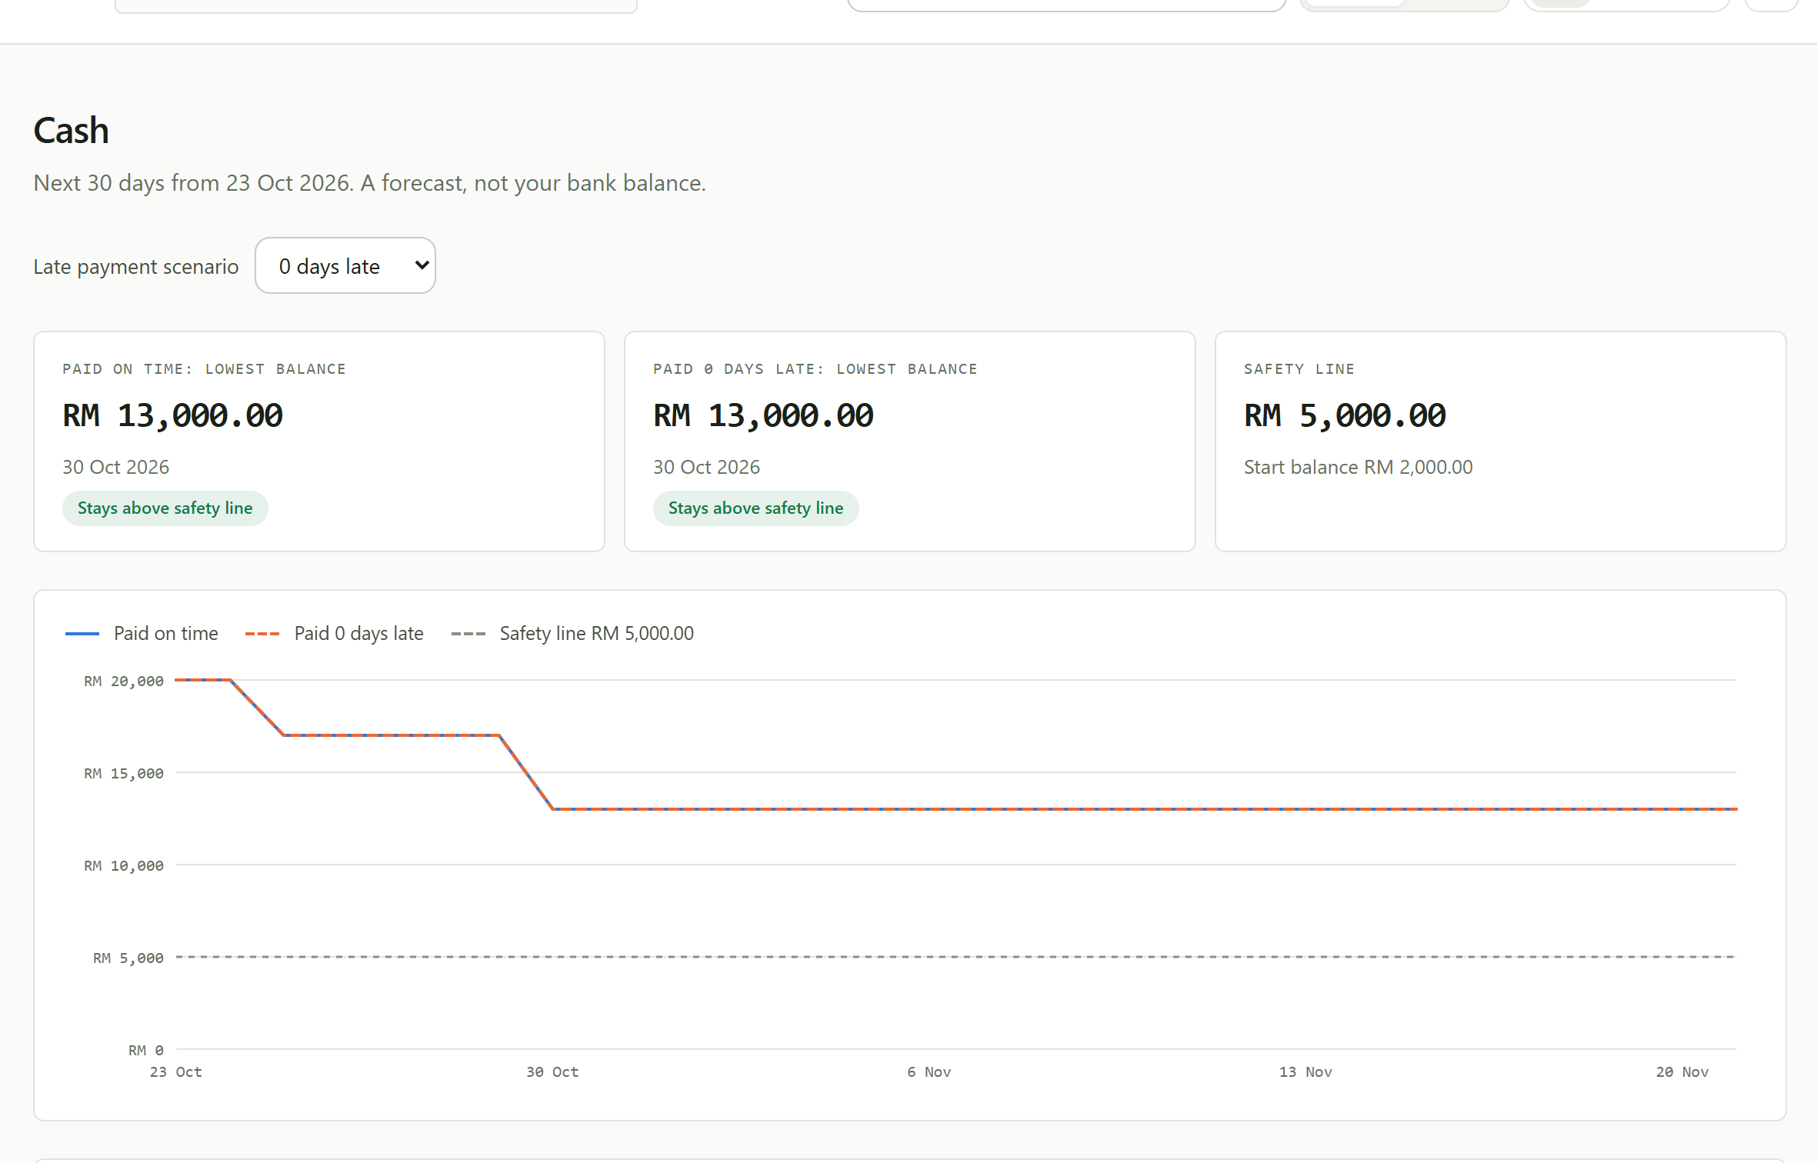
09 · CASH VIEW
A promise changes timing, never cash received
1
Promise captured
“I will pay the remaining RM9,000 on 28 Oct” is read by AI, then confirmed by Finance.
2
What if they pay late?
Switch to 7 days late: the expected receipt moves from 28 Oct to 4 Nov.
3
Actual vs expected
Approved payments are cash. Promises stay expected and are never counted twice.
4
Next 30 days
Lowest balance and the safety line, traceable to every entry.
Screenshot: live app before the demo payment is recorded; values shown are synthetic.
Milestone2Cash · 9/14
Notes:
[3:50–4:20] (Still in the app, or on this slide as backup.)
The client now promises the remaining nine thousand on the twenty-eighth. AI reads the date; Finance confirms it.
The forecast places the remainder on the twenty-eighth; switching to seven days late moves it to the fourth of November.
The nine thousand already approved stays actual cash and is never counted again. This is a scenario, not a guarantee.

Slide 10
10 · FEASIBILITY AND TRUST
Rules make the decisions; AI only reads
Architecture of the working prototype, hosted on Replit
Browser UI
Node.js API
Local OCR
BUILT-IN SAFEGUARDS
React · EN / 中文 / BM
17 operations · role checks
Tesseract.js on our server
AI cannot approve a payment
Screenshots are read on our server; account numbers masked before AI
API key stays server-side
Retries are safe: one bank credit is allocated once
Evidence changed? The match must be re-run
AI down? Template + manual fallback
Matching rules
DeepSeek
Amount · reference · time · duplicates
Redacted text only; no images
Finance approval
SQLite ledger
The gate before any record
Payments · log · 30-day forecast
Source: github.com/jake2ace/SDC-Tracker (docs/PRODUCT_SPEC.md, submission/PRODUCT_NARRATIVE.md).
Milestone2Cash · 10/14
Notes:
[4:20–4:50]
Under the hood: a React interface calls seventeen Node.js operations backed by SQLite. Tesseract reads screenshots on our own server; DeepSeek only receives redacted text for permitted tasks, and the key stays server-side.
The decision itself is deterministic: rules compare amount, reference, time and duplicates, and Finance approval is the gate before anything is recorded.
Retries cannot use the same bank credit twice, and if the AI is unavailable the app falls back to templates and manual entry.

Slide 11
11 · PROOF IT WORKS
Tested with real OCR and AI calls, errors kept in the score
Frozen synthetic set, run on 24 Oct 2026: 40 receipt images (4 layouts incl. cropped, noisy, dark) and 40 replies (EN, 中文, BM)
11/11
30/30
low-confidence replies sent to a person
matcher cases correct · 0 unsafe approvals
40/40
69
daily forecast checks match hand calculation
Historical baseline: 50 API, 16 UI, 3 browser runs
Reference misses: 5 letter O vs zero OCR confusions, kept in the score rather than corrected.
Synthetic accuracy, not real-bank accuracy. Staff time savings have not been measured yet.
Source: docs/evaluation/STEP7-METRICS.md and STEP7-INTEGRATION.md in the SDC-Tracker repository.
24 Oct 2026, c438678: 60 backend + 23 frontend checks and 13 contract/data groups. The 3 baseline browser runs were not rerun.
Milestone2Cash · 11/14
Notes:
[4:50–5:25]
We tested with real OCR and DeepSeek calls on forty synthetic screenshots in four layouts, including cropped, noisy and dark images, and forty replies in English, Chinese and Malay.
Amounts and transfer times were exact in all forty. References were exact in thirty-five — the five misses were letter-O-versus-zero confusions, and we kept them in the score. Reply intent was right in thirty-nine of forty.
All eleven low-confidence replies went to a person. The matcher passed all thirty frozen cases with zero unsafe approvals, and forty daily forecast checks matched hand calculations. Sixty-nine automated checks pass.
These are synthetic results; they do not prove real-bank accuracy, and we have not yet measured staff time savings.

Slide 12
12 · FIT AND IMPACT
Built to plug into Orbyte and serve many SMEs
1
Fits the Orbyte hub
2
Reusable across SMEs
Trigger: milestones in Orbyte Work
Results for Connect partner areas: payments, collections, accounting
Uses shared roles, approvals and audit trail
Two demo companies with separate data and forecasts
Any firm that bills by milestone and is paid by transfer
Interface in English, 中文 and Bahasa Melayu
Proposed integration · no live Orbyte link yet
Shown in the live app
3
Business model
4
SDG 8 impact
Usage-based, like Orbyte's credit wallet
Charged per verified payment check, not per seat
Free monthly quota for micro-firms
8.2: productivity through technology (less manual chasing and checking)
8.3: MSME growth (fewer missed balances, clearer cash)
Proposal · pricing not tested
Proposed alignment · impact not yet measured
Orbyte capabilities: Alpha Red's Orbyte introduction deck (SDC participant resources).
Milestone2Cash · 12/14
Notes:
[5:25–5:50]
Milestone2Cash is designed as an Orbyte module: milestones in Orbyte Work trigger it, and its results belong in the Connect areas Orbyte lists for payments, collections and accounting, using Orbyte's shared roles, approvals and audit trail.
It is reusable: the demo runs two companies with separate data, in English, Chinese and Malay.
We propose usage-based pricing per verified payment check, like Orbyte's credit wallet. We align with SDG 8.2 and 8.3 — proposed, not yet measured.

Slide 13
13 · HONEST SCOPE
What works today, what is simulated, what comes next
Working now
Simulated in the prototype
Next: how we will measure success
17 API operations, live on Replit
OCR + AI extraction with manual fallback
Bank CSV import, matching and Finance approval
Partial payments, promises, duplicate protection
30-day cash scenarios
Activity log and role checks
Mobile layout, EN / 中文 / BM, light and dark
All business, receipt and bank data are synthetic
Reminder sending is simulated
No live bank, WhatsApp, MyInvois or Orbyte link
Demo roles, not production login
Redeploying resets the demo data
Pilot with a consenting studio
Minutes per payment check: manual vs tool, same evidence
% of payment claims checked against the bank before recording
Reference accuracy ≥95% on a held-out set (now 87.5%)
A working prototype, not a production system. Phase 2 items are proposals, not results.
Milestone2Cash · 13/14
Notes:
[5:50–6:10]
To be clear about scope: the full workflow runs on Replit today. Data is synthetic, roles are demo roles, sending is simulated, there is no live bank, WhatsApp or Orbyte connection yet, and redeploying resets the demo data. It is a working prototype.
Next, we will pilot with a consenting studio and measure what matters: minutes per payment check, manual versus tool; the share of payment claims checked against the bank before recording; and better reference accuracy on a held-out set.

Slide 14
A screenshot is a claim.
Milestone2Cash turns it into a verified payment, and keeps what is still due in sight.
Live demo milestone-2-cash-proof-to-cash.replit.app
Code github.com/jake2ace/SDC-Tracker
Video (6:19) youtube.com/watch?v=pholjV_8vBM
AI READS · RULES CHECK · PEOPLE DECIDE
Team Lets go
Jiazhong Yang · Low Li Xin · Jieheng Li · Lingchen Wu — Monash University Malaysia · Universiti Malaya
Notes:
[6:10–6:25]
A screenshot is a claim. Milestone2Cash turns it into a verified payment, and keeps what is still due in sight.
The live demo and code are linked here. Thank you from team Lets go.

