Slide 1

P
W
W
S
restige rldwide ater lutions
Clean Drinking Water for Residents of Flint, Michigan
CBE 494L, Design Team #5
Nicholas Baker, Jacob Letcher, Troy Ramos, Jake Silva, and Esau Woodhouse

Slide 2
PWWS
Project Objective
Design a system that will:
Remove non-biological contaminants including Lead, Arsenic, Copper, etc.
Remove viruses and bacteria from water including cryptosporidium, giardia, and Escherichia coli.
Achieve a production rate of 1,000,000 gallons of clean water per day.
Provide a product to the residents of Flint, Michigan at a cut-rate.

Slide 3
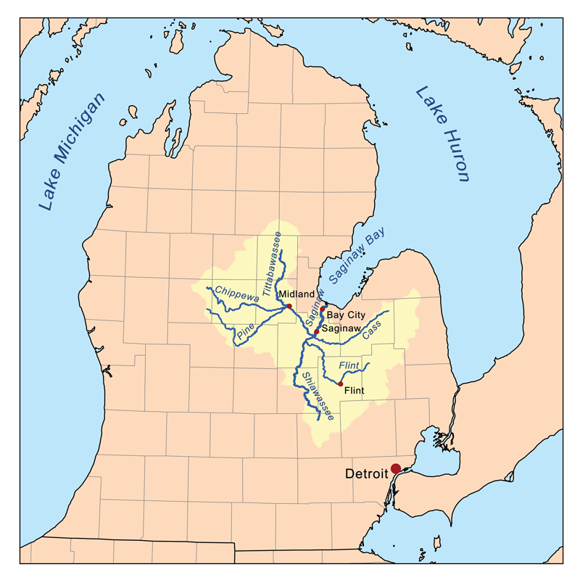
PWWS
Lake Huron
Flint River
Detroit River
http://michiganradio.org/post/map-take-closer-look-flint-lead-testing-results#stream/0

Slide 4
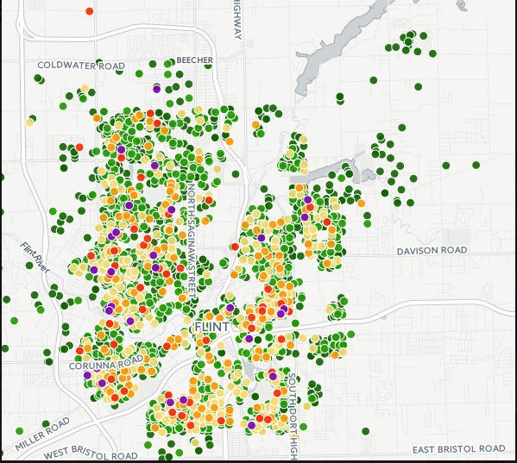
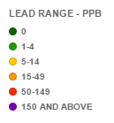
PWWS
EPA drinking water standards states that “ If lead concentrations exceed an action level of 15 ppb … the system must undertake a number of additional actions to control corrosion.”
https://www.epa.gov/dwreginfo/lead-and-copper-rule
http://michiganradio.org/post/map-take-closer-look-flint-lead-testing-results#stream/0

Slide 5
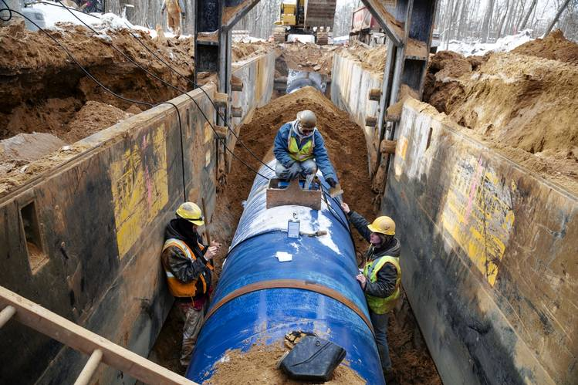
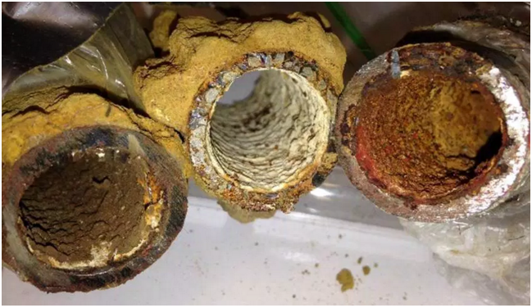
PWWS
Why is the Water Dirty?
In April 2014, Flint changed water source from Detroit Water and Sewerage Department (Source: Lake Huron and Detroit River) to Flint River.
Corrosion inhibitors were not added to distribution system.
Significant amount of scaling on pipes.
Scaled pipes polluted all water in the distribution system regardless of how the water was pre-treated.
http://www.wsj.com/articles/flint-water-crisis-shines-light-on-lead-pipes-crisscrossing-the-u-s-1453977180
http://flintwaterstudy.org/tag/drinking-water/

Slide 6
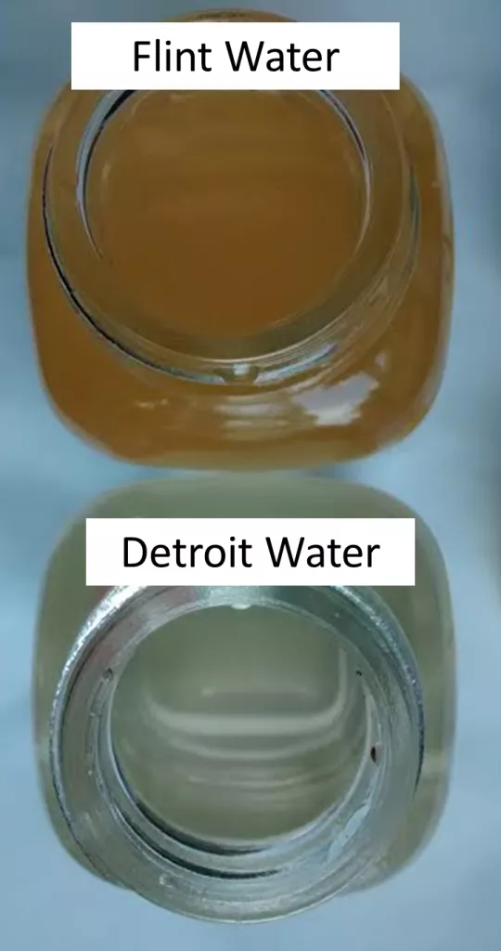
PWWS
Motivation
Lead Poisoning Health Effects
Abdominal pain
Constipation
Irritable
Loss of appetite
Memory loss
Painful/tingling hands
http://www.cdc.gov/niosh/topics/lead/health.html
http://flintwaterstudy.org/tag/drinking-water/

Slide 7
PWWS
Water Consumption for a Family of Four in Flint, Michigan
202 bottles of water per day
Used for cooking, washing hair, drinking, cleaning, brushing teeth, washing faces, etc.
Population of Flint, Michigan approximately 100,000
Demand: 655,000 gallons per day
or
38,757 bottles of water per day
http://www.cnn.com/2016/03/05/us/flint-family-number-daily-bottles-of-water/

Slide 8

PWWS
Benefits
Provide cheap purified water for human consumption specifically to low income families in Flint.
Provide local economic growth and job opportunities.
Reduce water related illnesses.
http://www.ibtimes.com/beyond-flint-poor-blacks-latinos-endure-oversized-burden-americas-industrial-waste-2277647

Slide 9
PWWS
Available Options
Providing emergency relief.
Bottle purified water and distribute it to local families in need
Purifying the water is required and can be done in a production plant
Replace piping system in flint and surrounding areasThis will cost up to $1 Billion for the entire system
System is un marked making it more difficult
Retrieve water from new source and put it into new
piping system
Potential plan to pull water from Lake Heron

Slide 10
PWWS
Important Information for Project Continuation
Gathered Information
Technology Utilization
What needs to be removed:
Lead
Arsenic
Pathogens
How much water is needed:
100,000 people in Flint
Emergency relief funding:
10 million provided already
Aspen plus™
Used for process design
PUMP-Flo™
Pump sizing and design
CAPCOST Excel
Economic analysis tool

Slide 11
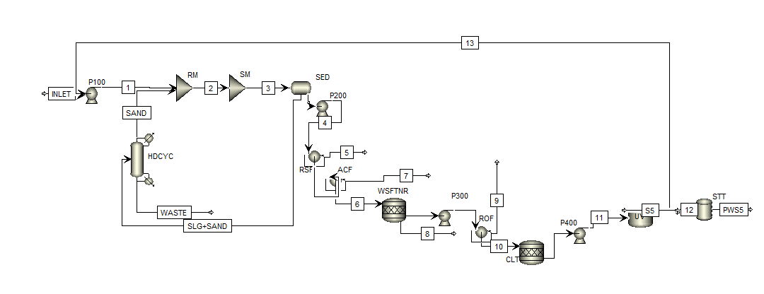
PWWS
Process Flow Diagram (PFD)

Slide 12
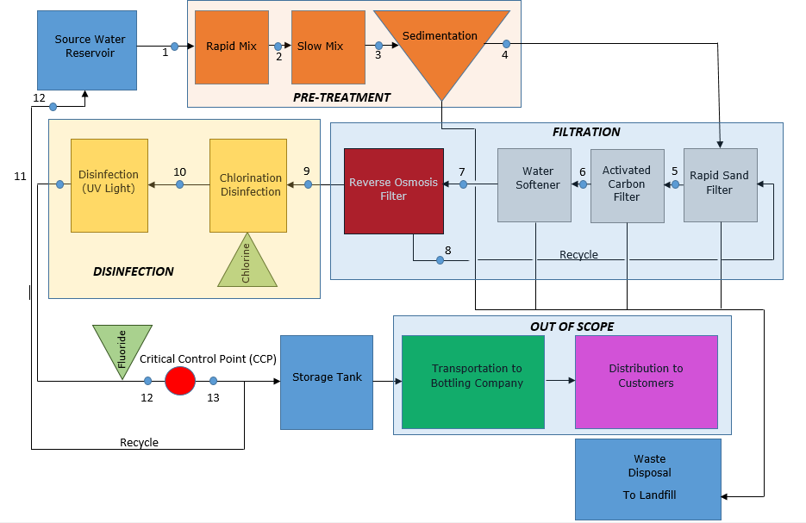
PWWS
Block Flow Diagram (BFD)

Slide 13
Pre-Treatment

Slide 14
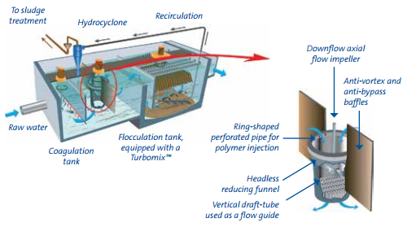
Rapid Mix/Slow Mix/ Sedimentation
ACTIFLO Turbo Schematic

Slide 15
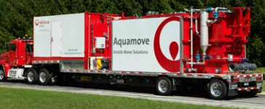
Rapid Mix/Slow Mix/ Sedimentation
ACTIFLO Turbo Specifications
Dimensions: 48 x 8.5 x 13.5 ft
Weight (Shipping/Operating): 65,000 lbs / 155,000 lbs.
Feed Water: 300 to 1500 GPM at 25psig
Service Water: 50 GPM at 60 to 90 psig
Product Water: 300 to 1500 GPM at 10 feet head
Sludge: 10 to 100 GPM at 17 feet head
Electrical Requirments: 480 VAC/ 3 Phase/ 100 AMP
Service Connections
Raw Water Inlet: 10 inches
Service Water Inlet: 2 inches
Clarified Water Outlet: 12 inches
Sludge Outlet: 3 inches
file:///C:/Users/Jake/Downloads/Brochure%20Actiflo%20Mobile.pdf

Slide 16
Filtration

Slide 17
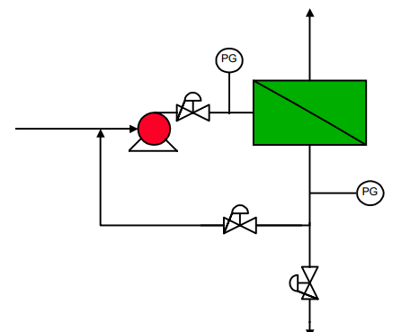

Reverse Osmosis Filter
Supplier: Evoqua Water Technologies
Unit: Vantage M86N-126 RO System
Feed Flow Rate: 747 gallons per minute
Product Flow Rate: 560 gallons per minute
Reject Flow Rate: 187 gallons per minute
Single Pass with 8” membranes
Dimensions: 287 in. x 94 in. x 128 in.
http://www.membranes.com/docs/trc/flowcon.pdf
http://www.evoqua.com/en/brands/IPS/Pages/vantage-m86.aspx

Slide 18
Reverse Osmosis Filter
Pressure: 275 psig [1]
Average Membrane Flux: 65% to 80% [2]
Efficiencies:
97% for Total Dissolved Solids [2]
95% for Naturally Occurring Organics [2]
Alternative Technologies: Microfiltration, Ultrafiltration, Nanofiltration
http://www.evoqua.com/en/brands/IPS/Pages/vantage-m86.aspx

Slide 19
Lead
Feed Lead Composition: 0 to 150 ppb [4]
EPA’s MCL: 15 ppb [5]
Effluent Lead Composition: 4.5 ppb
Arsenic
Feed Arsenic Composition: 0 to 50 ppb [4]
EPA’s MCL: 10 ppb [5]
Effluent Arsenic Composition: 1.5 ppb
E. Coli
Feed Arsenic Composition: 200 colonies per mL [6]
EPA’s MCL: 0 colonies per mL [5]
Effluent Arsenic Composition: 0 colonies per mL

Slide 20
Filtration
Selected Filters
Alternatives
Rapid/Slow Mix
Coagulation / clarification
Rapid Sand Filter
Compact/large volume capability
Activated Carbon Filter
Remove organics/free chlorine
Reverse Osmosis
Desalination
Slow Sand Filter
Handles smaller flow rates
Poly-fiber/sponge Filter
Replace activated carbon filters on small scale (aquariums)
Solar Desalination
Being researched and not fully developed

Slide 21
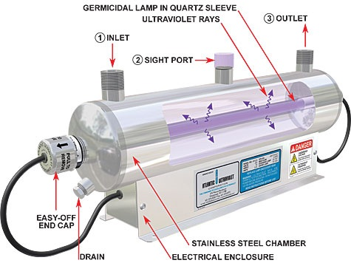
Water Treatment
Water Softening
Chosen: Chelating agent
Alternatives: Lime softening, distillation, ion exchange
Water Disinfecting
Chosen: Chlorination tank
Alternatives: Membrane filtration
Water Purification
Chosen: UV Radiation
Alternatives: Ozonation
http://www.xtremetechnologylb.com/index.php?page=ultraviolet-system

Slide 22
Disinfection

Slide 24
Environmental Concerns
PWWS
Nearby Residential Area
Noise Pollution
Chemical Usage

Slide 25
Economic Analysis - Assumptions
PWWS
Receive $4,000,000 of emergency federal funding
Receive tax exemptions for first 15 years
Bottling company agrees to all terms and conditions made by PWWT
All equipment used lasts until its manufacturer’s approved life time
UV lights consume minimal energy
Water is being sold to PWWT at price before emergency
A flat yearly maintenance cost of $100,000
1 piece of equipment will suffice in all situations except pumps

Slide 26
PWWS
Economic Analysis - Methods Implemented
Manufacturer Information
Websites
Call for quotes
Sizing information and guidelines
CAPCOST
Values determined by size and type of equipment based off manufacturer information
Modeled annual chemical and energy costs

Slide 27
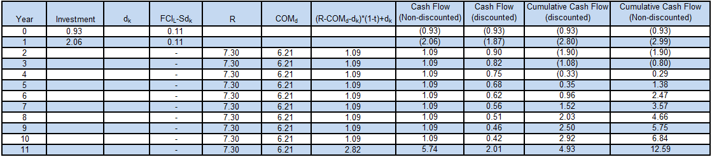
Economic Analysis - Cash Flow

Slide 28
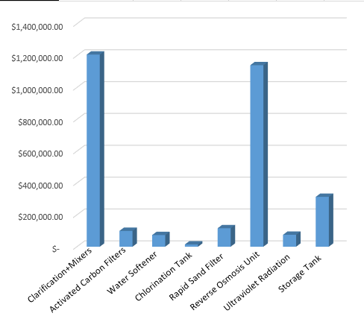
PWWS
Economic Analysis – Equipment Cost
Total Equipment Cost:
$3,037,172

Slide 29
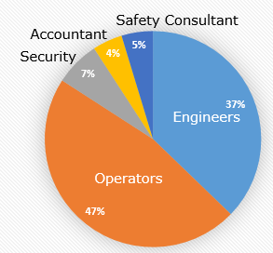
Economic Analysis - Employee Cost
PWWS
Total Employee Cost:
$1,593,000

Slide 30
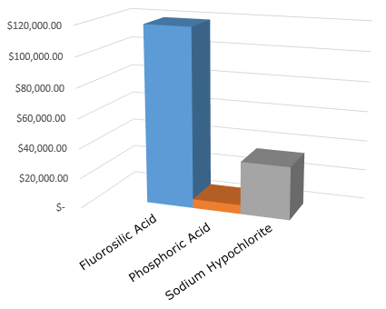
Economic Analysis - Chemical Cost
PWWS
Total Chemical Cost:
$160,011

Slide 31
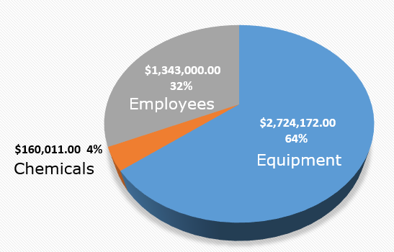
Economic Analysis
PWWS

Slide 32
Constraints
Time
Resources
Budget
Recommendations

Slide 33
Summary
Financing will be received from federal emergency relief funding
$4 millions dollars out of the possible $100 million
Provide 1,000,000 gallons of drinking water per day
500,000 gallons at reduced price for residents
500,000 gallons for the bottling company to sell at desired price
Water standards
Filtering pathogens, lead, arsenic
All will meet set EPA standards
Economics
Initial plant cost will be $2.99 million
Profit will occur at year 5

Slide 34
What was learned
Multiple water purification processes for drinking water
Filtration and treatment alternatives
EPA standards for drinking water
Lead, E. Coli, Giardia, Cryptosporidium
Plant design for large scale water treatment
Production scale of greater than 1 million gallons per day
Profitability of producing drinking on a large scale
Flint, Michigan is labeled a national emergency and does not have a “quick fix” approach
Cost approximately $50 million to $80 million replace pipe system in Flint
http://www.detroitnews.com/story/news/michigan/flint-water-crisis/2016/03/04/flint-begins-lead-pipe-removal/81333670/

