Slide 1

Tracing the arc
A Glimpse into the Past, Present, and Future of Artificial Intelligence
Dr. Edward Brash
A Lecture Series for the CNU Lifelong Learning Society
Fall 2023

Slide 2
Early Successes in AI
Logic Theorist (1955)
Capabilities:
Symbolic Reasoning: Developed by Allen Newell, J.C. Shaw, and Herbert A. Simon, the Logic Theorist was the first program to mimic human problem-solving skills, utilizing symbolic reasoning to solve mathematical theorems.
Proof Generation: It was capable of proving mathematical theorems by representing them as logical statements and utilizing a search tree to explore possible proofs, finding alternative solutions to the ones used by humans.
Learning and Optimization: The Logic Theorist could learn and improve upon its previous solutions, optimizing its performance in theorem proving.

Slide 3
Logical Reasoning
This is extremely interesting! It is a topic at the boundary between mathematics and philosophy
The idea is that logical human thought processes can be expressed in terms of mathematical expressions involving True/False statements.
Example: Jane is a medical doctor. All medical doctors are human. Therefore, Jane is a human.
Let the (predicate) statement “is a doctor” be represented by P
Let the (predicate) statement ”is human” be represented by Q
We can then represent the statement “All medical doctors are human” by: P ➔ Q (”P implies Q”)
We can represent the statement “Jane is a doctor” by: P = True
Thus, we can infer that Q = True. Therefore, Jane is human.

Slide 4
Logical Reasoning
Example 2:
“In Newport News, sometimes it is raining, and sometimes a person is asleep.”
Let “is raining” be represented by P
Let ”is asleep” by represented by Q
Consider now the expression P v Q … this means “P or Q”. We can construct a “truth table” for this:
 | P=0 | P=1
Q=0 | 0 | 1
Q=1 | 1 | 1

Slide 5
Logical Reasoning
Now, consider now the expression Q v P … We can construct a “truth table” for this:
Of course, it’s exactly the same! So, we can then write that:
P v Q = Q v P
This is known as an AXIOM. We can’t really “prove” axioms, but we accept them to be true statements, and can use them as parts of proofs of other statements.
 | Q=0 | Q=1
P=0 | 0 | 1
P=1 | 1 | 1

Slide 6
Logical Reasoning
Example 3:
Consider the following conversation:
Alice: “It is raining or snowing.”
Bob: “No, Alice, you are wrong.”
Charlie: “Oh, OK, I understand. It is … ?”
What should Charlie say?
Let “is raining” be represented by P, and “is snowing” be represented by Q.
Alice: P v Q. (i.e. “is raining or snowing).”)
Bob: ~(P v Q) (i.e. “is NOT (raining or snowing”)

Slide 7
Logical Reasoning
 | P = 0 | P = 1
Q = 0 | 0 | 1
Q = 1 | 1 | 1
 | P = 0 | P = 1
Q = 0 | 1 | 0
Q = 1 | 0 | 0
Example 3:
Alice Bob
 |  | P = 0 | P = 1
 |  | ~P = 1 | ~P = 0
Q = 0 | ~Q = 1 | 1 | 0
Q = 1 | ~Q = 0 | 0 | 0
Charlie: ”It is not raining and it is not snowing.”
~(P v Q) = ~P * ~Q

Slide 8
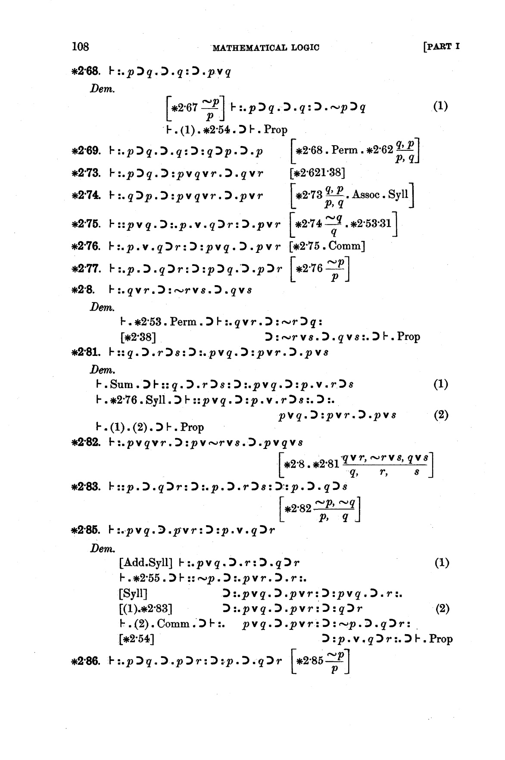
So, what’s the point?
In 1910, Whitehead and Russell published Principia Mathematica, where they developed a series of logical PROOFS, starting from a set of six basic axioms
The guys (Simon, Newell, and Shaw) that designed and wrote Logic Theorist set out to write a computer program that could figure out these proofs, using only the six axioms
The results were quite fascinating!

Slide 9
Logic Theorist
Simon: “We invented a computer program capable of thinking non-numerically, and thereby solved the venerable mind-body problem, explaining how a system composed of matter can have the properties of mind.”
The proofs were, in some cases, more direct (fewer steps) than the human proofs offered by Russell and Whitehead
The proofs were, in some cases, much more detailed than the human proofs offered by Russell and Whitehead
Pamela McCorduck: “proof positive that a machine could perform tasks heretofore considered intelligent, creative and uniquely human” -> Strong AI

Slide 10
Early Successes in AI
ELIZA (1966)
Capabilities:
Natural Language Processing: Developed by Joseph Weizenbaum at the MIT AI Lab, ELIZA was one of the first AI programs to conduct conversations in natural English, showcasing early capabilities in Natural Language Processing (NLP) – the first chatbot!!!
User Interaction: It could engage with users in a seemingly empathetic manner, mimicking a Rogerian psychotherapist and providing responses that reflected understanding and engagement.
Script-Based Responses: ELIZA utilized scripts (the most famous being DOCTOR) to identify keywords in user inputs and formulate responses, providing an illusion of comprehension and interaction.

Slide 11
ELIZA Example Conversation
ELIZA: Hi. What seems to be your problem ?
ME: Lately, I’ve been feeling a little depressed.
ELIZA: And how do you feel right now ?
ME: I feel sad, but relieved to be writing.
ELIZA: Of what does feeling sad remind you ?
ME: Well, I’m an alcoholic, and I’ve been sober for a long time, but I drank yesterday. And then I decided to stop drinking again. But still; that makes me feel sad.
ELIZA: Is it because you are an alcoholic that you came to me ?
ME: I suppose that that’s one of the reasons.
ELIZA: Can you elaborate on that ?

Slide 12
Early Successes in AI
Limitations:
Lack of Genuine Understanding: ELIZA did not understand language or context in a genuine sense. It operated through pattern matching and substitution methodology without grasping the semantic or emotional underpinnings of a conversation.
Limited Conversational Depth: While it could mimic conversational interaction, ELIZA lacked depth in managing prolonged or intricate dialogues, particularly when user inputs deviated from anticipated patterns.

Slide 13
Early Successes in AI
Limitations:
Ironically, though Weizenbaum had designed ELIZA to demonstrate how superficial the state of human-to-machine conversation was, it had the opposite effect.
People were entranced, engaging in long, deep, and private conversations with a program that was only capable of reflecting users’ words back to them.
Weizenbaum was so disturbed by the public response that he spent the rest of his life warning against the perils of letting computers — and, by extension, the field of AI he helped launch — play too large a role in society.

Slide 14
Impact of Logic Theorist and ELIZA
Significance and Impact:
Pioneering Efforts: Both the Logic Theorist and ELIZA represented pioneering efforts in AI, exploring the realms of problem-solving, learning, and conversational interaction through computational models.
Insights into Possibilities and Challenges: They illuminated the possibilities of machines engaging in intelligent behaviors (theorem proving, conversational interaction) while simultaneously highlighting the intrinsic challenges (genuine understanding, domain generalization).
Ethical and Social Considerations: Particularly in the case of ELIZA, questions about the social and psychological impacts of AI began to surface, touching upon issues related to empathy, deception, and emotional engagement.

Slide 15
The First AI Winter
The term "AI winter" refers to periods in the history of artificial intelligence research where progress slowed, funding became scarce, and skepticism regarding the potential of AI grew.
The first such period, primarily occurring in the mid-1970s, was characterized by a significant mismatch between the optimism that propelled initial AI research and the tangible results and applications that emerged.
As I said last lecture, researchers made the fatal mistake of “overpromise and underdeliver”!

Slide 16
The First AI Winter
Challenges and Setbacks
Technological Limitations
Computational Power: Early AI projects were constrained by the limited computational capabilities of existing technology, hindering the ability to develop and implement increasingly complex algorithms.
Storage Limitations: The storage capabilities were also modest, which limited the amount of data that could be processed and utilized by AI algorithms, restricting both the complexity and the scale of AI applications.
Inadequate Models: The models and algorithms used often lacked the sophistication needed to navigate the complexities and variances inherent in real-world applications (in most cases, related to limitations in computational power).

Slide 17
The First AI Winter
2. Inflated Expectations and Subsequent Disillusionment
Over-Promising Results: Early AI researchers, fueled by initial successes and an optimistic outlook, often promised results and milestones that were not feasibly achievable with existing technologies and understanding.
Failure to Meet Expectations: The inability to deliver on proclaimed promises led to a growing disconnect between expectations and actual deliverables, engendering skepticism and disillusionment among funders and the public.
Distrust among Stakeholders: The apparent disparity between projections and results eroded trust among stakeholders, including government agencies and private investors, leading to reduced funding and support.

Slide 18
The Machine Learning Era
As mentioned before, the vast majority of early AI research was in the area known as Symbolic AI (Logical Reasoning). While some progress was made, the AI field identified a number of limitations:
Symbolic AI operated on predefined rules and logical frameworks, deriving conclusions or making decisions based on explicit programming. While making a lot of sense from a MATHEMATICAL point of view, the human brain does not really work this way!
Symbolic AI hinges on manually curated knowledge bases. The ”knowledge” base of the AI system, then, is limited in both EXTENT and SCOPE of the provided knowledge base.
In other words, Symbolic AI appeared to be (a) incapable of actually “learning”, as a human would, and (b) was limited to ”mimicking” the human knowledge that it had access to.
Moreover, the human brain does not appear to work in this way, at a fundamental level.

Slide 19
The Machine Learning Era
At the same time (in parallel), more and more research in Machine Learning was emerging:
Machine Learning utilizes algorithms that learn from data, enabling models to recognize patterns, make predictions, and improve performance without being explicitly programmed for specific tasks – recall the coin-flipping game we studied last class!
Increased Computational Power: The surge in computational capacities facilitated the processing of large datasets and the execution of complex algorithms, which were critical for ML model training and deployment.
Availability of Data: The digital era ushered in an avalanche of data, providing ample resources for ML models to learn from and refine their capabilities.
Algorithmic Innovations: Developments in algorithms, including backpropagation in neural networks and advancements in optimization techniques, paved the way for more efficient and effective learning models.

Slide 20
Supervised vs. Unsupervised Learning
Supervised Learning
ML models, through supervised learning, began to adeptly navigate tasks like classification and regression by learning from labeled examples, heralding applications across domains, such as image recognition and predictive modeling.
Example 1: The coin-tossing game … we fed the AI engine data from games where the result was KNOWN, and then came up with the “weights” that best described this data. From there, we could PREDICT the results of future games.
Example 2: Consider a cab service company who wants to calculate the trip duration of the ride. It will train the model with data (distance covered, time taken, time of the day, weather conditions etc.) of past rides. By using a model like:
Time Taken = W0 + W1 * distance + W2 * time_of_day + W3*weather_conditions + ...
One can then determine the weights and come up with a predictive model.

Slide 21
Supervised vs. Unsupervised Learning
Unsupervised Learning
Unsupervised learning enabled models to extract patterns and structures from unlabeled data, facilitating capabilities like clustering, dimensionality reduction, and generative modeling.
Example 1: Suppose a supermarket wants to increase its revenue. It decides to implement a machine learning algorithm on its sold products’ data. It was observed that the customers who bought cereals more often tend to buy milk or those who buy eggs tend to buy bacon. Thus, redesigning the store and placing related products side by side can help them understand consumer mindset and increase revenue.
Example 2: SPAM Filters in email!!!! Machine Learning algorithms associate patterns/words/phrases/trends in email that YOU have put into the Junk email folder, vs. ones that you did not. Over time, the system “learns” what constitutes a SPAM email.

Slide 22
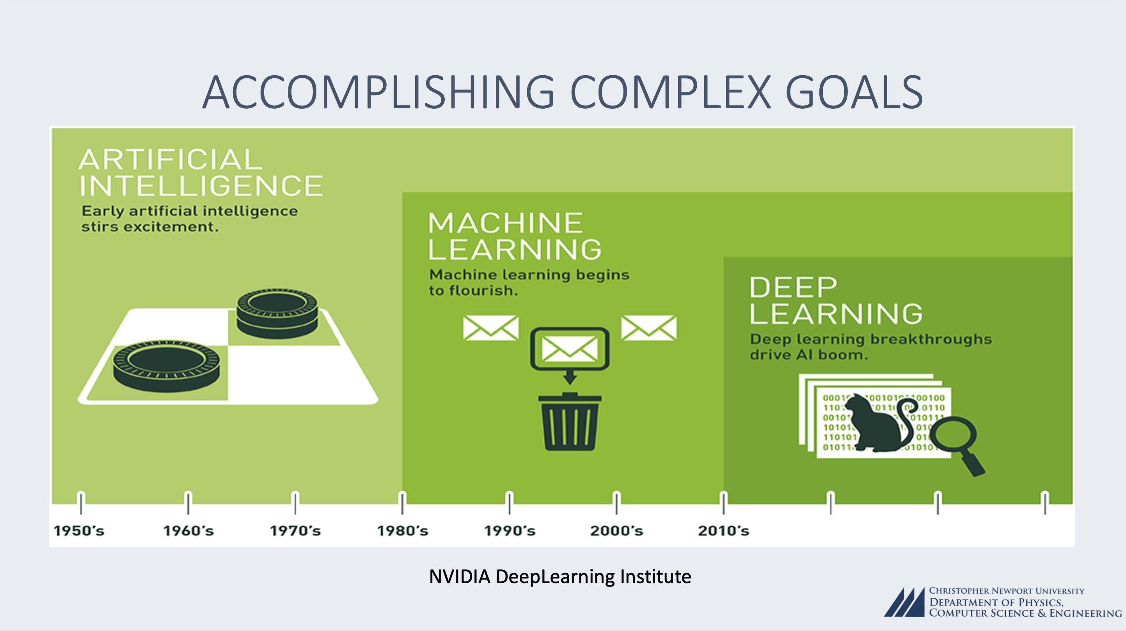

Slide 23
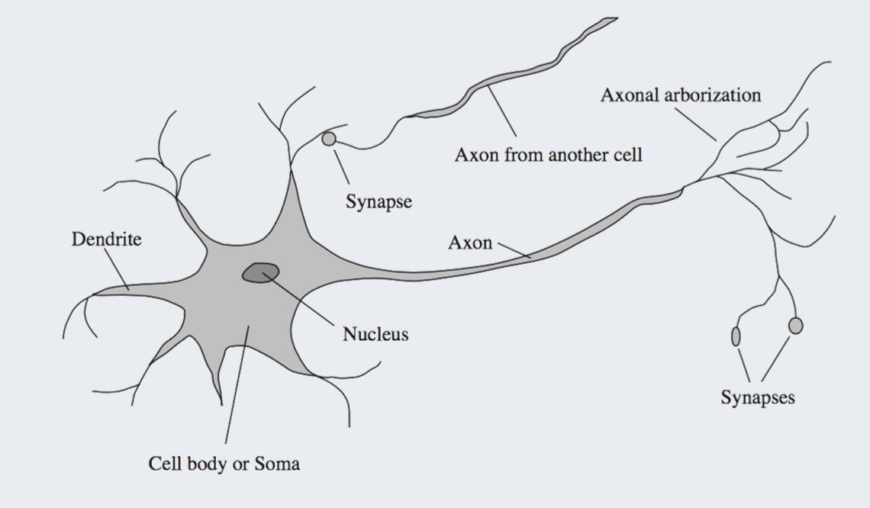

How does our brain work?
The human brain is comprised of fundamental building blocks called NEURONS
Neurons are nerve cells that send messages all over your body to allow you to do everything from breathing to talking, eating, walking, and thinking.
As illustrated, the neurons of the brain are CONNECTED, and synapses from one neuron can influence other neurons. Thus it is a connected network of neurons, or, a NEURAL NETWORK!
There are HUNDREDS of different types of neurons that send and receive messages in different ways!!!

Slide 24
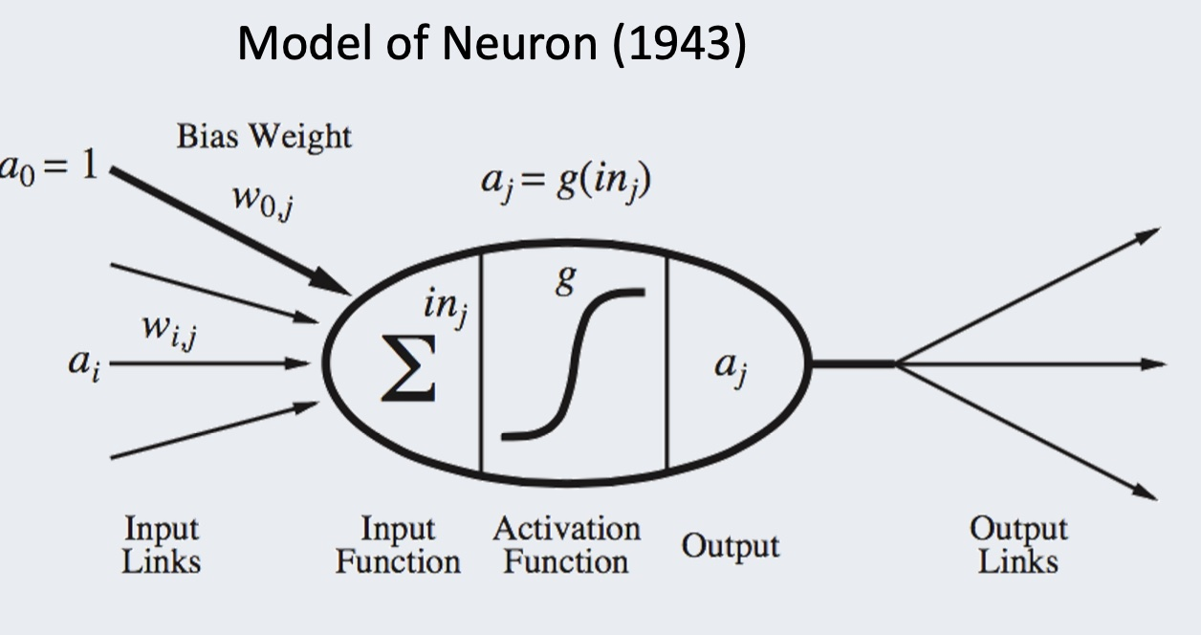

How does an Artificial Neural Network work?
An ANN is comprised of fundamental building blocks called NEURONS
The input links (a0, a1, a2, …) are like the sensory data collected by the dendrites
The input function and activation function together form the “mathematical model” that decides what the output result should be, just like a neuron in the human brain decides which synapses should fire.

Slide 25
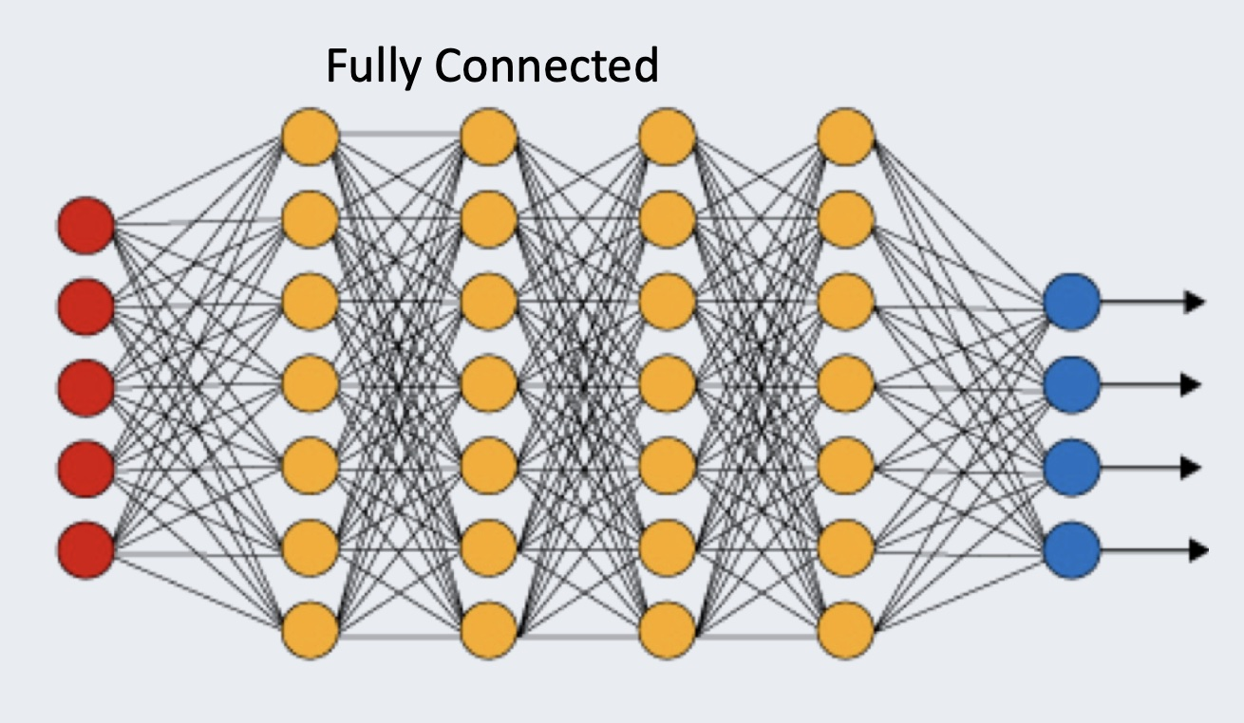
Deep Neural Networks
The red dots are the input data
The blue dots are the output results
The yellow dots are neurons
The lines joining things up represent the WEIGHTS in the model!!!!
Two interesting parameters in Neural Networks are:
The total number of neurons
The number of CONNECTIONS per neuron

Slide 26
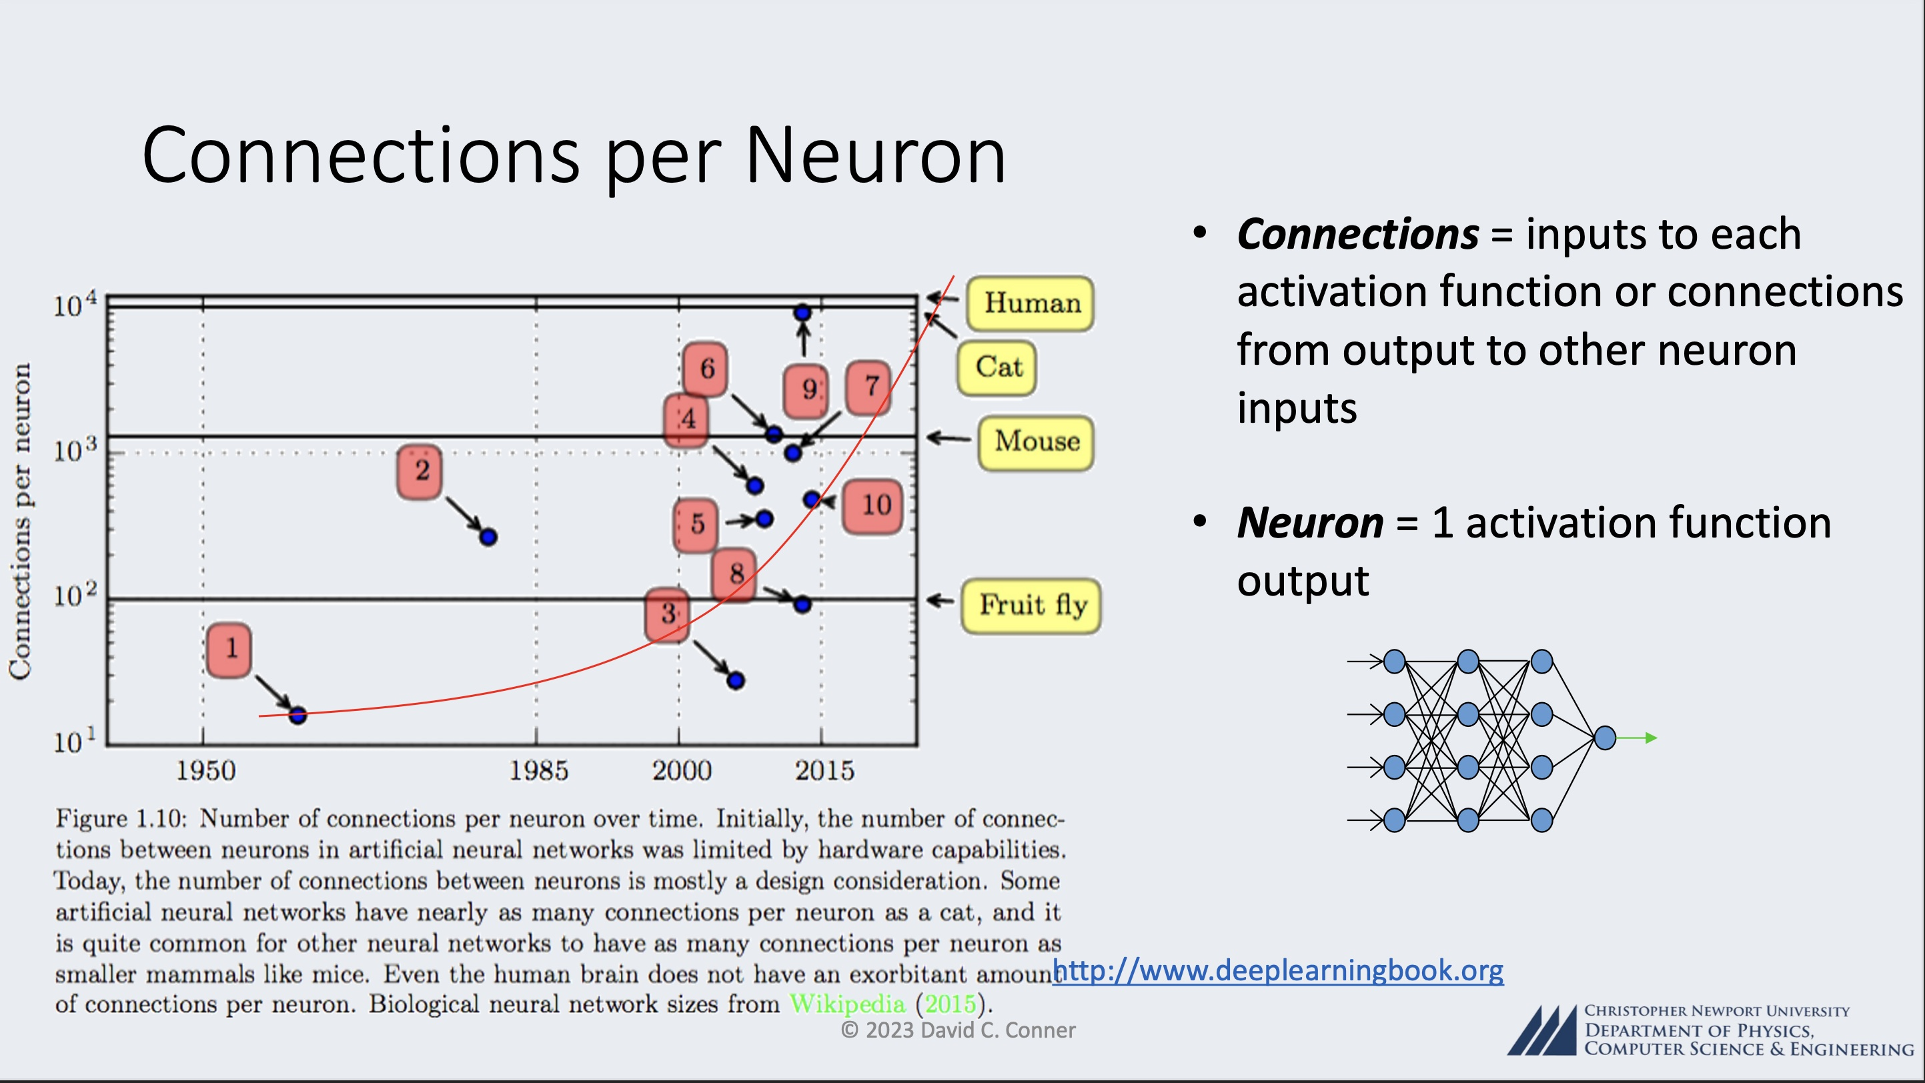

Slide 27
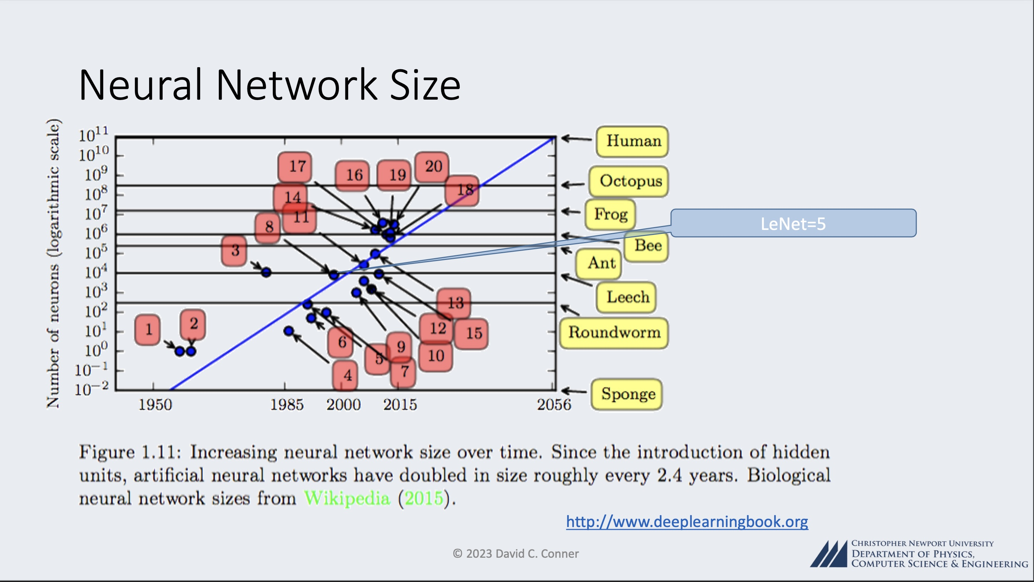

Slide 28
Applications of Deep Learning Neural Networks
Pioneering Models: Iconic models like LeNet-5, AlexNet, and VGGNet paved the way, demonstrating the potency of DLNNs in image classification tasks, notably in competitions like the ImageNet Large Scale Visual Recognition Challenge (ILSVRC).
Applications: DLNNs have permeated diverse domains, including:
medical image analysis
computer vision in autonomous vehicles
facial recognition, and more, any image-related ML task
Natural Language Processing (NLP): Deep learning, particularly models like Recurrent Neural Networks (RNNs) and Transformers, has revolutionized NLP, enabling machines to understand, generate, and translate human languages with unprecedented proficiency.

Slide 29
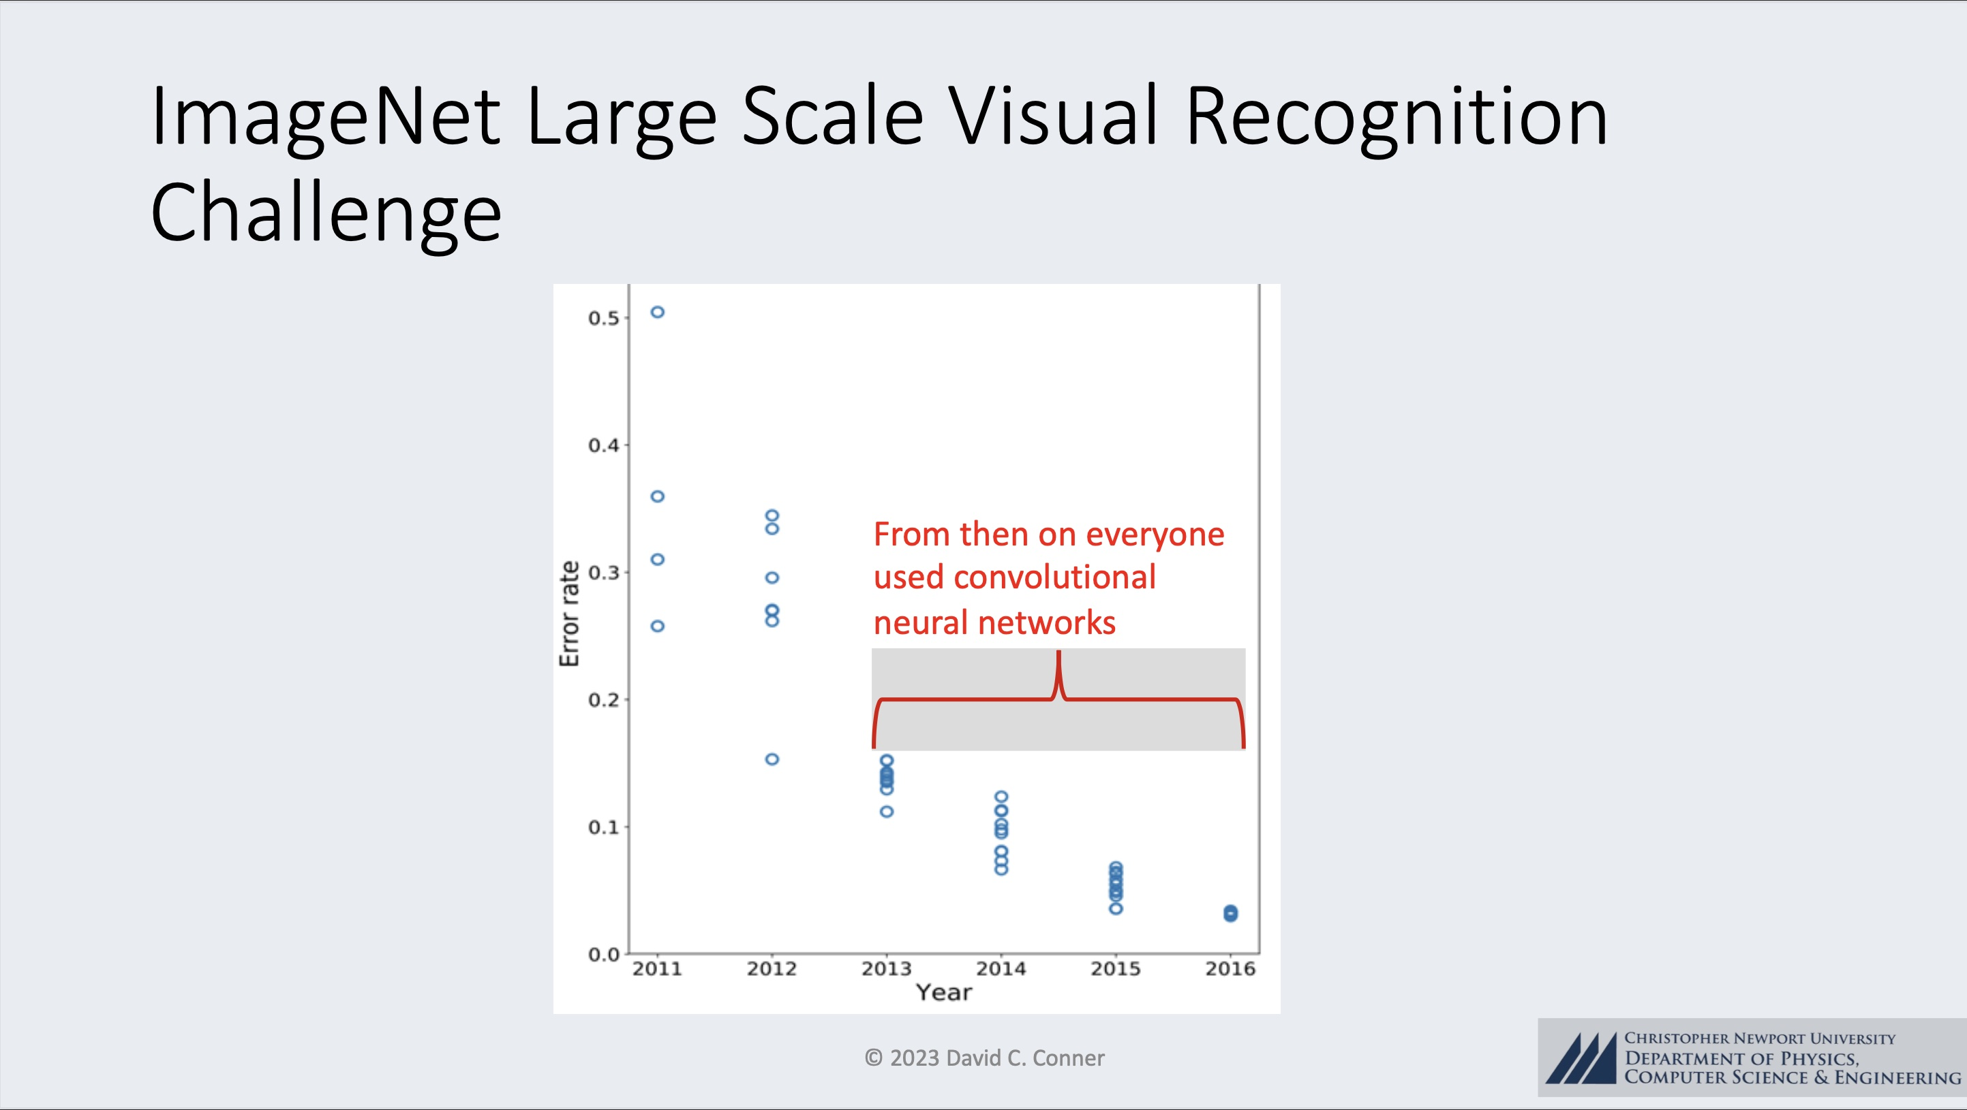
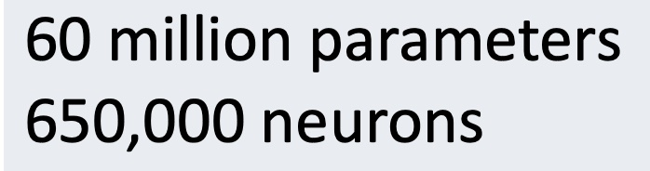
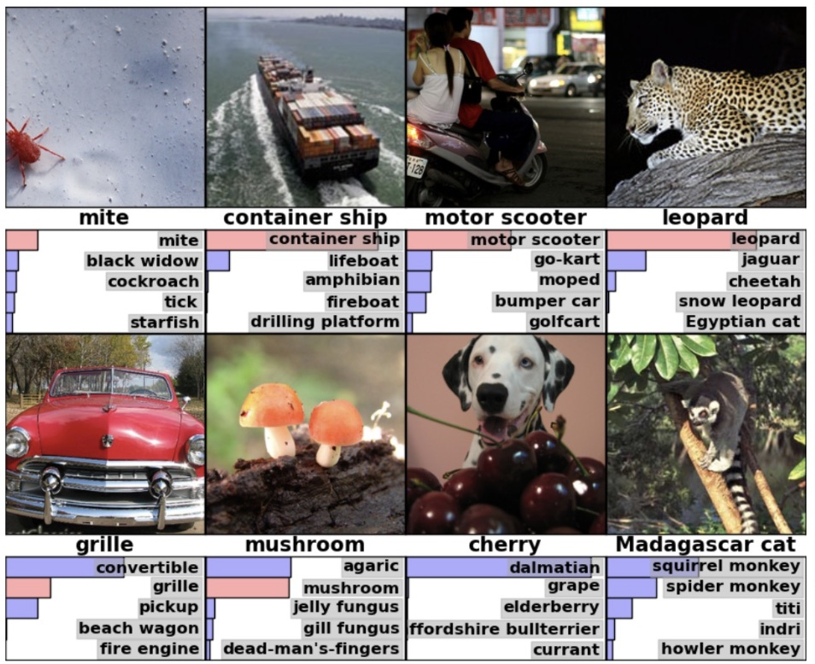

Slide 30
Applications of Deep Learning Neural Networks
Pioneering Models: Iconic models like LeNet-5, AlexNet, and VGGNet paved the way, demonstrating the potency of DLNNs in image classification tasks, notably in competitions like the ImageNet Large Scale Visual Recognition Challenge (ILSVRC).
Applications: DLNNs have permeated diverse domains, including:
medical image analysis
computer vision in autonomous vehicles
facial recognition, and more, any image-related ML task
Natural Language Processing (NLP): Deep learning, particularly models like Recurrent Neural Networks (RNNs) and Transformers, has revolutionized NLP, enabling machines to understand, generate, and translate human languages with unprecedented proficiency.

Slide 31
Conclusions
Deep Learning Neural Network Artificial Intelligence Engines can, in the present day, do AMAZING THINGS!!!
Many (most?) of these things HELP HUMANITY
With that said (and I believe it to be true), there are aspects of the implementation and regulation of this technology where there exist very real and very concerning ethical and societal concerns.
In the last lecture (next week), we will dig into this aspect of modern AI!!!

