Slide 1
OrderXpress
Where we redefine the way you order.
Presented by:
James Caranay
Jake Bartolay
Kristoffer Bomediano
Vince Adarne

Slide 2
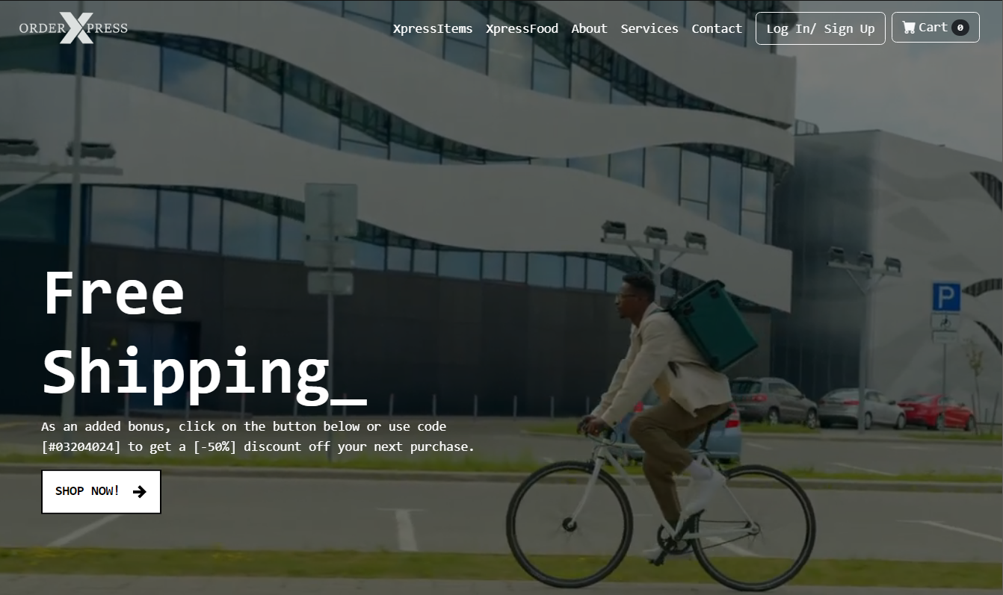
Table of Contents
01
02
03
Introduction
The Company
Why?
Why this Concept?
Technologies Used

Slide 3
The Company

Slide 4

Our Company
Experience the ease and convenience of OrderXpress. With just a few clicks, you can order anything you need and leave the rest to us. Sit back, relax and let us handle the rest.

Slide 5
About the Company
Effortless Ordering
Anything Under the Sun
Join Us!
OrderXpress is your go-to online destination for hassle-free ordering!
From groceries to Food, essentials to gifts, we’ve got you covered!
Join us today and discover freedom of effortless ordering!

Slide 6
Why?
Why did we choose the topic?

Slide 7
Why?
Expanded Reach
An online ordering website opens up opportunities to reach a broader audience
Convenience
Changing consumer Behavior
In today’s fast-paced world, people value convenience more than ever.
Consumer behavior has shifted significantly, with growing preference for online shopping and contactless transactions.

Slide 8
Why?
Increased Sales Potential
An ordering websitte can significantly boost sales potential.
Efficient Operations
For businesses, an ordering website streamlines operations and imporves efficiency.
Data Analytics
An ordering website enables business to gather valuable customer data and insights.

Slide 9
Technologies Used
HTML 5
CSS
ReactJs
Express Js
VERCEL
Bootstrap
Git Hub
Git Bash
Photoshop

Slide 10
Thanks!
Please keep this slide for attribution

