Slide 1


Proto BioCompiler
Jacob Beal
Demo Session
Autodesk & OWBDA
iGEM 2014
November, 2014

Slide 2
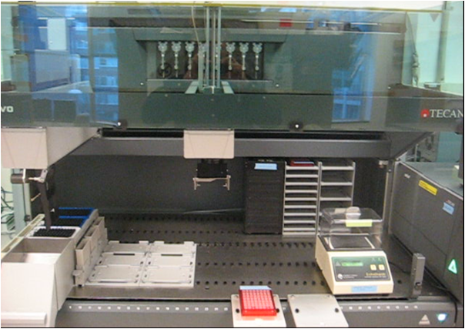

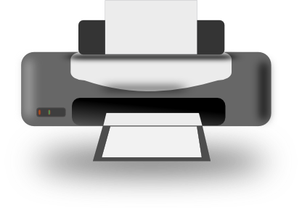
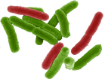

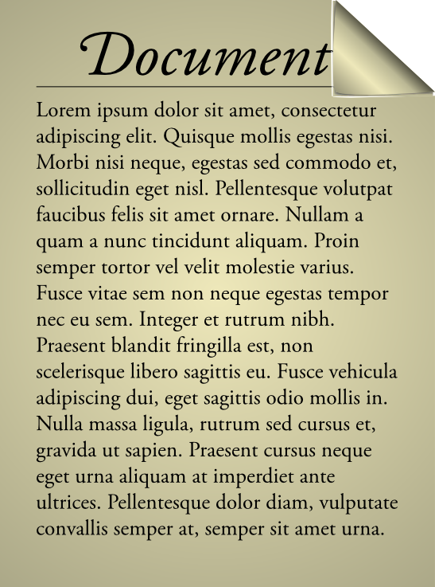
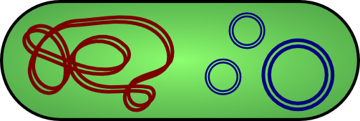
Vision: WYSIWYG Synthetic Biology
Bioengineering should be like document preparation:

Slide 3
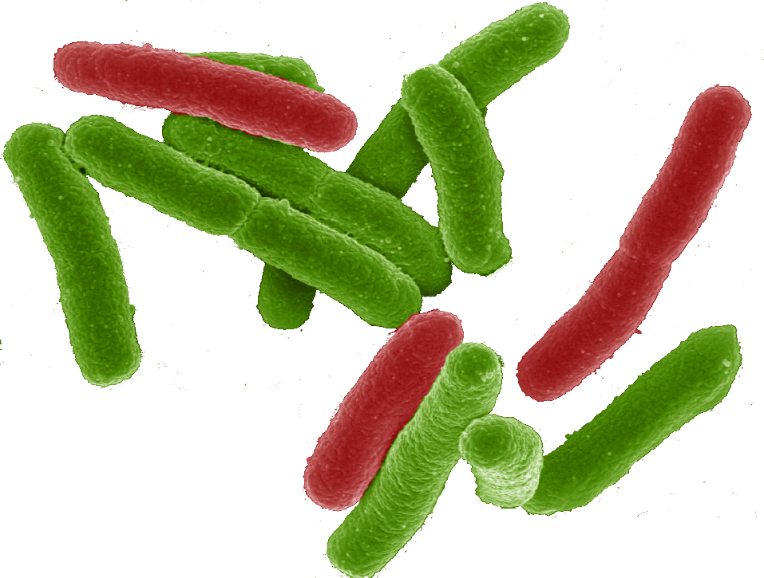
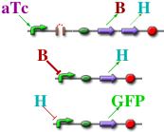
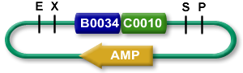

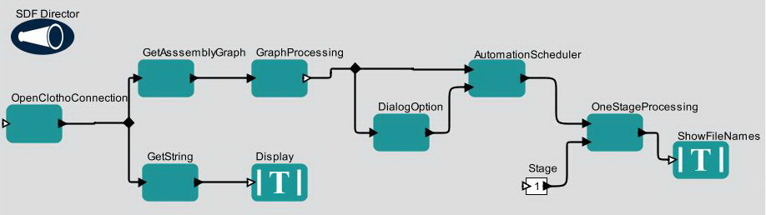

The Tool-Chain Approach:
Organism Aggregate Description
High level simulator
Single-Cell Description
If detect explosives:
emit signal
If signal > threshold:
glow red
Coarse chemical simulator
Abstract Genetic Regulatory Network
Detailed chemical simulator
DNA Parts Sequence(s)
Modular architecture also open for flexible choice of organisms, protocols, methods, …
Collaborators:
Assembly Instructions
Ron
Weiss
Testing
Douglas Densmore
Cells
[Beal et al, ACS Syn. Bio. 2012]

Slide 4
The Tool-Chain Approach:
Organism Aggregate Description
Proto
BioCompiler
High level simulator
Single-Cell Description
If detect explosives:
emit signal
If signal > threshold:
glow red
[Beal et al, PLoS ONE 2011]
Coarse chemical simulator
Alternate 2nd stages:
SBROME, CELLO, GEC, …
Abstract Genetic Regulatory Network
Detailed chemical simulator
DNA Parts Sequence(s)
Assembly Instructions
Next-Gen Synthesis,
Robotic / Microfluidic
Assembly, MAGE, …
Testing
Cells

Slide 5
Motif-Based Compilation
High-level primitives map to GRN design motifs
e.g. logical operators:
(primitive not (boolean) boolean
:grn-motif ((P high R- arg0 value T)))
arg0
value

Slide 6
Motif-Based Compilation
High-level primitives map to GRN design motifs
e.g. logical operators, actuators:
(primitive green (boolean) boolean :side-effect
:type-constraints ((= value arg0))
:grn-motif ((P R+ arg0 GFP|arg0 value T)))
arg0
GFP
value

Slide 7
Motif-Based Compilation
High-level primitives map to GRN design motifs
e.g. logical operators, actuators, sensors:
(primitive IPTG () boolean
:grn-motif ((P high LacI|boolean T)
(RXN (IPTG|boolean) represses LacI)
(P high R- LacI value T)))
IPTG
LacI
value

Slide 8
Motif-Based Compilation
Functional program gives dataflow computation:
(green (not (IPTG)))
IPTG
not
green

Slide 9
Motif-Based Compilation
Operators translated to motifs:
IPTG
not
green
IPTG
A
B
LacI
outputs
arg0
outputs
arg0
GFP
outputs
IPTG
LacI
A
B
GFP

Slide 10
Optimization
IPTG
LacI
A
B
GFP
Copy Propagation
IPTG
LacI
A
B
GFP
Dead Code Elimination
IPTG
LacI
A
GFP
Dead Code Elimination
IPTG
LacI
A
GFP

Slide 11
Design Optimization
(def sr-latch (s r)
(letfed+ ((o boolean (not (or r o-bar)))
(o-bar boolean (not (or s o))))
o))
(green (sr-latch (aTc) (IPTG)))
IPTG
GFP
LacI
B
I
F
E1
E2
D
I
aTc
C
J
H
G
TetR
A
J
Unoptimized: 15 functional units, 13 transcription factors

Slide 12
Proto BioCompiler
(def sr-latch (s r)
(letfed+ ((o boolean (not (or r o-bar)))
(o-bar boolean (not (or s o))))
o))
(green (sr-latch (aTc) (IPTG)))
IPTG
F
GFP
H
LacI
TetR
aTc
Final Optimized:
5 functional units
4 transcription factors
H
F
Unoptimized: 15 functional units, 13 transcription factors

Slide 13
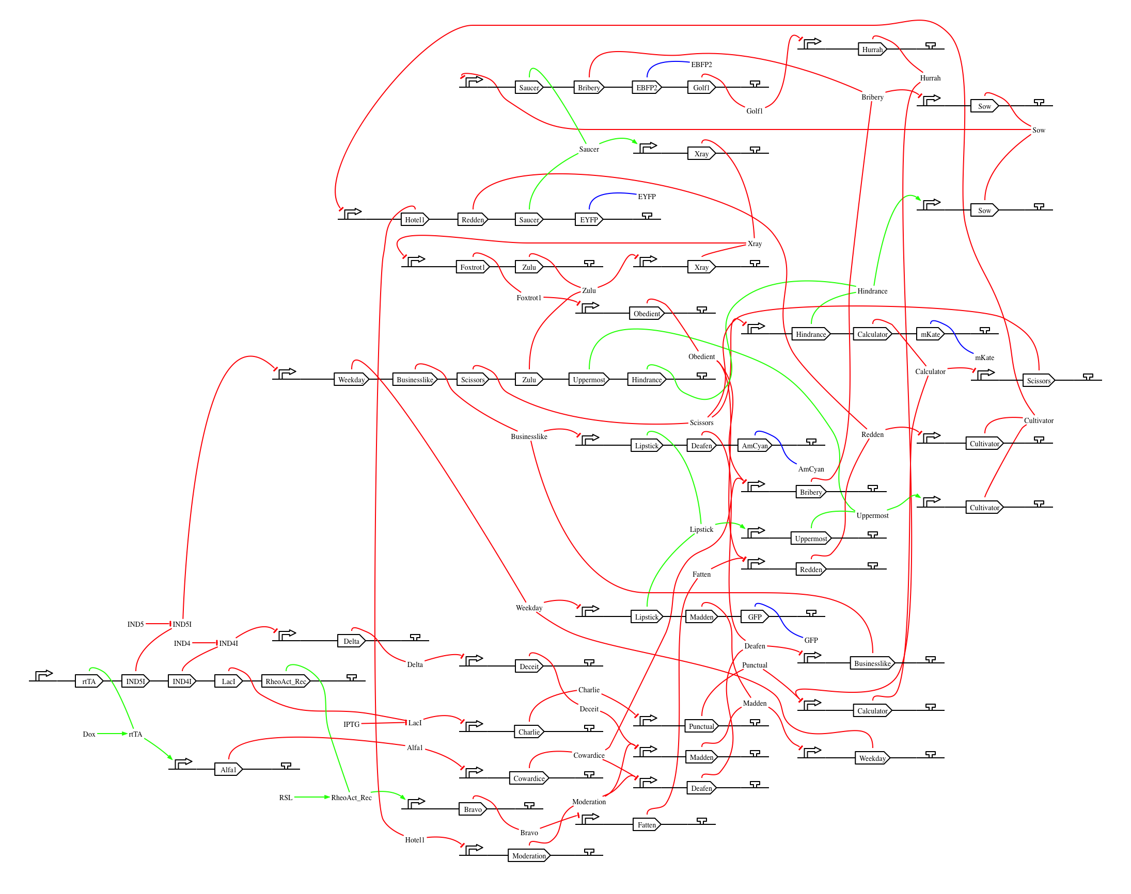
Complex Design: Differentiation Controller
compiled for mammalian
Optimized compiler already outperforms human designers

Slide 14
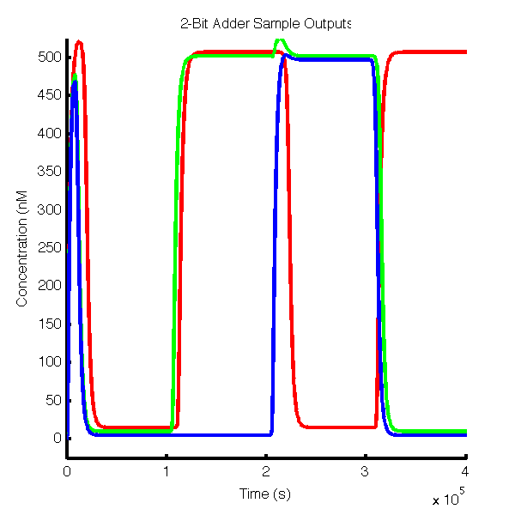
What about simple systems?
A little more design saves lots of wasted time and money
Humans are bad at inverse logic (e.g., repressors)
High-level language is cleaner, more intuitive, captures intent in design.
Automatically generated models aid in validation

Slide 15
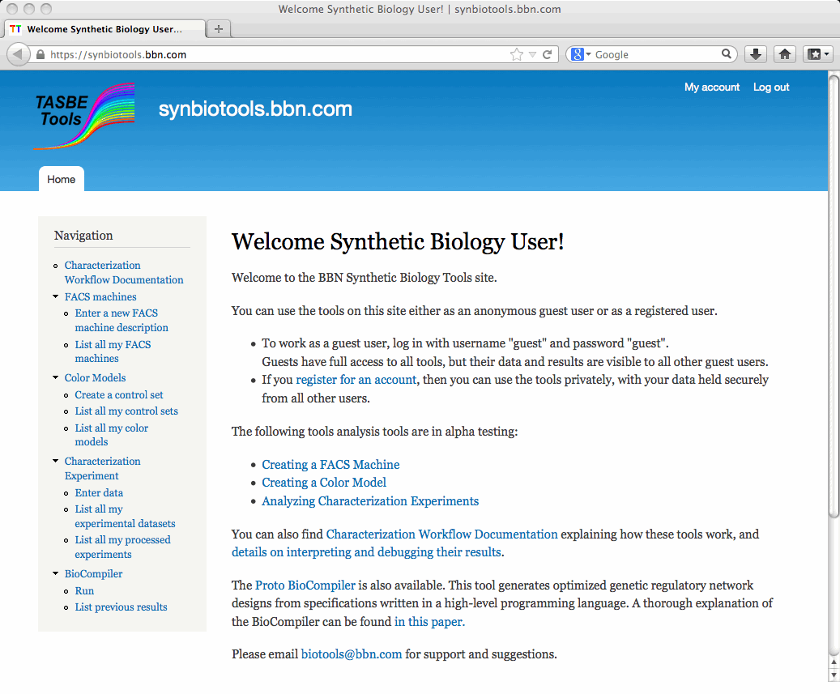
BioCompiler in TASBE web tools
https://synbiotools.bbn.com/
On first use, you will have to terms of service
Your data is secure, and can’t be shared on site.
FireFox recommended; Chrome has an image-display bug.
Works well, but an isolate stand-alone tool…

Slide 16
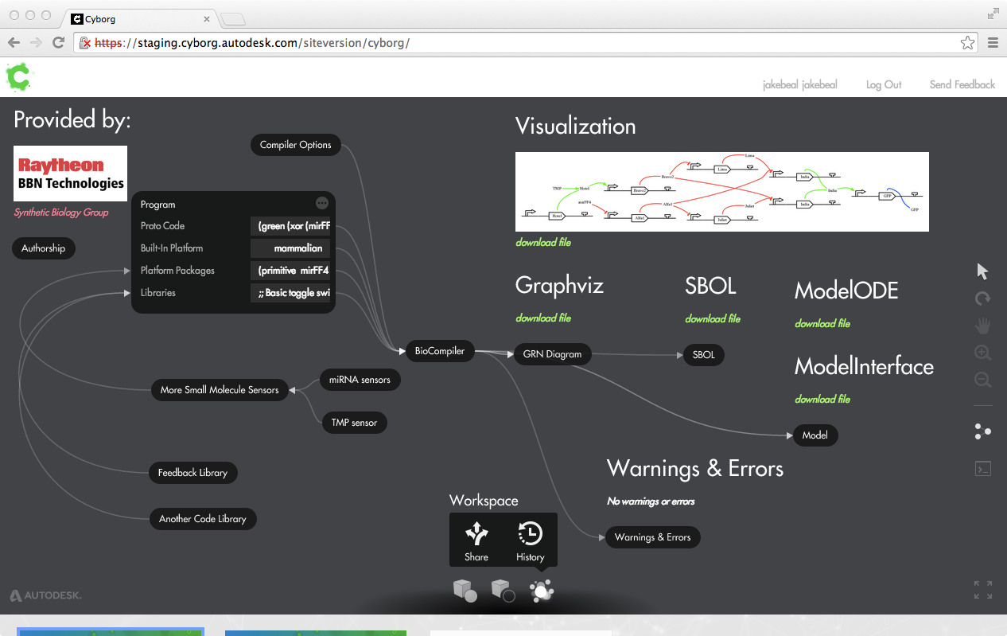
BioCompiler in Autodesk Cyborg

Slide 17
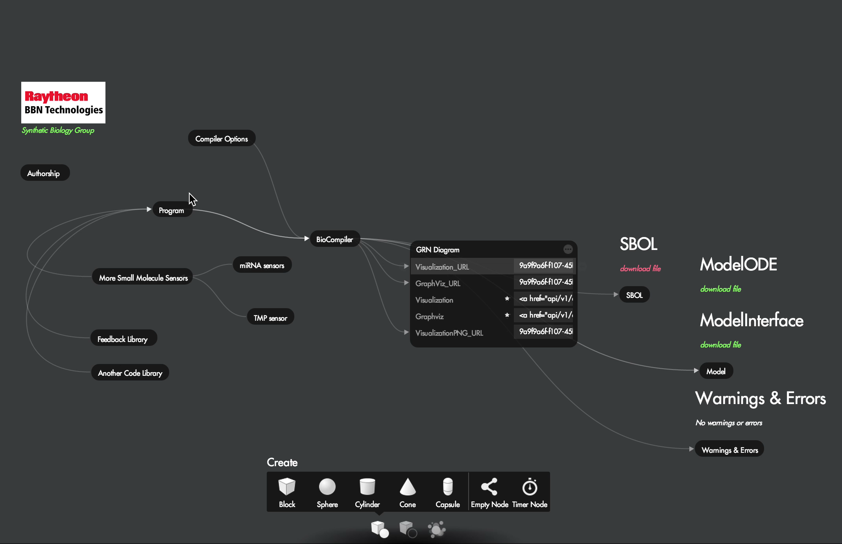
Cyborgized BioCompiler in Action
Video by Deepak Chandran

Slide 18
Proto BioCompiler: Avoid small mistakes. Save big on time.
Available Now!
Coming Soon!
https://synbiotools.bbn.com/
https://cyborg.autodesk.com/

