Slide 1


Fast, Scalable Demand-Shaping with ColorPower
Jacob Beal
January, 2013

Slide 2
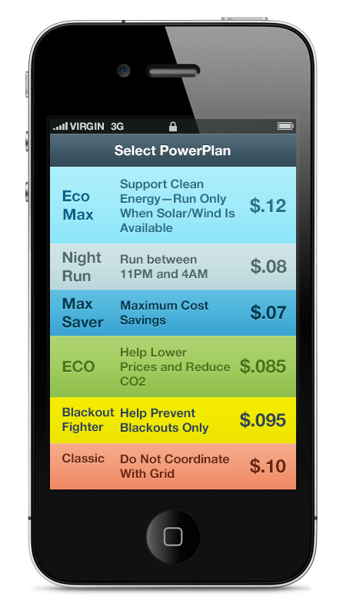
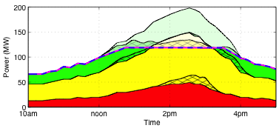
ColorPower in a Nutshell:
Energy service tiers…
… allow scalable distributed
demand management…
… bringing disruptive change to the
energy industry.
Traditional Utility
Vertical Resale Utility
Demand Aggregator
Retail Services
Customer

Slide 3
Talk Outline
Energy Flexibility Tiers
The ColorPower algorithm
Implications and Impact

Slide 4
The Demand Challenge
Future retail utilities must be able to effectively manage demand fulfillment at the margin
Defer consumption
Pull forward consumption
Cancel uneconomic consumption (in customers’ best interest!)
Problem: inadequate coordination between the grid and end user devices

Slide 5
Economists vs. Customers
Microeconomics View
Customer View
Customers can be modeled as rational marginal demand functions for a commodity
Customers can be modeled as virtual power plants
Customers need to be sent price signals to modify their behavior
I do not have a marginal demand for power, I want reliable service
I am not a virtual power plant
I don’t want price volatility risk or to do laundry at midnight

Slide 6
Retail Power Is a Service
Not a hot concert ticket
Not a basket of commodity electrons
Customers prefer to buy power as a service, not a commodity
Just like many other service industries
The service sector has largely abandoned congestion pricing as a way to manage demand peaking

Slide 7
Paradigms for Peak Demand Control
Industry | Process / Technology
Various (e.g. manufacturing) | “First Come First Serve” / Backlog Queue
Hospitals | “Most Urgent First” / Waiting Room
Road Transportation | “Alternating Access” / Traffic Light
General Digital Communications | “Best Effort Transport” / TCP/IP
Cellular | Automatic Protocol / CDMA
Cable Networking | Automatic Protocol / DOCSIS
DSL | Automatic Protocol / ATM
Electric Power - Today | Free-for-All / Circuit Breaker
Electric Power – Future Consensus | Real-time Auction / Smart Grid

Slide 8
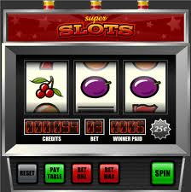
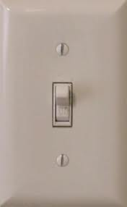
Technology As Auction Enabler
HOW MUCH IS THIS POWER WORTH TO YOU NOW?
HOW ABOUT NOW?
HOW ABOUT NOW?
SORRY YOU WERE JUST OUTBID BY R1CH_P0WRHAWG
YOUR POWER HAS MOVED TO A PLACE WHERE IT IS MORE APPRECIATED
[POWER OFF]
THE GOOD NEWS IS YOU HAVE NOW SAVED 26 OPEN SODA CANS WORTH OF CO2 EMISSIONS
Notes:
Having a human in the loop is a bad idea…

Slide 9
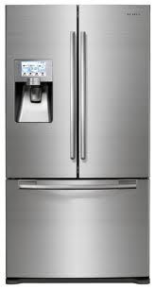
Energy efficiency or clever trading?
FrigidTrader 3000
Aggressive risk/reward tradeoff!
Detects and avoids hedge-fund price-manipulation strategies!
Free trading strategy upgrades!
Icemaker upgrade available
Notes:
Automating doesn’t make things much better.

Slide 10
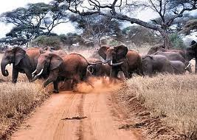
Retail Price Volatility: Be Careful What You Wish For
Price Signal
Smart Appliance/EV Stampedes
PEANUTS ARE VERY EXPENSIVE
RIGHT NOW
WIDE-SCALE PRICE VOLATILITY:
The Smart Grid
GOOD FOR SPECULATORS
BAD FOR CONGESTION CONTROL
CATASTROPHIC FOR SYSTEM RELIABILITY
WE’LL PAY YOU TO TAKE
THESE PEANUTS AWAY
The Smart Grid

Slide 11
Core problem: price is overloaded
Too many stakeholders, not enough leverage:
Customer preferences
Customer impact
Procurement of supply
Operations reliability
Regulatory policy
Shareholders and financial traders
Alternative: less information

Slide 12

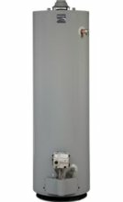
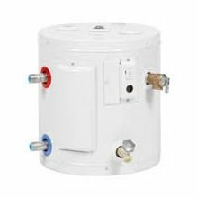
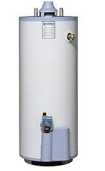
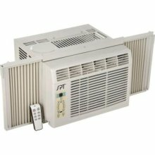




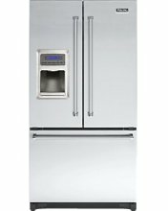
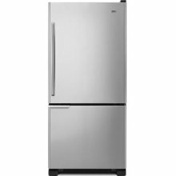






ColorPower: Tiered Energy Priority
Humans:
Always In Control
Privacy Respected
ColorPower Appliance Priorities
Obey Your Humans’ Preferences
Donate Flexibility to Power Grid
Smart Grid:
Coordinates Orderly Power Access For Flexible Appliances & Machines
Invisible to Humans
✔
Flexible
✔
✔
✔
Emergency
“Shed 12 MW of Flexible”
Not Flexible

Slide 13
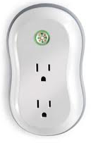
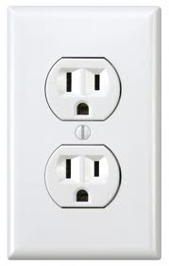
Self-Identification of Demand Flexibility
Leaf Button:
On = Flexible
Green = Price Sensitive
Yellow = Reliability Responsive
Red = Opt Out
Cloud Software
With More Options

Slide 14


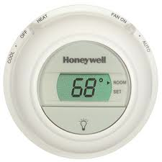

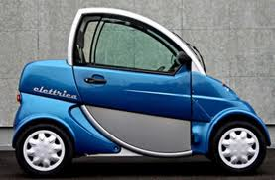
From Flexibility to Priority Tiers
Pool Pump
Priority Tiers
Turn Off
More Demand
Run Now
Resource Tier 500
Solar
Resource Tier 499
Export Power
Resource Tier 5
Thermostat
Resource Tier 1
-3 degrees
No Feedback
-6 degrees
Resource Tier -1
Facility Management
Resource Tier -5
Stay under 6kW
PHEV
Resource Tier -499
Charge
Resource Tier -500
Less Demand
Discharge Battery
Generator On
Default Tier Assignment Via Color/Device Type

Slide 15
Tiered Aggregations
Major Inconvenience
Emergency Load Dumping
Emergency Storage
Dispatchable Load
Resources
Emergency Dispatchable Load
Night Run Dishwashers
Battery Storage
No Inconvenience
Misc. Flex - Green
Pool Pumps - Green
HVACs - Green
Misc. Flex - Yellow
Sheddable Load
Resources
Pool Pumps - Yellow
HVACs - Yellow
Emergency Rationing
Major Inconvenience

Slide 16
Outline
Energy Flexibility Tiers
The ColorPower algorithm
Control Architecture
ColorPower Algorithm
Validation in Simulation
Implications and Impact
[Beal, Berliner, & Hunter, SASO’12; Ranade & Beal, SASO’10]

Slide 17

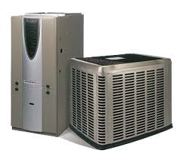
Basic ColorPower Architecture
Demand Shaping Target
Groups and Individual Devices Act Randomly, but Precisely in Aggregate
Feedback loop recruits resources until demand target satisfied
Demand Mgmt. Server
ADAPTIVE FEEDBACK LOOP
DEMAND REPORT:
ON: 203 MW
OFF: 342 MW
SHED: 127 MW
NOSHED: 432 MW
SYSTEM STATE:
NEED -12 MW
TOTAL DEMAND
RELIEF
Local Probabilistic Cooperation Calculation
Groups and Individual Devices

Slide 18
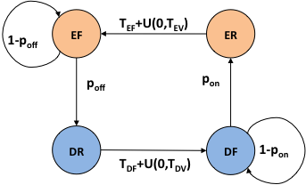
ColorPower State Transitions
(E)nabled vs. (D)isabled
(R)efractory vs. (F)lexible

Slide 19
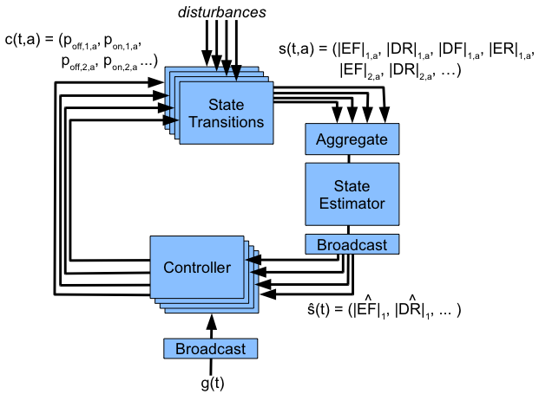
Formal Control Problem
For each ColorPower client, set p_{on} , p_{off} for each device group, such that the total enabled power in s(t) tracks g(t)

Slide 20
Outline
Energy Flexibility Tiers
The ColorPower algorithm
Control Architecture
ColorPower Algorithm
Validation in Simulation
Implications and Impact

Slide 21
ColorPower 2.0 Algorithm: Intuition
Flexibility accumulates as Refractory devices finish their timeouts.
Allocate flexibility budget in order of importance:
Goal tracking & hard priority constraints
Soft priority
Cycling devices to ensure fairness
Maintaining flexibility reserves for future needs

Slide 22
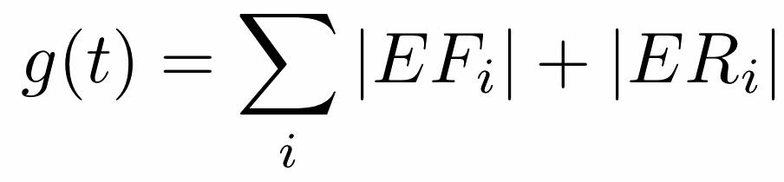
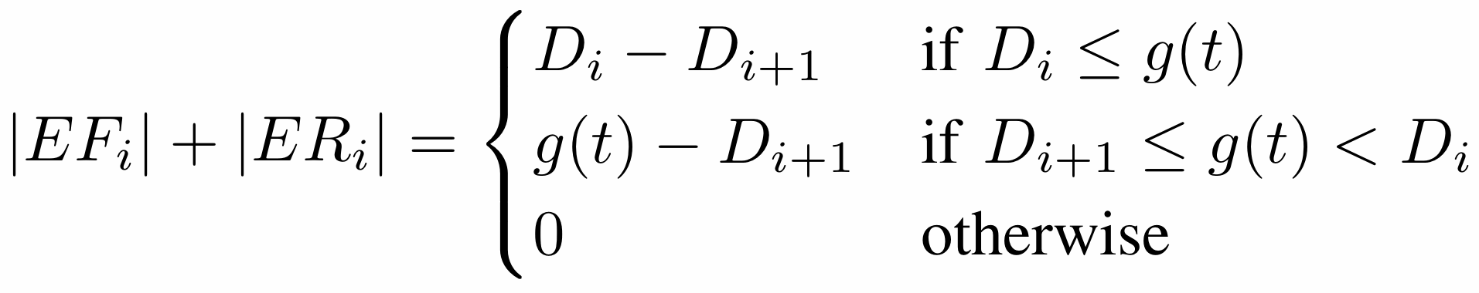
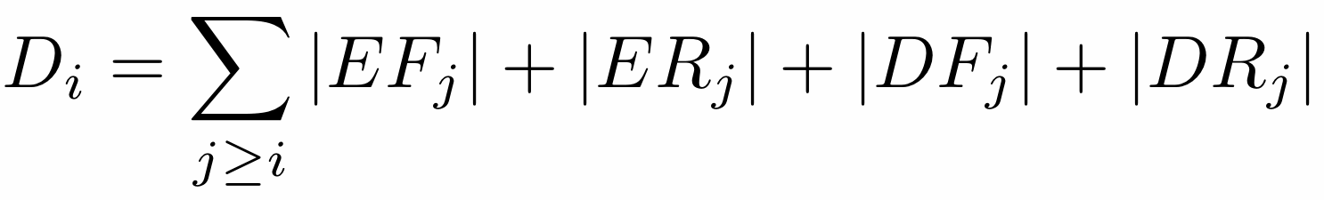
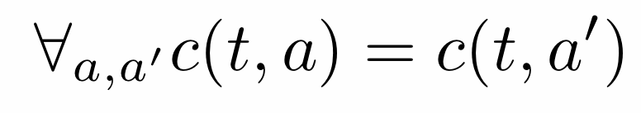
Constraints
Goal tracking: shape power demand
Color priority: respect user preferences
Fairness: no devices are favored
Cycling: don’t keep the same devices off

Slide 23
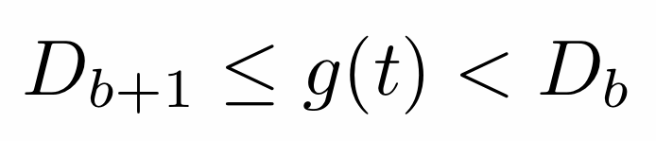
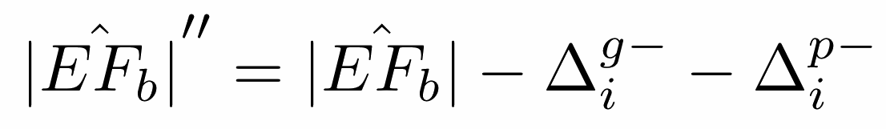
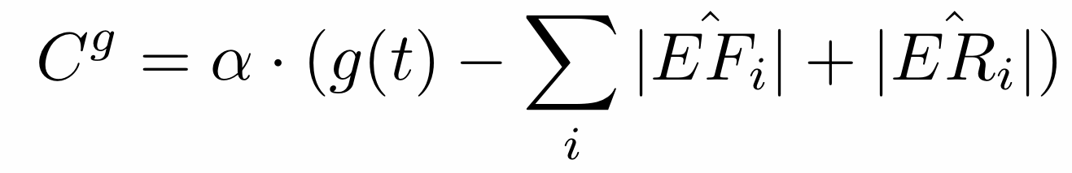
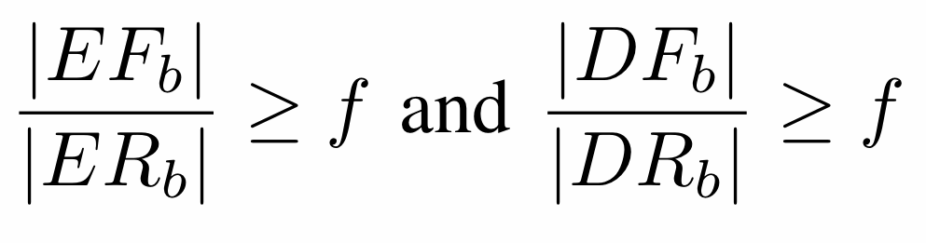
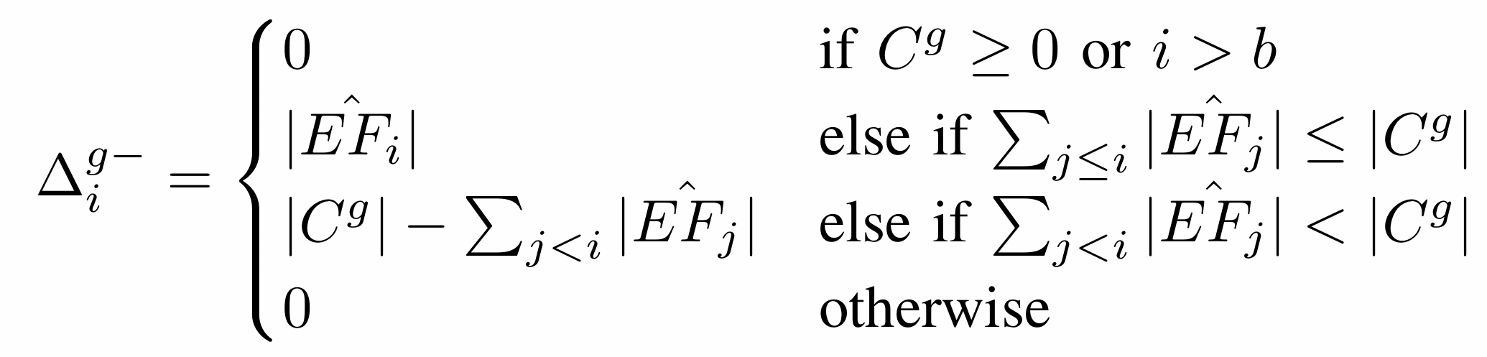
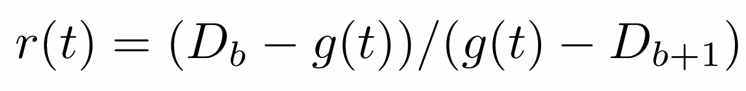
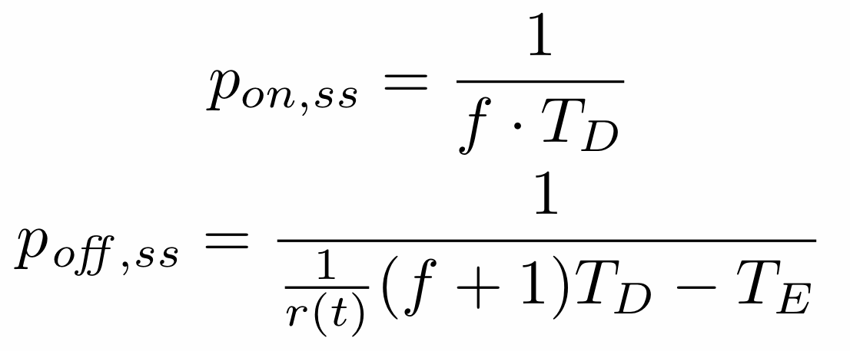
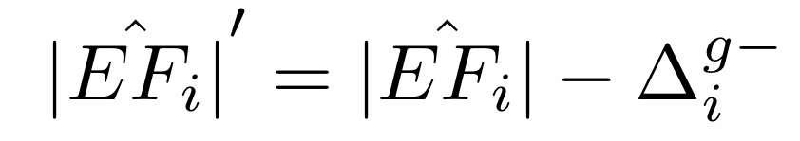
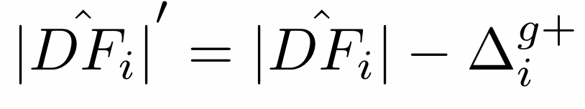
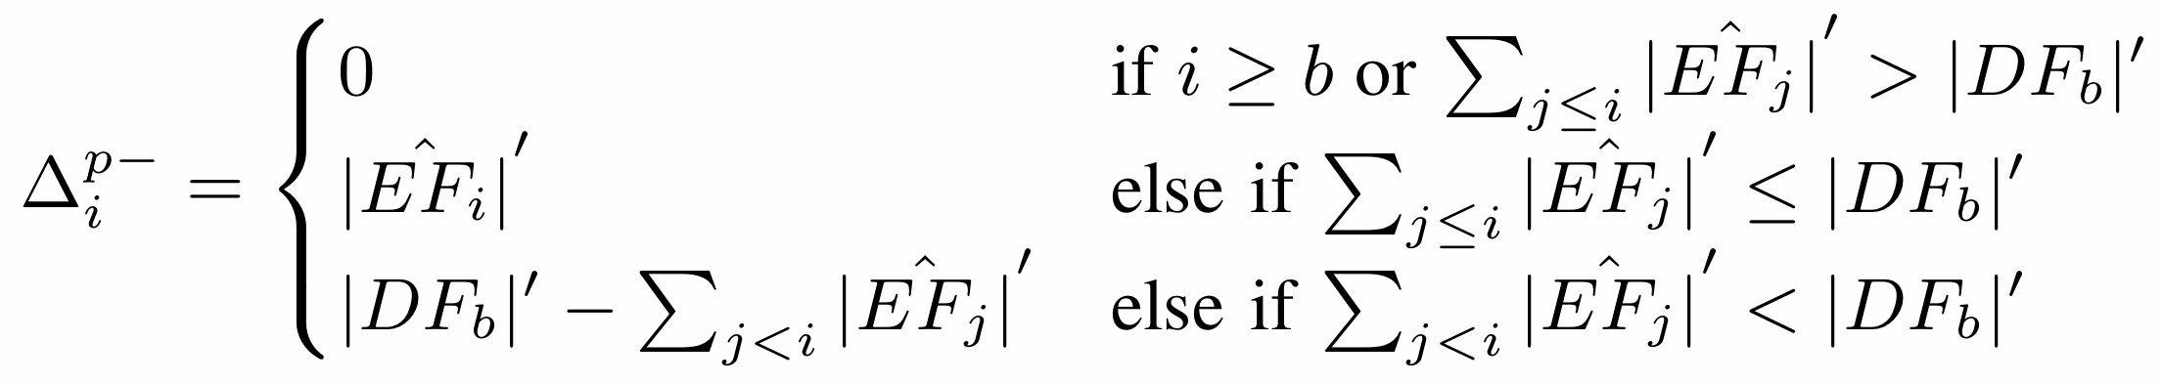
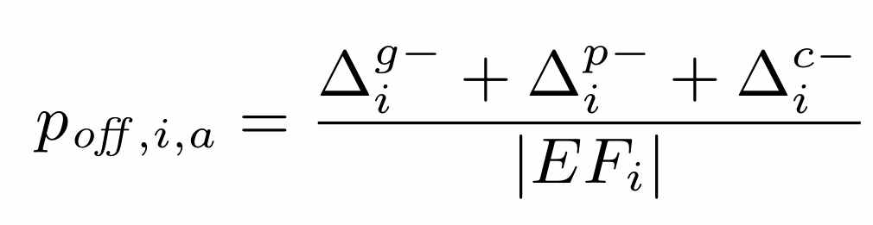
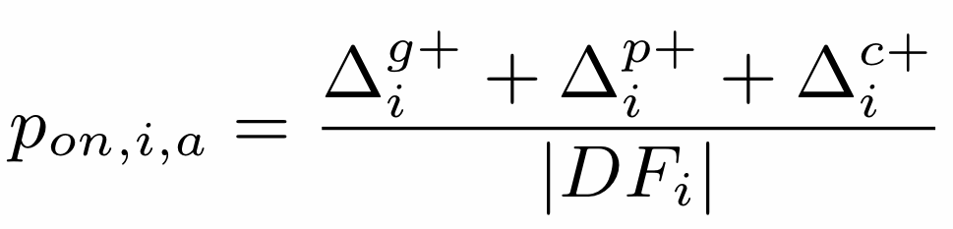
ColorPower 2.0 Algorithm: Equations
Allocation 3: Cycling
Boundary color b:
Allocation 1: Goal Tracking
and similar for other states
Correction Goal:
Reserve fraction f:
Downward shift:
when enabled
domainates,
else converse
Upward is converse
Allocation 2: Color Priority
Computing p_{on} and p_{off}
Downward shift:
Upward is converse

Slide 24
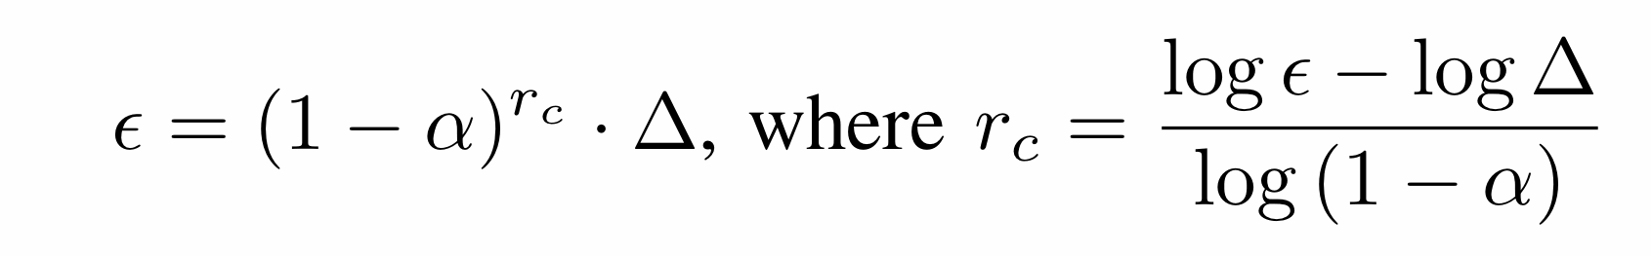

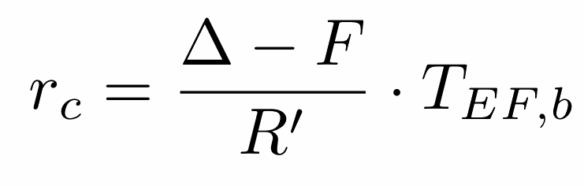
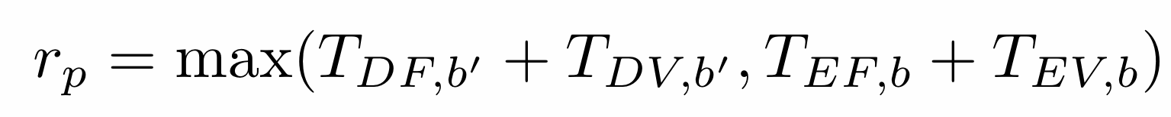
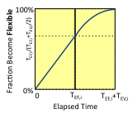
Analysis
Convergence:
Sufficient Flexibility:
Insufficient Flexibility:
Quiescence: (conservative)
Ramp Tolerance:
Quadratic:
Linear:
Priority constraint:
Total:

Slide 25
Outline
Energy Flexibility Tiers
The ColorPower algorithm
Control Architecture
ColorPower Algorithm
Analysis & Simulation
Implications and Impact

Slide 26
Control Example: Hot Summer Day
Flex
Emergency
Inflexible

Slide 27
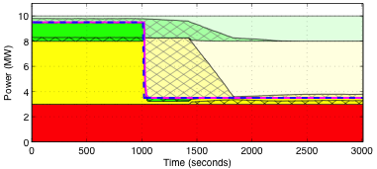
Control Example: Emergency Response
Flex
Emergency
Inflexible

Slide 28
Simulation Base Configuration
10,000 clients, each controlling a 1KW device
Coloring: 20% green, 50% yellow, 30% red
Measurement error: 0.1%
10 second rounds
Refractory time: U[400,800] seconds
Flexible reserve ratio: 1:1
Attempted correction/round: 80%

Slide 29
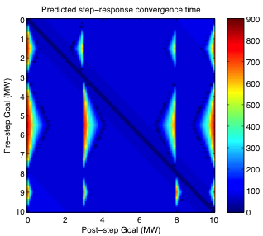
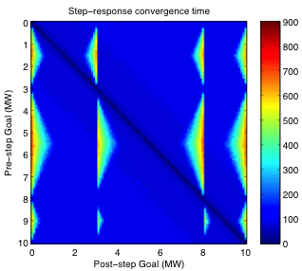
Simulation Studies: Convergence
Predicted
Measured
Excellent agreement

Slide 30
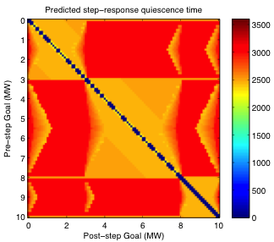
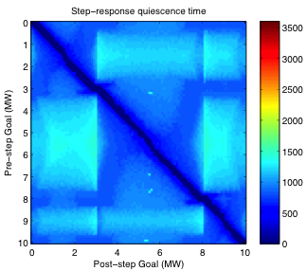
Simulation Studies: Quiescence
Predicted
Measured
Much better than conservative estimate

Slide 31
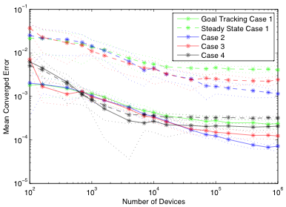
Simulation Studies: Scaling
More devices = better accuracy

Slide 32
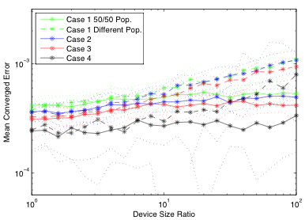
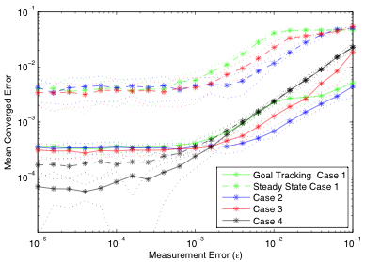
Simulation Studies: Heterogeny & Error
Heterogeneous Devices
Estimation Error
Robust to error and differences in devices

Slide 33
Outline
Energy Flexibility Tiers
The ColorPower algorithm
Implications and Impact

Slide 34

Locational x Program Control
Locational
Programs
Participants
Emergency Load Dumping
Emergency Storage
Emergency Dispatchable Load
Night Run Dishwashers
Battery Storage
Misc. Flex - Green
Pool Pumps - Green
HVACs - Green
Misc. Flex - Yellow
Pool Pumps - Yellow
HVACs - Yellow
Emergency Rationing
Emergency Load Dumping
Emergency Storage
Emergency Dispatchable Load
Night Run Dishwashers
Battery Storage
Misc. Flex - Green
Pool Pumps - Green
HVACs - Green
Misc. Flex - Yellow
Pool Pumps - Yellow
HVACs - Yellow
Emergency Rationing
Emergency Load Dumping
Emergency Storage
Emergency Dispatchable Load
Night Run Dishwashers
Battery Storage
Misc. Flex - Green
Pool Pumps - Green
HVACs - Green
Misc. Flex - Yellow
Pool Pumps - Yellow
HVACs - Yellow
Emergency Rationing
Emergency Load Dumping
Emergency Storage
Emergency Dispatchable Load
Night Run Dishwashers
Battery Storage
Misc. Flex - Green
Pool Pumps - Green
HVACs - Green
Misc. Flex - Yellow
Pool Pumps - Yellow
HVACs - Yellow
Emergency Rationing

Slide 35
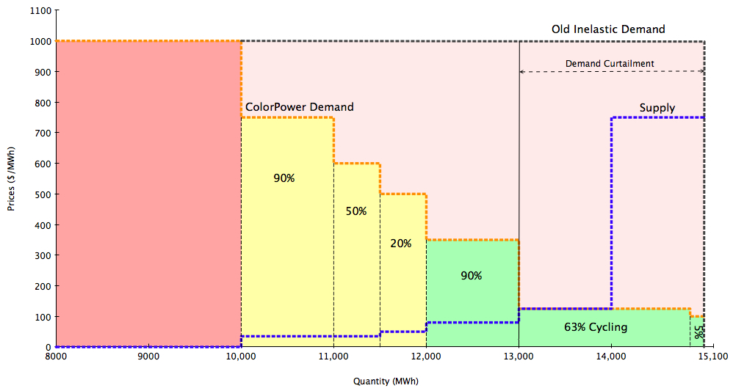
Demand Signals To Markets
Price signals to consumers from markets?
ColorPower can send demand signals from consumers to markets.

Slide 36
Disruptive Business Models
Traditional Utility
Value-added services for appliances:
ColorPower = 21st Century EnergyStar?
Deployment as a side-effect of normal replacement cycles
Demand shaping capacity sold directly or contracted to 3rd party managers
Vertical utilities:
Manufacturer / retailer assumes energy risk for a small premium
“Air conditioner with brownout protection plan”
“Pool pump with a lifetime energy supply”
Vertical Resale Utility
Demand Aggregator
Retail Services
~$1 cost
increment
Customer
ColorPower enablers: cheap hardware & networking,
ability to bundle at organization boundaries

Slide 37
Contributions
Energy flexibility tiers allow separation of demand management concerns
ColorPower algorithm allows fast, robust, and precise control of thousands to millions of devices.
ColorPower is pragmatically deployable, and allows disruptive new energy business models.

Slide 38
Next Steps & Collaboration Opportunities
Small-scale deployment (starting shortly)
Standardization
Improved integration with other grid systems
Adaptation of base principles to other grid control problems?

Slide 39


Acknowledgements
Jeff Berliner
Ryan Irwin
Steve Florek
Vinayak Ranade
Kevin Hunter

