Slide 1


A Dimensionless Graceful Degradation Metric for Quantifying Resilience
Jacob Beal
Eval4SASO Workshop
IEEE SASO
September, 2012

Slide 2
Problem: What is “Resilience”?
Which of these two systems is better?
Prior work has few quantitative metrics, and none are comparable and feasible to compute

Slide 3
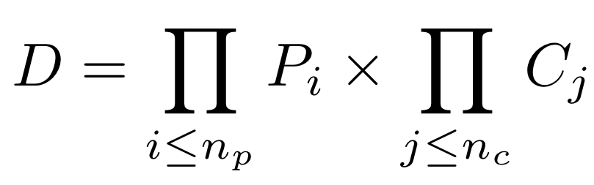

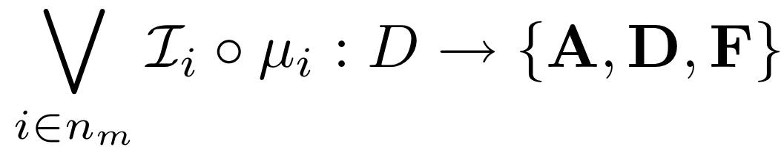
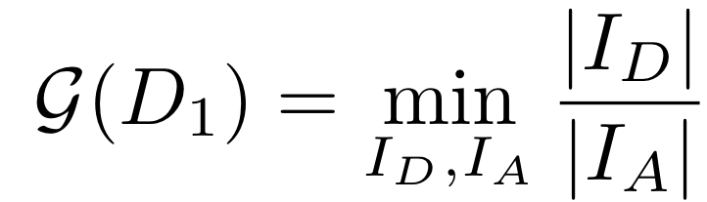
Formalizing Graceful Degradation
Domain of possible configurations:
Metrics of system performance:
Interpretation as acceptable/degraded/failing:
Graceful Degradation Metric

Slide 4
Example:
Failing
Failing
Acceptable
Axis of least graceful degradation
Acceptable
Degraded
Axis of least graceful degradation
Degraded
F
D
A
D
F
F
D
A
D
F
More graceful

Slide 5
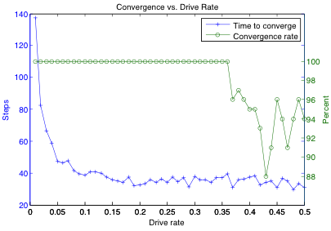
Computing Graceful Degradation
Analytic solutions generally impossible
Thorough surveys infeasible for most systems
Orthogonal (1-parameter) perturbation surveys:
Example from MADV study
of functional blueprints:
[Adler et al., 2011]
G(D) = 0.2

Slide 6
Handling Parameter Dependencies
Orthogonal perturbation assumes quasi-linearity
Often not true!
Alternate approach: random perturbation vectors
Based on manifold learning in [Freund et al. 2007]

Slide 7
Contributions
Proposed metric for graceful degradation
Readily comparable: dimensionless, invariant to linear transformations and extra dimensions
Feasible to compute via perturbation surveys
Proposed random perturbation survey method

