Slide 1


Precision Design of Expression from RNA Replicons
Jacob Beal, Tyler Wagner, Tasuku Kitada, Andrey Krivoy, Odisse Azizgolshani, Jordan Moberg Parker, Douglas Densmore, Ron Weiss
6th International Workshop on Bio-Design Automation
June, 2014

Slide 2
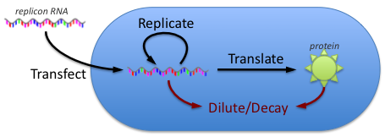
RNA Replicons
P726S
SGP
m⁷G
5’UTR
nsP1
nsP2
nsP3
nsP4
Fluorescent Protein
3’UTR
A₃₀
Advantages: self-amplifying, no path for integration
Challenges: small payload, poorly understood

Slide 3
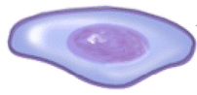
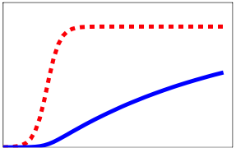
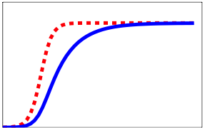
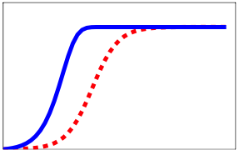
Expected Phases of Replicon Behavior
Low replicon dose
High replicon dose
Sparse Transfection
Dense Transfection
Fews cells expressing
1 founder replicon / expressing cell
Nearly all cells expressing
Many founder replicons / cell
Replication Limited
Translation Limited
Replicon
Fluorescence
Replicon
Fluorescence
Replicon
Fluorescence
Time
Time
Time

Slide 4
Approach:
Measure time dynamics of expression, competition in multi-replicon expression
Abstract model from first-order effects
Validate model predictions
Invert model to provide forward design
All work uses Sindbis replicons in BHK-21 cells

Slide 5
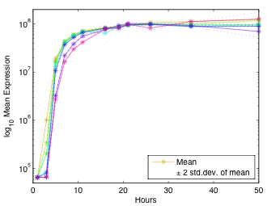
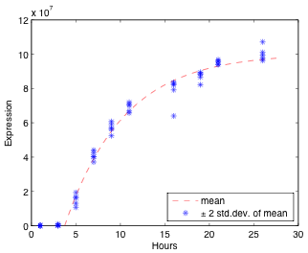
Constitutive Expression Dynamics (1/2)
Key: 21 ng, 41 ng, 103 ng, 206 ng, 411 ng, 1027 ng, 2055 ng
Expression rise consistent with translational limit

Slide 6
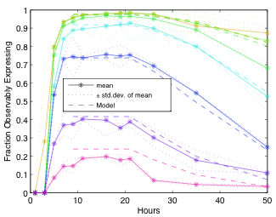
Constitutive Expression Dynamics (2/2)
Key: 21 ng, 41 ng, 103 ng, 206 ng, 411 ng, 1027 ng, 2055 ng
Fraction transfected follows Poisson distribution

Slide 7
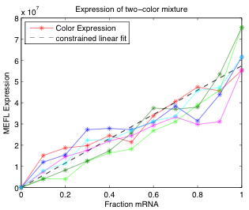
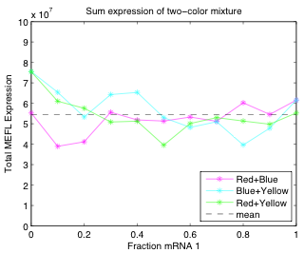
Cotransfection is Linear in Dose

Slide 8
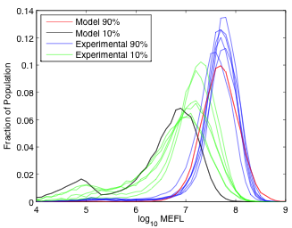
Log-Normal Expression Variation
Notes:
Figure 5: Experimental observations vs. model of fluorescence distribution for all 10%:90% ratios of two-replicon transfection, in all six combinations of colors.

Slide 9
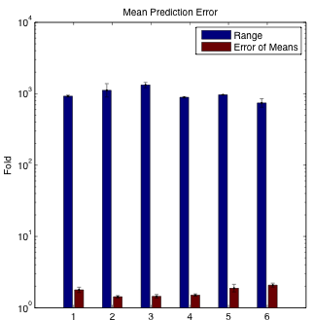
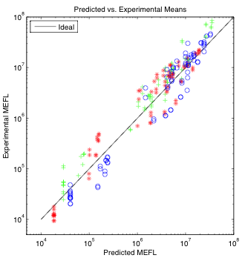
High Precision Predictions
Six three-replicon mixtures, measured in time series for 50 hours post-transfection:
Mix 1: 0.1Y, 0.1R, 0.1B Mix 2: 0.3Y, 0.3R, 0.3B Mix 3: 0.1Y, 0.5R, 0.4B
Mix 4: 0.2Y, 0.2R, 0.6B Mix 5: 0.01Y, 0.1R, 0.5B Mix 6: 0.4Y, 0.02R, 0.02B
(1.0 = 2200 ng)
Summary of results:

Slide 10
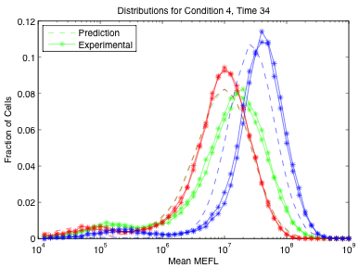
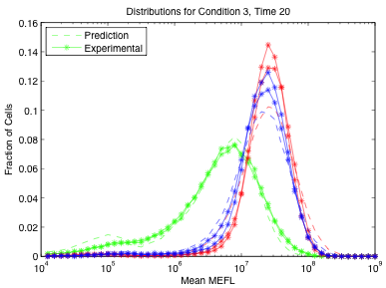
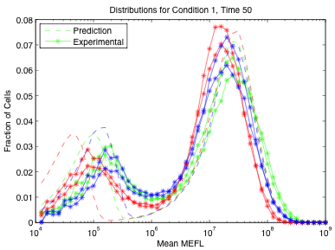
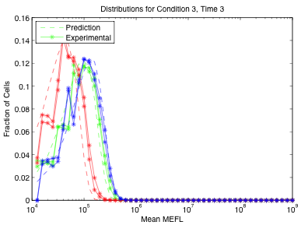
Precise Prediction of Distributions too!

Slide 11
Platform Development Workflow
Optimize Transfection
Experiment 2A: Time Series
S, λ_{E}, δ_{E},
λ_{D}, λ_{F}, δ_{F}
Experiment 1: Dose Challenge
Transcription-limit dominant?
Expression-Level Engineering
α, τ
Working Flow Cytometry
>90% viable?
Experiment 2B: Dual Transfection
σ
Cell size/resource variation: σ
Transcription-limited expression:
Saturated level: S
Rate of approach: λ_{E}
RNA replication:
Delay before significant expression: δ_{E}
Transfection process:
Poisson density multiplier: α
Efficiency: τ
Cell division:
Delay before impairment: δ_{F}
Base rate of division: λ_{D}
Impaired rate of division: λ_{F}
Proportional
expression?
Experiment 1: Dose Challenge:
Transfect: 10, 30, 100, 300, 1000, 3000 ng RNA
Measure at 24 hours
Experiment 2A: Time Series
Dose: 1.39/α ng (expected 75% positive)
Measure at 6, 12, 24, 36, 48 hours
Experiment 2B: Dual Transfection
Transfect: 4.61/α * {0/1, 0.1/0.9, 0.5/0.5, 0.9/0.1, 1/0} ng RNA
Measure at 24 hours

Slide 12

Two-Phase Expression-Level Engineering:
Viable design?
MEFL X
MEFL Y
…
Model-Driven
Dose Design
Fluorescent Proteins @
24 hours
Linear
Correction
(if needed)
Validate
Experimentally
Bulk Yield Prediction:
Design for ratio:
Design Examples:
Design “ballast” for absolute:

Slide 13
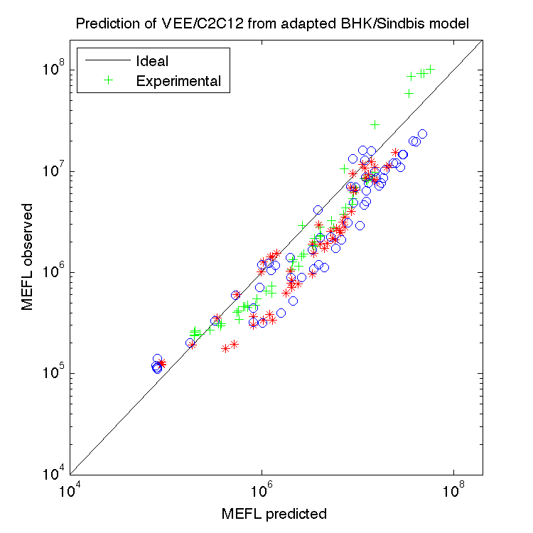
Contributions and Next Steps
RNA replicons are a good engineering platform
TASBE characterization gives good insight, enabling high-precision prediction and design
Next steps:
More relevant cell lines, in vivo
Regulation, multi-SGP
C2C12

