Slide 1


The Importance of Asymmetry for Rapidly Reaching Consensus
Jacob Beal
Social Concepts in Self-Adaptive and Self-Organising Systems
IEEE SASO
September, 2013

Slide 2
Asymmetry trades robustness for speed
Extremely
Robust, Fair
Extremely
Fragile
Total Symmetry
Total Asymmetry
continuum of optimal algorithms
for various applications
Laplacian
Consensus
Spanning Tree
Consensus
O(diameter²)
convergence
O(diameter)
convergence

Slide 3
Outline
Laplacian-based Consensus
Symmetric Flow → Slow Convergence
Acceleration through Asymmetry

Slide 4
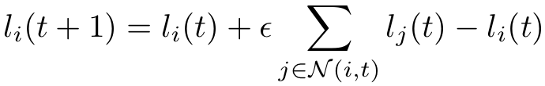
Motivation: approximate consensus
Sensor fusion
Modular robotics
DMIMO
Many spatial computing applications:
Flocking & swarming
Localization
Collective decision
etc …
Current Laplacian-based approach:
Many nice properties: exponential convergence, highly robust, etc.
For a good review, see:
[Olfati-Saber et al, 2007]

Slide 5
Laplacian Consensus

Slide 6
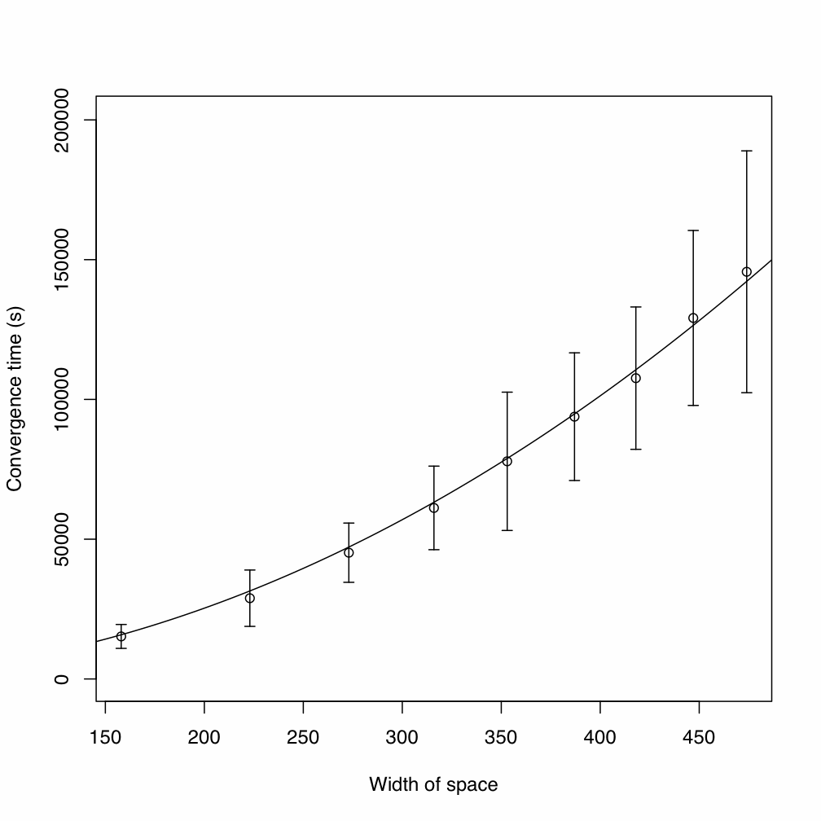
Problem: Laplacian consensus too slow
On spatial computers:
Converge O(diam²)
Stability constraint → very bad constant
[Elhage & Beal ‘10]

Slide 7
Laplacian Consensus vs. Correlations

Slide 8
Outline
Laplacian-based Consensus
Symmetric Flow → Slow Convergence
Acceleration through Asymmetry

Slide 9
Why is Laplacian consensus so slow?
No memory, no structure
→ equal information flow in all directions
The good: this is why it’s so robust!
The bad: information is always circling back
The ugly: stability only when each step is small!

Slide 10
Illustration: impulse response
1-dimensional network
Symmetry → exponential decrease

Slide 11
Illustration: instability
1-dimensional network

Slide 12
Breaking Symmetry
Asymmetry → correlated multi-hop flows
What is the extreme of asymmetry?

Slide 13
Extreme Asymmetry: Spanning-Tree Consensus

Slide 14
Continuum of Algorithms
Extremely
Robust, Fair
Extremely
Fragile
Total Symmetry
Total Asymmetry
???
Laplacian
Consensus
Spanning Tree
Consensus
O(diameter²)
convergence
O(diameter)
convergence

Slide 15
Outline
Laplacian-based Consensus
Symmetric Flow → Slow Convergence
Acceleration through Asymmetry

Slide 16
Idea: multi-hop overlay links
Power-Law-Driven Consensus:
Self-organize an overlay network, linking all devices to a random regional “leaders”
Regions grow, until one covers whole network
Every device blends values with “leader” as well as neighbors
In effect, randomly biasing consensus
Price: variation in converged value
[Beal ‘13]

Slide 17
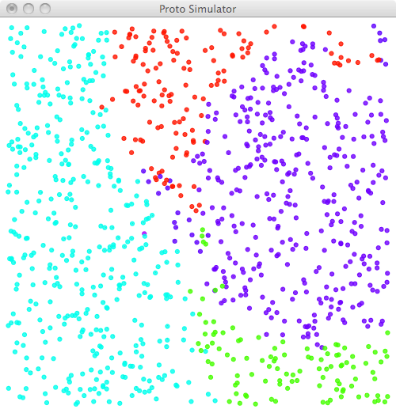
Self-organizing overlay
Creating one overlay neighbor per device:
Random “dominance” from 1/f noise
Decrease dominance over space and time
Values flow down dominance gradient

Slide 18
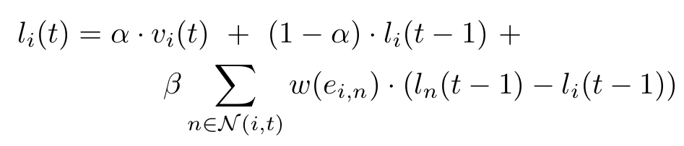
Power-Law-Driven Consensus
Asymmetric overlay update
Laplacian update

Slide 19
Power-Law-Driven Consensus

Slide 20
Analytic Sketch
O(1) time for 1/f noise to generate a dominating value at some device D [probably]
O(diam) for a dominance to cover network
Then O(1) to converge to D±δ, for any given α
(blending converges exponentially)
Thus: O(diam) convergence

Slide 21
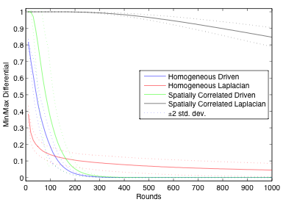
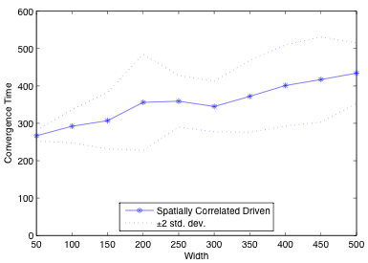
Simulation Results: Convergence
1000 devices randomly on square, 15 expected neighbors; α=0.01, β=0, ε=0.01]
Much faster than Laplacian consensus,
even without spatial correlations!
O(diameter), but with a high constant.

Slide 22
PLD-Consensus Weaknesses
Variability of consensus value:
OK for collective choice, not for error-rejection
Possible mitigations:
Feedback “up” dominance gradient
Hierarchical consensus
Fundamental robustness / speed / variance tradeoff?
Leader Locking:
OK for 1-shot consensus, not for long-term
Possible mitigations:
Assuming network dimension (elongated distributions?)
Upper bound from diameter estimation

Slide 23
Summary
Approximate consensus is a fundamental building block of many distributed systems
Laplacian-based consensus is impractically slow
Consensus can be vastly accelerated by self-organization of multi-hop asymmetries
Example: PLD-Consensus
What is the robustness / speed tradeoff curve?

