Slide 1


From Inspiration To Quantification
Jacob Beal
Panel on SASO systems - New research directions
IEEE SASO
September, 2012

Slide 2

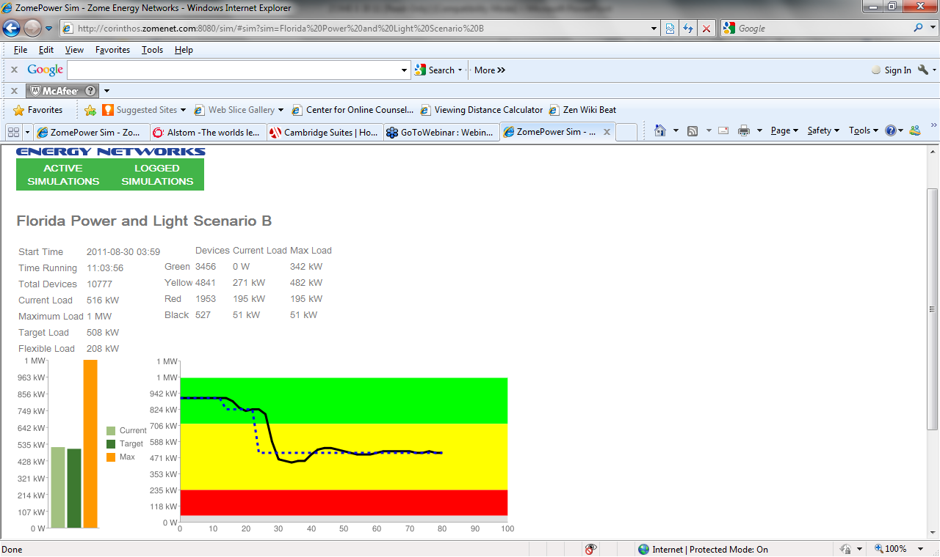
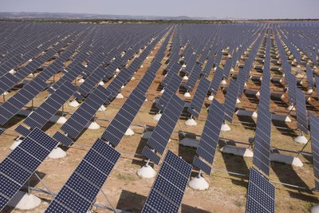
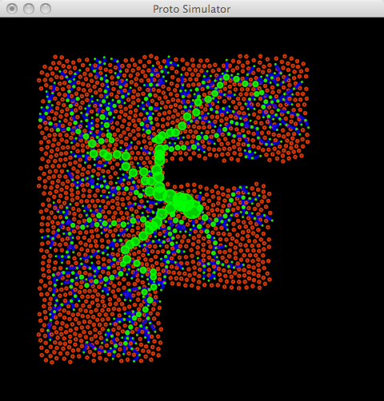
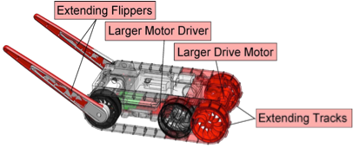
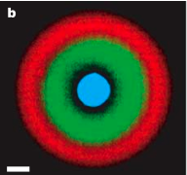
From Spatial Computing To Biology
How can millions of appliances coordinate to change how we use energy?
How can the parts of a design work together to adapt it to new uses?
How do you
program space?
Distributed Power
Demand Response
Morphogenetic
Engineering
device
neighborhood
Spatial
Computing
Synthetic
Biology
IPTG
F
GFP
H
How do you program the behavior of 10¹² cells?
LacI
TetR
aTc
H
F

Slide 3
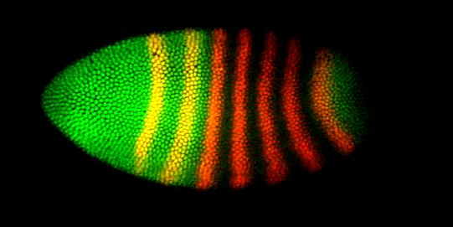
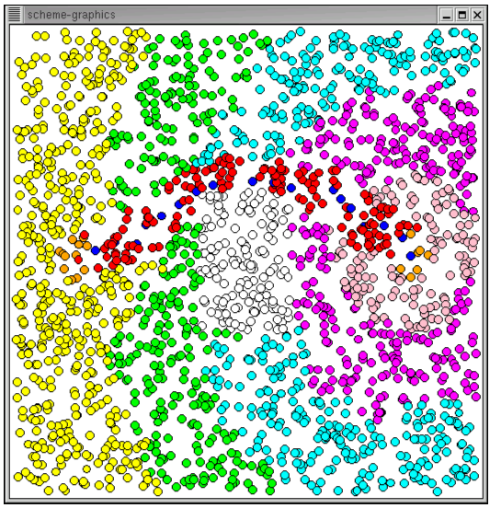
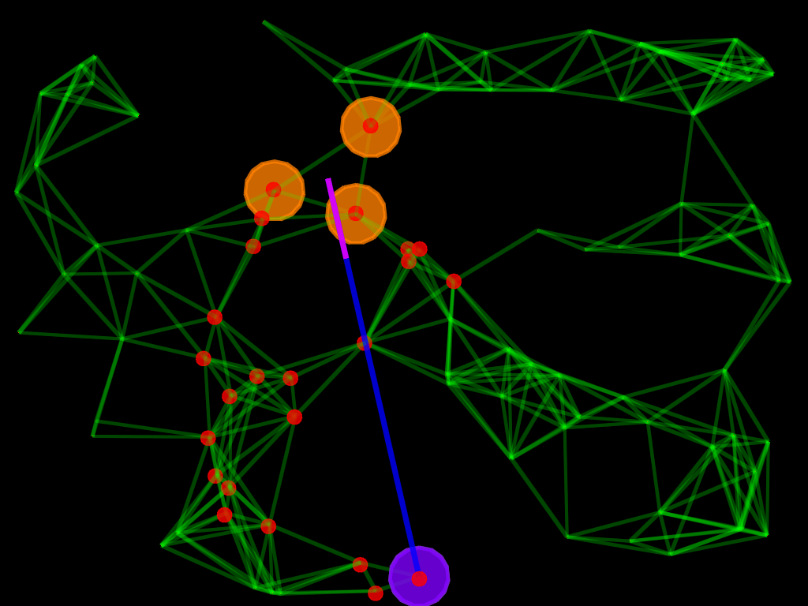
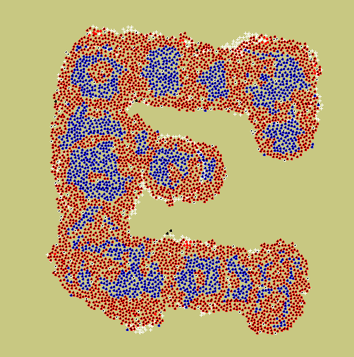
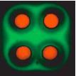

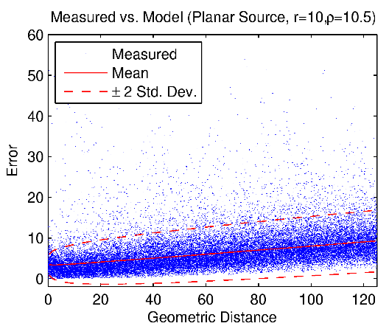
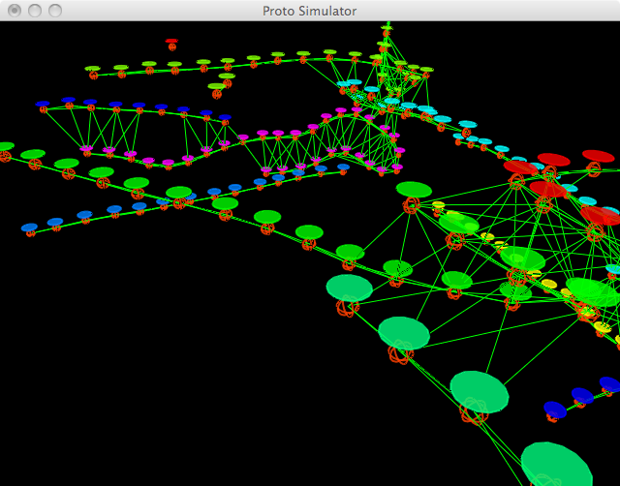
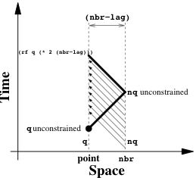
Scientific Progress in Engineering
Inspiration
Proof of Concept
Most SASO research lives in these stages
[Beal’06]
Application
[Clement & Nagpal, ‘03]
[Kondacs ’03]
We need to move toward here
Analysis of Principles
[Basu et al. ’05]
[Montagna et al. ’12]
Theorems and Laws
Fact is “when a statement [becomes] freed from the circumstances of its production”
– Bruno Latour
[Butera ’02]
[Beal et al. ’08]
[Beal et al. ’08]
Modular Component
[Beal et al. ’12]

