Slide 1


Superdiffusive Dispersion and Mixing of Swarms with Reactive Levy Walks
Jacob Beal
IEEE SASO
September, 2013

Slide 2
Scale-free random walk → good dispersion
Reactive Levy Walk [white] much better than
random walk, repulsive forces or pure reactive

Slide 3
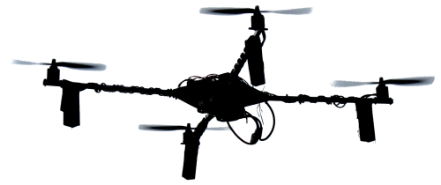
Problem: Low-Information Dispersion
Goal: rapidly deploy evenly over unknown space
Constraint: local interactions only
poor localization, low bandwidth, high turnover, etc.
Use Examples: network provision, field monitoring

Slide 4
Prior Methods
Mostly physics-based models
Random Walk
Repulsive Force
Many related variants and hybrids
All scale very badly

Slide 5
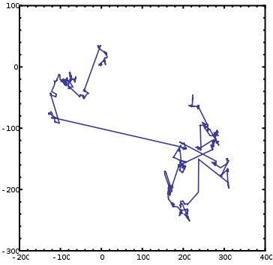
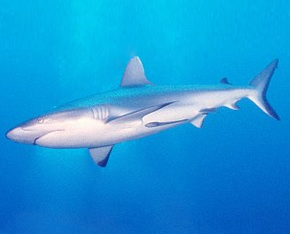
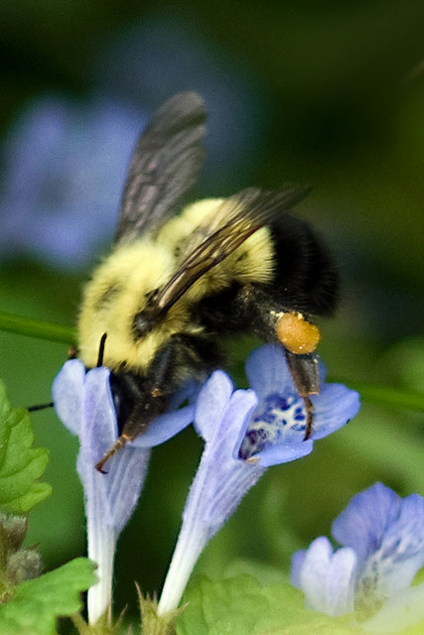
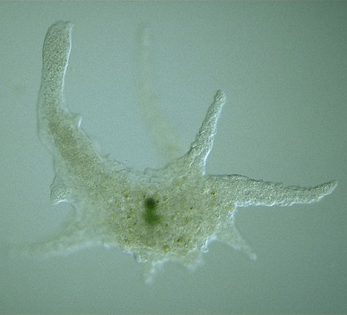
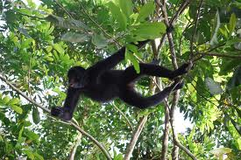
Levy flights / walks: scale-free balance of explore vs. exploit
Levy flight → scale-free (1/f) random steps
Levy walk → same, with bounded velocity
Models many type of animal foraging, motion, turbulent diffusion, plasma optics, etc.

Slide 6
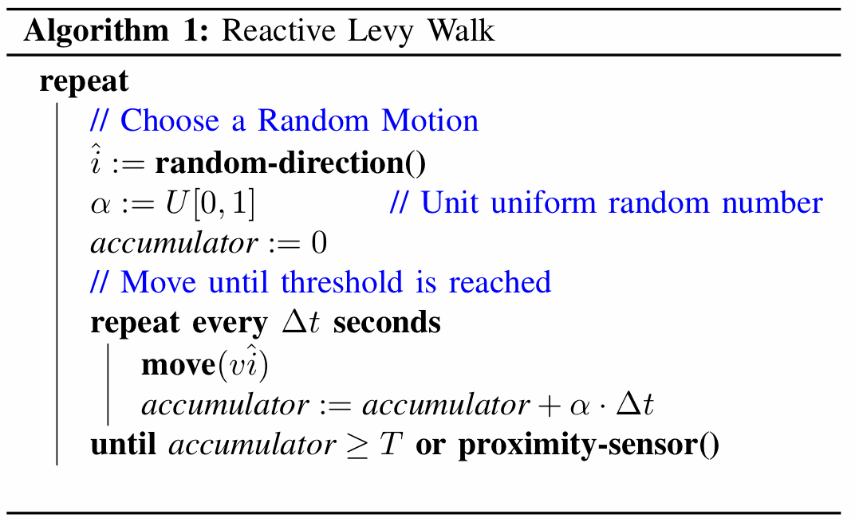
Reactive Levy Walk: Algorithm
Random
Scale-Free
Reactive

Slide 7
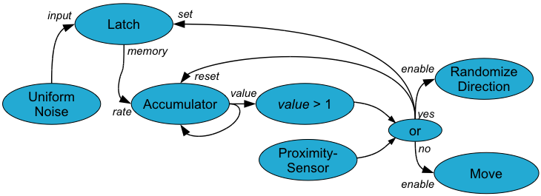
Reactive Levy Walk: Hardware

Slide 8
Dynamics: Exterior vs. Interior
Superdiffusive
Dispersion
Constrained
Random Walk

Slide 9
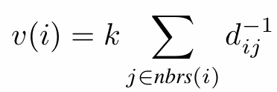
Evaluation in Simulation
Four algorithms
Reactive Levy Walk
Random Walk random direction every Δt
Repulsive Forces
Turn-on-Contact random direction on proximity
Parameters:
|v| = 1 m/s, Δt = 1 s, k = 0.05, r = 10 m
1000 individuals, initial 10x10 m uniform random

Slide 10
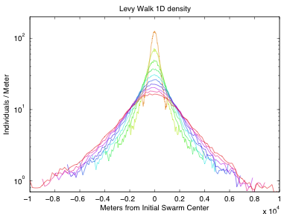
1D Dispersion (1/2)
10K seconds, density histogram every 1K seconds

Slide 11
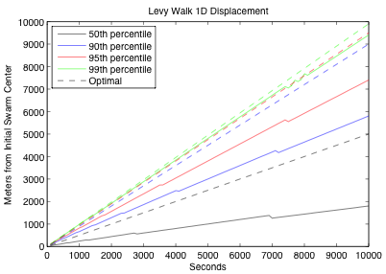
1D Dispersion (2/2)
Nth percentile moves linearly at differnent rates

Slide 12
2D Dispersion

Slide 13
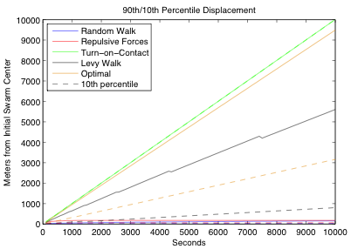
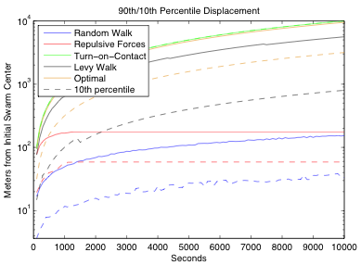
2D Dispersion: Method Comparison
[linear scale]
[log scale]
Reactive Levy Walk is competitive with optimal
Turn-on-Contact moves too quickly, leaving empty interior
Random walk, repulsive forces very slow

Slide 14
Constrained Dispersion

Slide 15
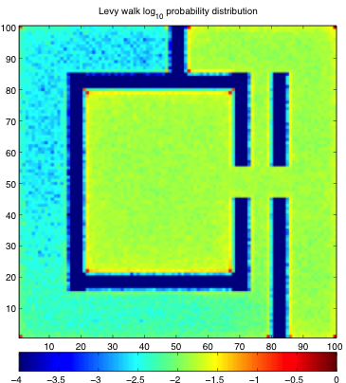
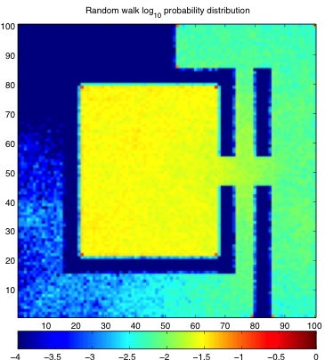
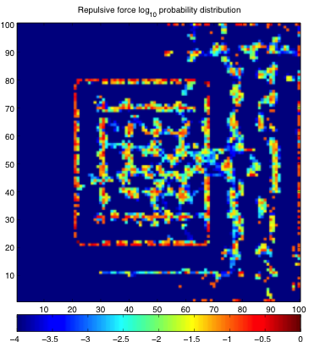
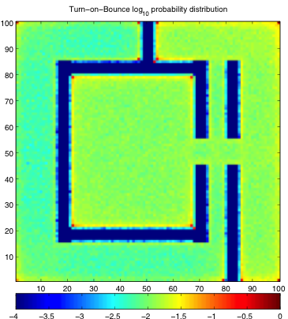
Constrained Dispersion
Occupancy histogram: warmer color = higher density (log scale)
Reactive Levy Walk
Random Walk
Repulsive Force
Turn on Contact
Reactive Levy Talk, Turn-on-Contact perform well,
Random Walk, Repulsive Force very poor

Slide 16
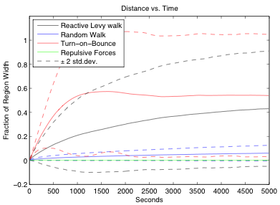
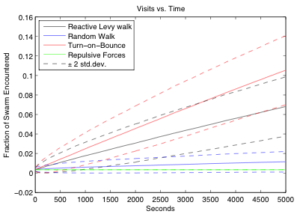
Dispersion → Mixing
Reactive Levy Talk, Turn-on-Contact perform well,
Random Walk, Repulsive Force very poor

Slide 17
Evolvability of Reactive Levy Walks
4. Adaptivity
input
Latch
set
1. Mobility
memory
enable
reset
3. Persistence
Randomize
Direction
Uniform
Noise
Accumulator
value
value > 1
rate
yes
5. Scale-Freeness
or
Proximity-
Sensor
no
Move
2. Reactivity
enable
Could this explain appearance of Levy statistics in biological organisms?

Slide 18
Contributions
Random walks and repulsive forces are very poor methods of dispersion.
Reactive Levy walks:
produce near-optimal unconstrained dispersion
also good for constrained environments, mixing
hardware implementation is incrementally evolvable
With constrained motion, reactivity dominates

