Slide 1


SBOL in Action:
The BBN BioCompiler
Jacob Beal
SBOL Workshop
April, 2013
Newcastle upon Tyne, UK

Slide 2
What is BioCompiler?
High-level program
→ (compile against motifs & platform)
Optimized GRN design
Three output formats:
SBOLv diagrams
Matlab ODE files
SBOL-ish XML
Challenges for using SBOL:
SBOLv vs. GraphViz
Written in C++

Slide 3
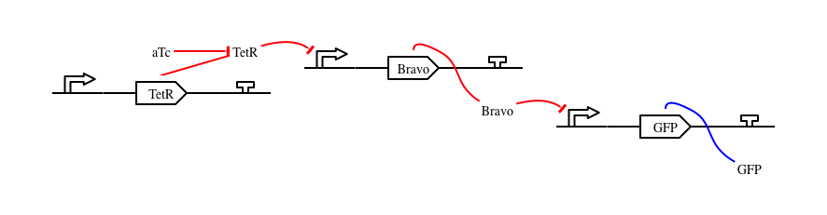
Simple Example: Inversion
(green (not (aTc)))
compiled for E. coli

Slide 4
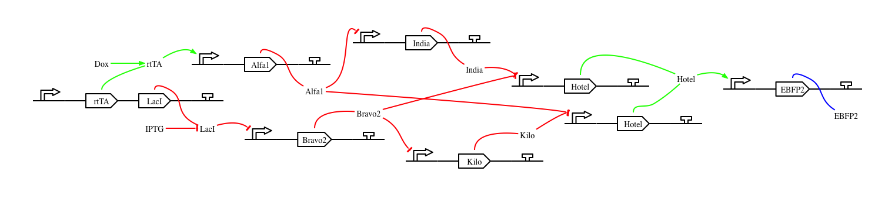
Not-Quite-So-Simple Example: XOR
(blue (xor (Dox) (IPTG)))
compiled for mammalian

Slide 5
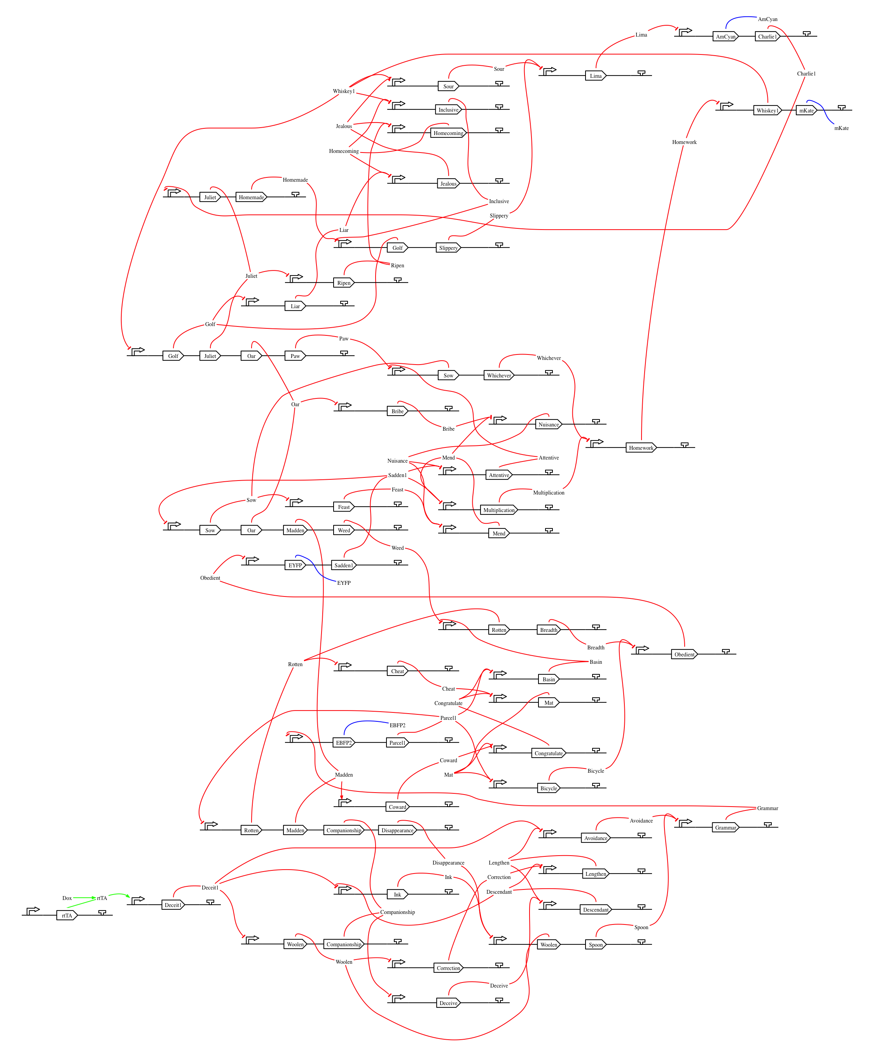
Complex Example: 4-bit Counter
(4-bit-counter)
compiled for mammalian

Slide 6
Public Web Interface
Anonymous access now available (but not private)
Further tool integration possible via XML RPC calls

Slide 7
Future SBOL Uses & Needs
SBOL output:
Use case: transmitting designs to other tools for visualization, editing, fabrication
Needs:
libSBOLc
Representation of species, regulatory interactions
SBOL input:
Use case: importing motif designs from other tools
Needs:
Device model with “ports” for interface
Representation of species, regulatory interactions

