Slide 1


Accelerating Approximate Consensus with Self-Organizing Overlays
Jacob Beal
2013 Spatial Computing Workshop @ AAMAS
May, 2013

Slide 2
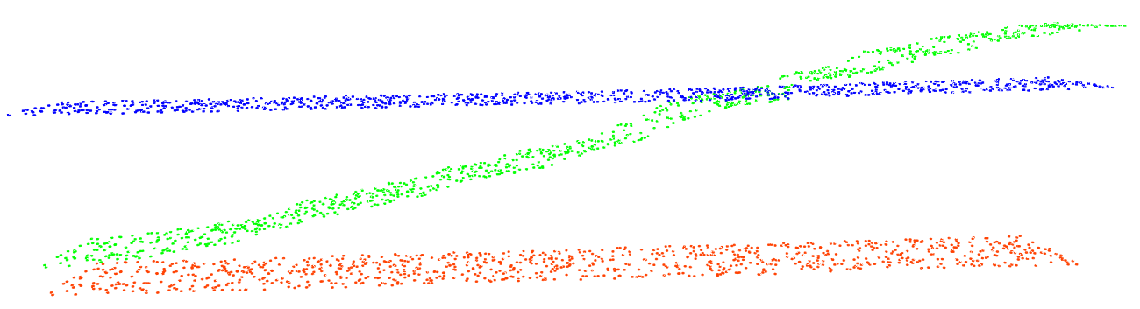
PLD-Consensus:
With asymmetry from a self-organizing overlay…
… we can cheaply trade precision for speed.

Slide 3
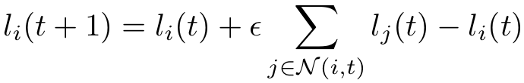
Motivation: approximate consensus
Sensor fusion
Modular robotics
DMIMO
Many spatial computing applications:
Flocking & swarming
Localization
Collective decision
etc …
Current Laplacian-based approach:
Many nice properties: exponential convergence, highly robust, etc.
But there is a catch…

Slide 4
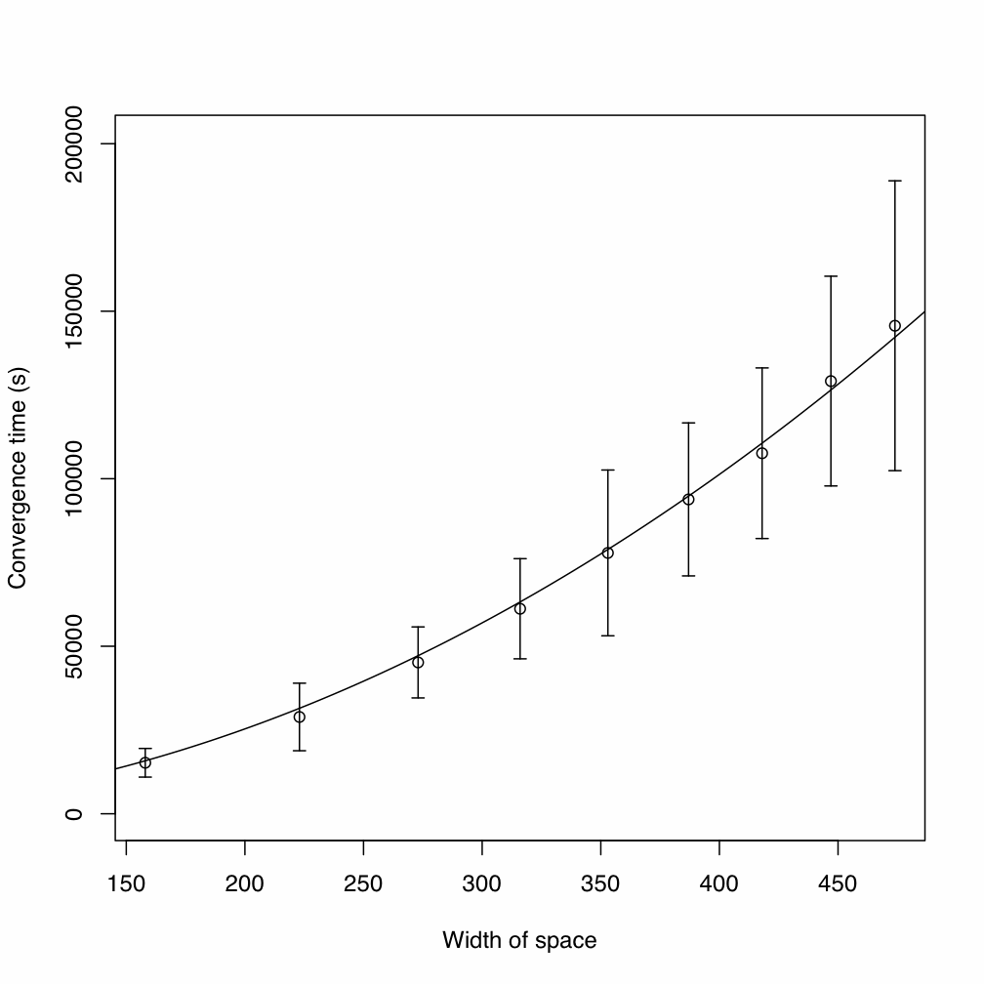
Problem: Laplacian consensus too slow
On spatial computers:
Converge O(diam²)
Stability constraint → very bad constant
Root issue: symmetry
[Elhage & Beal ‘10]

Slide 5
Approach: shrink effective diameter
Self-organize an overlay network, linking all devices to a random regional “leaders”
Regions grow, until one covers whole network
Every device blends values with “leader” as well as neighbors
In effect, randomly biasing consensus
Cost: variation in converged value

Slide 6
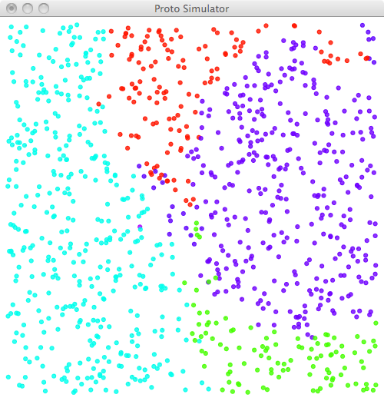
Self-organizing overlay
Creating one overlay neighbor per device:
Random “dominance” from 1/f noise
Decrease dominance over space and time
Values flow down dominance gradient

Slide 7
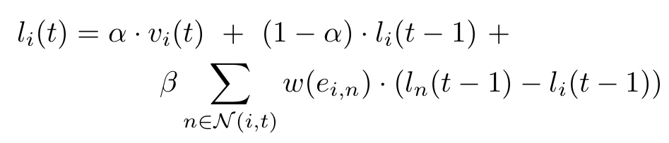
Power-Law-Driven Consensus
Asymmetric overlay update
Laplacian update

Slide 8
Race: PLD-Consensus vs. Laplacian

Slide 9
Analytic Sketch
O(1) time for 1/f noise to generate a dominating value at some device D [probably]
O(diam) for a dominance to cover network
Then O(1) to converge to D±δ, for any given α
(blending converges exponentially)
Thus: O(diam) convergence

Slide 10
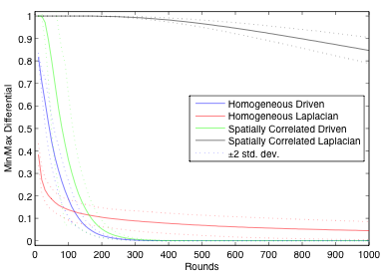
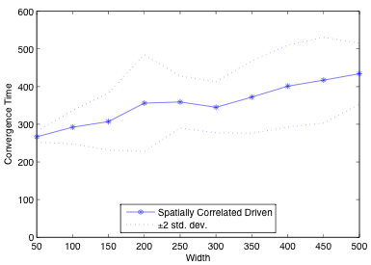
Simulation Results: Convergence
1000 devices randomly on square, 15 expected neighbors; α=0.01, β=0, ε=0.01]
Much faster than Laplacian consensus,
even without spatial correlations!
O(diameter), but with a high constant.

Slide 11
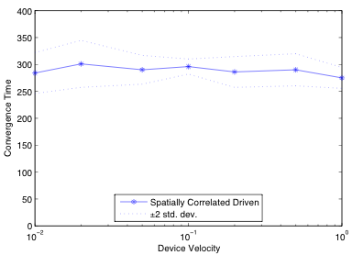
Simulation Results: Mobility
No impact even from relatively high mobility
(possible acceleration when very fast)

Slide 12
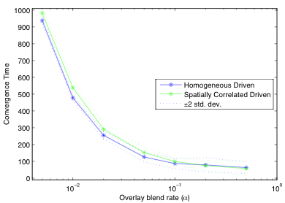
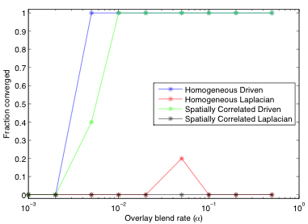
Simulation Results: Blend Rates
β irrelevant: Laplacian term simply cannot move information fast enough to affect result

Slide 13
Current Weaknesses
Variability of consensus value:
OK for collective choice, not for error-rejection
Possible mitigations:
Feedback “up” dominance gradient
Hierarchical consensus
Fundamental robustness / speed / variance tradeoff?
Leader Locking:
OK for 1-shot consensus, not for long-term
Possible mitigations:
Assuming network dimension (elongated distributions?)
Upper bound from diameter estimation

Slide 14
Contributions
PLD-Consensus converges to approximate consensus in O(diam) rather than O(diam²)
Convergence is robust to mobility, parameters
Future directions:
Formal proofs
Mitigating variability, leader locking
Putting fast consensus to use…

