Slide 1


Towards a Unified Model of Spatial Computing
Jacob Beal, Mirko Viroli, Ferruccio Damiani
7th Spatial Computing Workshop @ AAMAS '14
May, 2014

Slide 2
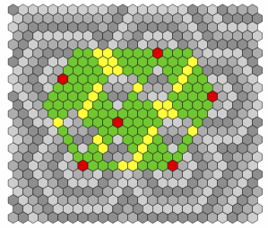


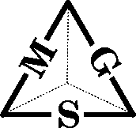
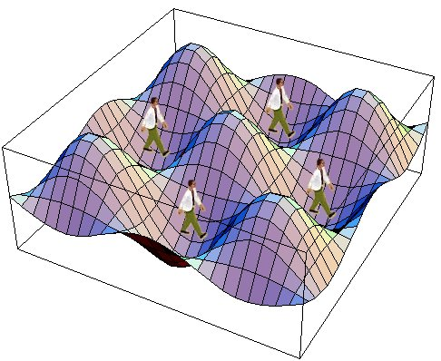

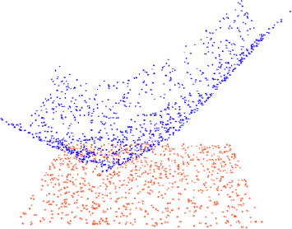
We Need a Unified Model
Many models; no clear means of comparison

Slide 3
A Search for Minimal Models
Proto
[Beal & Bachrach '06]
ST-Linda
[Viroli et al. '12]
Space-Time
Universality
Discrete Proto
Semantics
Spreading
Calculus
[Beal '10]
[Viroli et al. '11, '13]
[Viroli '13]
Continuous Proto
Semantics
DSL Survey
Field Calculus
[Beal et al. '12]
[Beal et al. '13]
[Viroli et al. '13]
[This Work]

Slide 4
Proof sketch
Field Calculus
2. Field calculus can
approximate those
Proto programs
1. Some Proto programs
are finitely approximable
Proto
3. This subset is enough
to get universality
Space-Time Universality

Slide 5
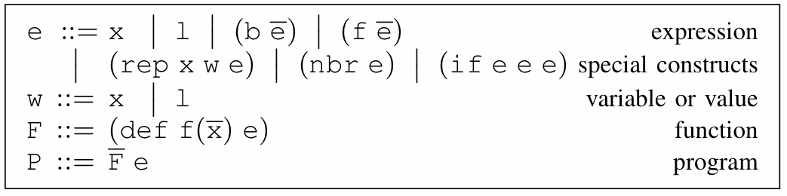
Field Calculus
State
Variable
Literal Value
Local Ops
Communication
Domain Change
Abstract & Call
Functions
[Viroli et al., ’13]

Slide 6
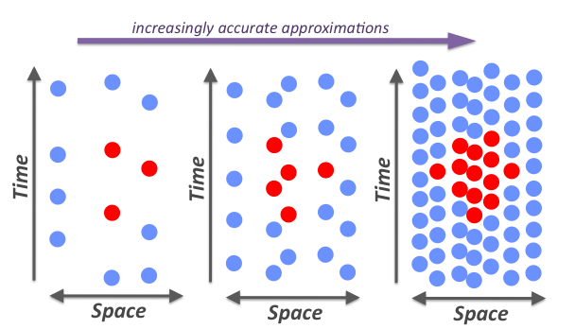
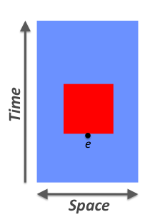
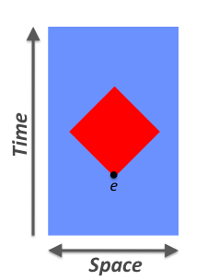
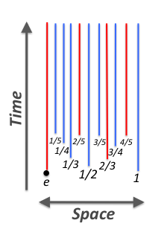
Field Calculus is Space-Time Universal
Space-time Universal = arbitrarily good approximation of any causal, finitely-approximable computation
Specification:
Acausal
Non-approximable
[Beal, ’10]

Slide 7
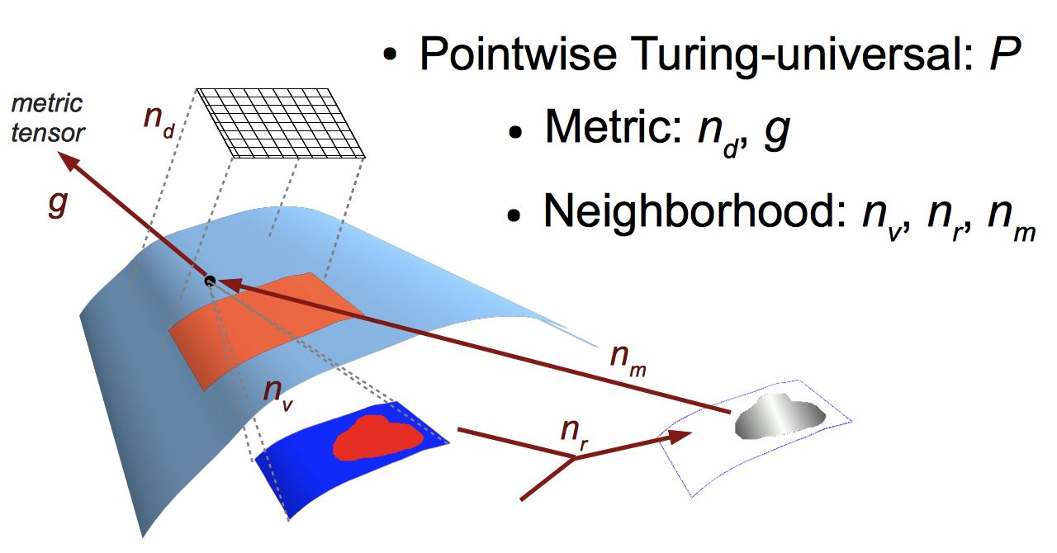
Proposed Universal Operators

Slide 8
Proto
(def gradient (src) ...)
(def distance (src dst) ...)
(def dilate (src n)
(<= (gradient src) n))
(def channel (src dst width)
(let* ((d (distance src dst))
(trail (<= (+ (gradient src)
(gradient dst))
d)))
(dilate trail width)))
evaluation
global to local
compilation
Global Local Discrete
platform
specificity &
optimization
device
neighborhood
discrete
approximation
Device
Kernel
[Beal & Bachrach, '06]

Slide 9
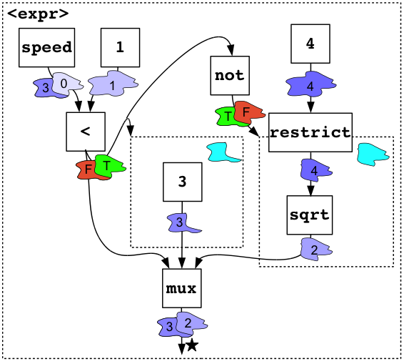
Proto as Dataflow Graph
Definition
Manifold
Submanifold
Field
Return Value
Operator
Well-defined program = no inconsistencies in domains, graph structure

Slide 10
Proof sketch
Field Calculus
2. Field calculus can
approximate those
Proto programs
1. Some Proto programs
are finitely approximable
Proto
3. This subset is enough
to get universality
Space-Time Universality

Slide 11
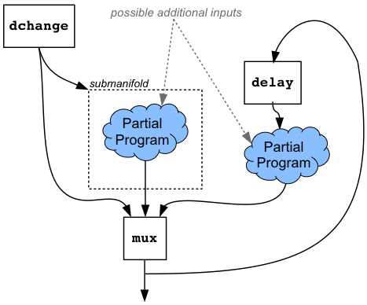
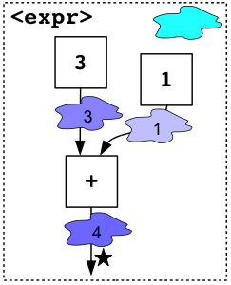
Theorem 1: Proto approximability
Any well-defined Proto program P = (M, F, O, R, D) composed only of finitely approximable operator instances is finitely approximable.
If inputs converge,
then output converges
Intuition: feed-forward composition + special forms
Note: some surprising things (e.g., '=') aren't approximable!

Slide 12
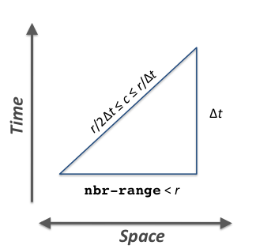
Neighborhood Independence
For consistent communication speed, neighborhood must shrink with time-step.
Neighborhood-independent programs aren't affected by this problem
A problem program:
(def use-speed-and-radius (bool)
(* (any-hood (nbr bool))
(distance-to bool)))

Slide 13
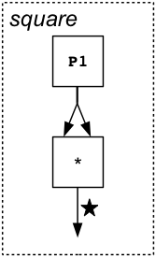
Theorem 2: Field Calculus → Proto
Any well-defined neighborhood-independent Proto program P = (M, F, O, R, D) composed only of finitely approximable operator instances can be approximated using field calculus.
(def function_1 (p_1)
(function_1_1 p_1))
(def function_1_1 (p_1)
(function_1_2 p_1 (* p_1 p_1)))
(def function_1_2 (p_1 v_1) v_1)
Intuition: construct equivalent graph in field calculus

Slide 14
Theorem 3: Field Calculus Universality
Field Calculus is Space-Time Universal
Corollary: Any well-defined finitely approximable Proto program can be approximated by field calculus.
Approximable subset
of Proto covers these
Metric tensor
can be a built-in
Intuition: Proto is nearly space-time universal.

Slide 15
Contributions
Field calculus is space-time universal
Minimal computational calculus can serve as a unifying point for understanding relationships of spatial computing approaches
Next steps: generating field calculus from space-time programs; showing coherent execution; extension to dynamically changing spaces

