Slide 1

Analysis and Visualisation of Gene Expression Data by Dr Jacob Beal

Slide 2


Speaker - iGEM
Anastasios Galanis After iGEM
Jacob Beal
Raytheon BBN Technologies
iGEM Engineering Committee

Slide 3
Data Analysis and Visualization
Content:
Relating data to biology
Graphical Presentation

Slide 4
RELATING DATA TO BIOLOGY

Slide 5

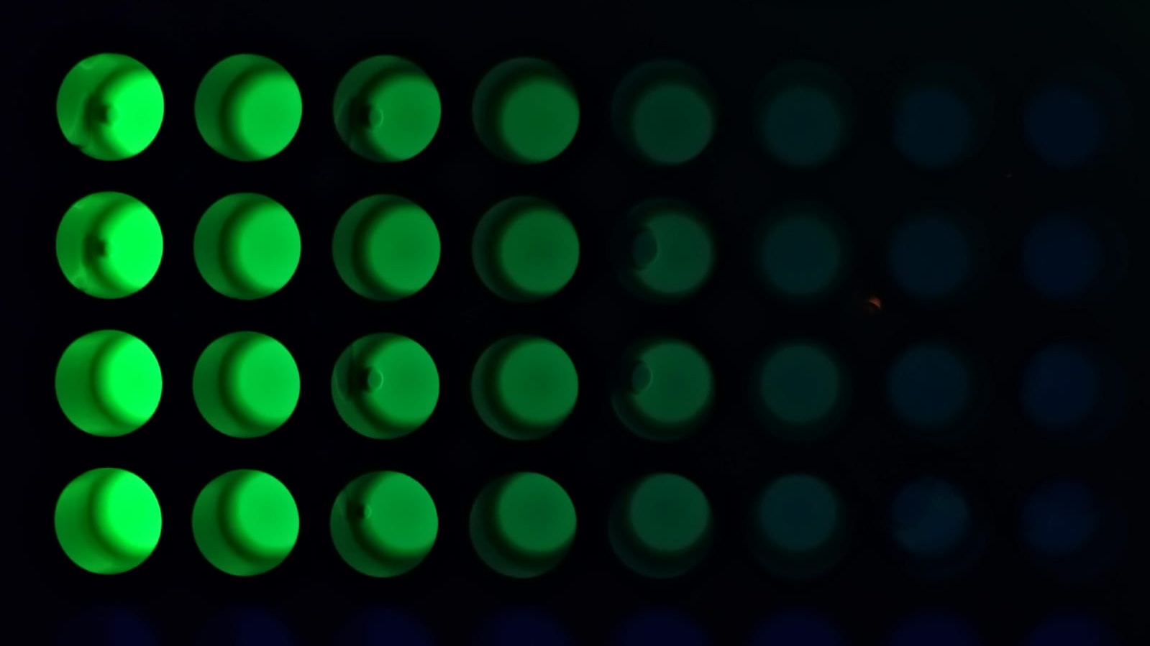
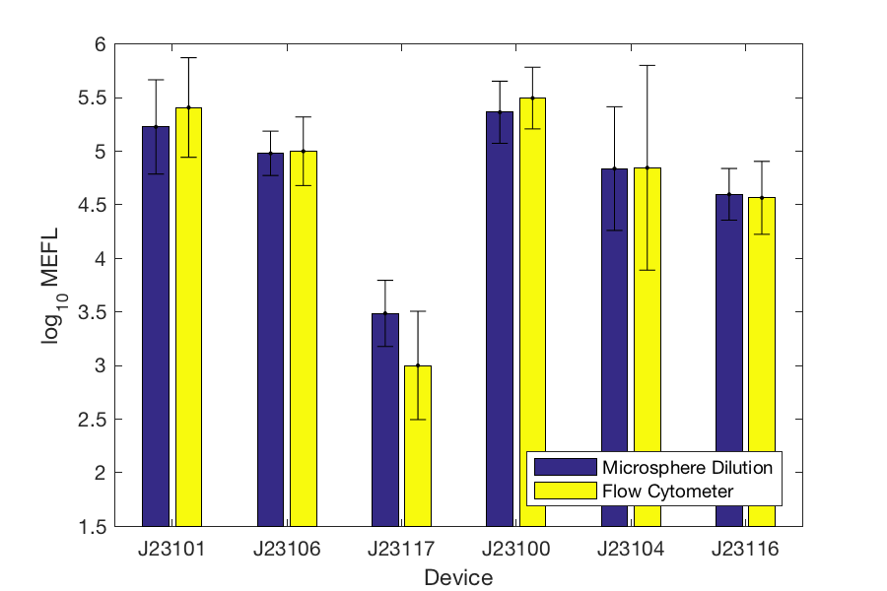
Avoid Relative and Arbitrary Units
Example: calibration of fluorescence & OD measurements
Flow Cytometry: NIST-certified beads, WT, color controls
Plate reader: fluorescein, Texas Red, cell-like microspheres
Result: directly comparable MEFL units
[Roederer, ‘02; Wang et al., ‘08; NIST/ISAC, ‘12; Beal et al., ‘12; Castillo-Hair et al., ’16; Beal et al., ‘18, Beal et al.,’20, Beal et al., ‘21]

Slide 6

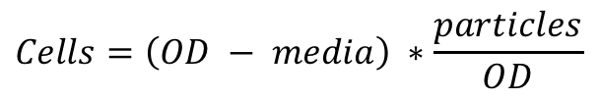
Think Carefully About Relating Measurement to Biology
Example: estimating cell and molecule counts from plate reader data
Raw readings include background, even after calibration
To estimates counts, subtract the background:
$$Cells=\left(OD − media\right) ∗\frac{particles}{OD}$$
$$\frac{MEFL}{Cell}=\left(a.u. −WT a.u.\right) ∗\frac{MEFL}{a.u.} ∗ Cells$$

Slide 7
Use Geometric Statistics for Gene Expression
Why geometric stats?
Complex catalytic reactions → multiply many rates:
R_{express} = R₁R₂R₃R₄R₅…
Central Limit Theorem → converge to log-normal!
Gamma distribution bursting also implies geometric stats
[Davidsohn et al., 2015], [Beal, 2017]

Slide 8
Take Advantage of Process Controls
Experimental Controls:
Is my hypothesis true?
One control per factor under study
Best when new data
Control very close to experiment conditions
Process Controls:
Should I trust the data?
One control per assumption in study
Best when known value
Control should have minimal relation to experiment conditions

Slide 9
Example of Experimental vs. Process Controls

Slide 10
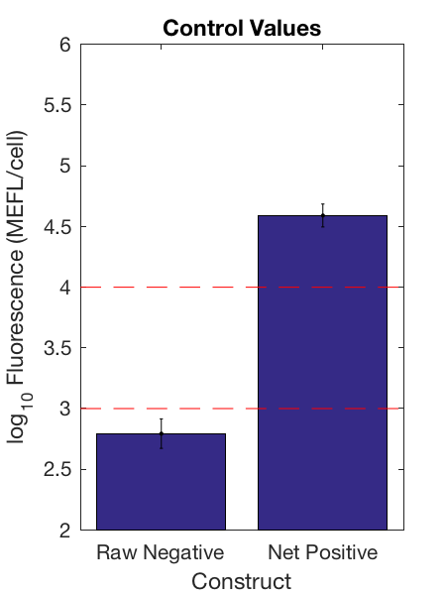
Sanity Check Your Control Values
Compare to calibrants to ensure instrument linear range
Compare positive to max number of proteins per cell:
E. coli: 2e6
Yeast: 6e7
Human: 2e9
Negative control should be much smaller than positive
Problems with values indicate likely process failure
Example: E. coli negative <1e3, positive >1e4
http://book.bionumbers.org/how-many-proteins-are-in-a-cell/

Slide 11
GRAPHICAL PRESENTATION

Slide 12

Presenting data is just as important as collecting it!

Slide 13
Core Principles of Data Presentation
Show the data
Focus the viewer on data comparison, not graphic design
Avoid distorting the data
Principled choice of axis bounds, scale
Don’t hide bad results
Present many numbers densely and coherently
Show both broad overview and fine structure of data
Serve a clear purpose: e.g., description, exemplification, exploration
Integrate graphics with statistical and prose descriptions

Slide 14
Applying the Core Principles
Purpose: data exploration
Axis bound:
Ceiling of max data
X-offset dots:
dense presentation
of fine structure
Meaningful units
Log scale for
gene expression
Bar + error:
broad overview
Axis bound:
Floor of min
measurable
Focus on
comparison
Bad results
visible
Example from iGEM 2018 interlab publication: [Beal et al.,’20]

Slide 15

Tell stories in your captions
This is a horse.
What about it?

Slide 16
Tell stories in your captions
Fluorescence per cell after 6 hours of growth.

Slide 17
Tell stories in your captions
Purpose
Anticipating questions
Key results
Fluorescence per cell after 6 hours of growth, comparing calibrated flow cytometry to estimates using cell count from CFU and microsphere dilution protocols (LUDOX/water is not shown as the units it produces are not comparable). Microsphere dilution produces values extremely close to the ground truth provided by calibrated flow cytometry, whereas the CFU protocol produces values more than an order of magnitude different, suggesting that CFU calibration greatly underestimates the number of cells in the sample. Bars show geometric mean and standard deviation. Team count per condition provided in Supplementary Data 3 Teams Per Condition.
Interpretation

Slide 18
QUESTIONS?

Slide 19
THANK YOU!

