Slide 1

Advanced Security 2
Assignment 1
Jake Bolger – C18395341

Slide 2
PART A - SKILLS
Skills research
Certifications and Training
In-depth knowledge of computer operating systems, hardware and software.
First-class problem-solving skills.
A strong ability to work well under pressure.
Solid telecommunications knowledge.
Rigorous attention to detail.
persistence and determination.
Excellent abilities in mathematics.
Technical Aptitude.
Knowledge of Security Across Various Platforms. ...
Communication Skills.
Fundamental Computer Forensics Skills.
A Desire to Learn.
An Understanding of Hacking.
CISSP
CISA
CISM
Security+
Certified Ethical Hacker (CEH)
GSEC
SSCP
CASP+
GCIH
OSCP

Slide 3
Discuss why there is a shortage of security personnel worldwide.
lack of corporate security programs
underfunded security resources
lack of good tools and protocols
not enough security patches
not enough email security practices and finally people who don’t follow the policies of their company in security
Other reasons are the lack of interest from younger generations, increased number of attacks and not enough skilled defenders

Slide 4
Do you think you have enough skills to be a security expert? If no, what are you missing and if yes what are your strengths?
What measures/actions should be taken to address this shortage?
Teaching students should be done through real life scenarios.
Support mental health and wellness initiatives.
The last on is invest in employee training and certification. 93% of employees would stay at a company longer if it invested in their career.
No, although I have a basic understanding of security, I am no expert.

Slide 5
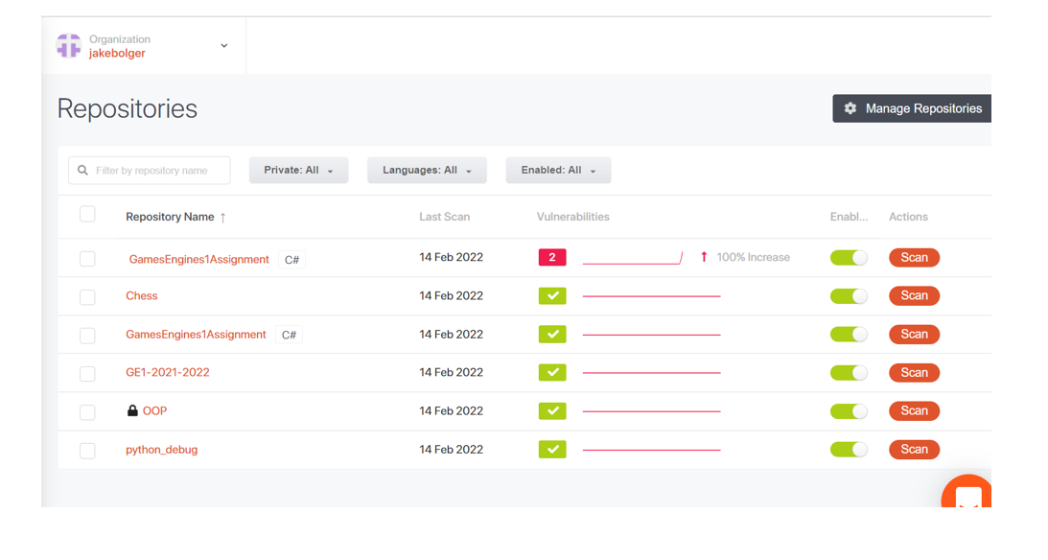
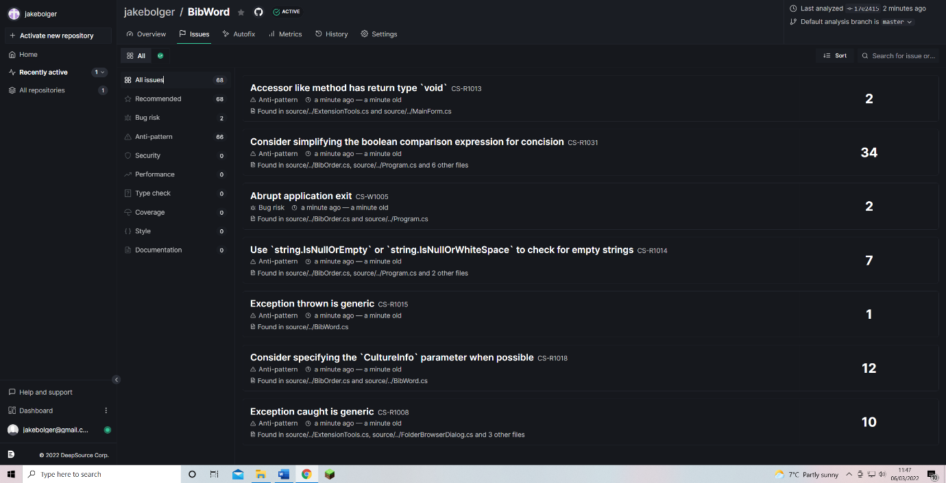
PART B – SECURITY FLAWS
Guardrails
Deep-Source

Slide 6







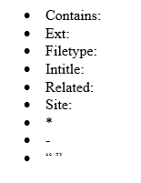
PART C
Operators
Search Engines
Equivalent Operators

Slide 7
PART D - VULNERABILITIES
Injection
Broken Authentication
Sensitive Data Exposure
Broken Access Control
Security Misconfiguration
Cross-Site Scripting
Insecure Direct Object References
Cross-Site Request Forgery
Using Components with Known Vulnerabilities
Insufficient Logging & Monitoring

Slide 8
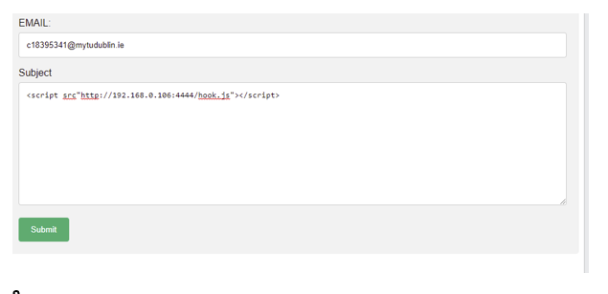
EXPLOITS
Cross Site Scripting
Cross Site Request Forgery

