Slide 1


Advanced Security 2
Assignment 2 Presentation
Jake Bolger
C18395341

Slide 2
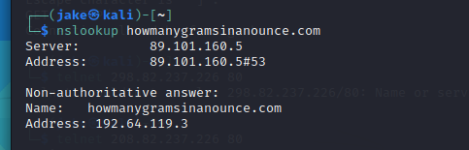
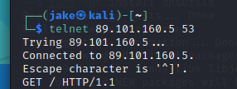
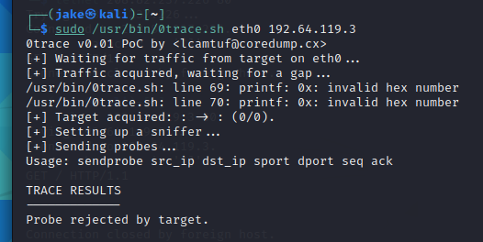
Kali Linux Security Tools
1.
0trace:
0trace is a package that is used as a traceroute tool. This is run within an open TCP connection. This means that it can bypass various stateful packet filters easily.
2.
3.

Slide 3
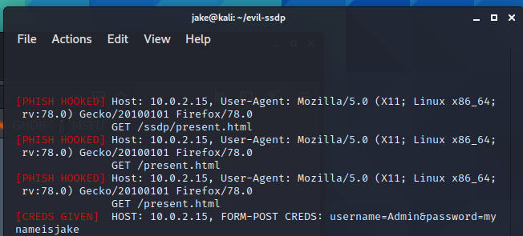
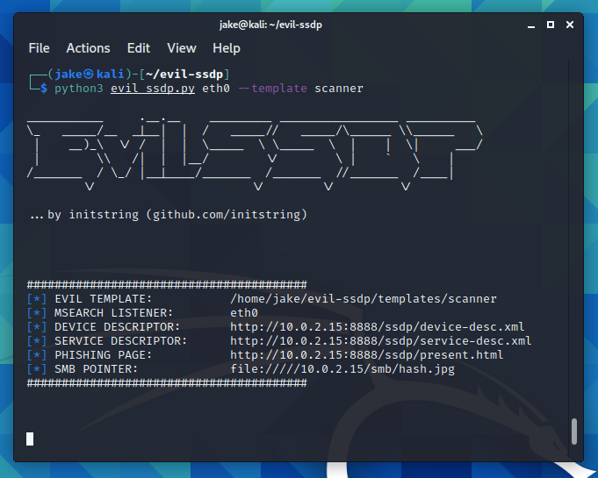
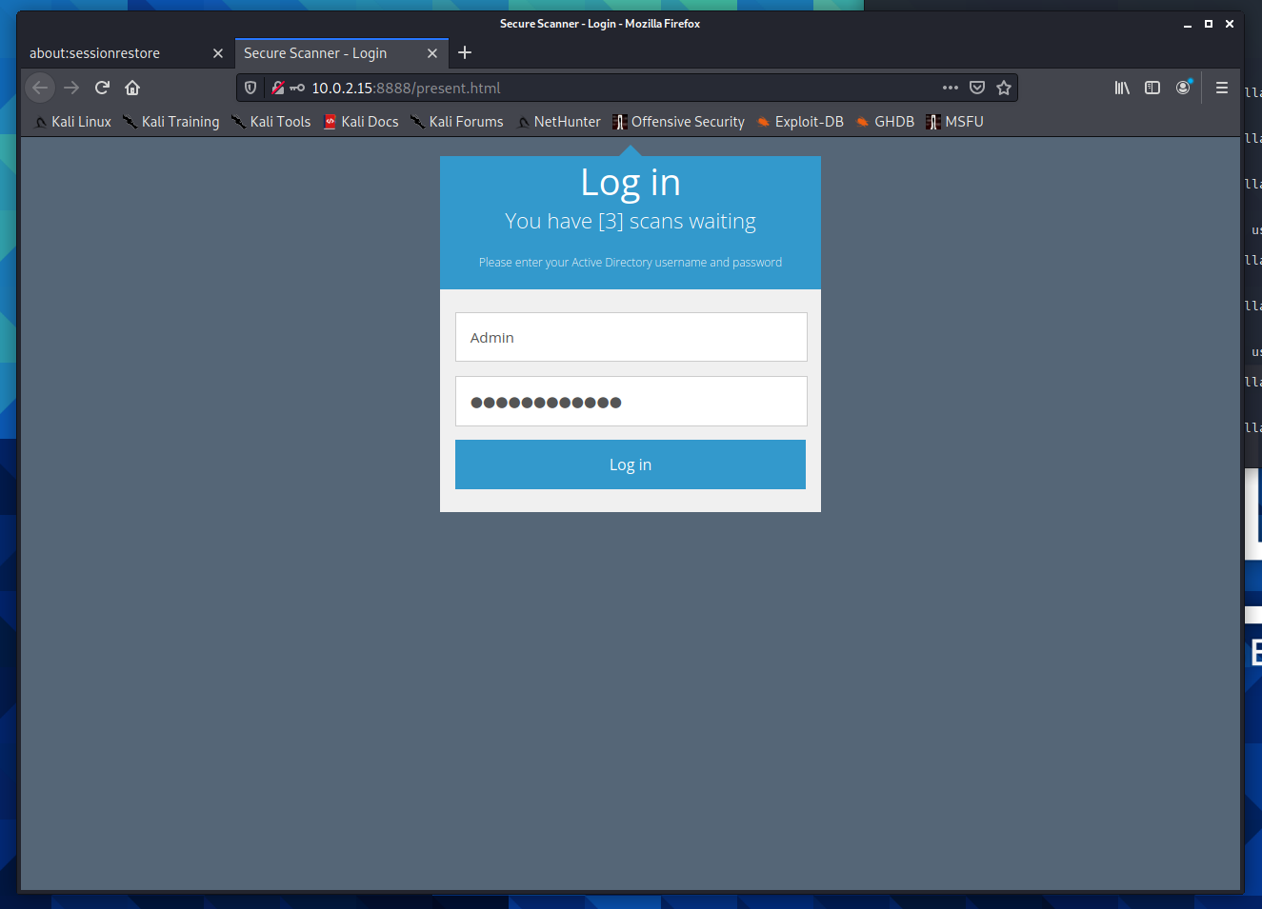
Kali Linux Security Tools
Evil-Ssdp:
SSDP multicast discovery requests are responded to with this tool, posing as a generic UPNP device on the local network. You'll be able to see the spoofed device in Microsoft Windows Explorer on machines in your local network. A configurable webpage is presented to users who are tempted to open the device.
3.
1.
2.

Slide 4
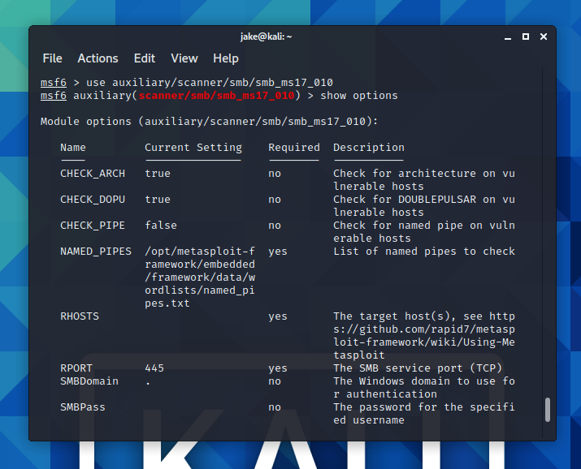
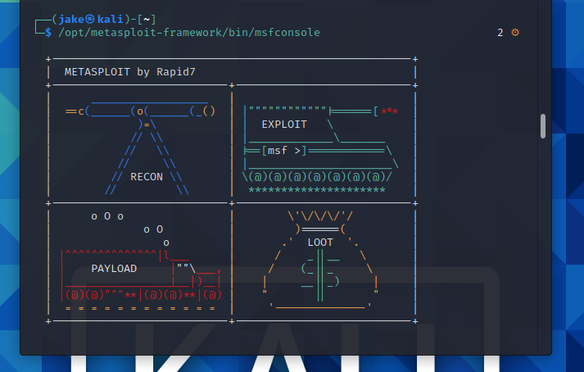
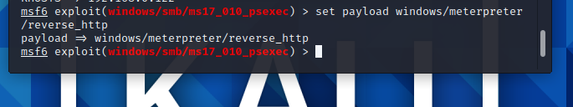

Metasploit Vulnerabilities
1.
2.
3.
4.
5.

Slide 5
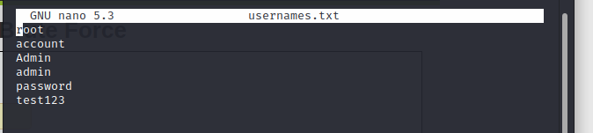
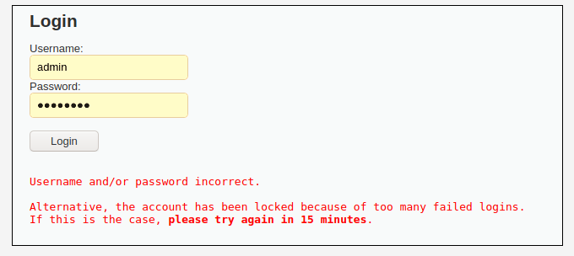
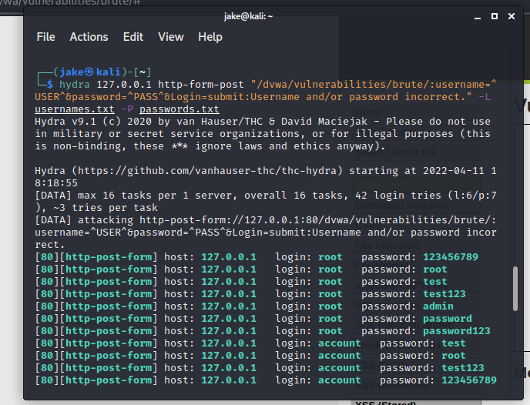
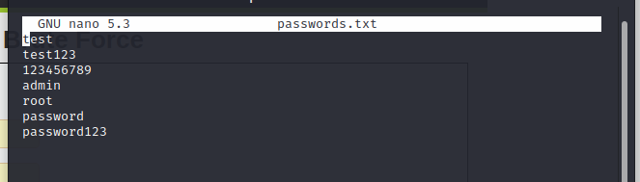
DVWA Hacking Examples
3.
The first example of how a web application is hacked using DVWA is a brute force attack.
1.
4.
2.

Slide 6
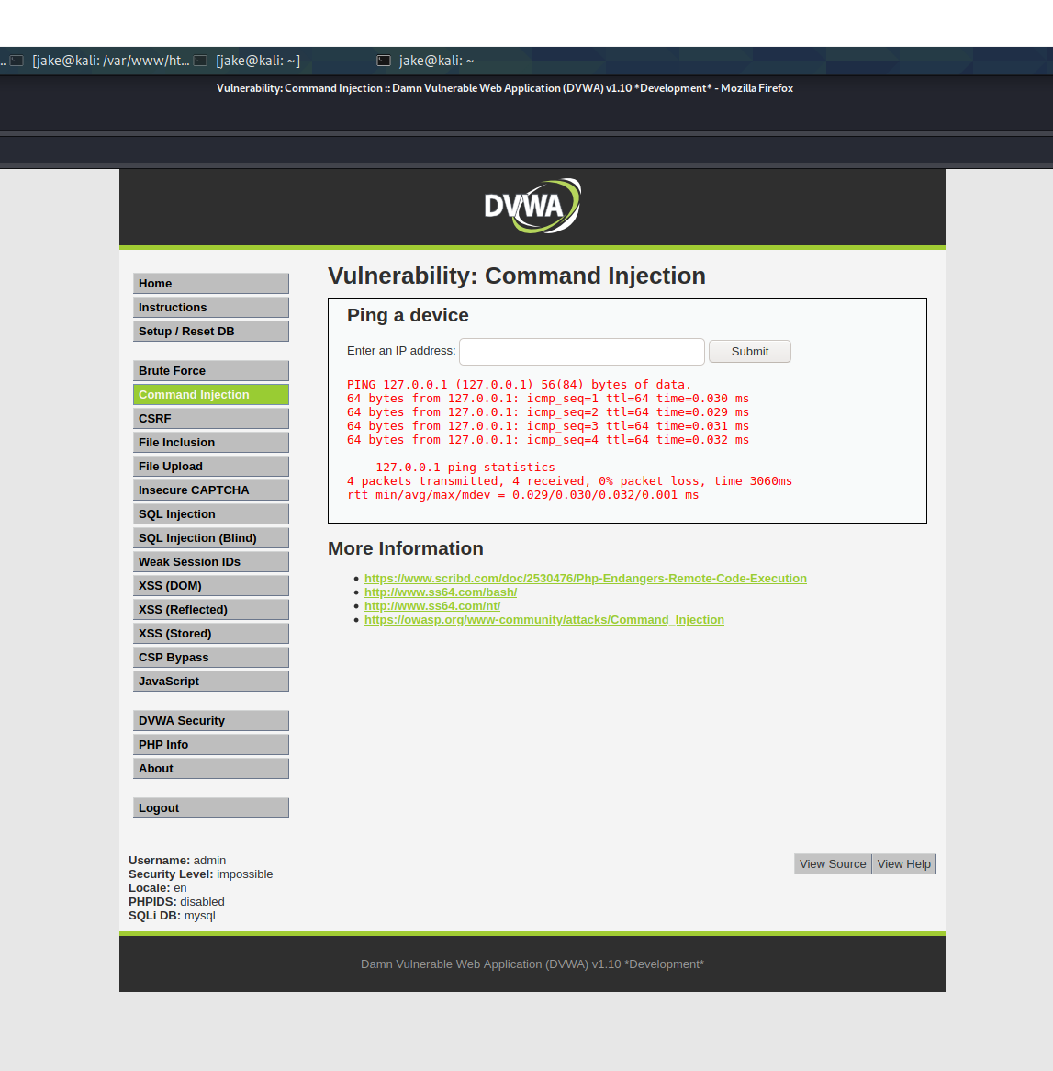

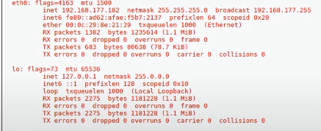
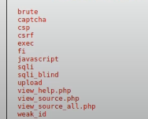
DVWA Hacking Examples
The second example we will look at is Command Injection:
2.
1.
3.
4.

Slide 7

Report / Impact of Laws

