Slide 1
Particle Filter Localization of the Deep Autonomous Profiler (DAP)
Phil Parisi and Jake Bonney
OCE Seminar
4/20/23

Slide 2
Background

Slide 3
Problem

Slide 4
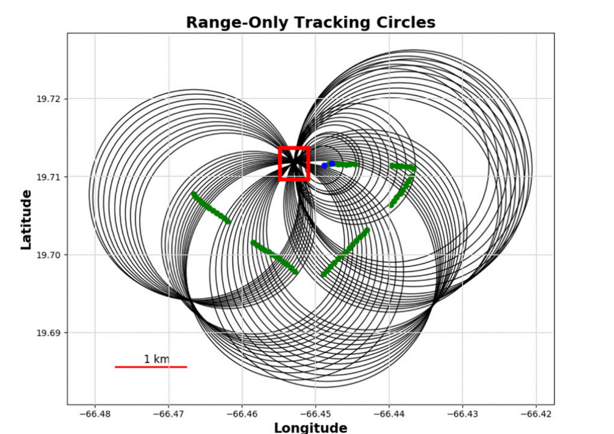
Current Solution

Slide 5
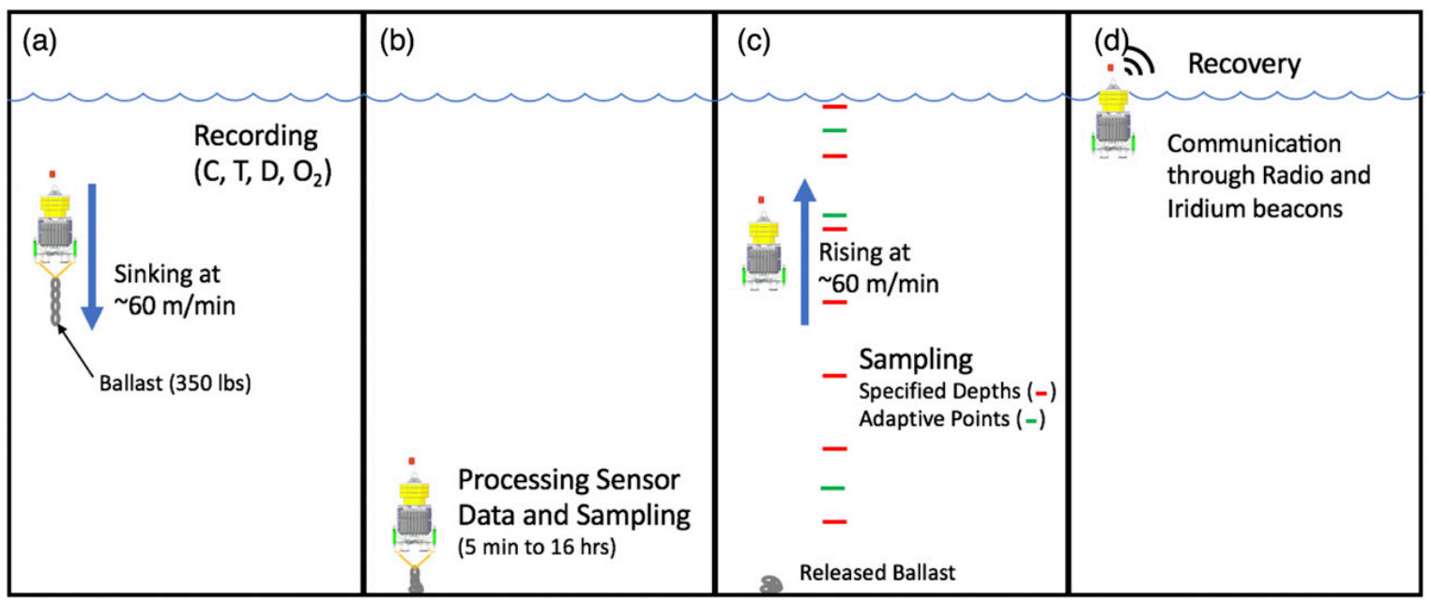
DAP Dynamics

Slide 6
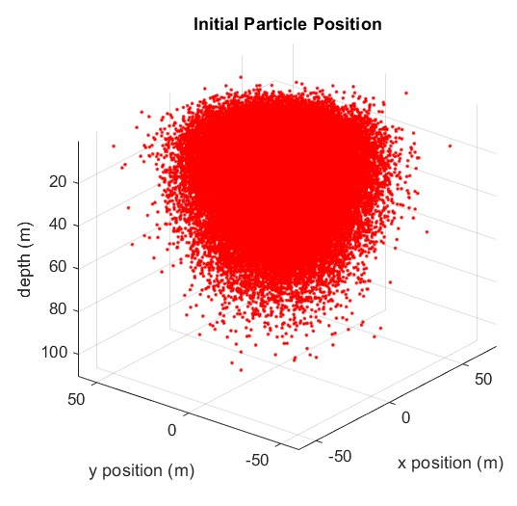
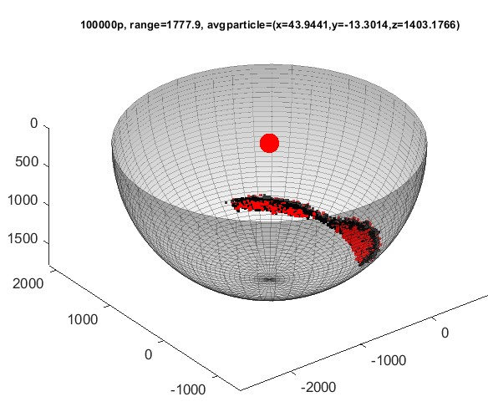
Particle Filter Approach
Particle Initialization
t = 0
Motion Model Update
t = 1,2,…,n
Measurement Update
if measurement exists…
Resample & Cull Particles
if measurement exists…
state.x (m)
state.y (m)
state.z (m)
state.u (m/s)
state.w (m/s)
state.v (m/s)
state.weight (P)
state.mode (0,1,2,3)
state.bottom_time (s)
state.total_bottom_time (s)
state.z_transition (m)

Slide 7
Particle Initialization
t = 0

Slide 8
Motion Model

Slide 9
Measurement Update

Slide 10
Resampling and Culling

Slide 11
Results

Slide 12
Future Considerations

