Slide 1


Using NLP to Predict Authenticity of Tweets about Disasters
CSC440 Data Mining Final Project
Jake Brehm • Josh Jingtian Wang

Slide 2

Background and motivation
Collective human knowledge can be more accurate than that of a single expert
Twitter has become an important channel of communication
Tweets could be used to identify disasters in real time
Natural language processing could help in this effort
Notes:
"Wisdom of the crowd" is the idea that collective human knowledge can be more accurate than that of a single expert, due to the fact that a large number of responses can cancel out the noise associated with each individual judgement. The advantage of this extends to crowd-sourcing: it is believed that people are better at problem-solving and innovating as a collective.
Twitter has become an important communication channel in times of emergency. By utilizing crowd-sourcing, tweets can be analyzed to provide accurate and real-time reports of natural disasters. Because of this, many agencies such as news stations and disaster relief organizations actively monitor Twitter for natural disaster reports.
However, human speech has an overwhelming amount of complexities that can make it unclear whether a tweet is announcing a real natural disaster or not. While it is clear to humans that some tweets may include a figure of speech, it can be a challenge for a machine to discern the tweet’s meaning.
In this project, our aim is to build a predictive classification model using natural language processing techniques to discern which tweets are about real natural disasters and which tweets are not.

Slide 3

How accurately can we predict whether or not a Tweet is announcing the occurrence of a natural disaster using NLP?
Notes:
Our problem statement is:
“How accurately can we predict whether or not a Tweet is announcing the occurrence of a natural disaster using NLP?”

Slide 4

Our dataset
From Kaggle competition
Broken into training and testing datasets
Approximately 10,000 observations in total
Columns: id, keyword, location, text, target*
Text is by far the most useful column
*only in the training dataset
Notes:
The dataset that was used originates from a Kaggle competition, titled Natural Language Processing with Disaster Tweets, and contains tweets that were hand classified.
The data was provided in two parts: a training set and a testing set. We actually decided to concatenate these two datasets for word cloud and sentiment analysis, which are techniques that don't require any testing. This allowed us to get a closer look at a larger data set instead of just being limited to training data, and potentially catch any extra data cleaning that we must perform. Once combined, the 7613 observations in the training data set and the 3263 rows in the testing data set became 10876 tweet observations in total.
There were four columns in the test set: id, keyword, location, and text. Text was the content of the tweet, which made it the most useful of the columns. The training set had the same four columns, with one additional one: target. This column was a binary value: "1" for disaster or "0" for not a disaster.

Slide 5
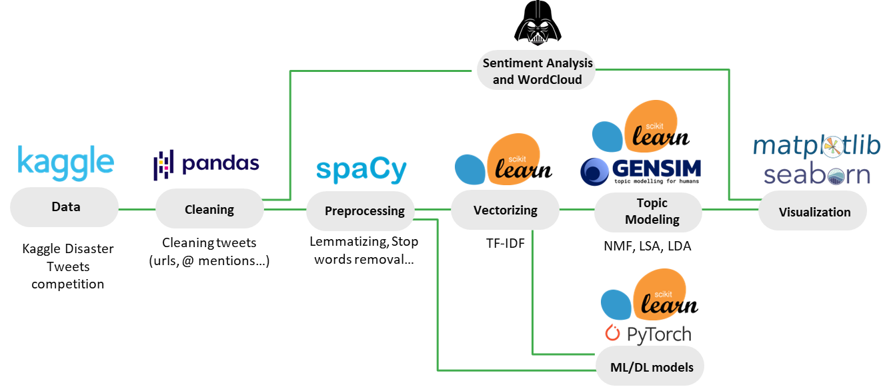
Methodology
Notes:
This is an overview of our workflow. Details to be found in following slides.

Slide 6
Data preprocessing
Combine dataframes
Remove URLs
Remove “@” mentions
Unescape HTML entities
Remove the appropriate non-alphanumeric characters
Remove canned phrases
Convert to lowercase
Drop duplicates
Notes:
Since the dataset comes from a Kaggle competition, it has already been cleaned, at least to a reasonable extent. However, that does not mean that it is immediately ready for analysis or training purposes; some additional data preprocessing needed to be performed before we could train any models or perform any analysis.
We removed URLs for obvious reasons–they are not actual words most of the time, and we would by skewing sentiment analysis by keeping them. Keeping them would also result in us seeing the URLs (either partially or fully) in the word clouds.
Also, usernames are not typically relevant to the subject of a tweet, so a username might skew the results of sentiment analysis. For this reason, anything immediately preceded by an "@" symbol was removed.
We then used Python’s html library to unescape HTML entities such as “&amp;”, which corresponds to an ampersand. This was important to do, because if it’s wasn’t, the text in entities such as “amp” or “gt” would appear in visualizations like the word cloud.
Next, we utilized regular expression substitution to remove all non-alphanumeric characters except spaces and quotation marks (to preserve contractions).
Then, we noticed that some observations contained one of a few canned phrases such as
"I liked a YouTube video"
"I added a video to a YouTube playlist"
that were not actually written by the author of the tweet. We removed these strings in order to uphold the integrity of our analyses.
Finally, we converted all text to lowercase and dropped all duplicates.
By the end of the data cleaning process, our dataframe had a single extra column labeled text_lower, which held the lowercase variation of our original text column.

Slide 7
Exploratory Analysis
Notes:
Now, we can move onto the models we made and the analyses we performed.

Slide 8
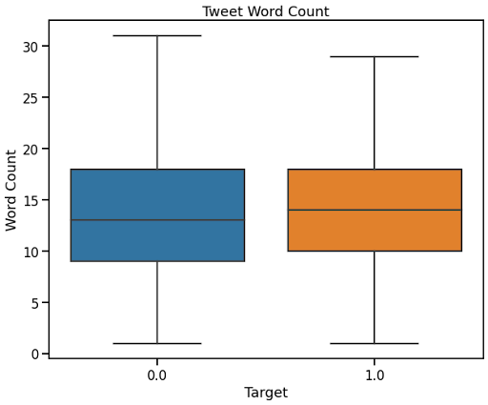
Word count of tweets
The word count of tweets are not associated with whether or not a tweet was announcing a real disaster
Notes:
One of the first things we tried to do was determine if there was some kind of association between word count and whether or not a tweet was announcing a real disaster, but the boxplot clearly shows that there was no association between the number of words in a tweet and whether or not the tweet was about a real disaster.

Slide 9
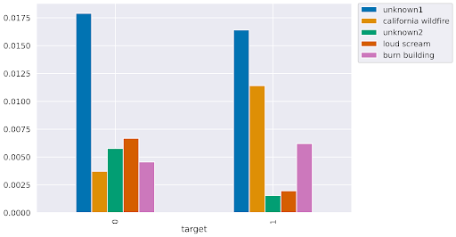
Topic modeling
There is a clear connection between the subject of each topic and whether or not the tweet was about an authentic disaster
Notes:
In NLP, topic modeling is used for discovering the abstract "topics" or hidden semantic structures that appear in a text or a collection of texts. In the context of this research, we can use a topic model to determine which topics were most frequently discussed in non-disaster tweets and compare those results to the topics that were found in disaster tweets.
To perform this analysis in Python, stop words were removed from the text, and the text was then lemmatized. We then performed tokenization using term frequency-inverse document frequency (TF-IDF), which is a numerical statistic that is meant to illustrate the importance of an individual word in a text. Then, we tested three different dimensional reduction approaches to obtain topics from the tweets, and eventually found that NMF generated the most interpretable results.
It’s clear that topics such as “california wildfire” are related to real natural disasters, whereas “loud scream” doesn’t exactly mean there’s a natural disaster happening.

Slide 10
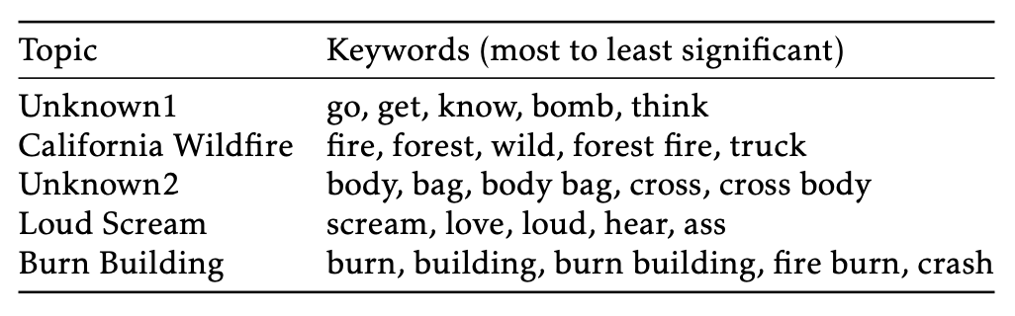
Topic modeling (cont.)
Notes:
Shown in this slide are the top 5 keywords for each of the top 5 topics.

Slide 11
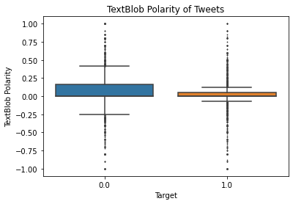
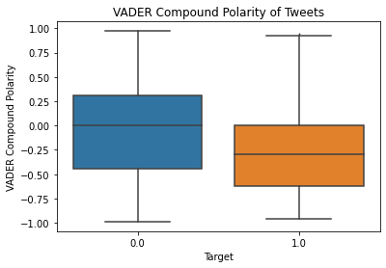
Sentiment Analysis
Used two methods: TextBlob and VADER
Both return a polarity score between -1 (negative words) and 1 (positive words)
Polarity is associated with the authenticity of the disaster tweet
Notes:
Two Python libraries were used to perform sentiment analysis: textblob (TextBlob) and vaderSentiment (VADER).
TextBlob gives us a polarity score that ranges from -1 to 1. A score of -1 means that mostly words with negative connotations were used in the text, whereas a score of 1 means that the string was mostly positive.
VADER gives a polarity score based on how positive, negative, and neutral its sentiment is, and these scores are returned separately; then, those three scores are normalized and returned to us as a compound score which ranges between -1 and 1. When comparing to results from TextBlob, we want to use VADER's compound score.
We used these two libraries to analyze the sentiment of both disaster and non-disaster tweets.
The polarity boxplots illustrate that there is quite a significant difference in polarity and overall sentiment between tweets that refer to a real disaster and tweets that do not refer to a real disaster.

Slide 12
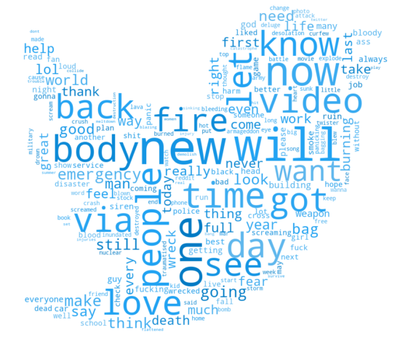
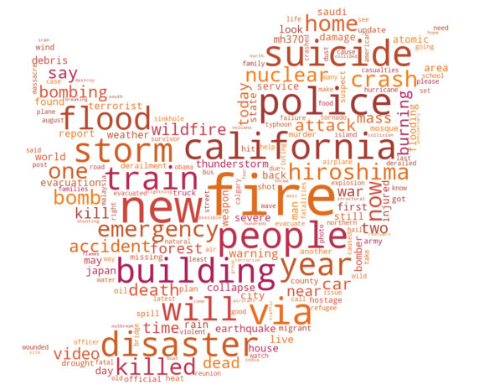
Word clouds
Graphical representations of how frequently individual words appear
Summarize the theme of a text or view of an audience
Words in tweets of real disasters are generally more negative
Words in tweets of falsely identified disasters contains a lot of slang
Notes:
Word clouds are graphical representations of how frequently individual words appear in text. While word clouds aren't normally useful for quantifiable analysis due to the lack of a size scale and the arbitrary nature of the word placement, they can be useful tools to summarize the views of an audience or theme of a text.
As demonstrated by the two word clouds, the frequent words in real disaster tweets are generally more negative, intense, and/or vulgar; comparatively, tweets that aren't about real disasters seem to have words that generally have more of a positive connotation. It is, however, clear as to how those tweets could be misinterpreted as announcements of real disasters. Many of the words in the non-disaster word cloud are words that have multiple meanings, or are used as slang terminology. For example, "fire" is a word that, in today's slang, could be a synonym for "cool"--however, this is a word that also obviously could be describing a real disaster.

Slide 13
Predictive Models
Notes:
Now, we can move onto the models we made and the analyses we performed.

Slide 14
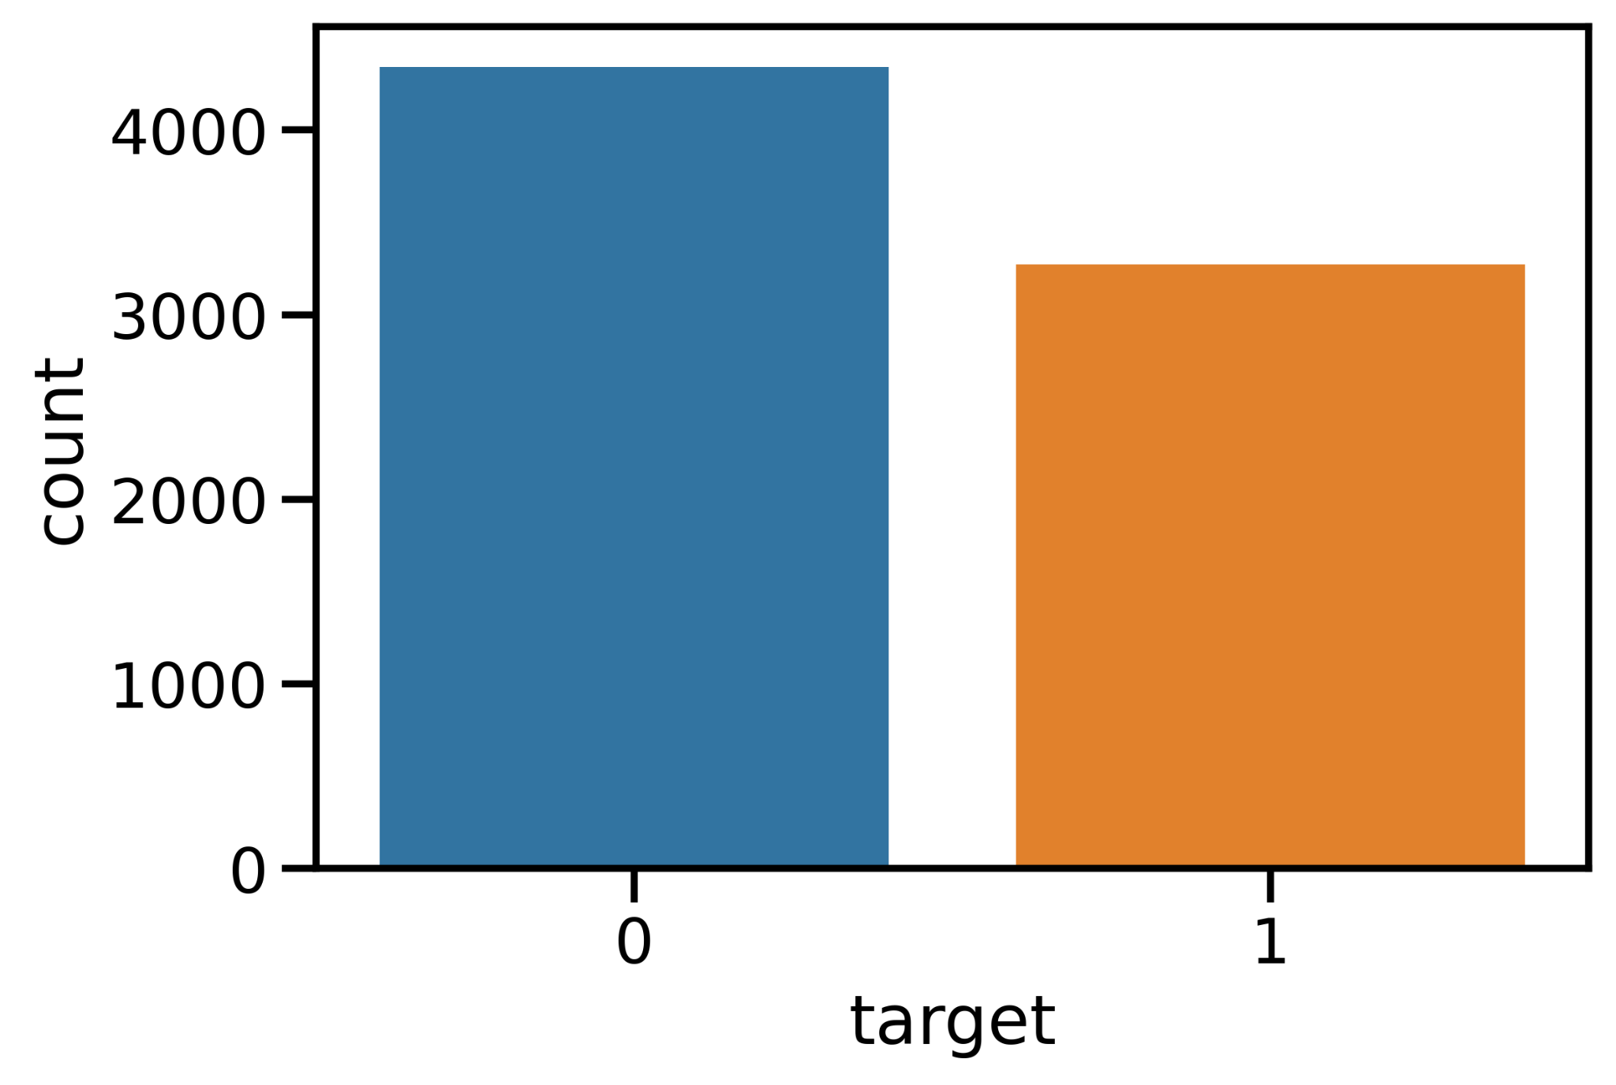
Evaluation metrics
No class imbalance - Accuracy
False negatives are bad - F1 score
Notes:
Because there is no class imbalance, we decided to look closely at accuracy. However, since the use case of this research is to closely monitor natural disaster, and false negatives may lead to undesirable consequences, we thought it may be more important to focus on our model's ability to identify the positive class (i.e. the disaster tweets). Thus, we also looked at the F1-score, which is the harmonic mean of the precision and recall scores.

Slide 15

Naive Bayes
Preprocessed using spacy
{TF-IDF → MultinomialNB} pipeline to prevent data leakage
cross validated over 5 folds
Hyperparamters tuned using GridSearchCV
Result:
Baseline Accuracy: 0.7845
Baseline F1: 0.6949
Accuracy after GridSearchCV#1: 0.7933
F1 after GridSearchCV#1: 0.7293
Notes:
We removed stop words from and lemmatized the text using the spacy library. To prevent any data leakage, we incorporated TF-IDF tokenization into an sklearn 5-fold cross-validation pipeline. Hyperparameters were tuned using GridSearchCV, which is part of the sklearn library.
Tuned hyperparameters can be found in the report.

Slide 16

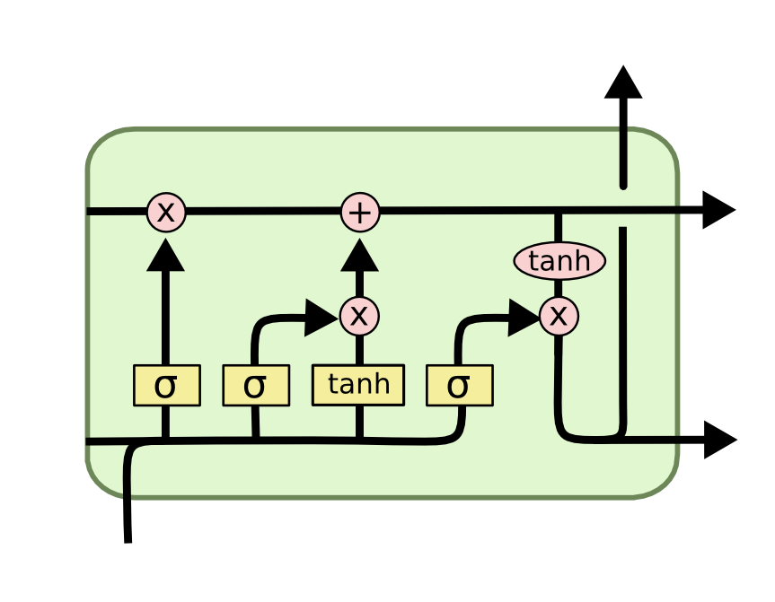
LSTM
Preprocessed using torchtext and spacy
Batched by tweet lengths
Bidirectional, 3 layer LSTM
12 epochs cross validated over 3 folds
Result:
Mean Validation Accuracy: 0.7638
Mean Validation F1: 0.6692
Notes:
LSTM is great for NLP tasks, as it can memorize important information in sequential data.
We used Python's torchtext and spacy libraries to load the tweets and build vocabulary. We then used the BucketIterator from the torchtext library to group the tweets of similar lengths into batches. Having batches with similar length examples provides a lot of gain for recurrent NNs and transformers where padding will be minimal. We then used 3-fold cross validation and trained the LSTM in 12 epochs for each fold. Both accuracy and F1-score were considered.

Slide 17
Conclusion
Results are unsurprising:
A tweet’s word count is not associated with its authenticity
A tweet’s polarity is associated with its authenticity
Word clouds verified that disaster tweets have a theme
Naive Bayes classification performed better than LSTM
This is the type of problem that data mining excels at.
Notes:
In most aspects, the results are not exactly surprising. The number of words contained in a tweet does not correlate with whether or not a tweet is about a real disaster; however, the polarity that was calculated using sentiment analysis is correlated. Further exploratory analysis using word clouds verified that there is a very real and distinguishable theme to disaster tweets when compared to non-disaster tweets, and topic modeling confirmed that certain topics were more frequently discussed in disaster tweets. Naive Bayes classification performed better than LSTM, most likely due to the relatively small size of the dataset and hyperparameter Gridsearch.
Overall, this project taught us a lot about how to apply the data mining knowledge we've acquired on a more real-life scenario. This is the type of problem that data mining and its associated analysis and machine learning techniques excel at, and it is also the type of problem that could benefit society as a whole.

Slide 18

Future Directions
Other models (GRU, transformers…)
Using prior knowledge to improve our models (location data, tweet timing data)
Deployment of the model
Notes:
In the future, we could try using other classification models such as random forest (after
vectorization of the text data), deep learning models such as GRU, and transformers such
as BERT.
Furthermore, we could improve our models using prior or additional knowledge–
assuming it is possible to collect extra data about the tweets; for example, we could segment
our dataset by geographical region. Tweets coming out of California with keywords such
as ”fire” or ”smoke” could be given more weight to help more accurately detect forest
fires. Similarly, tweets coming out of the central United States (termed Tornado Alley)
with keywords such as ”storm”, ”tornado”, or ”cloud” could be given more weight when
patrolling for tornadoes or other natural disasters.
Once an acceptable performance is achieved, we could deploy our model to monitor
tweets in real time. This would, of course, benefit society in general, but more specifically
the authorities that are trying to prevent and/or aid when disasters occur.

Slide 19

Thank you!
Jake Brehm
Josh Wang
Notes:
Thank you!

