Slide 1
Software Design Processes and Management
SWE 3633-Software Design & Architecture

Slide 2
Analysis and Resolution
Regarding Design
  What do you think analysis is about?
  What do you think resolution is about?
  See next slide

Slide 3
Analysis and Resolution – cont.
Analysis is breaking down a
design problem to understand it.
Resolution is solving a design problem.

Slide 4
Analysis and Resolution in Software Design (p 48)
4
Notes:
4

Slide 5
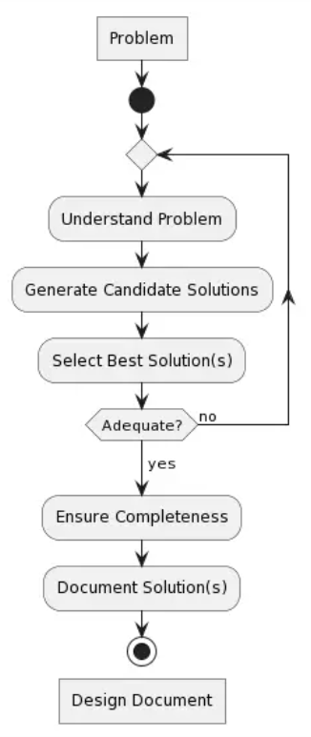
A Problem-Solving Process
Understand the problem
Generate candidate solutions
Evaluate candidate solutions
Select the best solution/s
Iterate if no solution is adequate
Ensure the solution is complete
and well-documented, and deliver it

Slide 6
Analysis and Resolution
Let’s first look at iteration between analysis and resolution
and then elaborate on the resolution activity
See next two slides

Slide 7
A Generic Design Process
(p 50)

Slide 8
A Design Resolution Process (p 51)
This diagram shows details of the resolution activity from the previous diagram.

Slide 9
Design Process Characteristics
The best solutions are rarely the first solutions designers think of.
  Designers should generate many candidate solutions.

Slide 10
Design Process Characteristics
The design process is highly iterative.
  Designers must frequently reanalyze the problem and must generate and improve solutions many times.

Slide 11
A Generic Software Product Design Process

Slide 12
A Generic Software Engineering Design Process

Slide 13
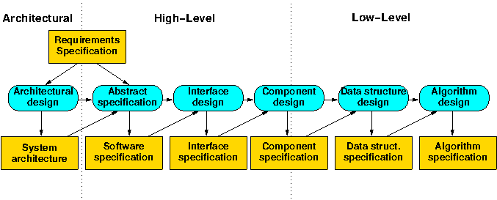
Architectural and Detailed Design
Architectural design is high-level software engineering design resolution.
Detailed design is low-level software engineering design resolution.

Slide 14
Operations versus Projects
Operations are standardized activities that occur continuously or at regular intervals.
  Payroll
  Hiring and performance evaluation
  Shipping and receiving

Slide 15
Operations versus Projects – cont.
Projects are one-time efforts to achieve a particular current goal.
  Process improvement
  Business restructuring
  New product introduction (including design)

Slide 16
Operations versus Projects
Planning
Organizing
Staffing
Tracking
Leading

Slide 17
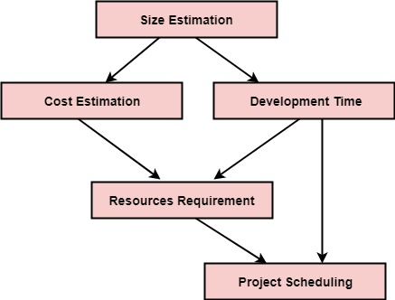
Operations versus Projects – cont.
Planning
  Formulating a scheme for doing a project.

Slide 18
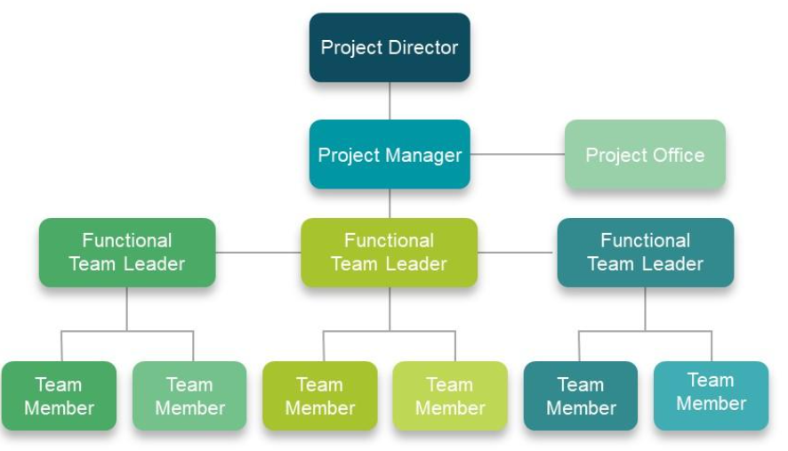
Operations versus Projects – cont
Organizing
  Structuring the organizational entities involved in a project and assigning them authority and responsibilities.

Slide 19
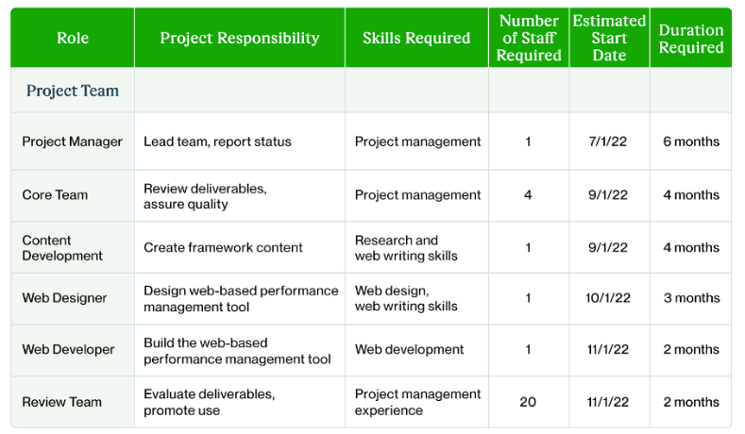
Operations versus Projects – cont
Staffing
  Filling the positions in an organizational structure and keeping them filled.

Slide 20
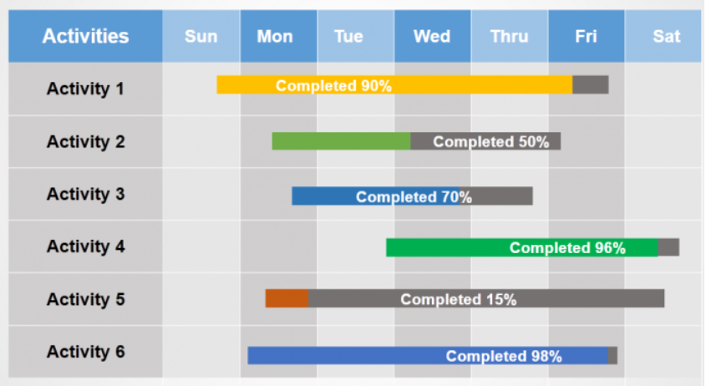
Operations versus Projects – cont
Tracking
  Observing the progress of work and adjusting work and plans accordingly.

Slide 21
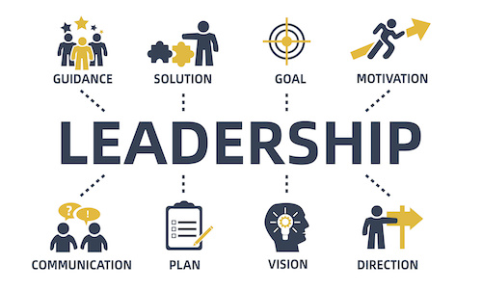
Operations versus Projects – cont
Leading
  Directing and supporting people doing project work.

Slide 22
Project Management Activities
Planning—Formulating a scheme for doing a project.
Organizing—Structuring the organizational entities involved in a project and assigning them authority and responsibilities.
Staffing—Filling the positions in an organizational structure and keeping them filled.
Tracking—Observing the progress of work and adjusting work and plans accordingly.
Leading—Directing and supporting people doing project work.

Slide 23
Project Planning
Estimation is calculation of the approximate cost, effort, time or resources required to achieve some end.
A schedule specifies the start and duration of work tasks.
Risk analysis is an orderly process of identifying, understanding, and assessing risks (any occurrence with negative consequences).
Policies, procedures, tools, and techniques are specified to govern work.

Slide 24
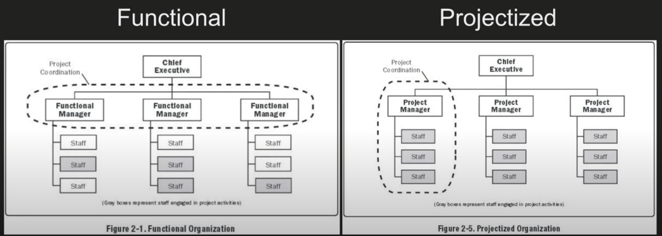
Project Organizing
Organizational structures
  Project organization
  Functional organization

Slide 25
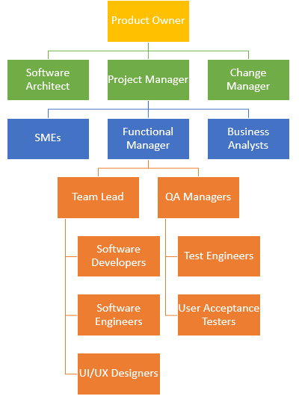
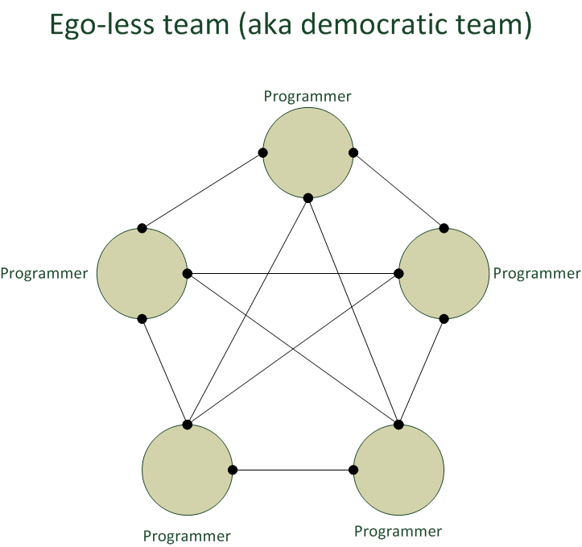

Project Organizing
Team structures
  Hierarchical teams
  Democratic teams
$$\frac{n∗(n−1)}{2}$$

Slide 26

Project Staffing
Staffing
  Often the single most important factor in success is having good people to do the work.

Slide 27
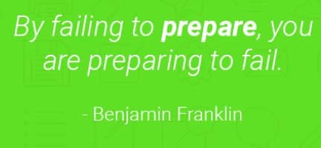
Project Tracking
Projects may not go as planned for many reasons.
  Resource consumption is not as expected.
  Tasks do not take as long as expected.
  Policies, procedures, tools, or techniques cause problems.
  Something bad occurs (illness, budget cuts, equipment failures, etc.
When plans fail, they must be adjusted.

Slide 28
Leading a Project
Direction is needed to follow plans, use resources efficiently, etc.
Directing people is not enough—people need inspiration, help, a friendly work environment, emotional support, etc.

Slide 29
Iterative Planning and Tracking
Good planning requires knowledge of tasks and their costs, risks, and other details not known until the project is under way—but this is not known when plans are made.
Iterative planning and tracking is making a rough base or initial project plan, and refining it at fixed periods during a project in light of tracking data and completed work products.

Slide 30
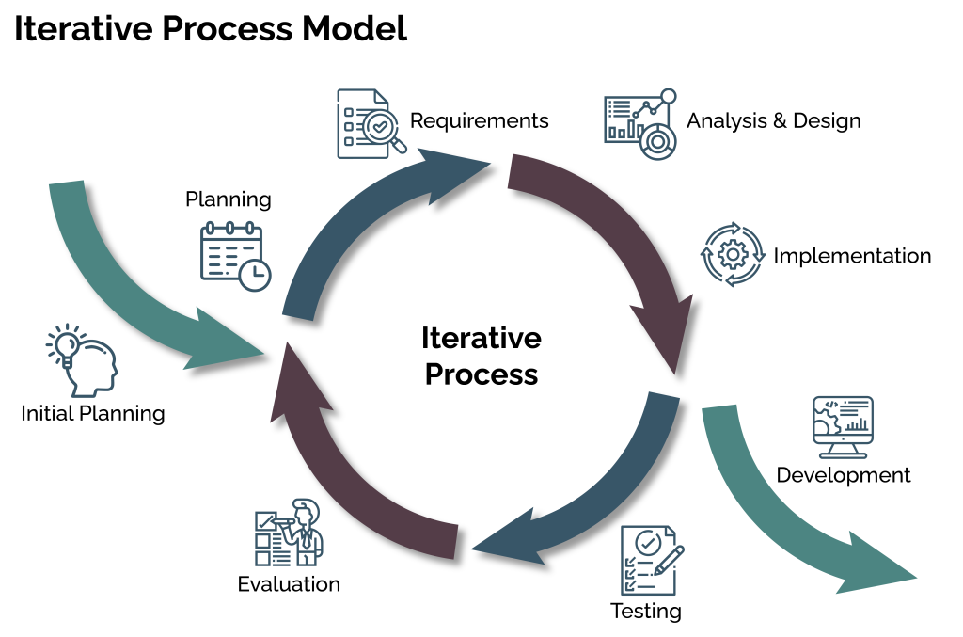
Iterative Planning and Tracking
Many believe that iterative planning and tracking is the best approach to planning and tracking.

Slide 31
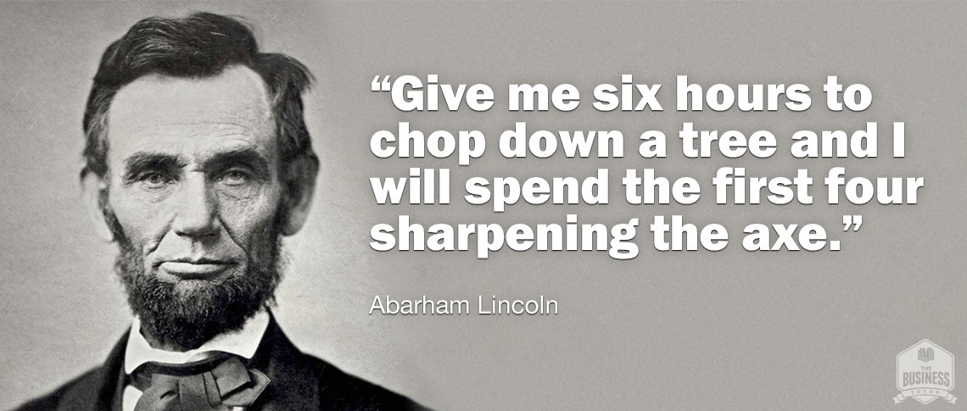
Design Project Management
All five project management activities are needed to manage a design project.
Design constitutes the largest activity in software development, so design can drive an entire development project.
The design project decomposition on the next slide is useful for planning, organization, staffing, and tracking.

Slide 32
Design Project Decomposition
Work Phase |  | Typical Work Products
Product Design | Analysis: Design Problem | Statement of interested parties, product concept, project scope, markets, business goals Models (of the problem) Prototypes (exploring the problem)
 | Analysis: Detailed Needs | Client surveys, questionnaires, interview transcripts, etc. Problem domain description Lists of needs, stakeholders Models (of the problem) Prototypes (exploring needs)
 | Resolution: Product Speciﬁcation | Requirements speciﬁcations Models (of the product) Prototypes (demonstrating the product)
Engineering Design | Analysis | Models (of the engineering problem) Prototypes (exploring the problem)
 | Resolution: Architectural Design | Architectural design models Architectural design speciﬁcations Architectural prototypes
 | Resolution: Detailed Design | Detailed design models Detailed design speciﬁcations Detailed design prototypes

Slide 33
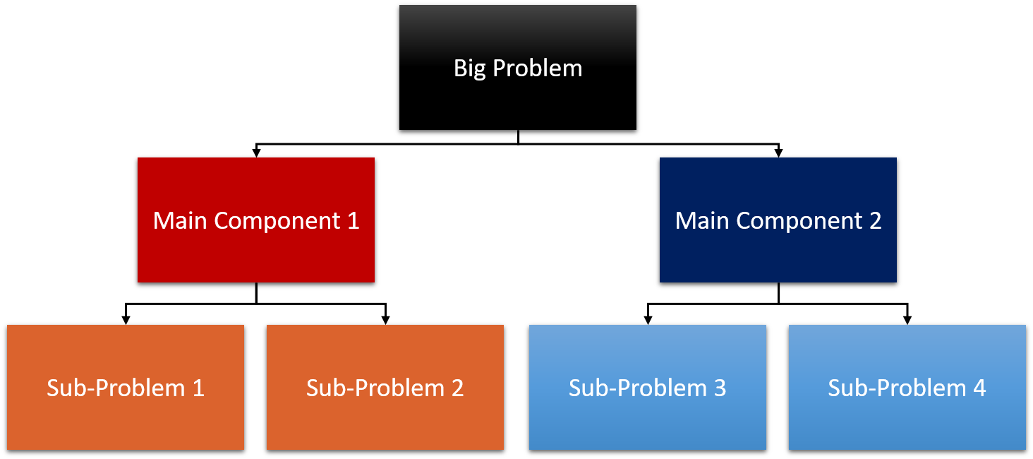
Summary
Analysis is breaking a design problem down to understand it; resolution is solving a design problem.

Slide 34
Summary
Design processes begin with analysis and have a highly iterative resolution phase.

Slide 35
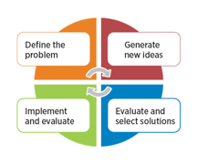
Summary
Designers should generate many candidate solutions and expect to reanalyze and resolve the problem repeatedly.

Slide 36
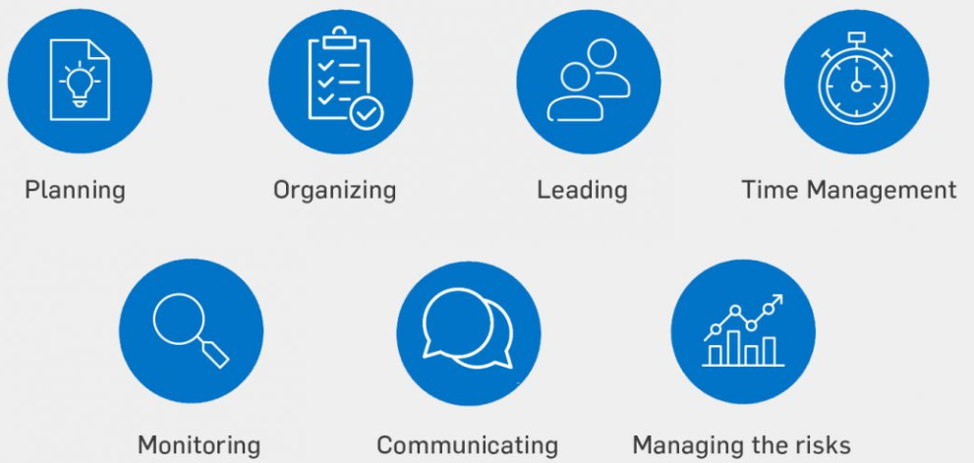
Summary
Design management is project management and hence requires planning, organization, staffing, tracking, and leadership.

Slide 37
Summary
Iterative planning and tracking is the best way to make and revise plans during a project.

