Slide 1
BELLABEAT
How Can a Wellness
Company Play It Smart?
A look at smart device usage data and what it means for marketing
By Jake Chervitz | Google Data Analytics Capstone

Slide 2
THE BUSINESS TASK
What Bellabeat wants to figure out
01
02
03
What Bellabeat asked
Product I picked
How I went about it
Look at how people are using smart fitness devices in general, and figure out what that could mean for Bellabeat's app marketing.
The Bellabeat app — it's the layer connecting Leaf, Time, and Spring, and it's where users actually engage with the brand day to day.
Two months of public FitBit data from 35 users, cleaned in Python, turned into findings, then into specific suggestions worth A/B testing.
BELLABEAT
2 / 11

Slide 3
DATA & METHOD
What we worked with
35
FitBit users
TOOLS
Python (pandas, matplotlib, seaborn) for the heavy lifting. Excel and PowerPoint for the final visuals and this deck.
61
days of data
WHAT IT CAN'T TELL US
Small sample (35 users) — findings are directional, not airtight
No demographic data — can't confirm match with Bellabeat's women-focused audience
2016 data — pre-pandemic, before remote work changed sitting habits
Sleep data only covers 24 of 35 users (about 70%)
46K+
hourly observations
4
data files used
BELLABEAT
3 / 11

Slide 4
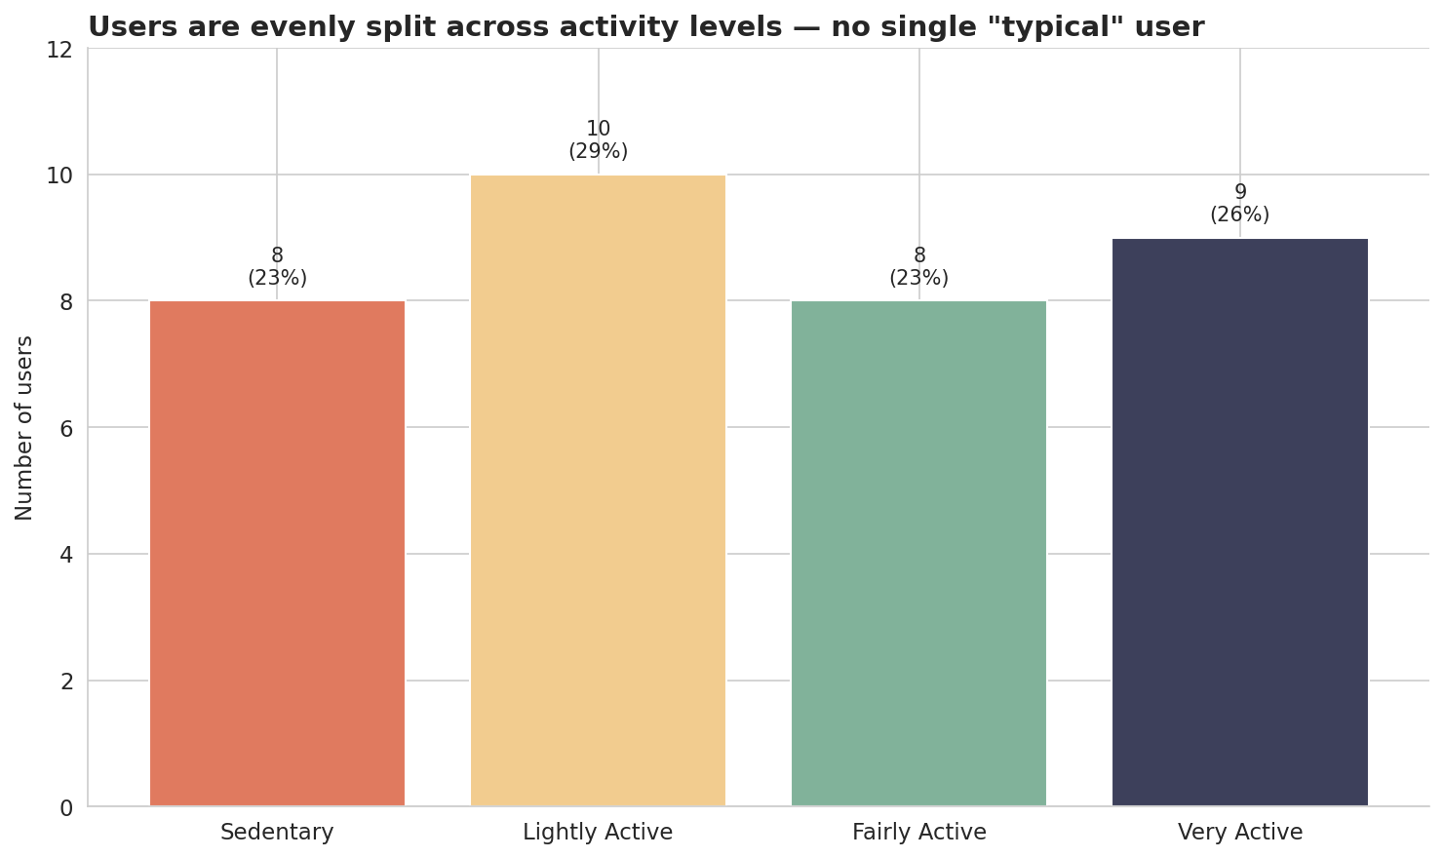
FINDING 1
There's no "typical" user — segments split evenly
SO WHAT?
Each tier holds 23–29% of users. No tier is bigger than 30%.
A single message can't reach more than a quarter of users well. The data points pretty clearly toward building four user personas.
BELLABEAT
4 / 11

Slide 5
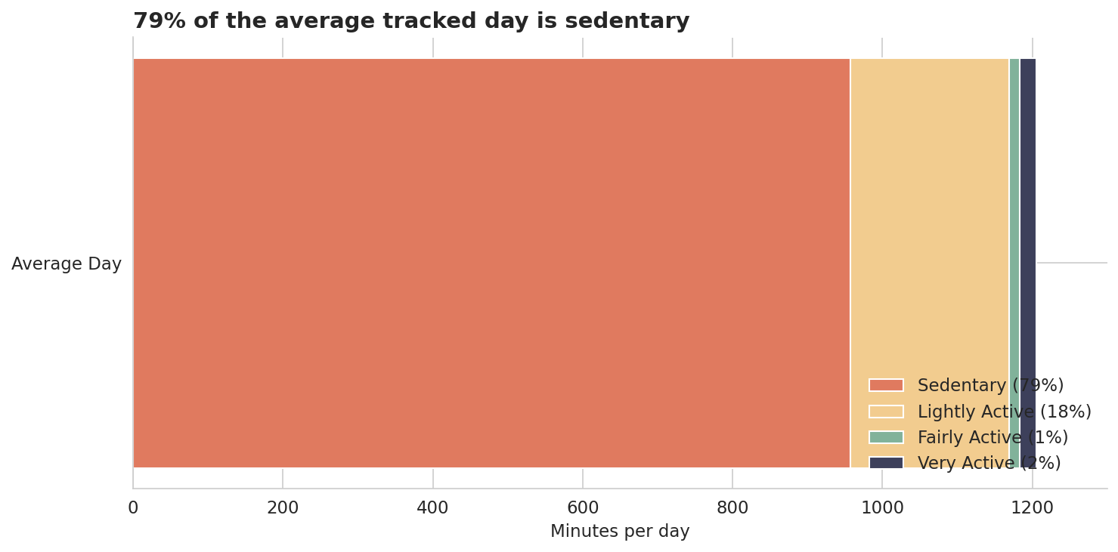
FINDING 2
People sit a lot. Like, a lot.
79%
sedentary
vs. only 3% in fairly or very active states.
That's 26 sedentary minutes for every 1 genuinely active minute. Even the most active users sit most of the day.
The biggest health lever is probably reducing sitting time, not adding more workouts.
BELLABEAT
5 / 11

Slide 6
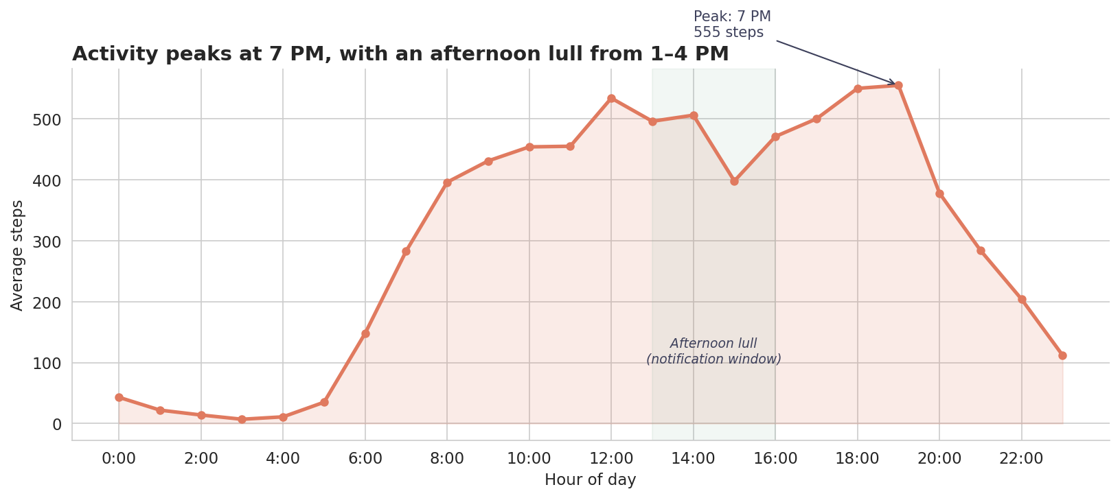
FINDING 3
Activity peaks at 7 PM with a clear afternoon dip
NOTIFICATION WINDOWS
1–4 PM
Movement nudges
Activity dips between lunch and the evening peak — the perfect window to nudge.
9–10 PM
Bedtime prep
Activity is already winding down — natural moment to suggest going to bed.
BELLABEAT
6 / 11

Slide 7
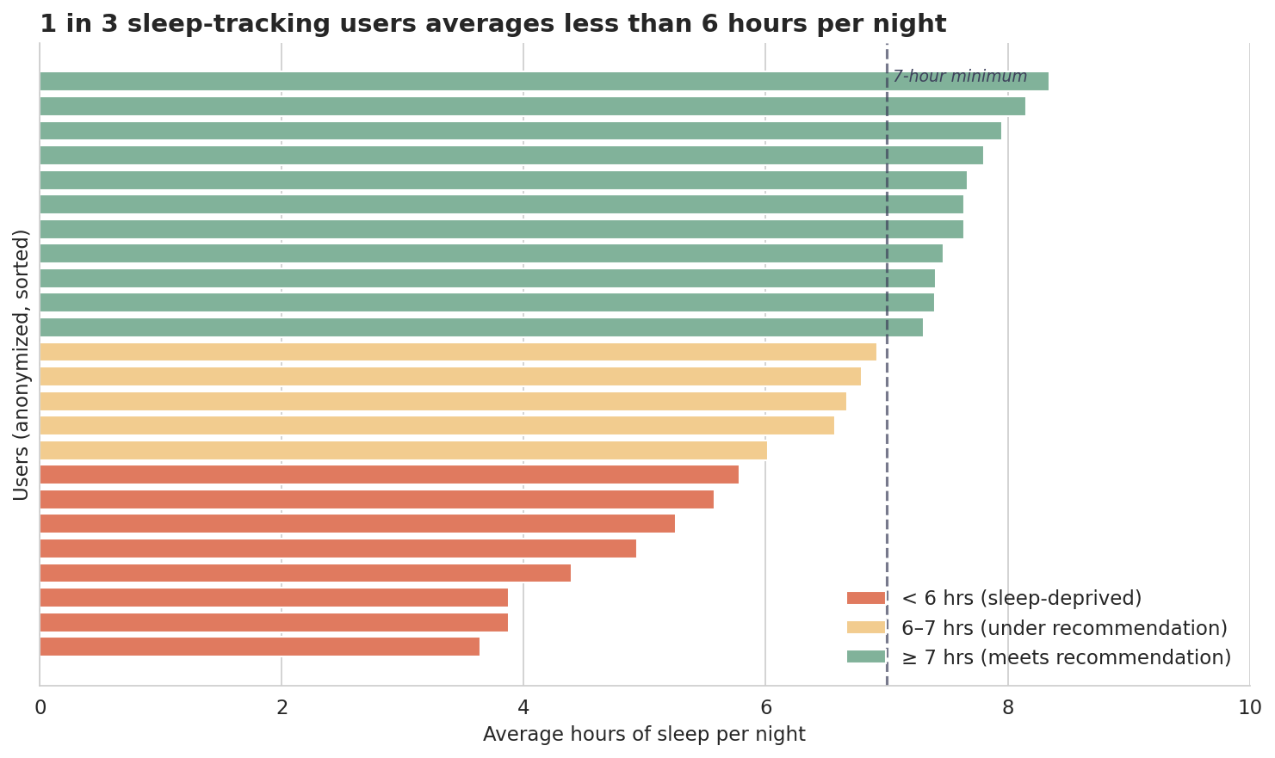
FINDING 4
A third of sleep-trackers get under 6 hours per night
46%
meet the 7-hour minimum
33%
sleep less than 6 hours
92%
sleep efficiency (high)
High efficiency + low duration = the issue is bedtime, not biology.
BELLABEAT
7 / 11

Slide 8
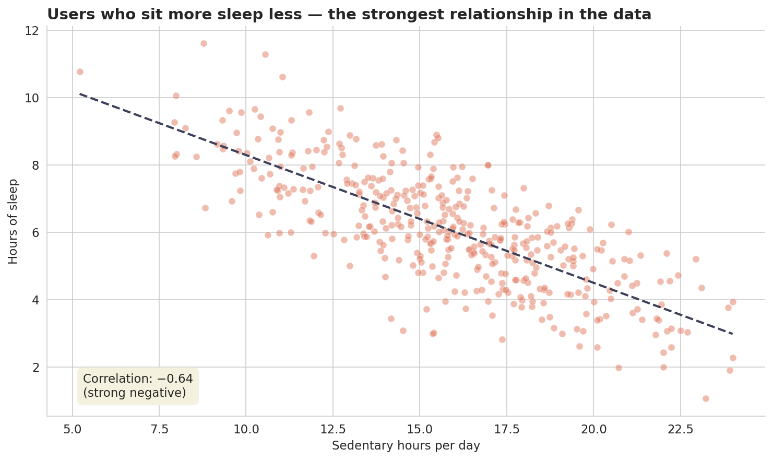
FINDING 5
Sitting more = sleeping less (the strongest signal in the data)
CORRELATION WITH SLEEP
Sedentary minutes
−0.64
Total steps
−0.20
Very active min
−0.09
Reducing sitting time might improve fitness AND sleep — pretty good two-for-one.
BELLABEAT
8 / 11

Slide 9
RECOMMENDATIONS
Five suggestions for the Bellabeat app
01
02
03
04
05
Different messages
for different users
Lean into
sitting less
Time notifications
better
Real sleep
coaching
Re-engage
lapsed users
Build content streams for each tier. Stop using one voice for everyone.
Make movement minutes the hero metric. Less "track your workout," more "stand up."
Movement nudges in the 1–4 PM lull. Bedtime prompts at 9–10 PM.
Build a "bedtime drift" feature. The fix is going to bed earlier, not sleep quality.
Notify at 3 days, email at 7, digest at 14. Skip streak-based shaming.
BELLABEAT
9 / 11

Slide 10
SUCCESS METRICS
How we'd know each one is working
01 Different messaging
A/B test segmented vs. unsegmented push notifications. Track open rate and click-through over 30 days.
02 Lean into sitting less
Month-over-month drop in average sedentary minutes per active user.
03 Time notifications better
Engagement rate on time-targeted vs. ad-hoc notifications. Step lift in the hour after.
04 Real sleep coaching
Average sleep duration among bedtime-reminder users. Conversion to paid Bellabeat membership.
05 Re-engage lapsed users
Reactivation rate within 14 days of lapse. Retention at 30, 60, 90 days post-reactivation.
BELLABEAT
10 / 11

Slide 11
NEXT STEPS
Where this could go next
Get current data — 2016 behavior probably doesn't match 2025
Use Bellabeat's own user data instead of FitBit's
Add demographics to confirm patterns hold for the target audience
A/B test the segmented messaging idea against current copy
Connect engagement metrics to actual subscription conversion
Thanks for reading.
Completed with AI assistance (Claude) for code structure and writing polish. Analytical decisions are my own.

