Slide 1
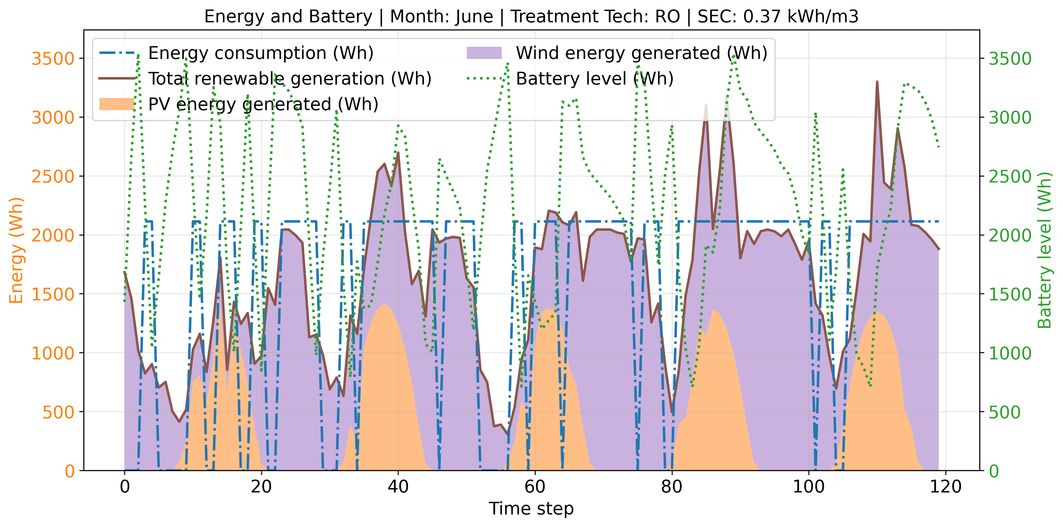
Information Flowchart
Flexible Operations Profile
Water Demand
Multiperiod Optimization
Site
Water
Quality
Component Sizes, Total Cost
Treatment SEC
WaterTAP
Other Sources
CAPEX and OPEX
System Advisor Model
Energy Profile

