Slide 1
Clustering

Slide 2
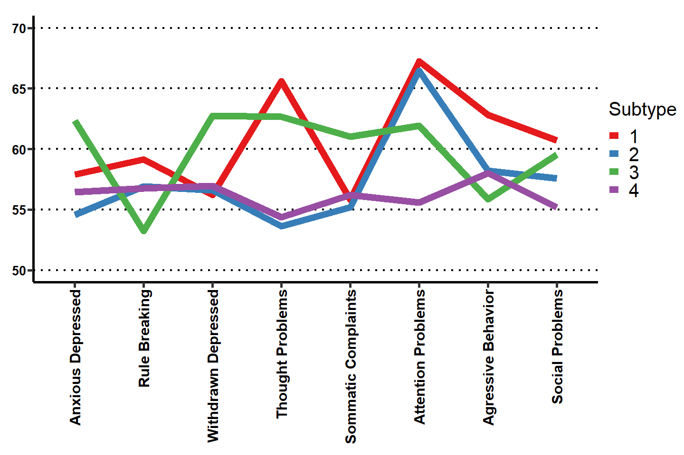
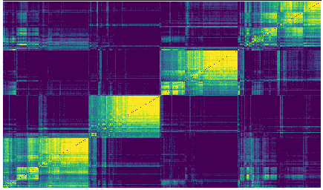

Slide 3
Functional Connectivity Clusters

Slide 4
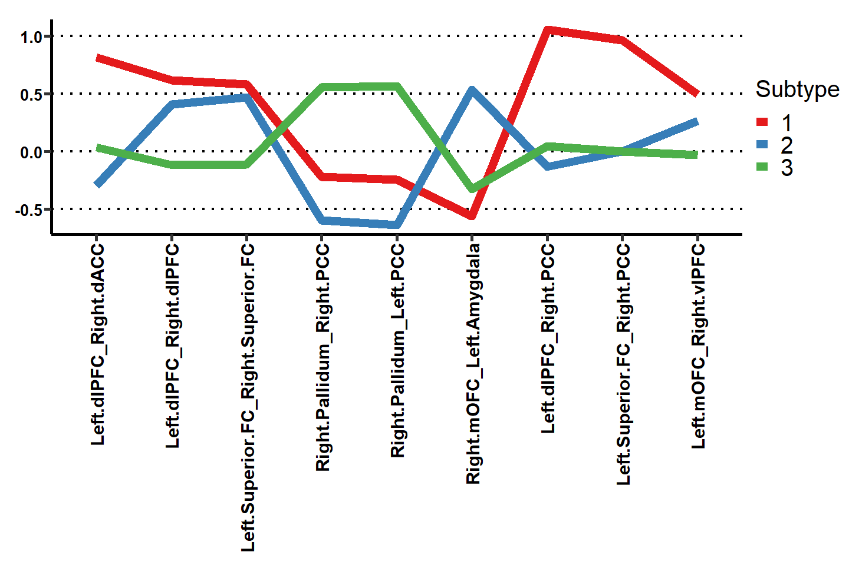
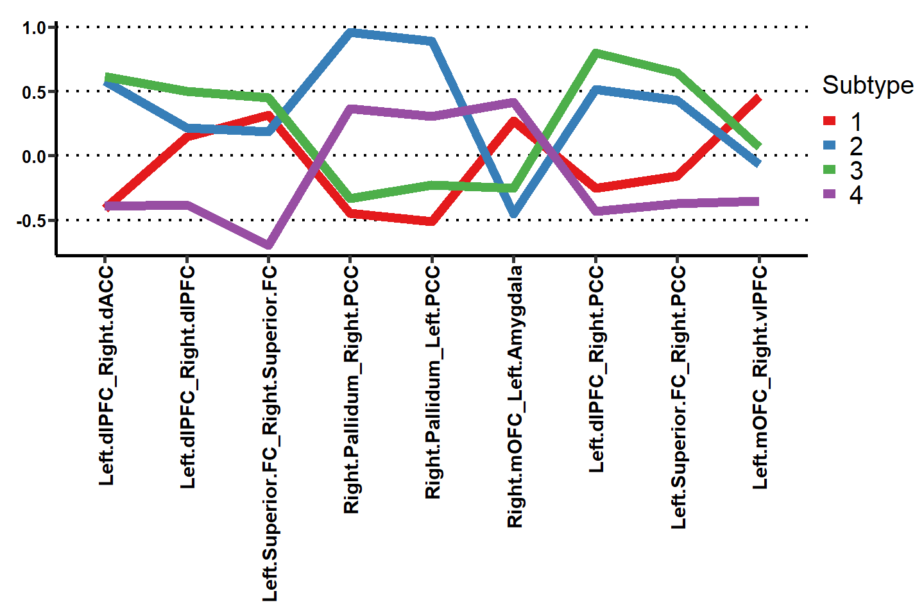
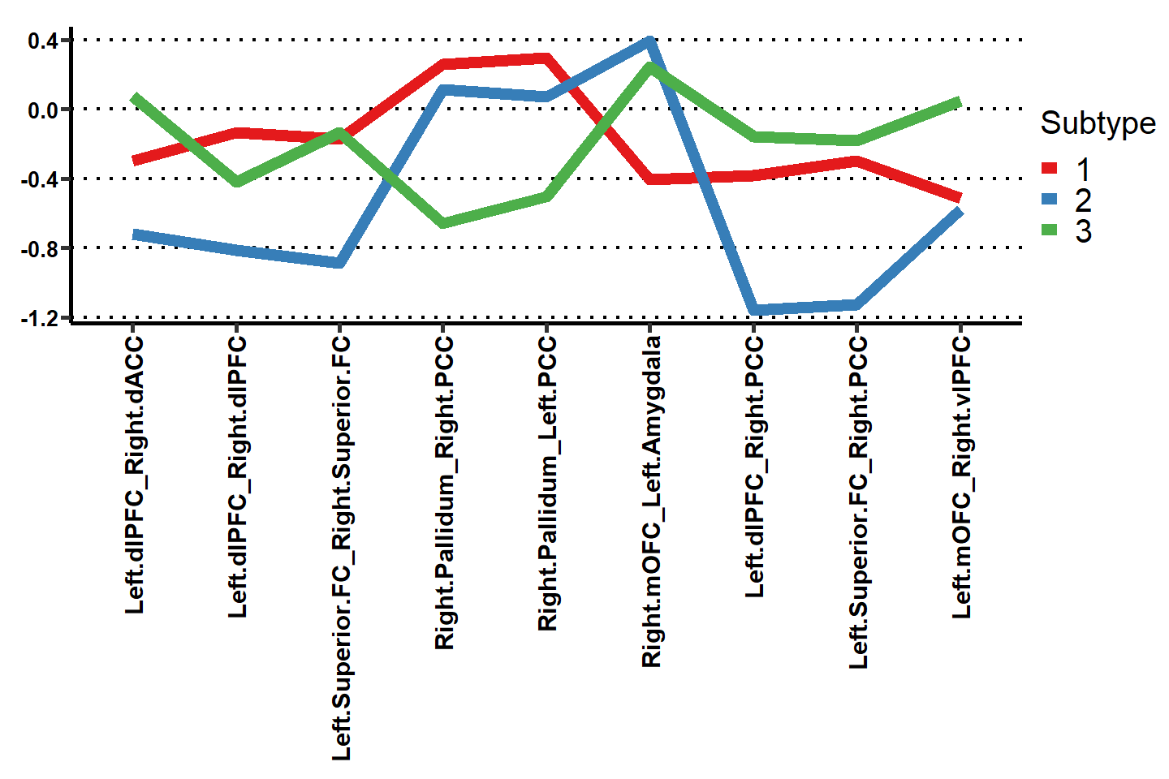
Ages 5 – 9 n = (223)
Age Bins
Ages 10 – 12
n = (257)
Ages 13 – 21
n = (151)
No significant ANOVA difference or interactions

Slide 5
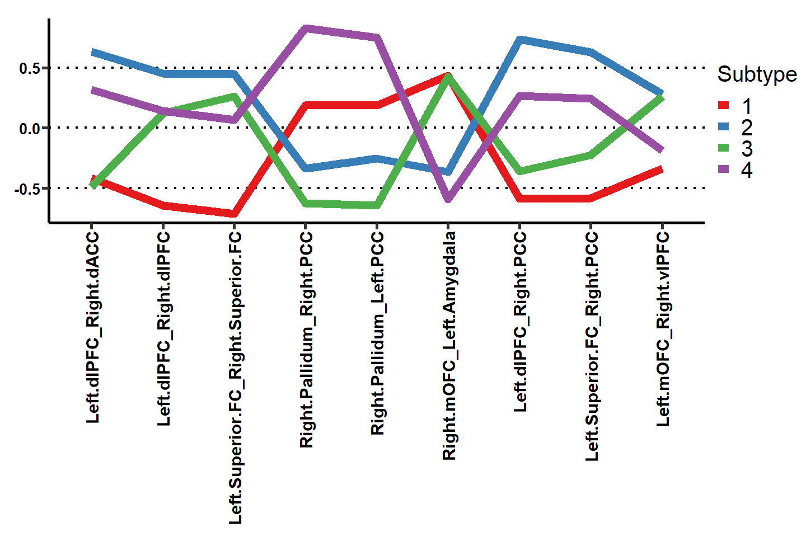
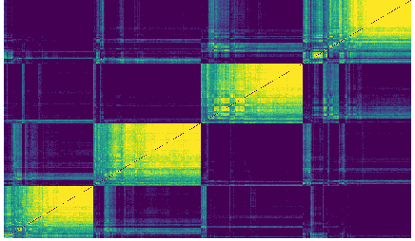
Full Sample Clusters

