Slide 1
Group 1 Project
Contributors:Jon Duea, Kyle Smith, Nick Dillner, Peyton Hall, Jake Olson
Notes:
Peyton

Slide 2
Project Scope
Generate a list of suppliers for sales outreach by leveraging internal customer transaction data and external web data.
Data Sources
  Internal (ORG Data)
  External (Web Scraped Data)
Processes / Methodologies
  Data processing pipeline
  API and Database Operations
  Filtering Criteria
  Exploratory Data Analysis
Deliverable
  Ranking of suppliers
  Reasoning for using method
Notes:
Peyton

Slide 3
Steps Performed (Overview)
Obtained the primary data from github.
Using the data, created a Python script to scrape APIs, taking turns attempting to pull and, overall, getting a feeling for how to scrape data and share it over github.
We gathered, and built a database using all the data gathered from everyone, ensuring consistency.
Together, created a database and explored it using different methods, primarily SQL/Python
Trimmed down invalid or missing data.
We then built different models using different methods based on observed data, questions asked about the data, and discussions among one another.
It’s important to remember: There was no necessarily “wrong” method to do this.
Each method was based upon logic, what information we’re given, and real world situations.
After discussion, we settled on one model. Each one has their own weights and we can spot similarities between them.
Our detailed results are in the next few slides.
Notes:
Kyle - This is intended to just be a vague overview of what we’ve done with the data. Think about handing off the API calls and running the python script, building the database, ETC.

Slide 4
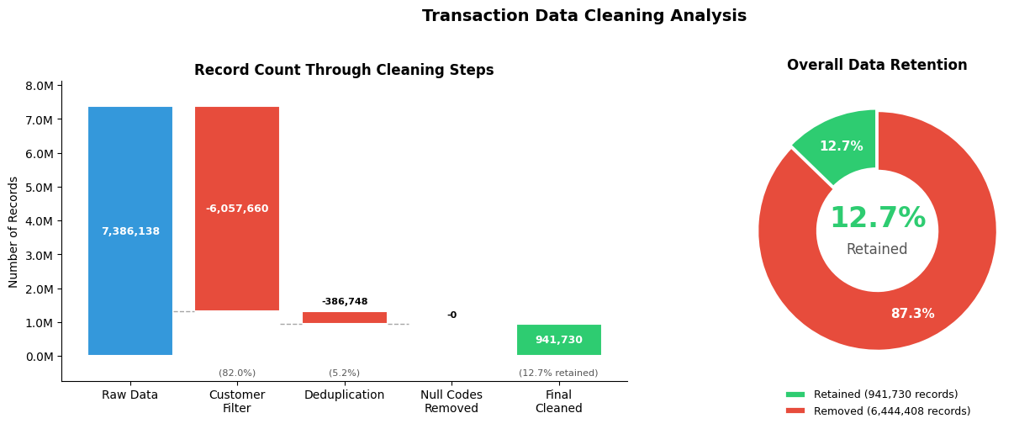
Data Processing Pipeline
Load & validate the data, then clean the raw transactions and customer data before sampling
Valid Code Lengths: 11-14 numeric characters
Notes:
Jon
Initial Transaction count before cleaning: 7,386,138
Initial Customer Records: 30,903
Customer cleaning steps:
Drop unused customer columns
Strip whitespace from ORG ID
Removed approximately 70 NA/Duplicate ORG IDs
Transaction cleaning steps:
Keep only transactions that have customer details associated with them
Remove all non-digit characters
Null out duplicate codes with leading zeros removed, since a code with a 0 in front is treated the same as a code without the zero when retrieving data for it from the itemdb
Filter out any product codes that aren’t 11-14 digits in length.
Drop any duplicates remaining
After the transaction cleaning we go back and filter out any customers that now have 0 transactions
After Cleaning counts:
Transactions 941,740 (approx 88% reduction)
Organizations 6,433
At this time, missing annual revenue values were filled from the industry median available, and revenue ranges calculated based on annual revenue values, as well as filling any missing Industry ORG, Industry Vertical, and Industry Segment values with ‘Unknown’

Slide 5
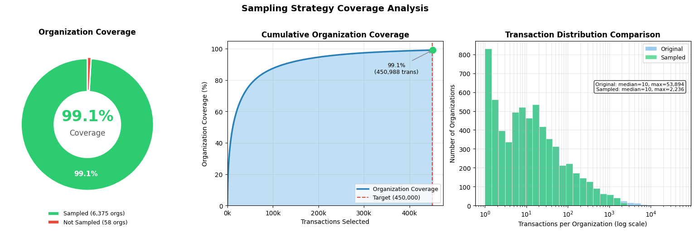
Final 450K Sample
Total Organizations to sample from: 6,433
Total Transactions across those organizations: 941,740
Notes:
Jon
Due to time/api limits we set a target of 450,000 items to collect data from the ItemDB api for.
This presents a sampling problem where we wanted to maximize the number of organizations we could cover while still staying within our target limit of api calls we’d have to make.
By starting with organizations with the lowest number of transactions and adding more organizations until we hit our target limit, we were able to achieve about 99% coverage of all the organizations we had cleaned transaction data for.
This 450k sample is what we used for making the api calls.

Slide 6
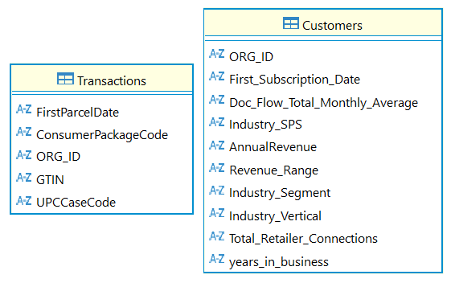
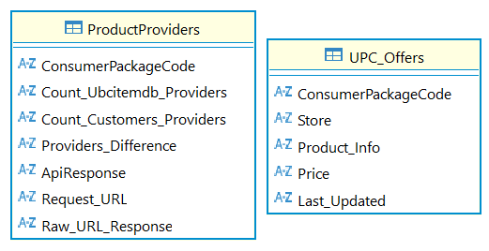
API and Database Operations
Product Providers: Data retrieved via the API. Tracking the UPCs, API Responses, and Request URLs.
UPC_Offers: Data retrieved via the API. Includes individuals offers per UPC.
Initial Datasets Customers and Transactions loaded from .csv files located on ORG GitHub.
Notes:
Nick
Throughout this project, we built out the necessary database structure and API integrations to support the analysis. We began by creating the Customers and Transactions tables, using the cleaned CSV files provided through the ORG GitHub. All individual transaction files were consolidated into a single Transactions table, preserving the original data.
After establishing the base tables, we moved into making the required API calls. The API process generated two additional tables. The first was the Product Providers table, which stores the distinct customer package codes found within the Transactions table, the API URL used for each request, and the corresponding API response were stored for reference. The second table was the UPC Offers, which contains the individual line-items of each offer returned for each customer package code.

Slide 7
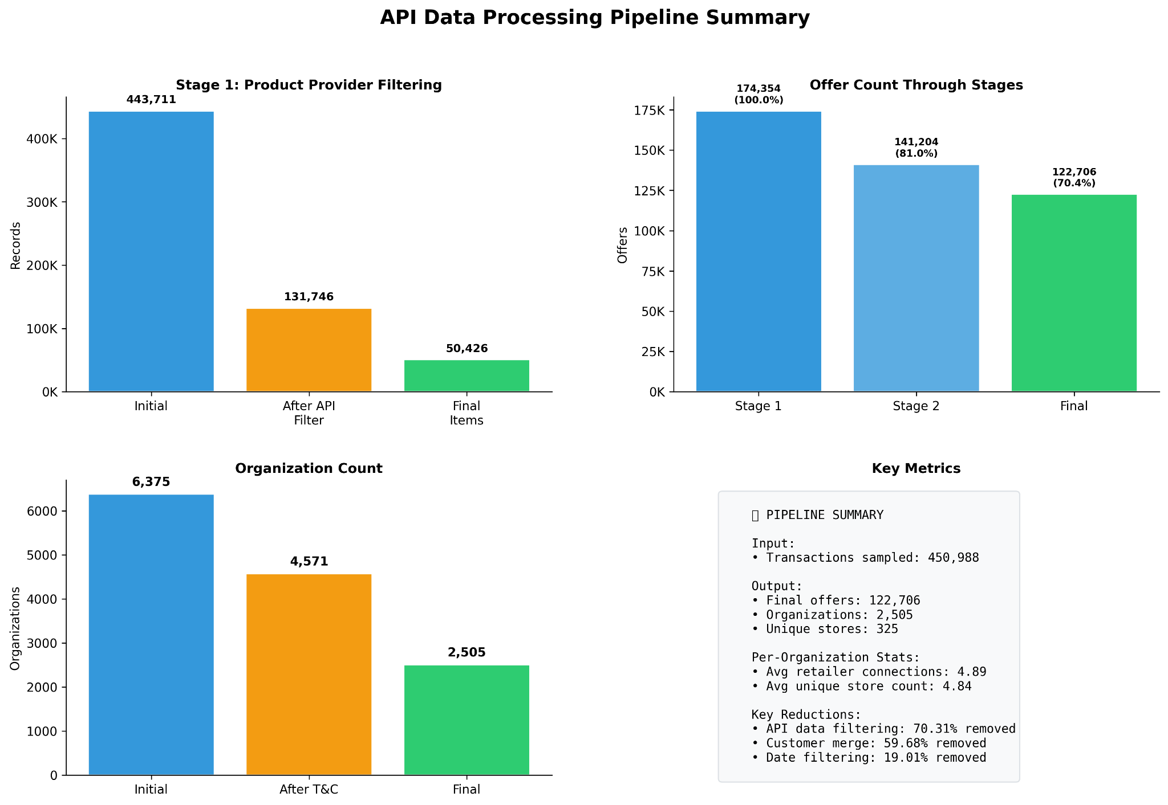
API Data Processing Pipeline
Overview:
Product Provider Filtering
  Filter and Merge
Offer Data Cleaning
  Filter by Date
  Remove “Used Offers”
Final steps
  Match Stores and Deduplicate Offers
  Calculate Unique Store Count
Critical Operations
Not related to api data quality:
T&C Customer filtering
Complete removal of transactions containing related to more than one org
Removing records that didn’t return valid offer data
Notes:
Jon
After getting the Data back from making our api calls, some extra cleaning was necessary before moving on to our ranking/analysis.
Organizations:
Organizations with T&C product status were identified as organizations we should not be considering in our analysis, which about 28% of the organizations in our sample were so we dropped those.
Transactions:
ConsumerPackageCodes associated with multiple organizations should have been removed completely in our initial cleaning, dropping these removed about 5% of transactions.
Product Providers (API calls):
Only about 30% of the calls actually returned any api data, leaving us with about 132K records with item data.
About 3% of the items we did get data back for, didn’t have any offers associated with them so we removed those items as well.
After merging our data we got from the API calls with our transactions/organization data we were left with approx 174k offers related to 50kish items spread across 2505 organizations.
Offer Cleaning:
Approximately 20% of those offers were removed because they were last updated before the associated organizations first subscription date
Only about 500 offers were removed because they were offers for used items
After store matching/deduplication, another 5% of offers were removed resulting in approximately 133k unique offers to analyze.

Slide 8
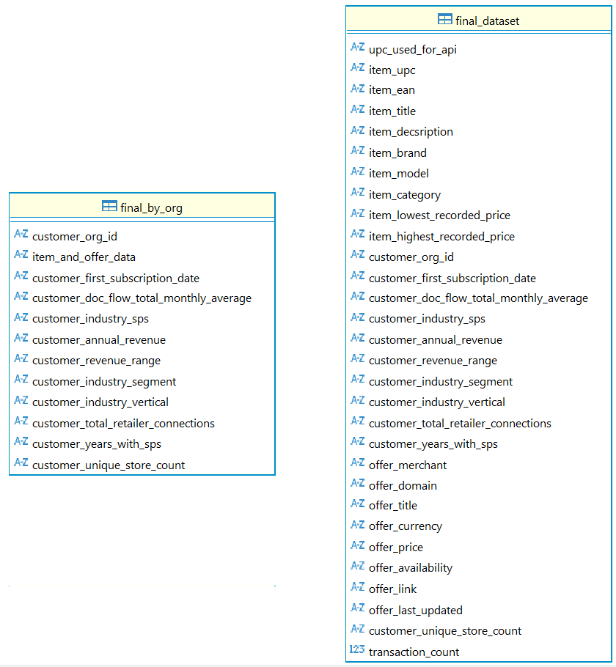
Finalized Dataset
Organizations to rank: 2,505
  ≅ 40% of the original sample we collected data for.
Unique Items: 50,426
Unique Offers: 122,706
Notes:
Jon
Give a broad overview of the final dataset after all the cleanings done.

Slide 9
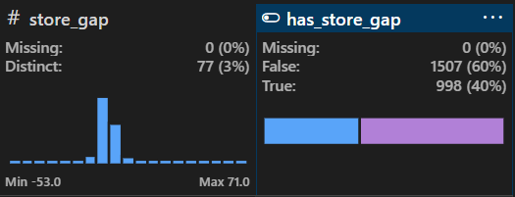
Modeling and Exploration
Overview:
Feature Engineering and Log Transformations
Exploratory Data Analysis
Ranking Approach
Store_gap = customer_unique_store_count - customer_total_retailers
Customer_unique_store_count (Scraped count of connections)
Customer_total_retailers (ORG provided count of connections)
Notes:
JO-
We will be focusing on the modeling and exploration of our data for the rest of the presentation. First well go over some engineered features and log transformations. Then our Exploratory Data Analysis and lastly our ranking approach.
Before jumping into rest of our feature engineering I want to explain the store_gap feature because you’ll hear that label a lot.
So, “Store_gap” determines if ORG has missed opportunities within the organizations they service.
We calculated this by taking the variables “customer_unique_store_count” (which was pulled from our API calls) and subtracting that from“customer_total_retailer_connections” which was provided by ORG.
if unique store count is greater than ORG’s known total retailer then we have evidence that there are missed connections with that organization.
We then used that Store_gap variable and converted it to a boolean called has_store_gap,
If Store_gap is greater than or equal to 1 then the Boolean is True. If less than or equal to 0 it is false.
Key points of graph

Slide 10
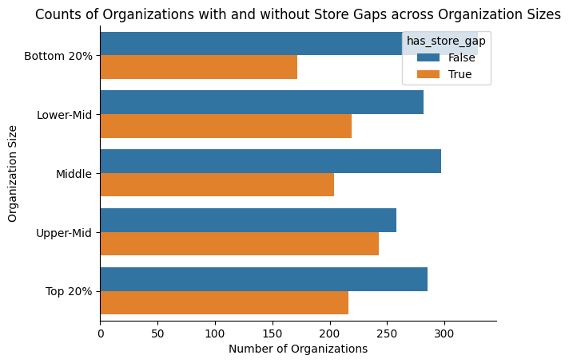
Feature Engineering
Organization Size
Count of Unique Items by Organization
Log Transformation
Notes:
JO-
Instead of using revenue range or annual revenue we decided to bucket orgs based on their annual revenue. There are 5 buckets at roughly 20% distribution.
This grouping of organizations will help us simplify and visualize revenue data while still retaining its importance.
Item_count - this feature calculates the total number of distinct items by each organization that we could verify are being sold somewhere online.
Lastly, we needed to address some skewed data. Abnormal data distribution is very common when working with financial Variables,
and many of our numeric variables such as (doc_flow and Item_count) were positively skewed.
Meaning that data points were clustered on the left of the bell curve while a few extreme values pull our average to the right of the curve.
This process mitigates the influence of outliers, resulting in more stable and robust performance for any models we subsequently train.

Slide 11
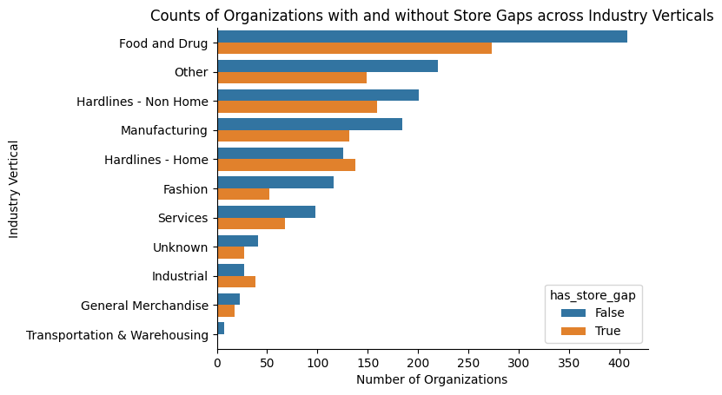
Exploratory Data Analysis
Org store gap distribution is relatively consistent across industry verticals
Dominant Vertical
  Food and Drug
Potential weak points
  Hardlines-Home
  Industrial
Notes:
JO-
Here we analyzed the number of organizations with and without store gaps by industry verticals.
At the top you can see Food and Drug dominates industry vertical in terms of quantity. Nearly 30% of all ogranizations are of the food and drug vertical
Another thing to note is that “Hardlines - Home” and “Industrial” seem to have “weak points” where the number of orgs with store gaps is larger than those without store gaps.
Overall, a majority of vertices have more organizations without store_gaps than with store_gaps.

Slide 12
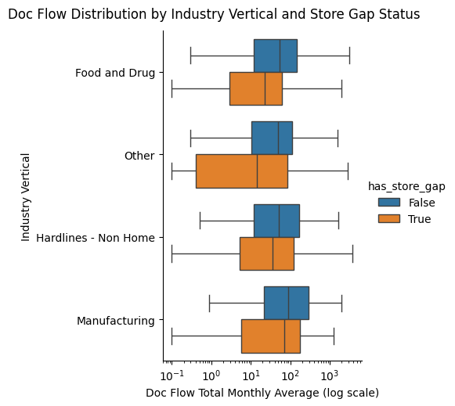
Exploratory Data Analysis
Top 4 industry verticals
  By Doc Flow Avg (log scaled)
    Grouped by has store gap (T/F)
What does this tell us?
Notes:
JO- here we dove a little deeper into industry vertical showing the top 4 verticals from our previous slide but we have compared their Average monthly doc flow and orgs with or without store gap.
We used this graph to visualize if industry vertical would help in our ranking approach.
But seeing that there isn't a significant difference in doc flow between vertices or within vertical store gap groupings we decided that industry vertical would not yield helpful result in the ranking of organizations.

Slide 13
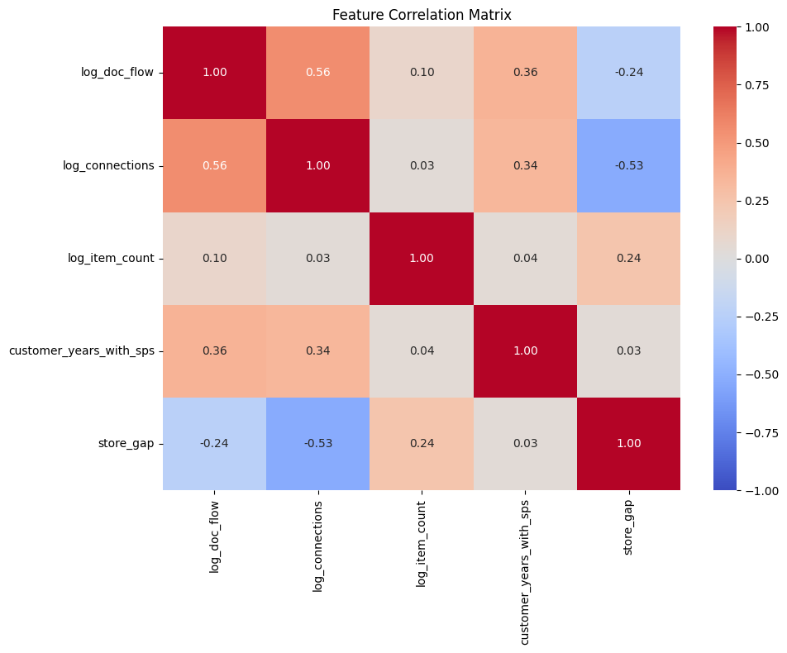
Exploratory Data Analysis
Identified multiple moderately strong correlations that informed our modeling approach.
Document Flow ↔ Retailer Connections:
  Positive correlation of 0.56
  Indicates that customers with more retailer connections tend to have higher document flow.
Store Gap ↔ Retailer Connections:
  Negative correlation of -0.53
  As retailer connections increase, the likelihood of having a store gap decreases.
Notes:
Nick
As part of our exploratory data analysis, we generated a feature correlation matrix to better understand how the variables interact with one another. Several moderately significant correlations emerged. For instance, Document Flow and Retailer Connections showed a positive correlation of .56, meaning that customers with more connections tend to process more documents.
On the other hand, Store Gap showed a negative correlation of .53 with Retailer Connections, suggesting that as connections increase, the likelihood of having a Store Gap decreases.

Slide 14
Explored Ranking Methods
Method 1:
Calculate derived performance metrics
Store Gap = unique stores − retailer connections
Velocity per Store = total transactions / retailer connections
Doc Flow per Store = avg doc flow / retailer connections
Normalized each metric
Apply weighted scoring formula
Store Gap - 45%
Doc Flow per Store - 25%
Transaction Velocity - 15%
Years with Org - 15%
Generate final opportunity score
Weighted sum of all normalized metrics
Higher = greater opportunity / priority
Method 2:
Filter based on UPCs
Identify store gap based on unique stores and connections
Focuses more on total UPC counts + Doc Flow
Normalized each metric
Apply weighted scoring formula using linearity
Doc Flow per Store - 45% (X1)
Valid UPC counts - 40% (X2)
Years with Org - 5% (X3)
Annual Revenue - 2% (X4)
Generate final opportunity score
Using a linear matrix formula X1+X2+X3+X4 = Score
General targeted areas highlighted in next slide
Notes:
Nick/Kyle
Throughout the analysis, we tested various ranking and modeling approaches to determine the strongest method for selecting our top 10 customers. On this slide, we highlight two of the ranking strategies we experimented with. On the following slide, we walk through why we ultimately shifted to our final approach.
For Method 1, we constructed a weighted scoring system using the key performance metrics. These metrics included:
Store Gap
Velocity per Store, calculated as total transactions divided by retailer connections
Document Flow per Store, calculated as average document flow divided by retailer connections
Years with ORG
Each metric was normalized, and then weighted according to importance:
45% Store Gap, 25% Document Flow, 15% Velocity, and 15% Years of Service.
After applying the weights to the normalized values, we calculated a final opportunity score for each customer, which produced the ranked list.

Slide 15

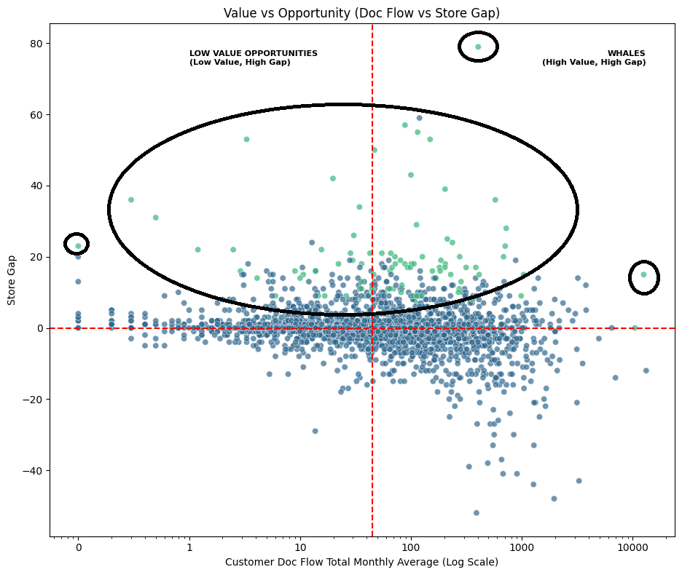
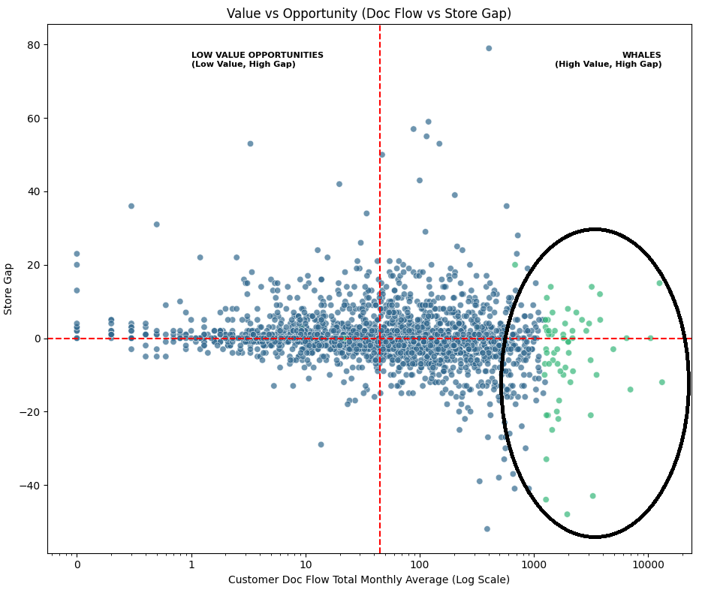
Explored Ranking Methods - Graphs
Method 1:
Method 2:
Notes:
Nick
This slide visualizes the customers selected by both ranking methods. On the left plot, the Y-axis represents Store Gap our measure of missed opportunity while the X-axis represents Document Flow, which we defined as our high-value opportunity metric.
With Method 1, the selected customers shown in green cluster heavily along the top of the graph, in Quadrants 1 and 2. This indicates that Method 1 strongly prioritized high Store Gap, at the expense of balancing the Document Flow.
In contrast, Method 2 produced a spread of customers across Quadrants 1 and 4, showing that this approach placed more emphasis on high Document Flow and less on Store Gap.
This comparison helped us understand the tradeoffs and informed our decision to refine our final method.

Slide 16
Final Ranking Approach
Rank key metrics using percentile ranks
Flow Rank: Percentile rank of monthly average document flow
Gap Rank: Percentile rank of the store gap metric
Compute composite score
40% Document Flow Rank
60% Store Gap Rank
Filter and select top targets
Only include orgs where store_gap > 0
Top 100 organizations by highest composite score
Notes:
Peyton
We chose this approach because it focuses on Doc flow and Store Gap, which give the clearest insight into where there’s both growth opportunity and profit potential. By combining these two factors, it highlights customers who can deliver the biggest impact. The resulting ranking balances opportunity with profitability.

Slide 17
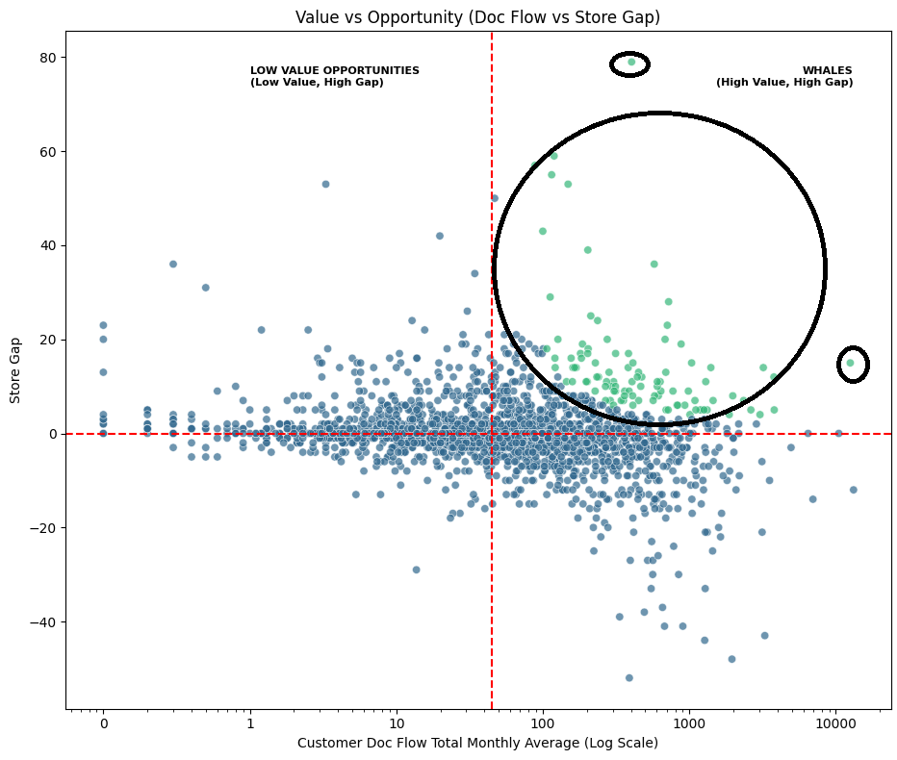
Final Ranking Approach - Graph
Notes:
Peyton

Slide 18
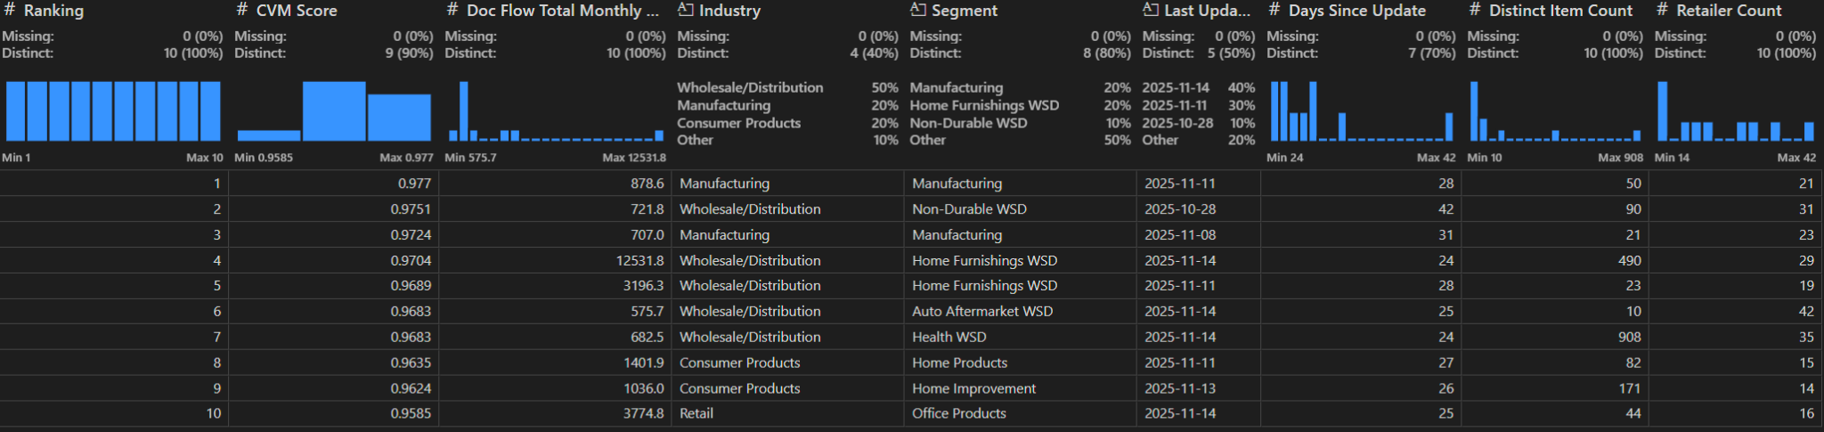
Top 10 Opportunities

Slide 19
Problems Encountered
For the future, we have to account for emojis of all things as this messed up our python scripts when trying to name things automatically.
All data pulled should also be verified. There are some UPCs that didn’t get named properly, though they are accounted for as far as a UPC for that organization.
Unifying the data between not just people, but groups is very difficult. Not to mention, ensuring that no problems occur when transferring data.
Some products pulled have a max value of 0 and a min value of 0. These could be discontinued or generally not sold to the public and probably shouldn’t be considered, but it would take more scripting and work to eliminate these from the weights than time allows.
Notes:
Kyle

Slide 20
Future Considerations
With the advancement of technology and, given more time, AI could be used to investigate more potential customer contacts. (Keras can be used to spot potential outliers, for example.)
While we had a lot of information from the company itself, we don’t have data regarding successful or failure of outreaches. If we had results from previous years and how successful their outreaches have been for instance, we can much better weigh the top opportunities.
Notes:
Kyle

Slide 21
Questions

