Slide 1
Cluster
CIS 598
team project management made simple
by Jake Willson

Slide 2
Contents
Background
Purpose
Design
(3.1) Front-End
(3.2) Back-End
Demo

Slide 3
(1) Background

Slide 4


About Me
Senior in Computer Science
Focus on Software Development
Post-Graduation
Cerner Dev Academy
Returning Intern

Slide 5



Cerner Dev Academy
Academy Management System
Ruby on Rails
Behavior-Driven Development
Continuous Integration
Unit Testing
Notes:
4 min

Slide 6
(2) Purpose

Slide 7
Purpose
Cluster is a project management tool for software development teams
It provides team members with an immediate answer to the question:
“who is doing what, and how much time do they need?”
Notes:
Quick sidetrack into my experience with Cerner

Slide 8
Assumptions
Project is hosted on GitHub
Work is separated by branches
Team members trust one another
(Jira-oriented permissions – for now)
Notes:
So the permissions are more or less anarchist for now

Slide 9
Difference from Jira
Quick Setup
Social network-based
Replaces the “game of telephone” with a picture
Notes:
8 min

Slide 10
(3.1) Design: Front-End
Notes:
8 MIN

Slide 11





Framework
Development
Testing
Production
Notes:
- MVC

Slide 12
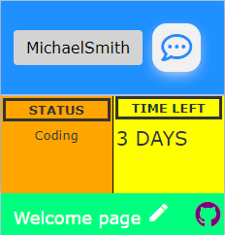
Cards
Encapsulation
User
Task
Notes:
Code a little, test a little
- Helps reason about bugs very well

Slide 13
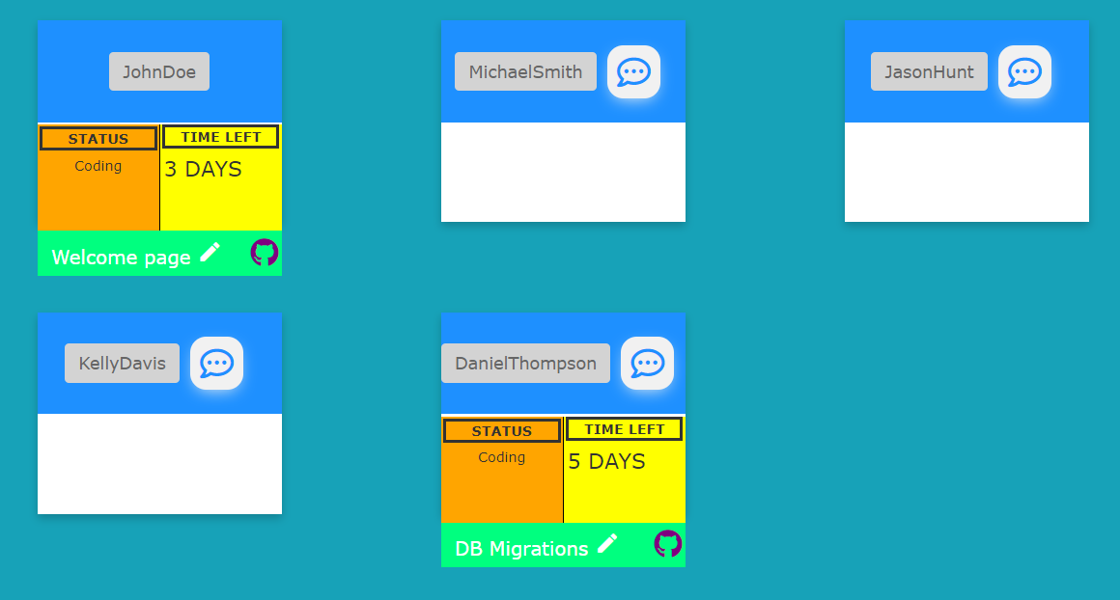
Teams
Notes:
Keep logic out of the views
Maximize delegation to the model (testability)

Slide 14
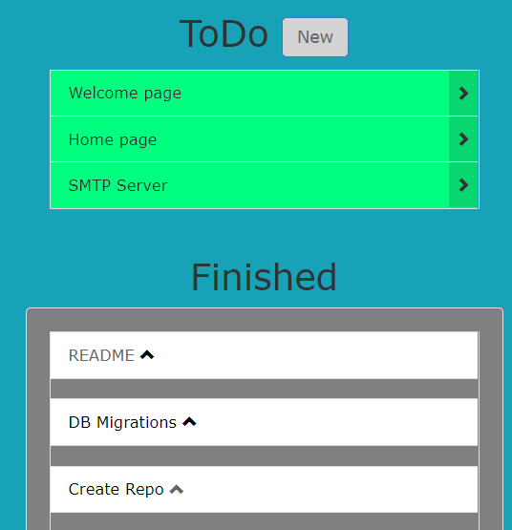
Task Management
Queue
History
Notes:
12 min

Slide 15
(3.2) Design: Back-End
Notes:
12 min

Slide 16
Back-End
SQLite Database
Rails Active Records
Notes:
Keep logic out of the views
Maximize delegation to the model (testability)

Slide 17
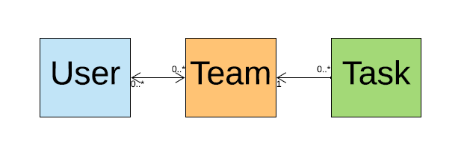
Relational Entities

Slide 18
User
* Username
* Email
* Password
(FirstName)
(LastName)
has_many :teams
has_many :tasks, :through => :teams
Notes:
Keep logic out of the views
Maximize delegation to the model (testability)

Slide 19
Team
* Name
(Description)
(GithubURL)
has_many :users
has_many :tasks
Notes:
Keep logic out of the views
Maximize delegation to the model (testability)

Slide 20
Task
* Name
* Status
(Description)
(GithubURL)
* belongs_to :team
belongs_to :user
Notes:
Keep logic out of the views
Maximize delegation to the model (testability)

Slide 21
(4) Demo
Notes:
16 min

Slide 22
Features
Authentication and Signup
Create a Team
Invite other Users
Create Tasks
Assign Tasks
Send Direct Messages
Notes:
25

Slide 23
Limitations
Permissions
SMTP Server
Loose GitHub integration
Notes:
Keep logic out of the views
Maximize delegation to the model (testability)

Slide 24
Challenges
JavaScript
Production
Firewall
Notes:
28

Slide 25
Conclusion
Experience with:
Time Management
Front-to-Back Vertical Slicing
CSS/HTML/JavaScript
Development to Production
Notes:
Keep logic out of the views
Maximize delegation to the model (testability)

Slide 26
Questions?

