Slide 1
DividenConquer
team project management
with GitHub integration

Slide 2
Overview
Web-Based Team Project Management
Create and Assign Tasks
Direct Messages and Announcements

Slide 3










Team Page
DividenConquer
stable
Queue | Finished
Implement Authentication
Fix Client GUI
Implement Web socket
Implement Forgot Password
Reformat Price Display
+ Add Task
Jake
2:35:00 LEFT
Luke
18:45 LEFT
Implement Authentication
Fix Client GUI
Zach
5:00:00 LEFT
Implement Web Socket

Slide 4
Task (Properties)
Deadline (-> Countdown)
GitHub Branch
Developer
Priority
belongs_to :user

Slide 5




Queue
Priority Queue of Incomplete Tasks
Can Enable Auto-Assignment
has_many :tasks
Queue | Finished
Implement Authentication
Fix Client GUI
Implement Web socket
Implement CAPTCHA
Reformat Price Display
+ Add Task
Queue | Finished
Upload Documentation
Create README

Slide 6
User (Attributes)
Name
Email
Password
has_one :inbox
belongs_to_many :teams

Slide 7
Features
Task Management
Auto-Assignment
Direct/Group Communication
Email Invitations

Slide 8



Implementation
Development
Test
Production

Slide 9
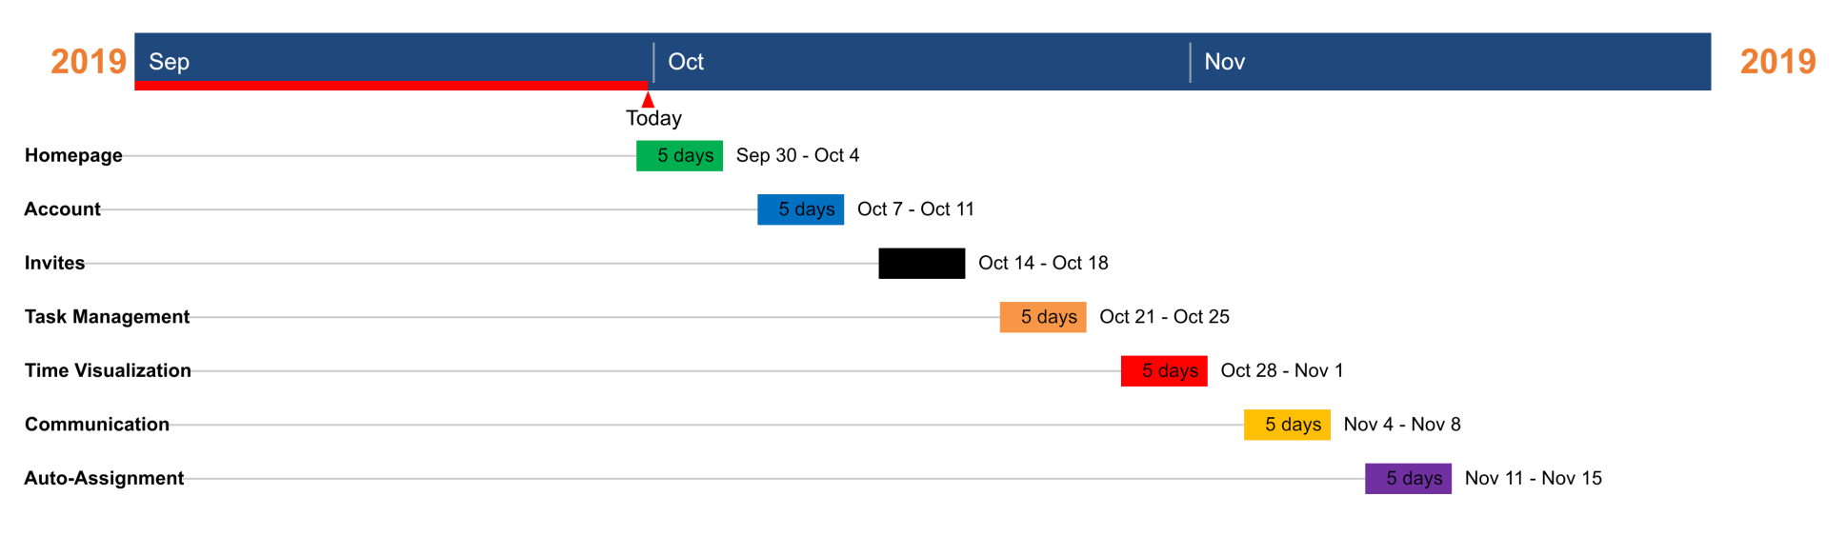
Timeline

