Slide 1
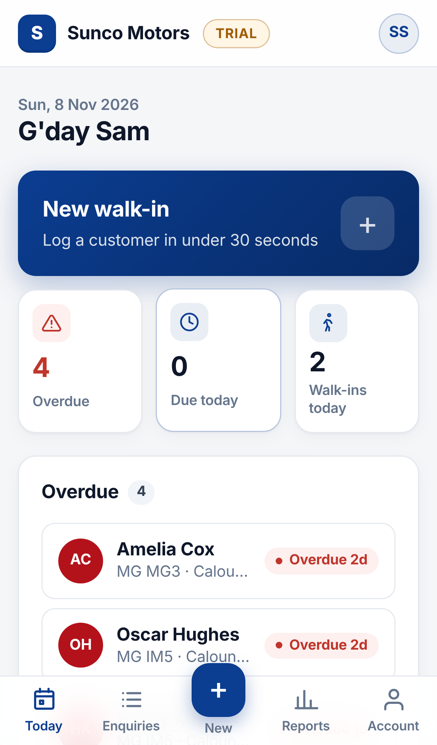
Walk-In CRM: salesperson guide
SUNCO MOTORS
Log every walk-in in 30 seconds, follow up on time, and see your own numbers.
Notes:
Welcome. This guide shows salespeople how to use the new Walk-In CRM that replaces the walk-in spreadsheet. It covers logging a walk-in, working your follow-ups, finding enquiries and reading your own numbers. Everything shown is the real app with demo data.

Slide 2




Why we are moving off the spreadsheet
Log a walk-in in 30 seconds
Never miss a follow-up
Pick from buttons and lists. The date, month, your name and the site fill themselves in.
Every open enquiry has a next follow-up date. Overdue ones go to the top of your Today screen.
No more month-end tabs
Your numbers, any time
One list for everything. Open enquiries stay open until sold or lost, with nothing to carry over.
See your enquiries, test drives and conversion for today, this month or this year.
Notes:
The spreadsheet made people type the same things again and again, and enquiries got lost between monthly tabs. The CRM fixes both: entry is mostly taps, follow-ups are tracked automatically, and there is no month-end carry-over.

Slide 3
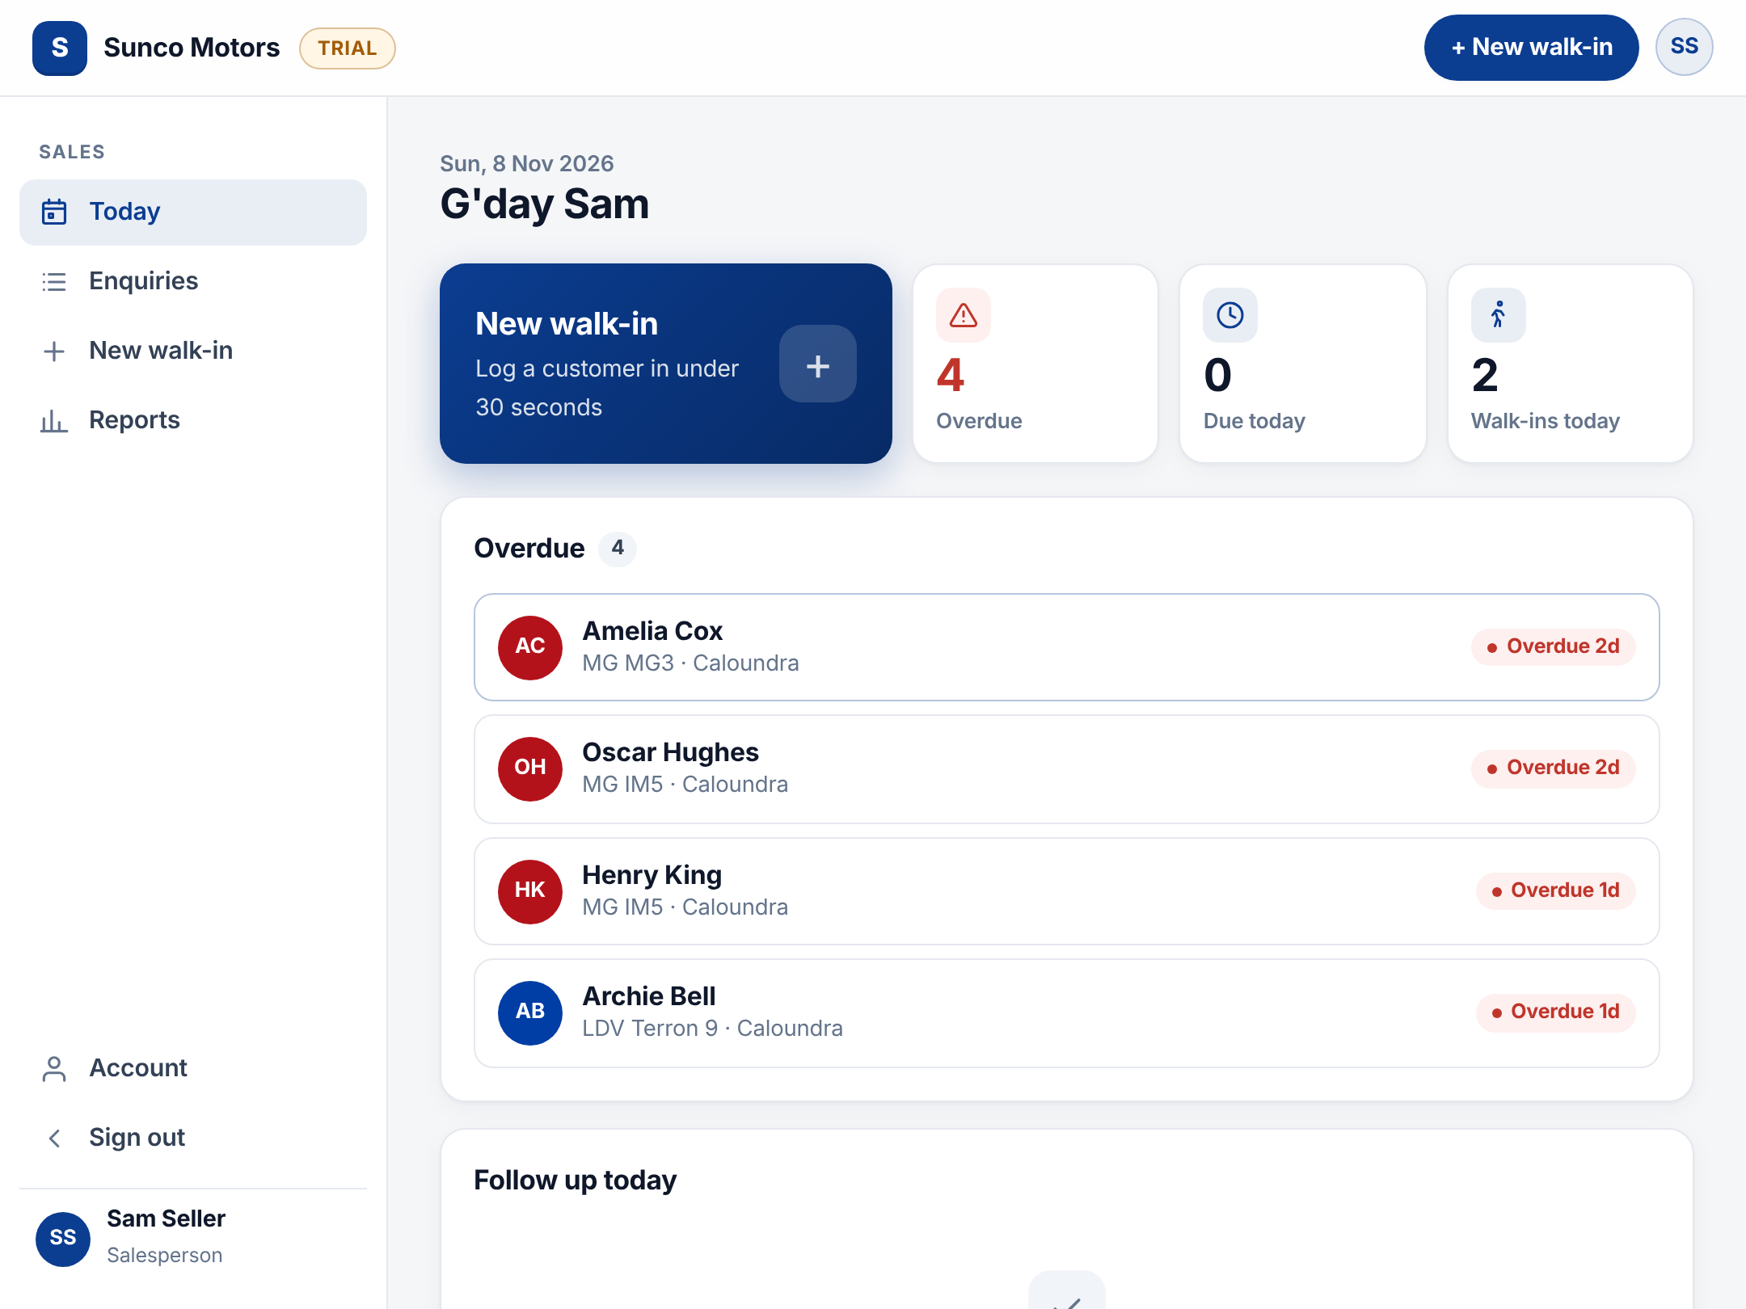
Your day starts on the Today screen
1
New walk-in
The big blue button. Tap it the moment a customer arrives.
2
Overdue
Follow-ups you have missed. Clear these first.
3
Due today
The people to contact today.
4
Walk-ins today
Everyone you have logged so far today.
Notes:
Sign in with your username and password. The Today screen is home. Work top to bottom: overdue first, then due today. The lists under the tiles show the first five, with See all for the rest.

Slide 4
Logging a walk-in
Three steps, about 30 seconds, while the customer is still with you
Notes:
The form has three numbered steps: vehicle, customer, visit.

Slide 5
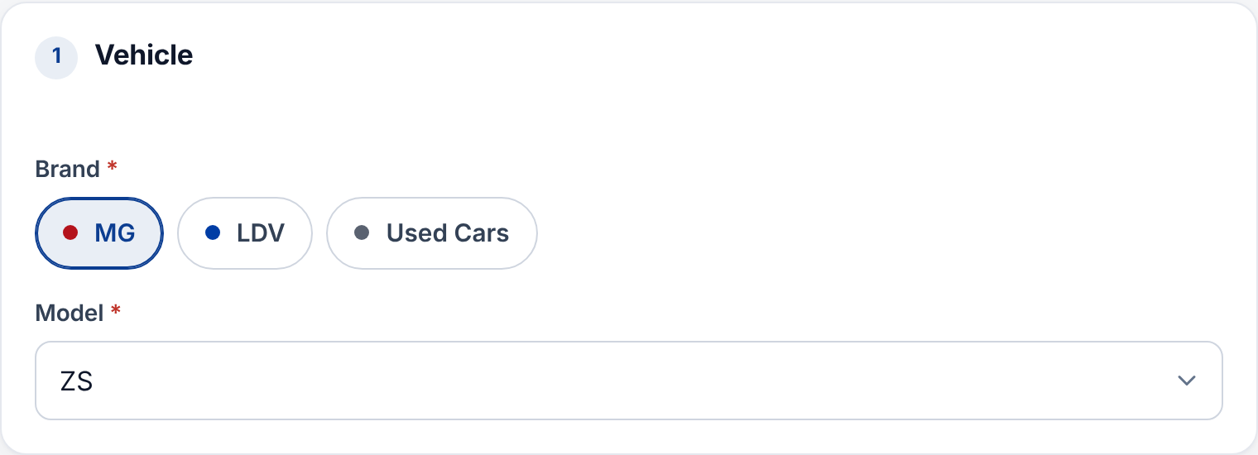



Step 1: pick the brand and model
Tap your brand
Only the brands you sell at your site appear. If you only sell one, it is already picked.
Choose the model from the list
No typing, so every "CX-5" is spelt the same and reports stay accurate.
Model missing?
Tell your sales manager. They add it in Admin and it appears straight away.
Tip Open the form from the blue New walk-in button on Today, the + in the phone tab bar, or New walk-in at the top of any page.
Notes:
Brand buttons only show the brands you are assigned to at your site, so you cannot log an enquiry against the wrong franchise. Models come from a fixed list per brand.

Slide 6
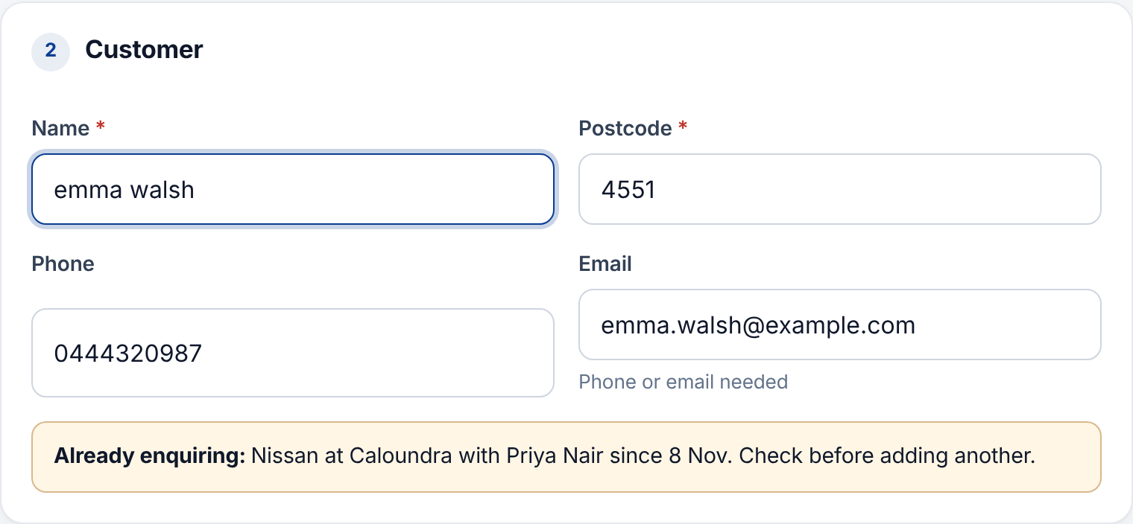



Step 2: who is the customer?
Name and postcode are required
Type it any way you like: "emma walsh" is saved as "Emma Walsh".
Phone or email
At least one. Phone numbers are checked and tidied to 0412 345 678.
Already enquiring?
If the customer is already open with someone else, you see who and where before you save.
Notes:
The duplicate warning checks every site, so two salespeople do not chase the same customer. If you see it, talk to the colleague or your manager instead of adding a second enquiry.

Slide 7
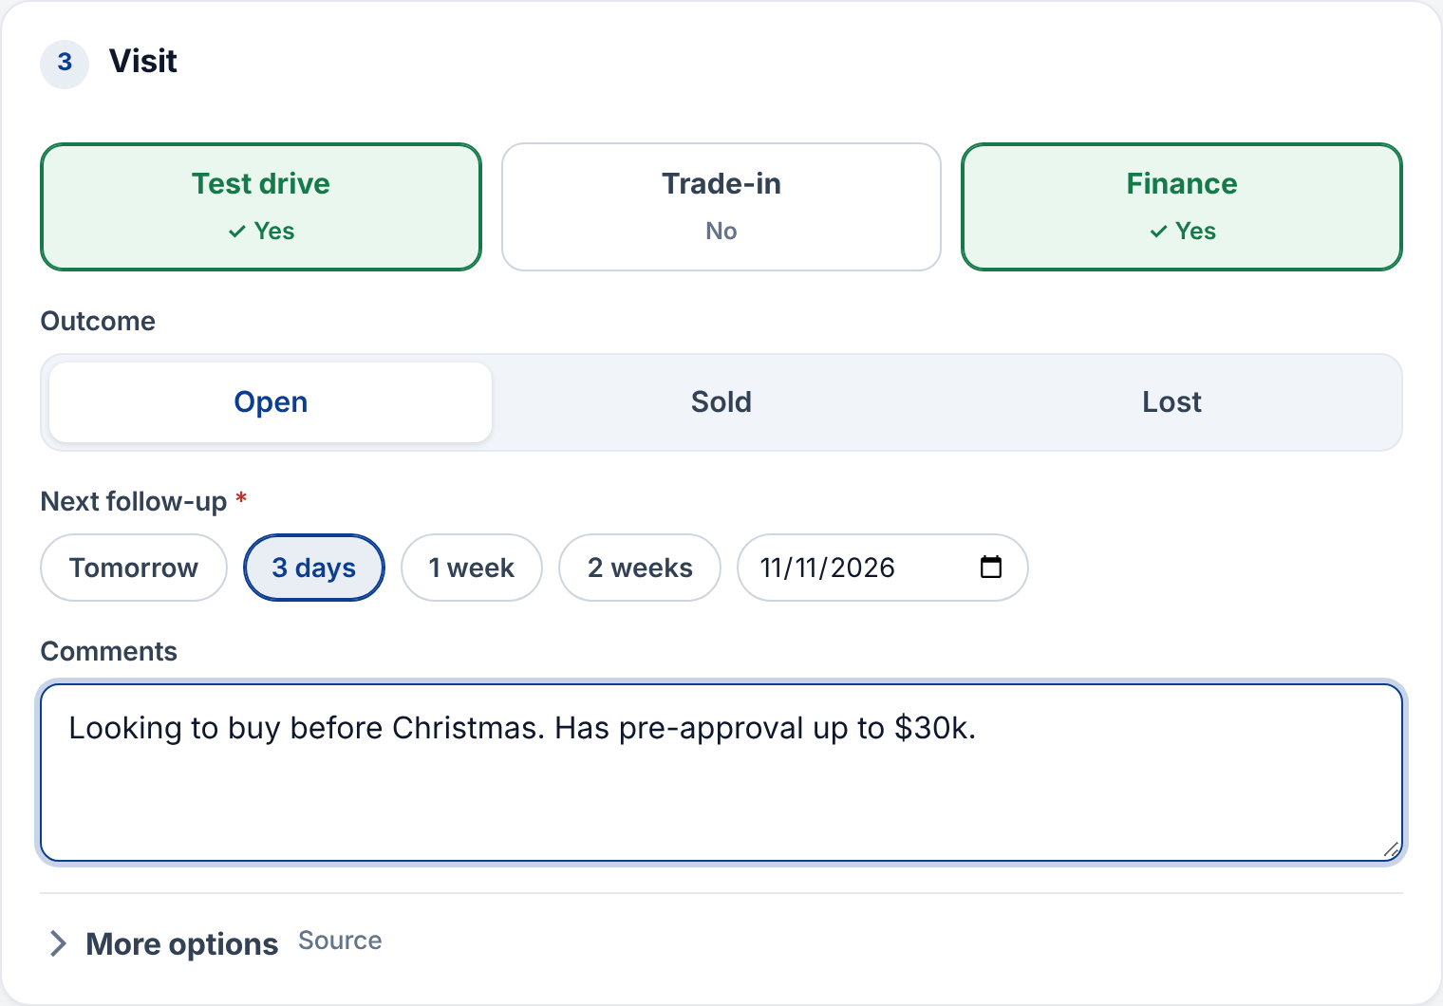
Step 3: the visit and the next follow-up
1
Tap Test drive, Trade-in, Finance
Green means yes. Leave the rest as no.
2
Leave it Open
Unless they bought or walked away today.
3
Set the next follow-up
Tomorrow, 3 days, 1 week or 2 weeks, or pick a date.
4
Add a short comment and Save
Budget, timing, trade details: one line is enough.
Notes:
Every open enquiry needs a next follow-up date; that is what drives the Today screen and the morning email. Save takes you back to Today.

Slide 8
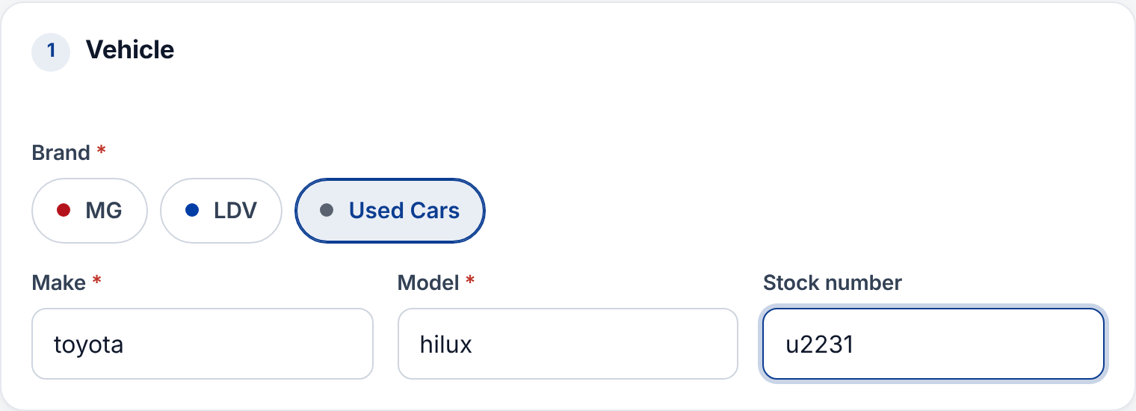



Used cars: just type the make and model
Type it as you say it
Suggestions appear as you type. "toyota" and "hilux" are saved as Toyota HiLux.
Small typos are fixed
"hodna" is matched to Honda, so the reports group them together.
Stock number is optional
Add it when the customer is looking at a specific car. You can search by it later.
New cars use fixed lists Typing is only for used cars. For the brands we sell new, the model is always picked from the list.
Notes:
Choose Used Cars as the brand. A make that has never been entered before, like Cupra, is added automatically for next time.

Slide 9
Working your enquiries
Find a customer, log what happened, close the deal
Notes:
This section covers the Enquiries list, the enquiry page, follow-ups and marking sold or lost.

Slide 10
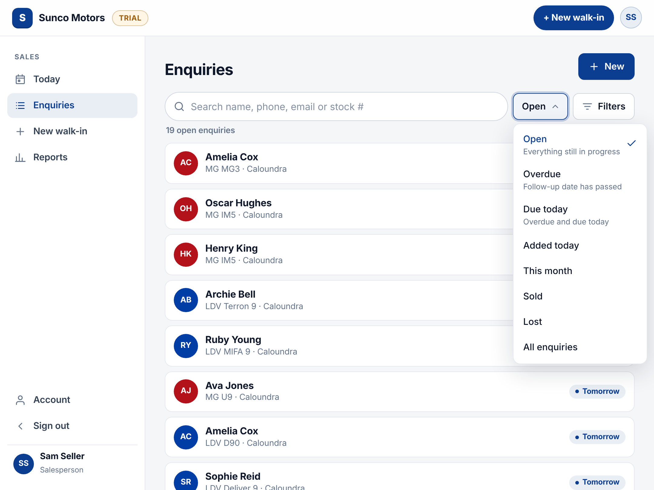




Find any enquiry in seconds
Search
Name, phone number, email or stock number.
Show
One dropdown: Open, Overdue, Due today, Added today, This month, Sold, Lost.
Filters
Narrow by brand or change the sort order. Tap a filter tag to remove it.
Only yours
You see your own enquiries. Managers see their whole team.
Notes:
Open is the default view: everything still in progress, soonest follow-up first. On a desk PC the list shows as a table; on a tablet the selected enquiry opens beside the list.

Slide 11
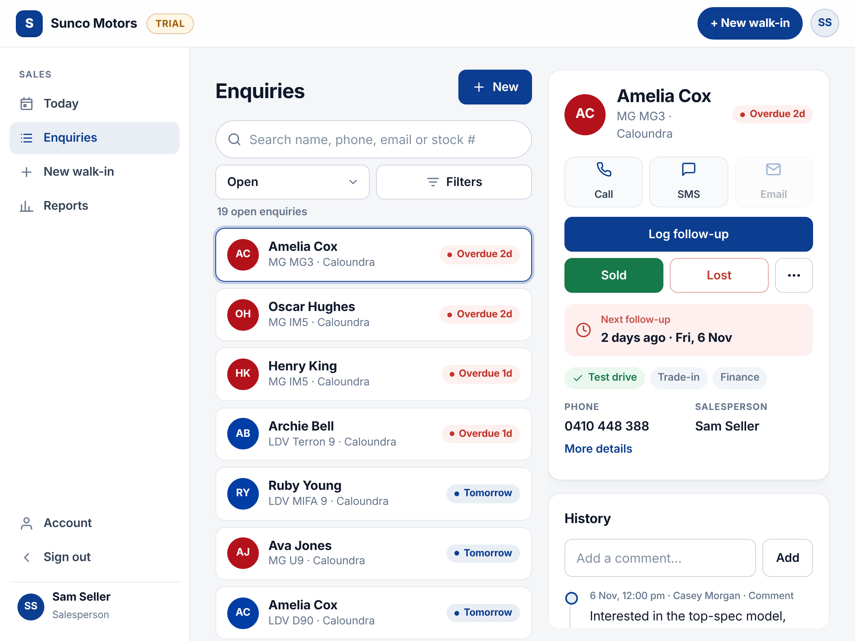
Everything about a customer on one page
1
Call or SMS
One tap on a phone. The number is also shown below.
2
Log follow-up
Record what happened and set the next date.
3
Sold or Lost
Close it off when the customer decides.
4
⋯ More
Edit details. Managers also reassign or re-open here.
Notes:
The top of the page shows only what you need to act. More details reveals postcode, source and date of entry. History at the bottom shows every call, comment and change, newest first.

Slide 12
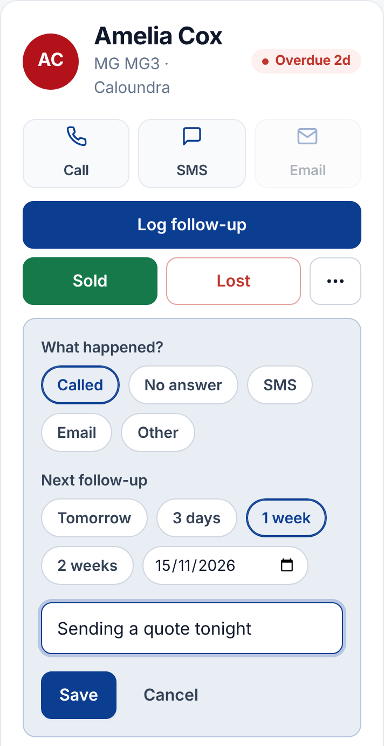
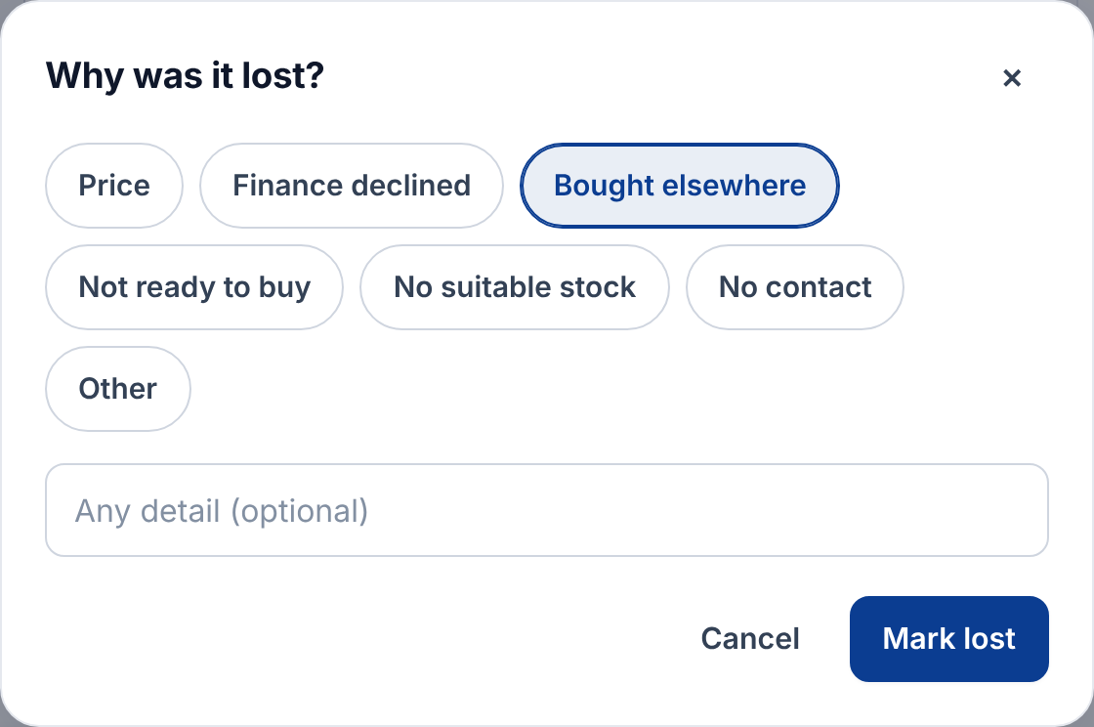
Log a follow-up, or close it off
1
What happened?
Called, No answer, SMS, Email or Other.
2
Next follow-up
Tap a quick date. It is required while open.
Lost needs a reason
Pick one: price, finance declined, bought elsewhere and so on. Management uses this to see why deals are lost.
3
Optional note, then Save
It is added to the history with the time and your name.
Notes:
Logging a follow-up records whether it was done on time, which shows in the reports. Sold records today as the sale date. If an enquiry was closed by mistake, your sales manager can re-open it.

Slide 13
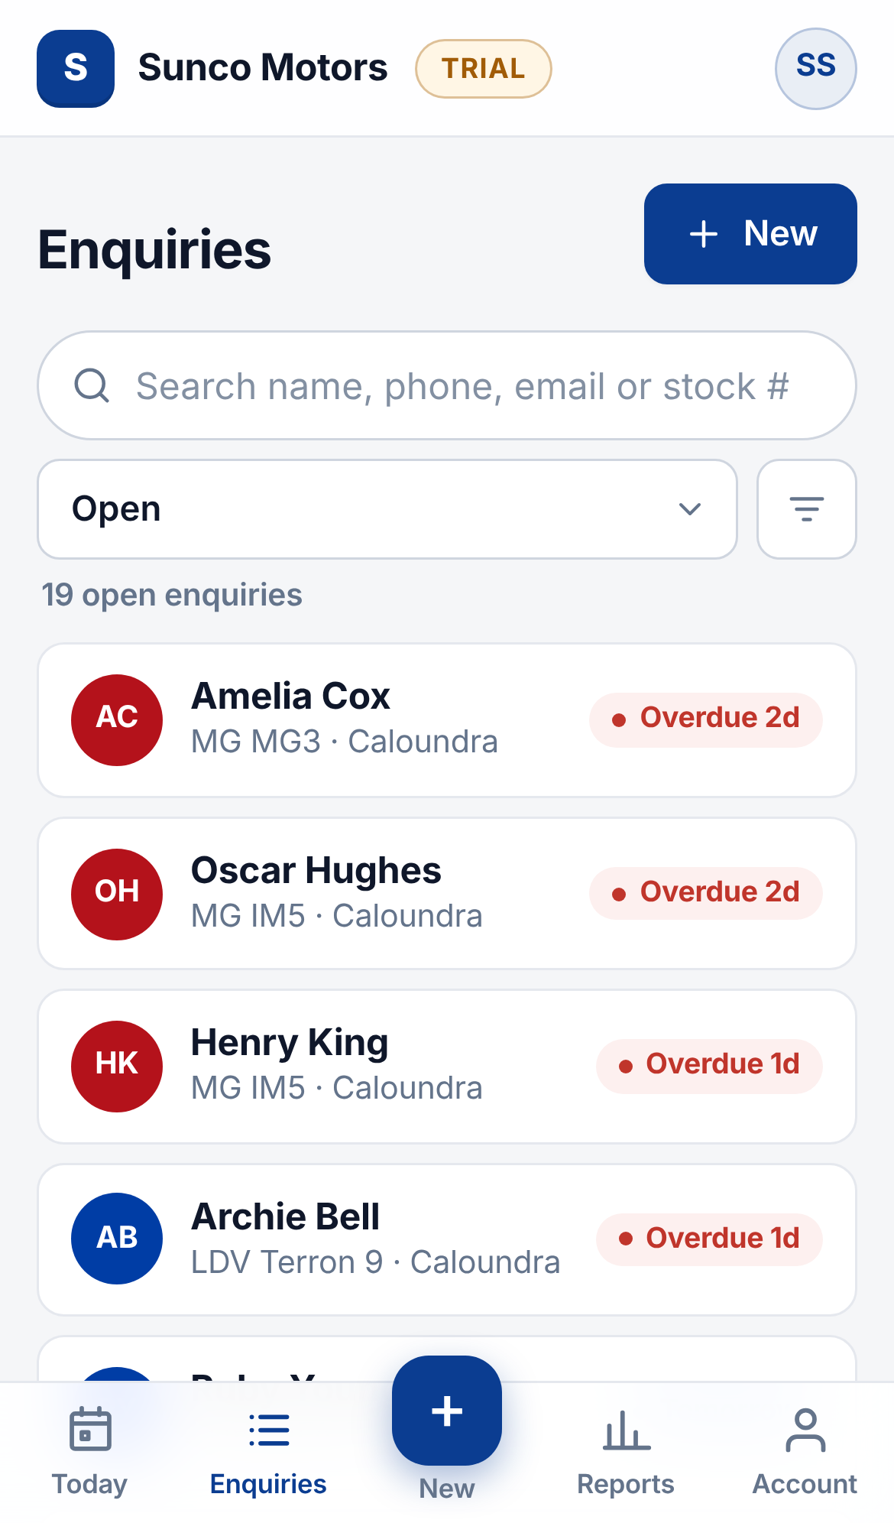
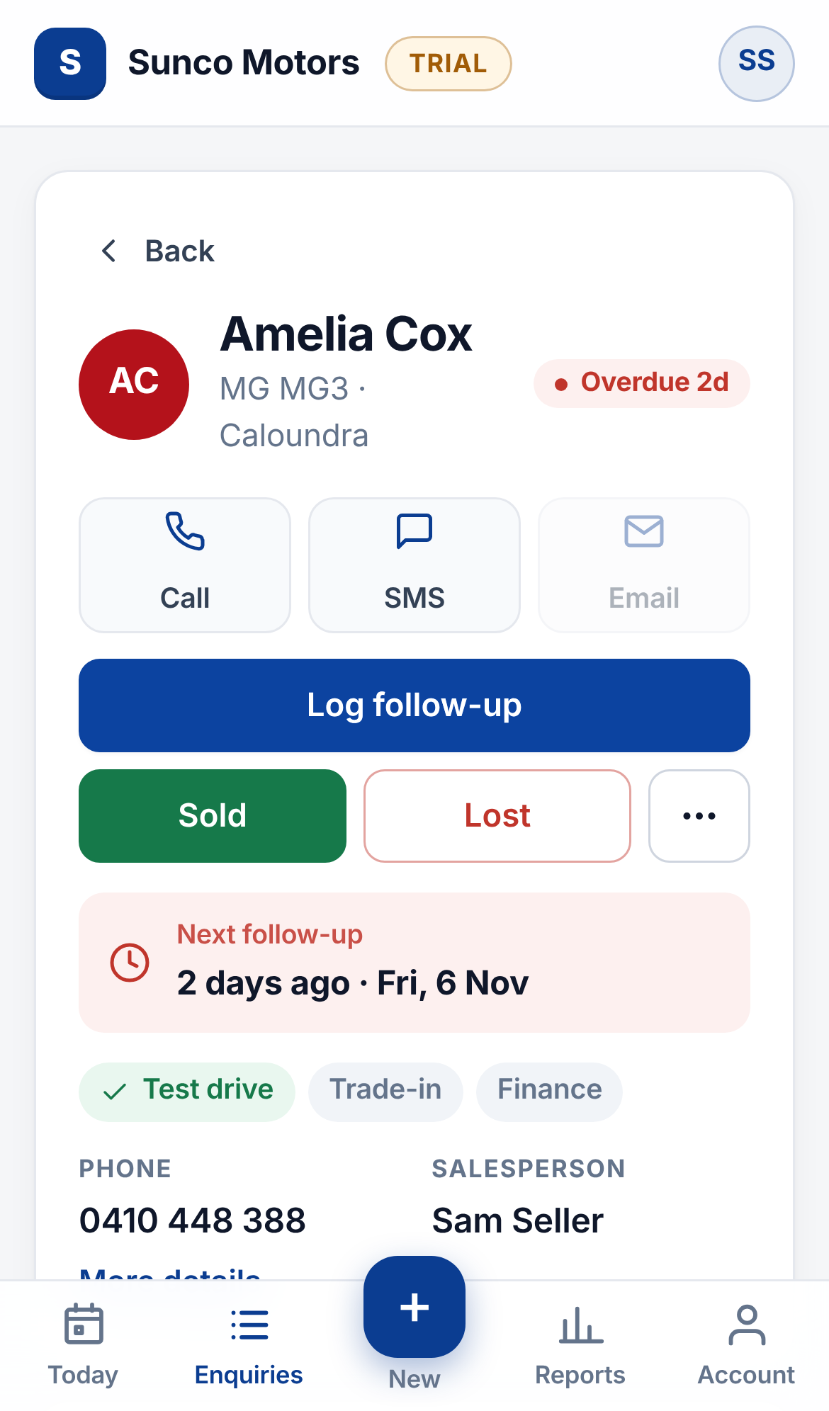
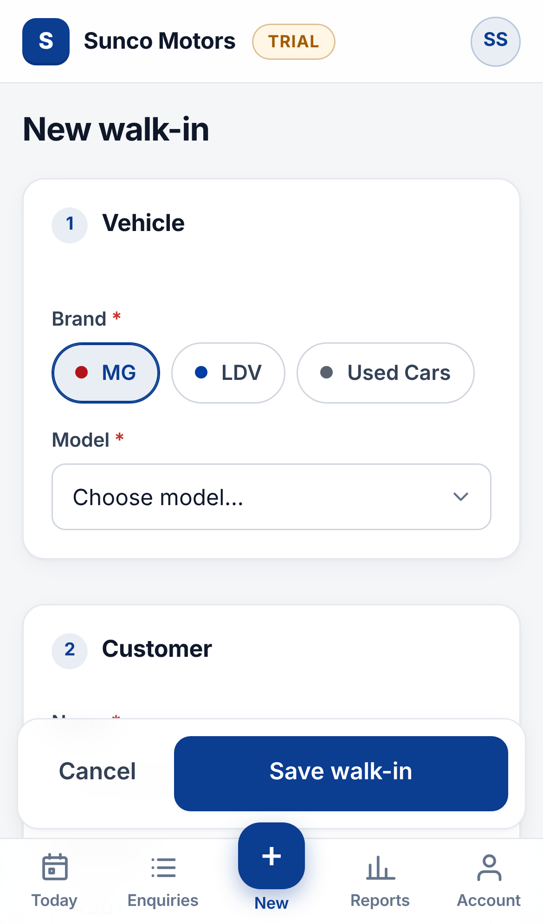
It works the same on your phone
Today
Enquiries
An enquiry
New walk-in
Notes:
Add it to your home screen: in Safari use Share then Add to Home Screen, in Chrome use the menu then Add to Home screen. It opens like an app. The bottom bar has Today, Enquiries, the + for a new walk-in, Reports and Account.

Slide 14
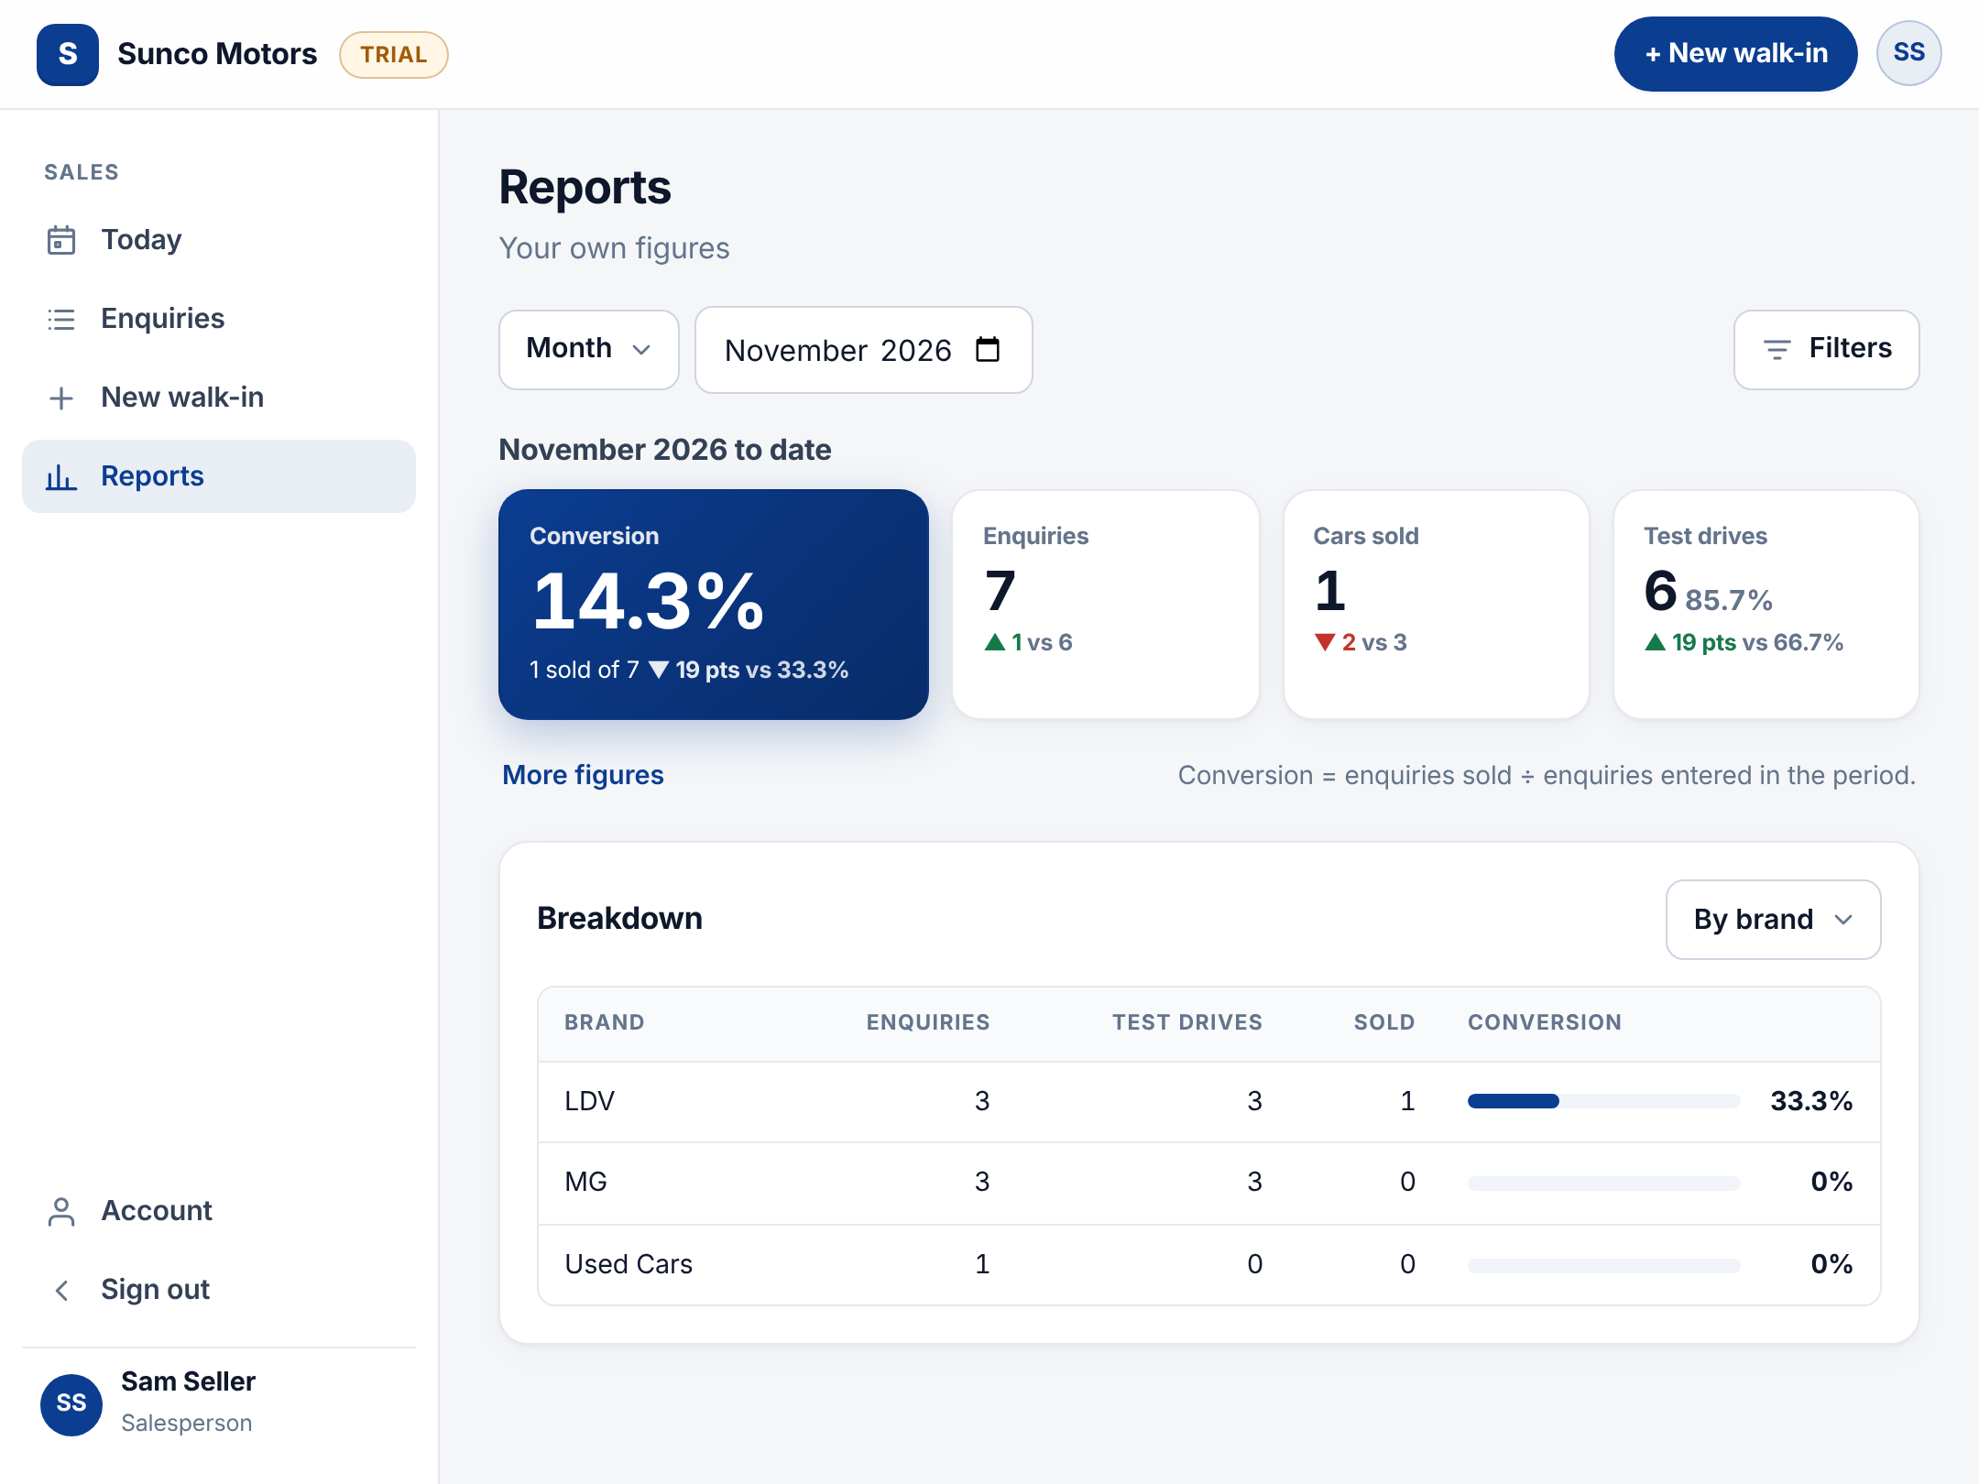


See your own numbers any time
33%
20 sold from 60 enquiries. Conversion = enquiries sold ÷ enquiries entered in the period.
Day, month or year
Change the period from the dropdown at the top.
One breakdown at a time
By brand, model, source or lost reason.
Notes:
Salespeople see only their own figures. The example 33% is 20 sold from 60 enquiries. Each number shows how it compares with the previous period. More figures shows trade-in and finance rates and how many follow-ups you did on time.

Slide 15





Five habits that make it work
Log it while they are with you
Always set the next follow-up
Clear overdue first thing
Thirty seconds at the desk beats trying to remember at 5pm.
Use the quick-date buttons. No date means no reminder.
Open Today each morning and work top to bottom.
Log every call, even no answer
Close it off promptly
The history shows your manager the work you have put in.
Mark Sold or Lost the day it happens so the numbers stay true.
Notes:
These habits are what make the CRM useful. If everyone logs every walk-in and keeps follow-up dates current, nobody has to rebuild a spreadsheet at month end.

Slide 16



Every walk-in.
Every time.
Sign in with your own username
Add it to your phone home screen
Questions about access, brands or models: ask your sales manager. Forgot your password? Your manager can reset it.
Watch for the morning email
Notes:
Close by asking everyone to sign in today, add the app to their phone and log their next walk-in in the CRM rather than the spreadsheet.

