Slide 1
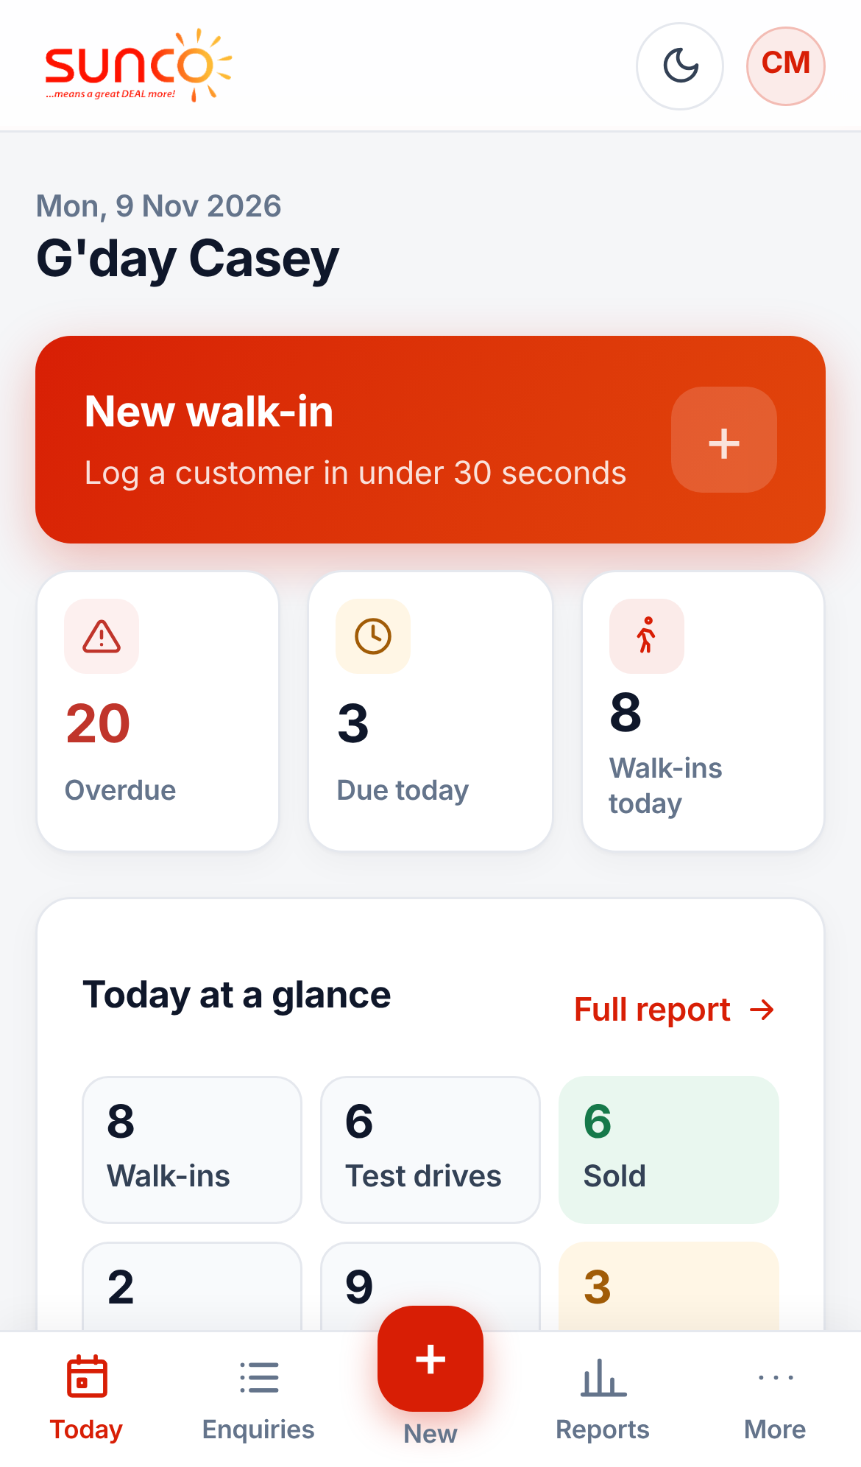
Sales manager guide
Running your team
ENQUIRY MANAGEMENT CRM
Approve sales, keep follow-ups on track, coach with the numbers and look after your team.
Notes:
This guide is for sales managers and general managers. It covers approving sold and lost enquiries, checking that salespeople are using the CRM properly, reports, and managing your team. Every screen shown is the real system with demo data.

Slide 2




Your four jobs in the CRM
Approve sold and lost
Keep follow-ups on time
Nothing closes until you approve it. Always give a reason.
Check overdue every day and chase the right person.
Coach with the numbers
Look after your team
Compare walk-ins, test drives and conversion by salesperson.
Add people, reset passwords and hand over enquiries.
Notes:
You see every enquiry for the brands and sites you manage. Salespeople see only their own. Your approval is what makes the sold and lost numbers trustworthy.

Slide 3
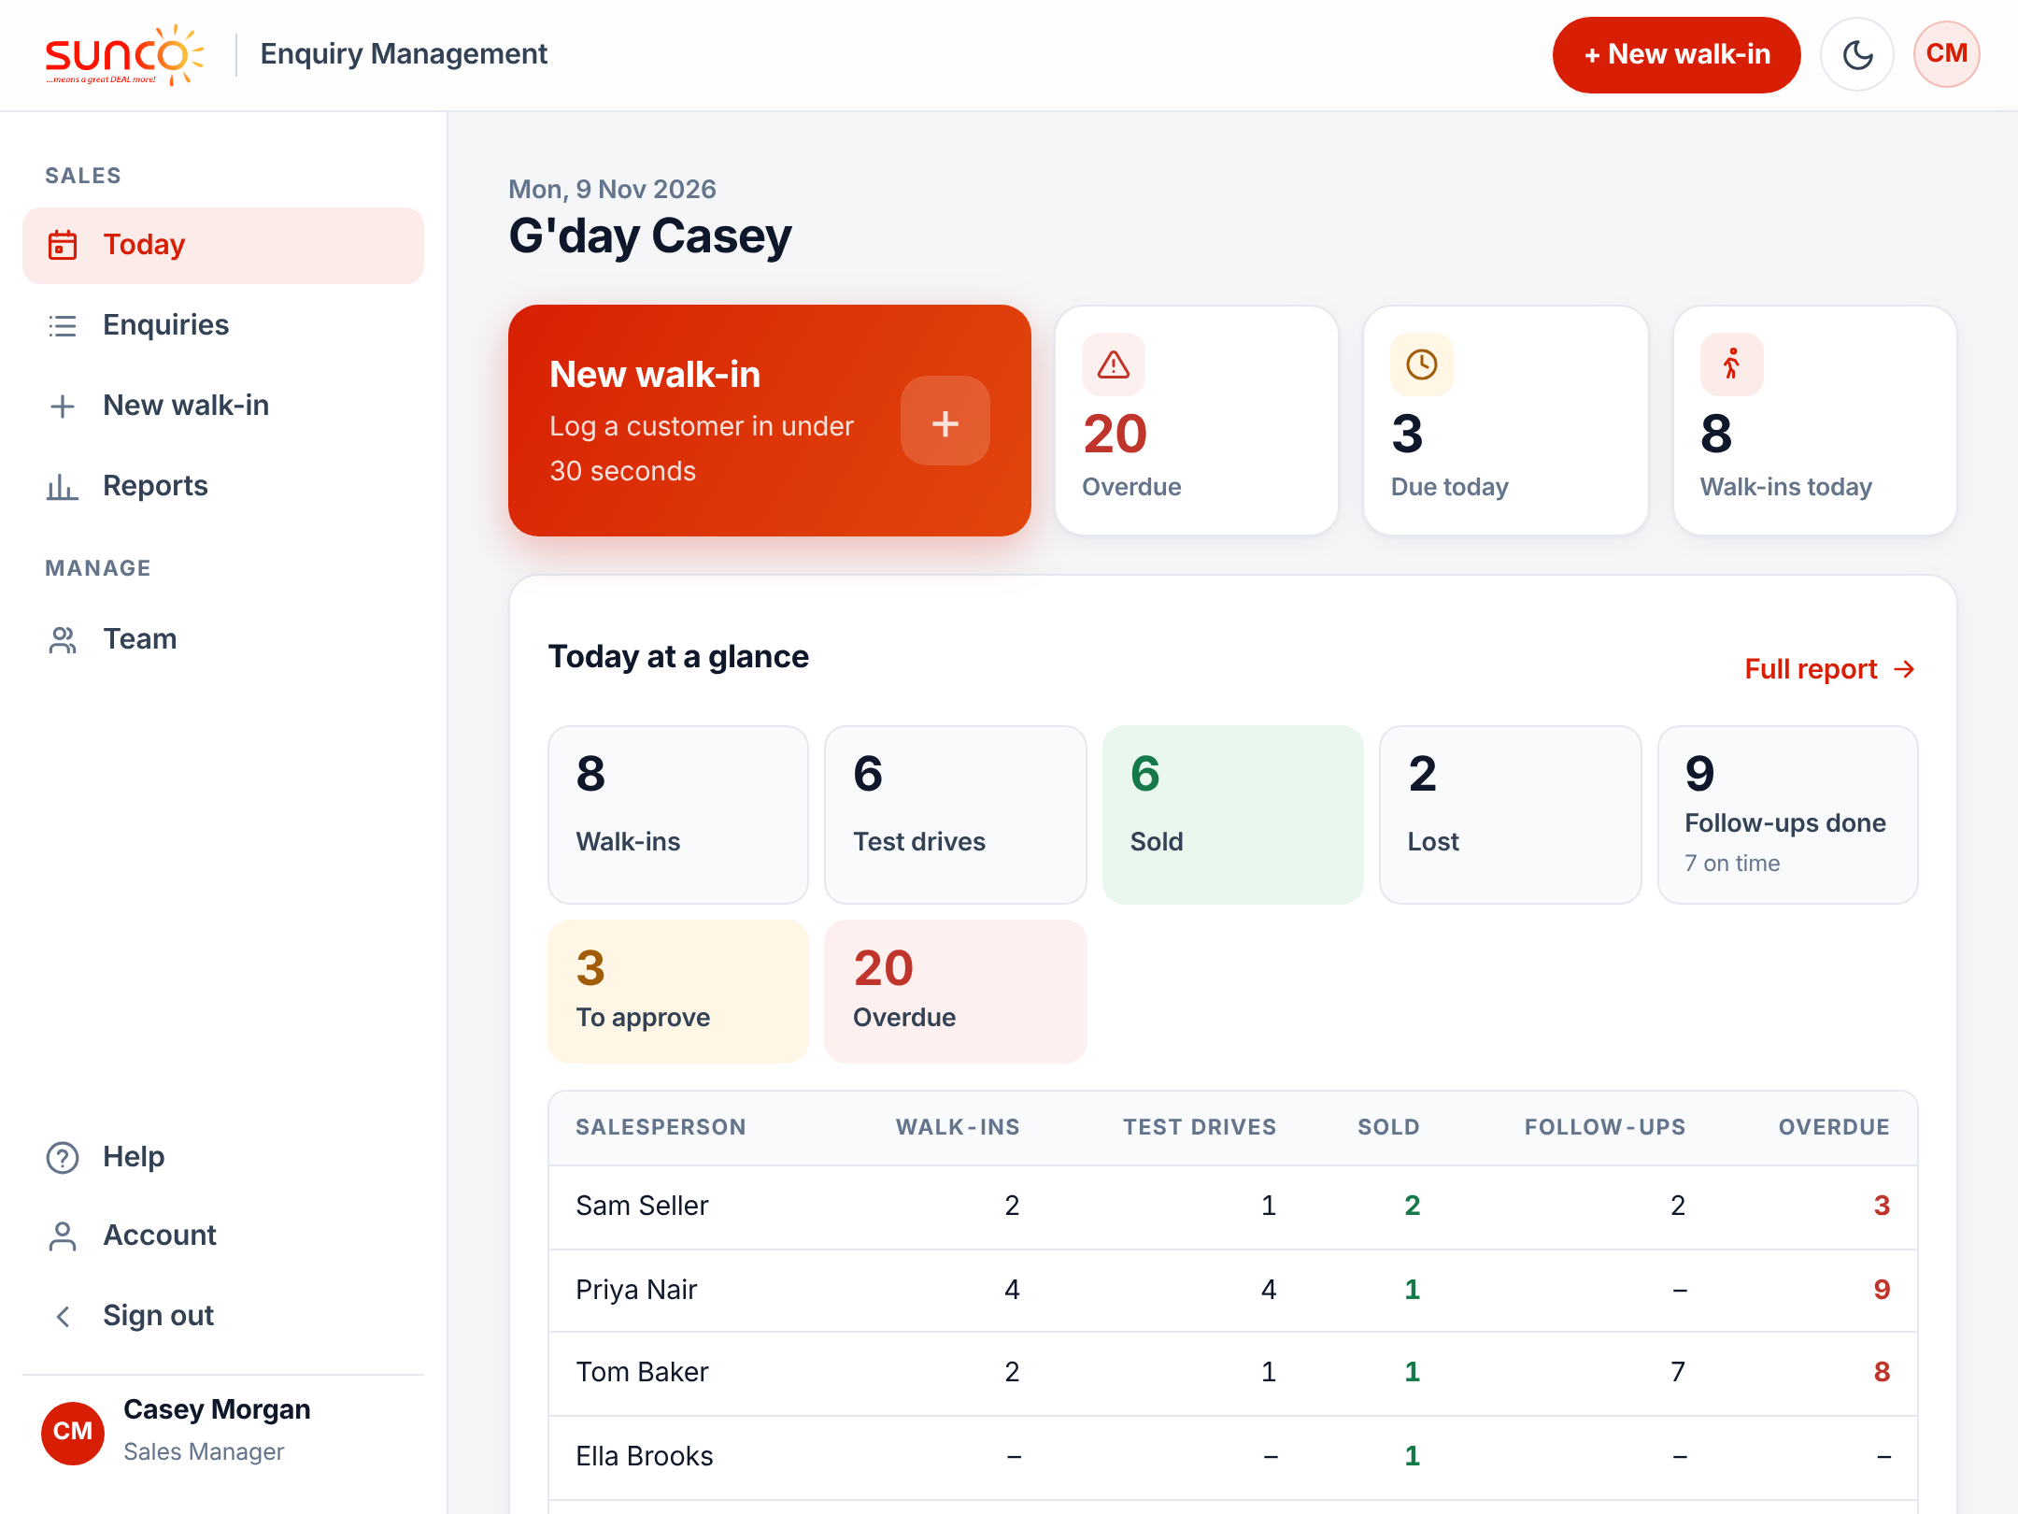
Your Today screen
1
Today at a glance
The day’s numbers for your whole team.
2
Waiting for your approval
Sold and lost requests from your team.
3
Overdue
Every overdue follow-up in your brands.
4
Due today
What your team should contact today.
Notes:
Managers see the whole team on Today, not just their own enquiries. The morning email lists the same things, including what is waiting for your approval.

Slide 4
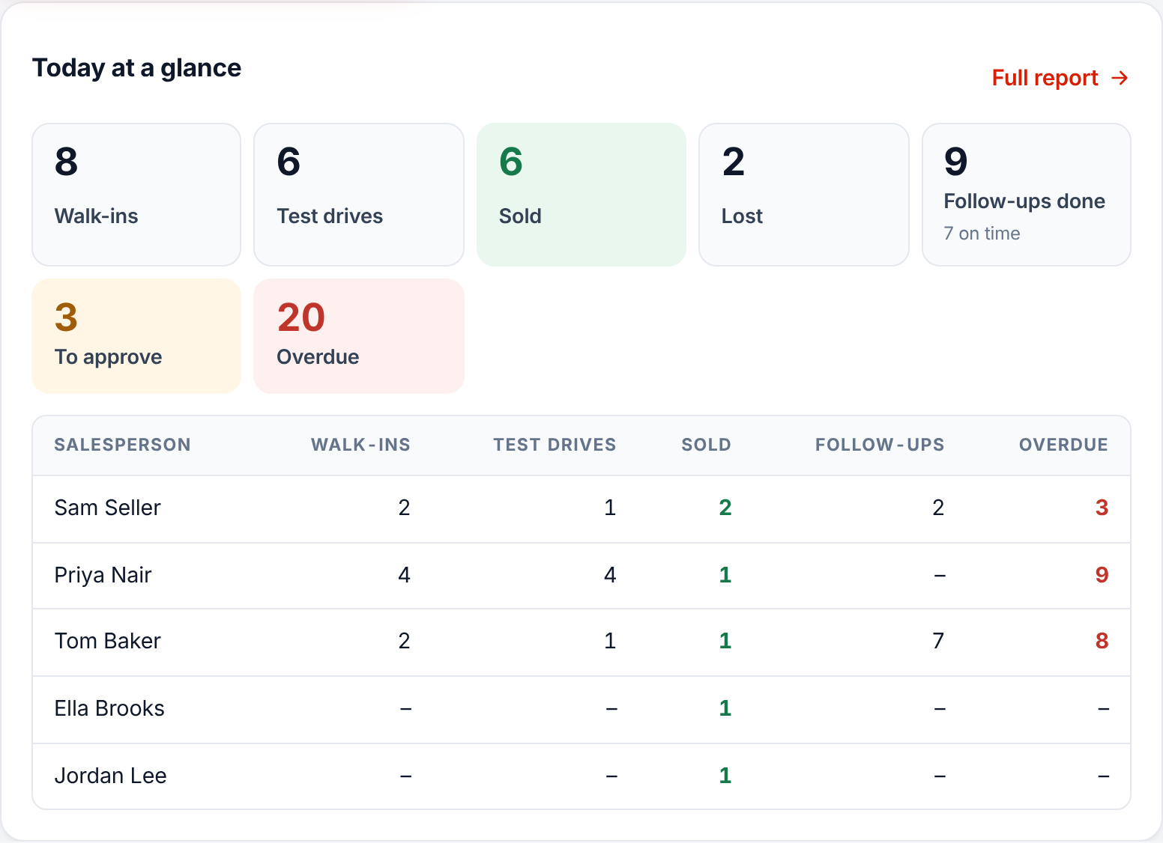




Today at a glance
The day in seven numbers
Walk-ins, test drives, sold, lost, follow-ups, approvals, overdue.
By salesperson
Everyone is listed, even on a quiet day.
Faded row?
Nothing logged yet today. Have a word.
Tap a number
Opens the list behind it.
Notes:
Today at a glance sits at the top of Today for sales managers and the general manager. The general manager sees it split by site. Sold counts approved sales only. Full report opens Reports for today.

Slide 5
Approving sold and lost
Nothing closes until you say so
Notes:
When a salesperson marks an enquiry Sold or Lost it goes to pending. The sales manager for that brand and site approves or declines it, always with a reason.

Slide 6
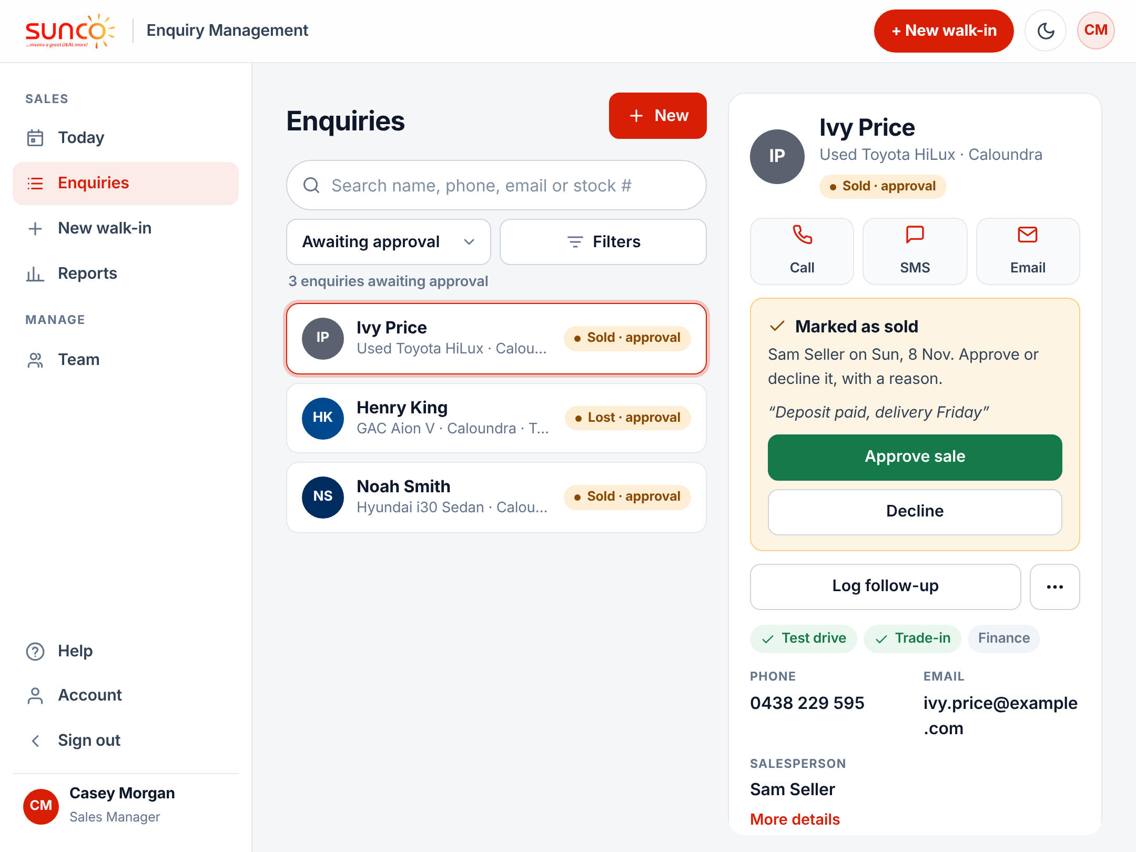



How a request reaches you
Marked "Sold · approval"
Or "Lost · approval" in every list.
Awaiting approval
Show this view to see every request.
Read their note
The salesperson says why it is sold or lost.
Approve or Decline
On the yellow card on the enquiry.
Notes:
Requests appear on Today, in the Awaiting approval view of Enquiries, and in your morning email. Only managers who look after that brand at that site can approve it.

Slide 7
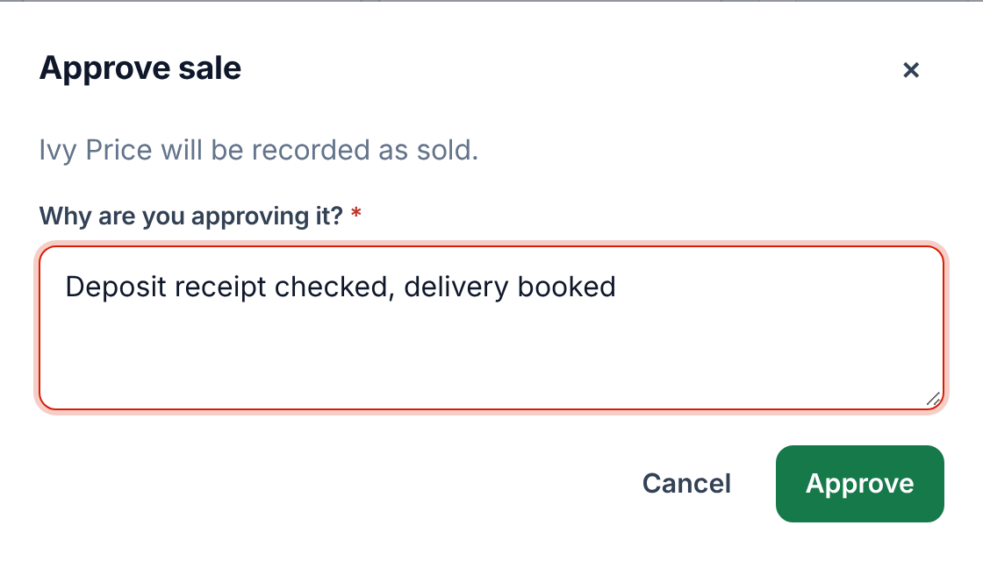
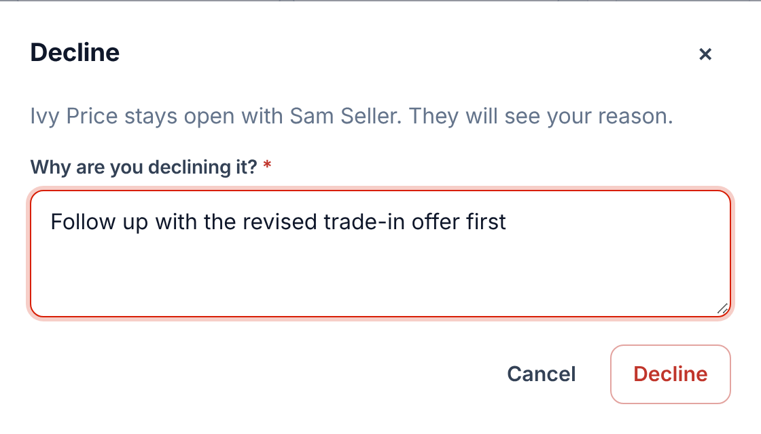


Always give a reason
Approve
Decline
Say what you checked, e.g. "Deposit receipt checked". The sale counts from the day it was sent.
Say what to do next. It stays open and lands on their Today screen.
Notes:
A reason is required both ways and is kept in the history. When approving a sale, check there is a deposit or signed contract. When approving a lost, check the reason makes sense and that the customer really has been contacted.

Slide 8
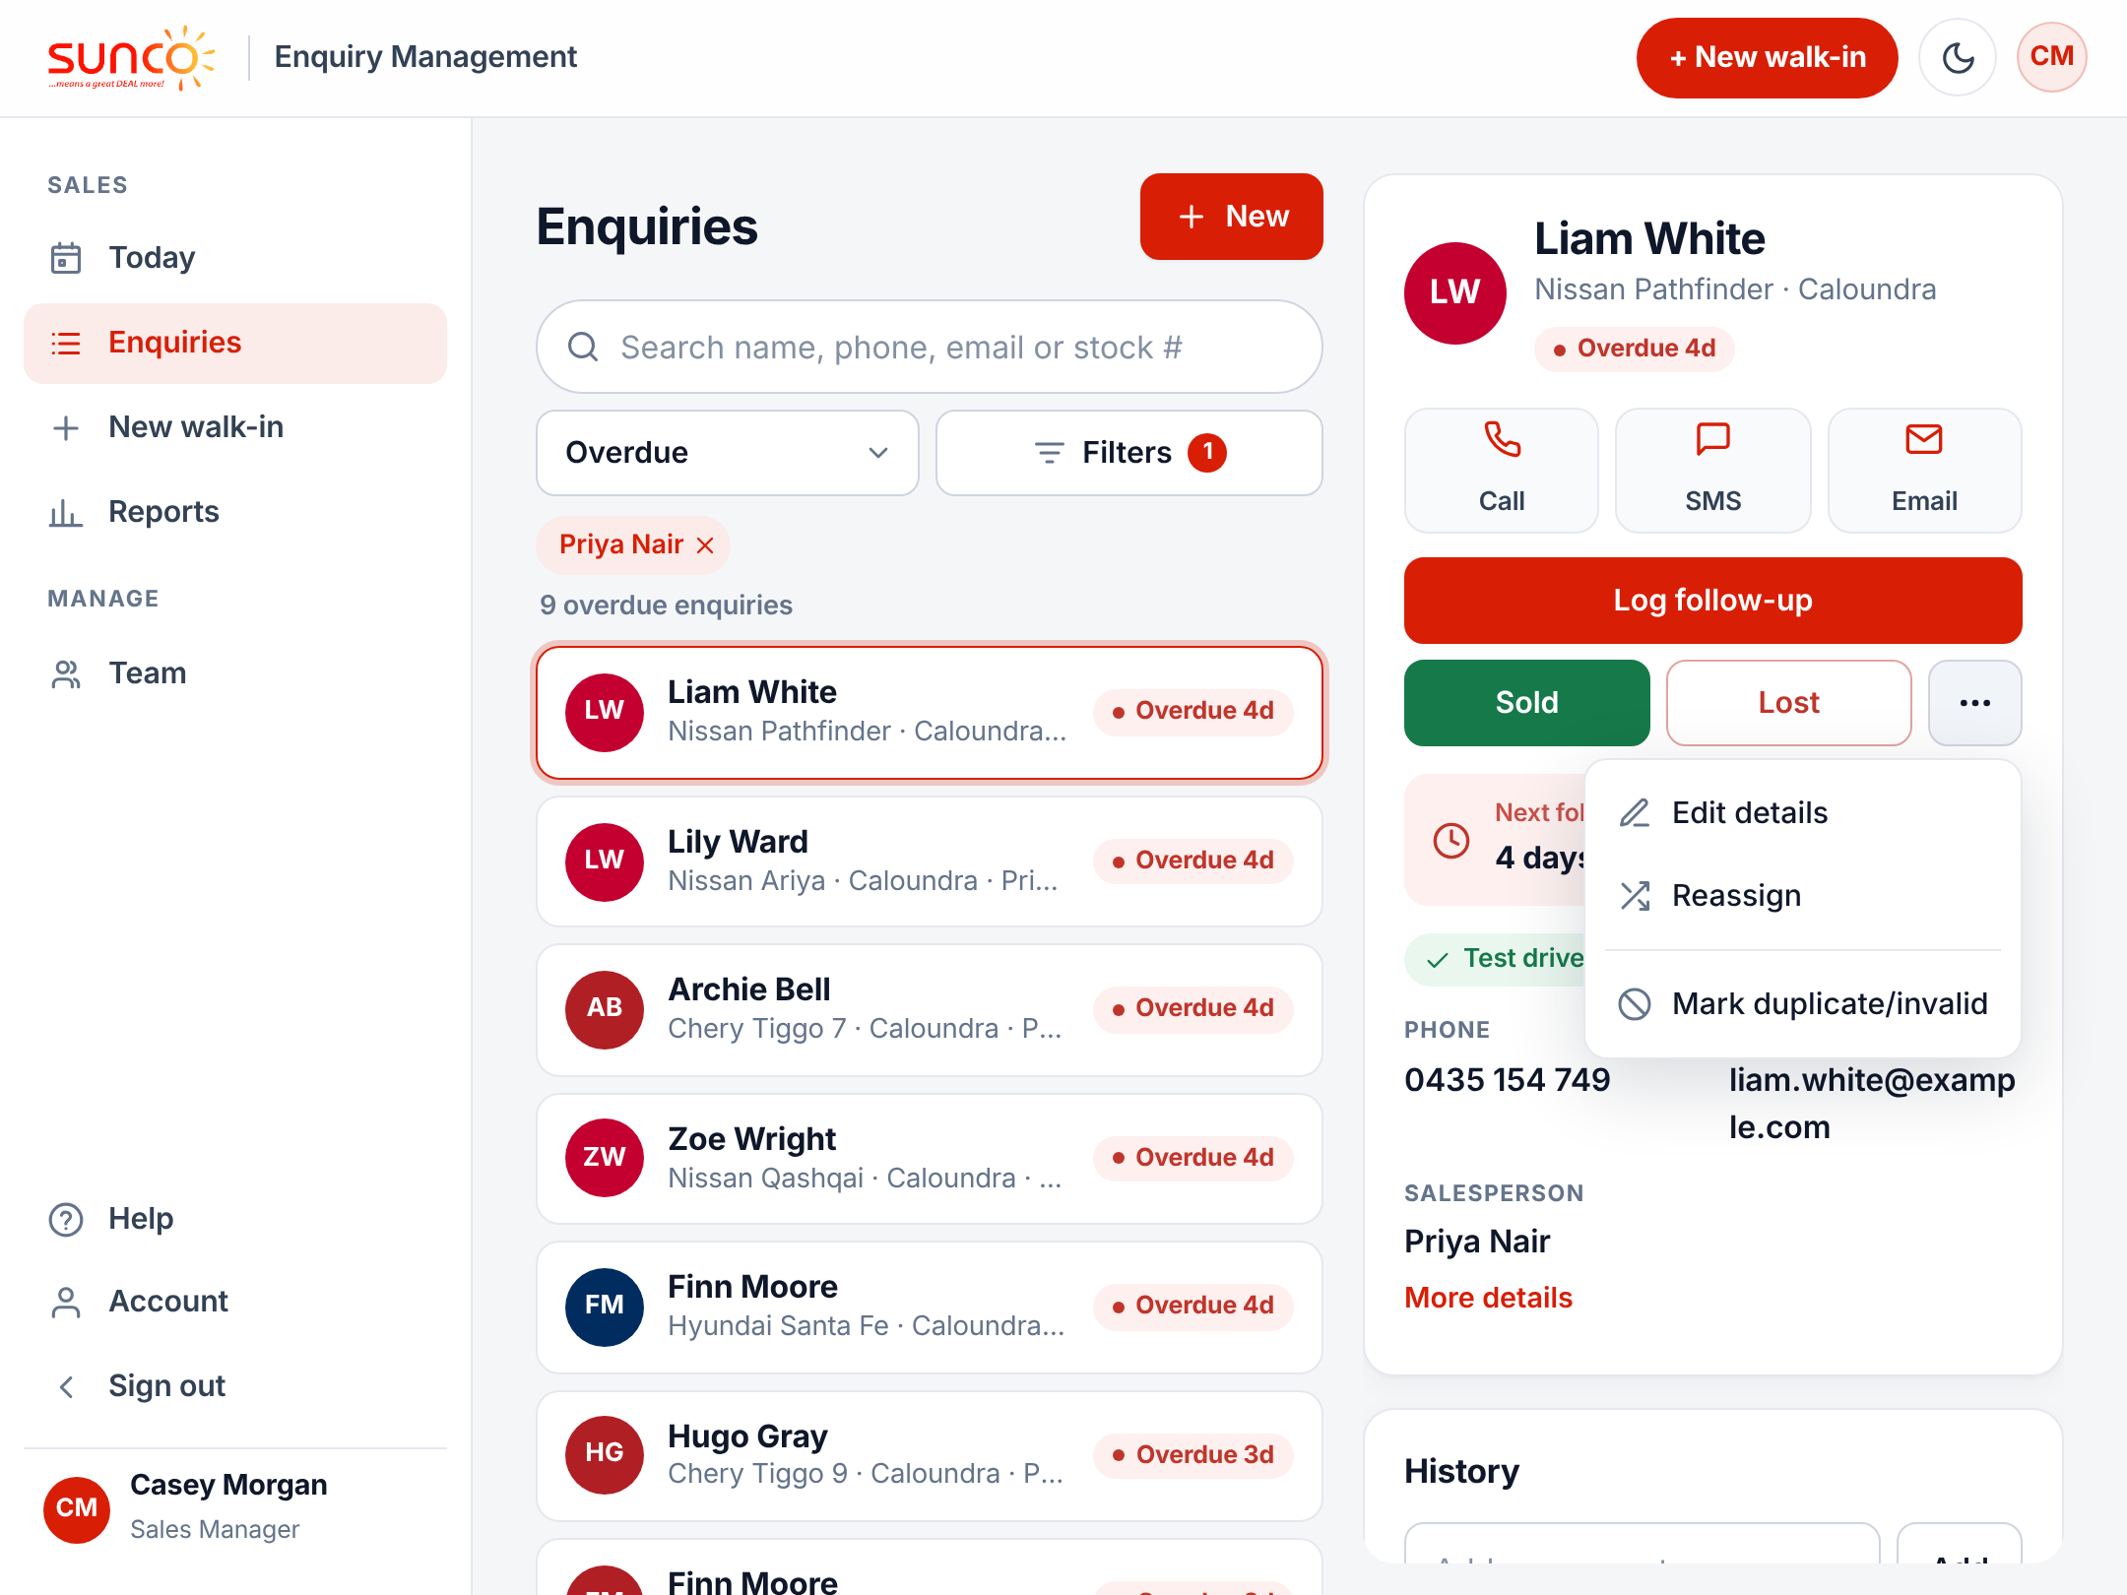




Fix or hand over an enquiry
Edit details
Correct a wrong model, phone or postcode.
Reassign
Give it to another salesperson.
Duplicate or invalid
Hides it from reports. Nothing is deleted.
Re-open
If a sold or lost was closed by mistake.
Notes:
These are on the ··· button on any enquiry. Enquiries are never deleted: duplicates and test entries are marked invalid so they drop out of the numbers but stay in the history.

Slide 9
Keeping your team on track
Ten minutes a day keeps the CRM true
Notes:
This section is about making sure every salesperson logs every walk-in, follows up on time and closes enquiries promptly.

Slide 10
Your 10-minute daily routine
1
Read Today at a glance
2
Clear approvals
Any faded rows? Do the walk-ins match the floor?
Approve or decline everything waiting, with a reason.
3
Chase overdue
4
Spot-check notes
Filter by salesperson and ask about anything 3+ days late.
Open two or three enquiries and read the history.
Notes:
Do this first thing each morning, ideally before the sales meeting. The morning email gives you the same list if you are not at a desk.

Slide 11
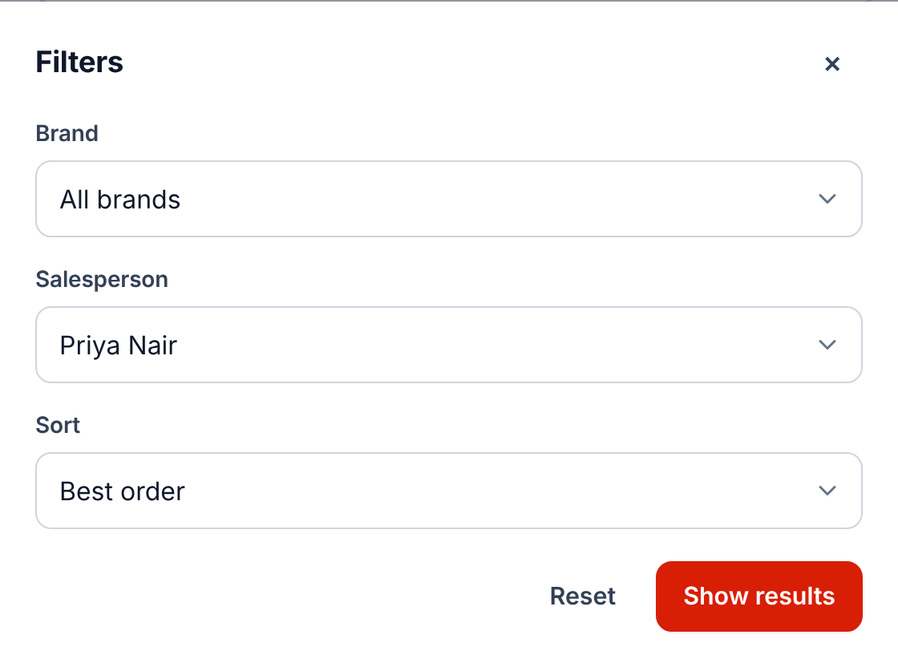
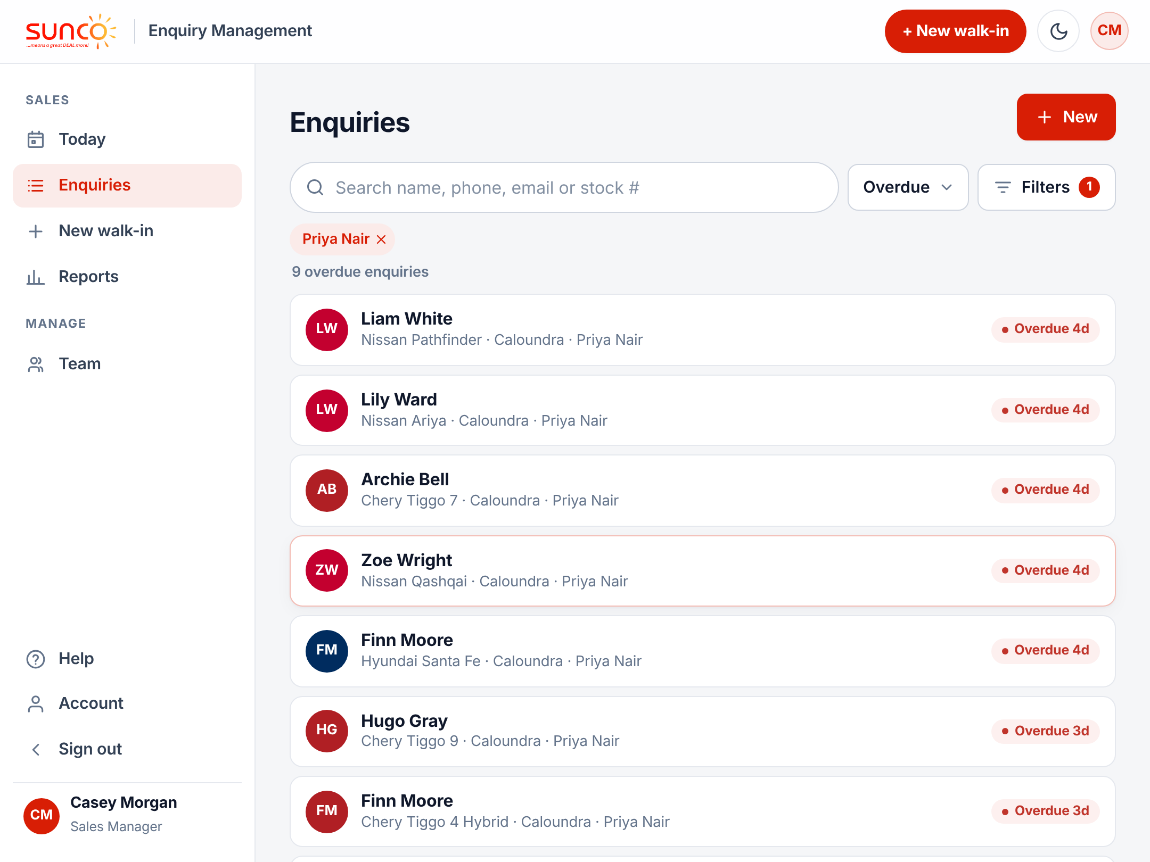
Check one salesperson’s work
1
Show Overdue
Then tap Filters.
2
Pick the salesperson
And Show results.
Notes:
The same filter works with any view: Open, Due today, Sold, Lost or Awaiting approval. The red pill shows the filter is on; tap the x to clear it. Use this in one-on-ones.

Slide 12
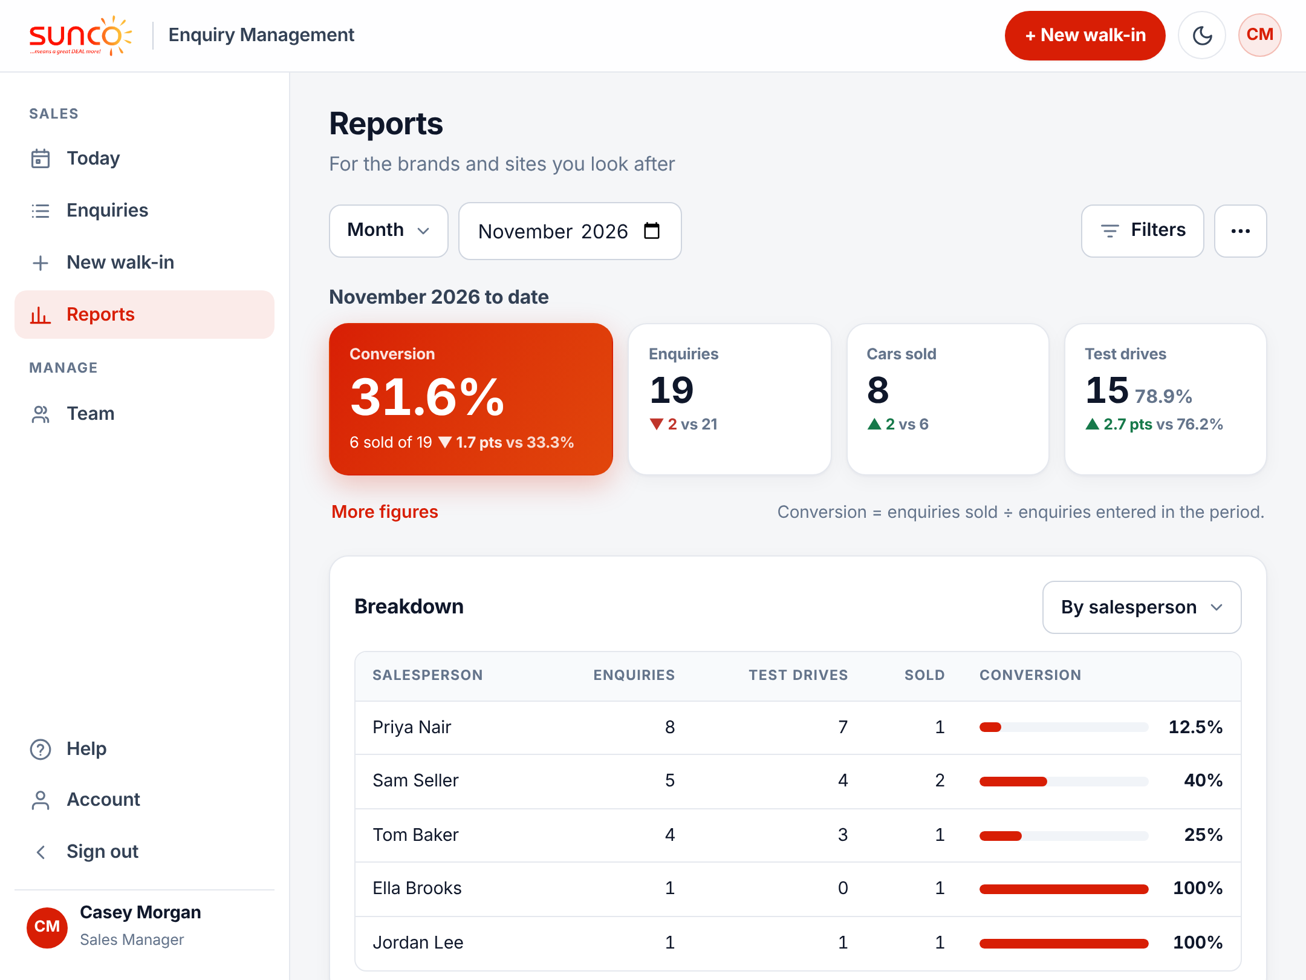


Compare salespeople in Reports
Day, month or year
Pick the period at the top.
Breakdown by salesperson
Enquiries, test drives, sold and conversion.
Export to Excel
The ··· button, top right.
Notes:
Conversion is enquiries sold divided by enquiries entered in the period. The breakdown can also be by brand, model, source or lost reason. Export gives every enquiry in the period and filter as a spreadsheet.

Slide 13
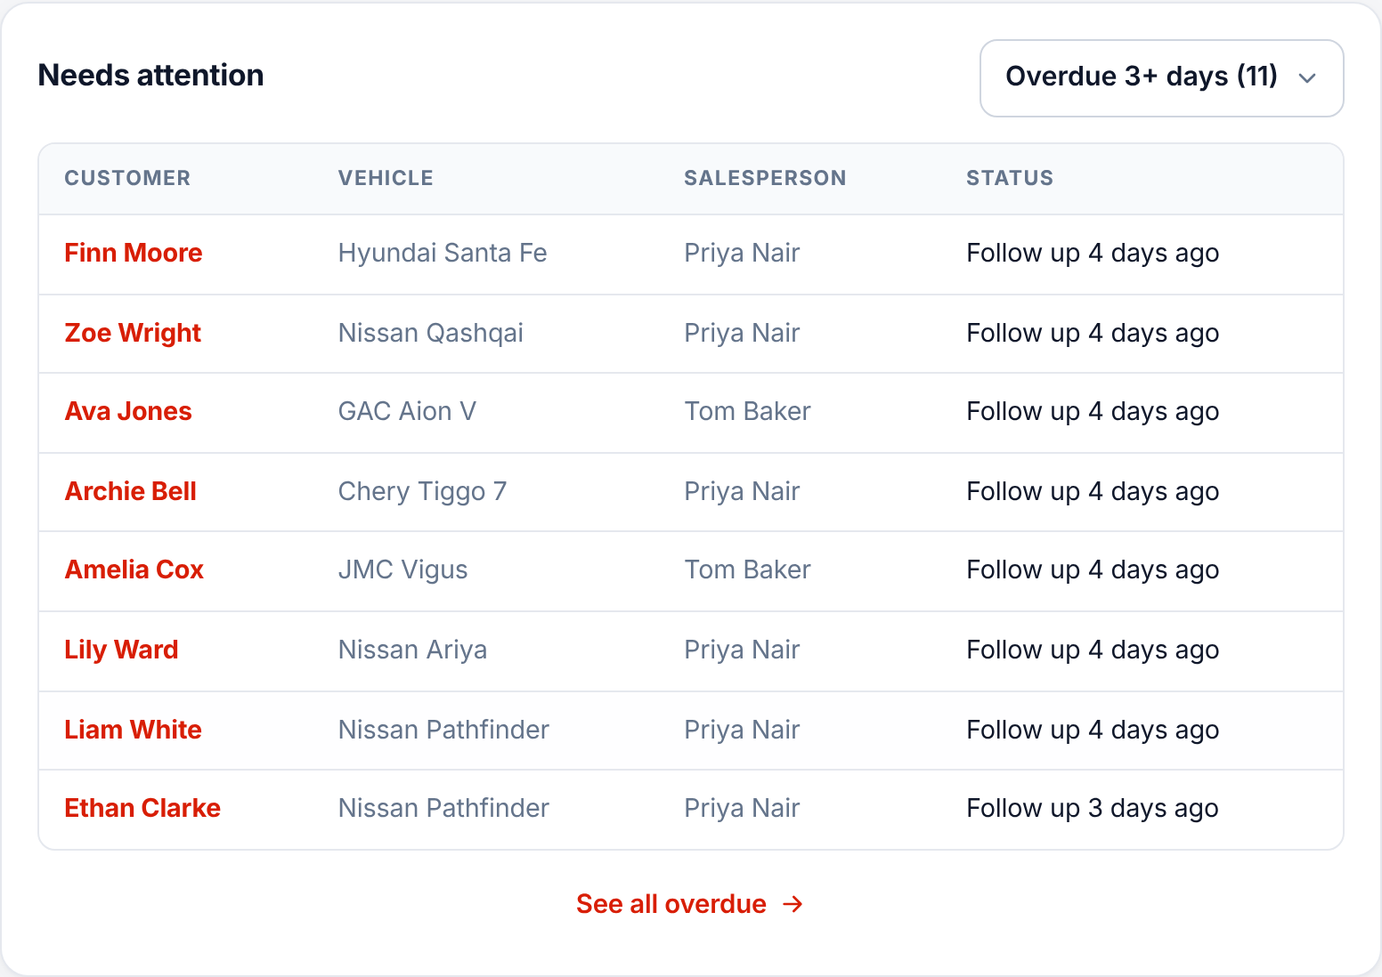


See who needs a hand
Needs attention
Enquiries 3+ days overdue, at the bottom of Reports.
Look for a pattern
One name keeps appearing? Have a chat.
Act on it
Ask them to follow up today, or reassign.
Notes:
Needs attention lists overdue follow-ups, longest first. Customers who have not been contacted for days are the most likely to buy elsewhere.

Slide 14






Signs the CRM is not being used properly
Low walk-in count
Overdue piling up
Empty history
Fewer logged than you saw on the floor.
Follow-ups days late, or pushed back again and again.
No comments, or only "No answer".
Vague lost reasons
Sales missing
Duplicates
Everything "Other", with no detail.
A delivery booked but never sent for approval.
The same customer entered twice.
Notes:
Any of these is a coaching conversation, not a telling-off. The fix is nearly always the five salesperson habits: log it on the spot, always set a follow-up, clear overdue first, log every call, close it off promptly.

Slide 15
Managing your team
Add people, reset passwords, hand over enquiries
Notes:
The Team page lists everyone in your brands and sites. Managers can add salespeople and change which brands they work on.

Slide 16
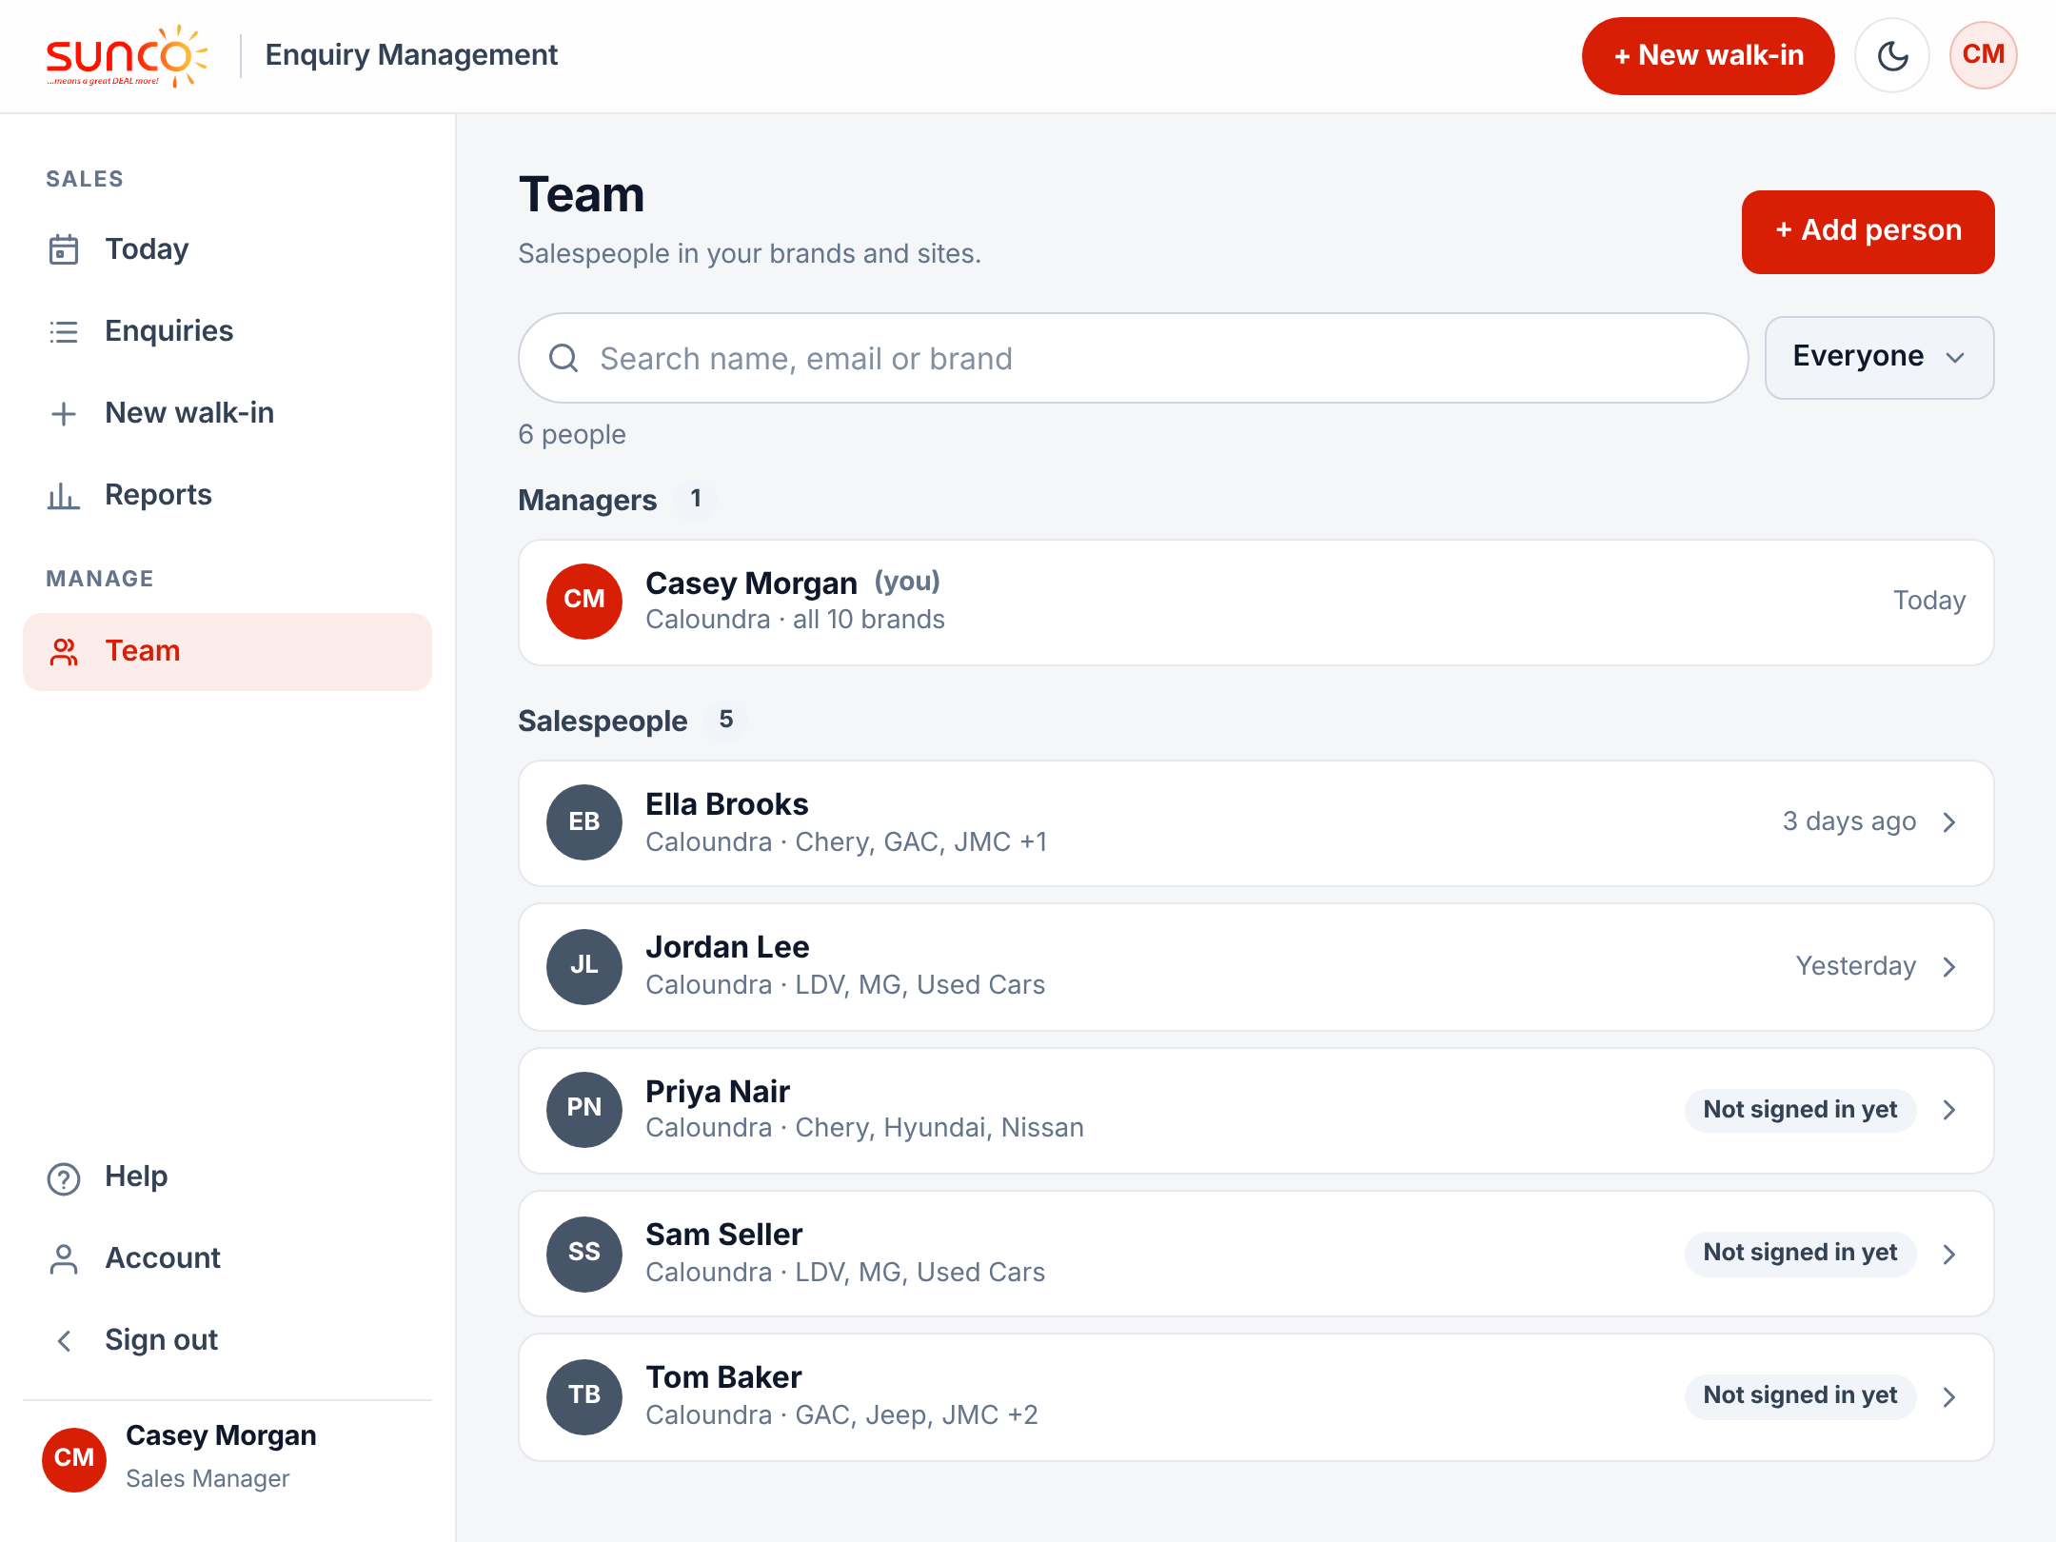


The Team page
Search
Name, email or brand.
Filter
By role, and by site for the GM.
Not signed in yet
They have not started using it.
Tap a person
To change brands or use More.
Notes:
One short row per person: their brands and when they last signed in. Disabled people are hidden; tap Show disabled to see them. Brands and sites decide what each person can see and log.

Slide 17
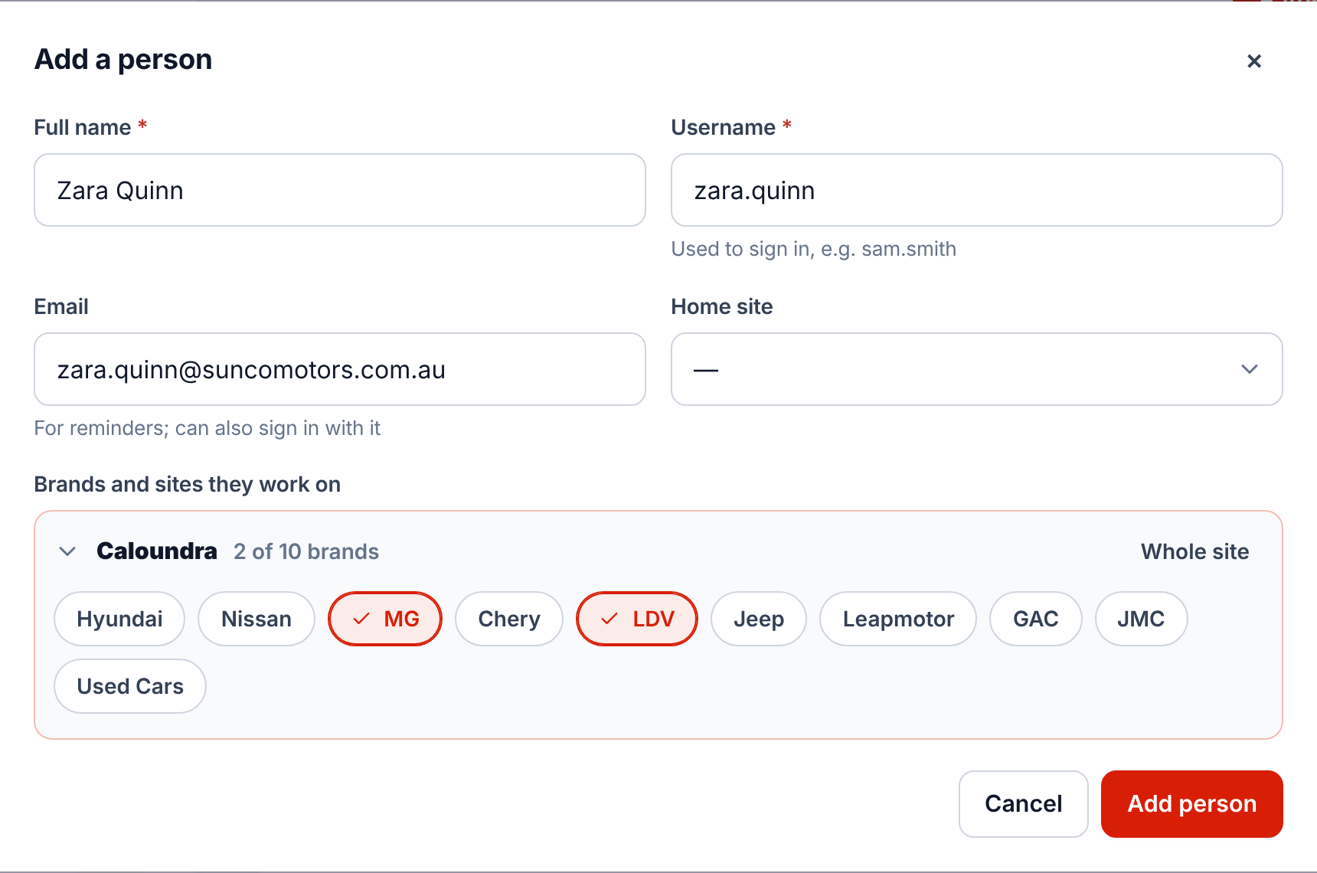
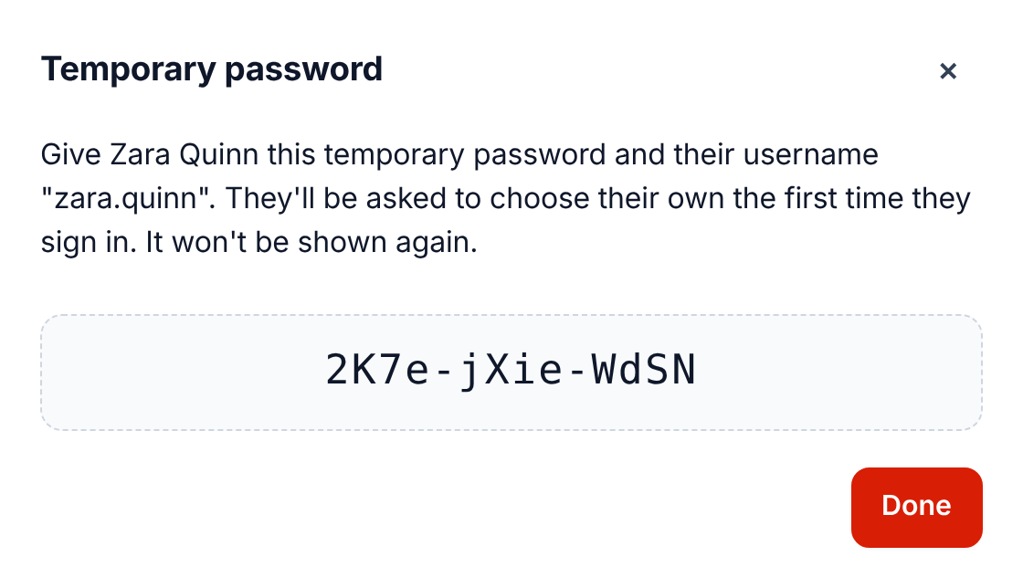


Add a new salesperson
Name, username, brands
Temporary password
Open their site and tap the brands they sell, then Add person.
Give it to them in person. They choose their own when they first sign in.
Notes:
Add an email address so they get the morning reminder. The temporary password is only shown once; if it is lost, use Reset password.

Slide 18
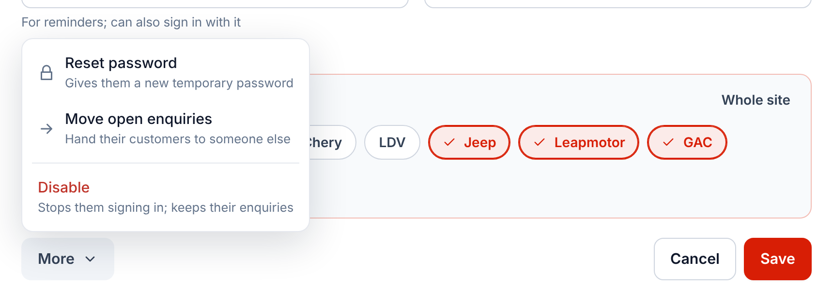
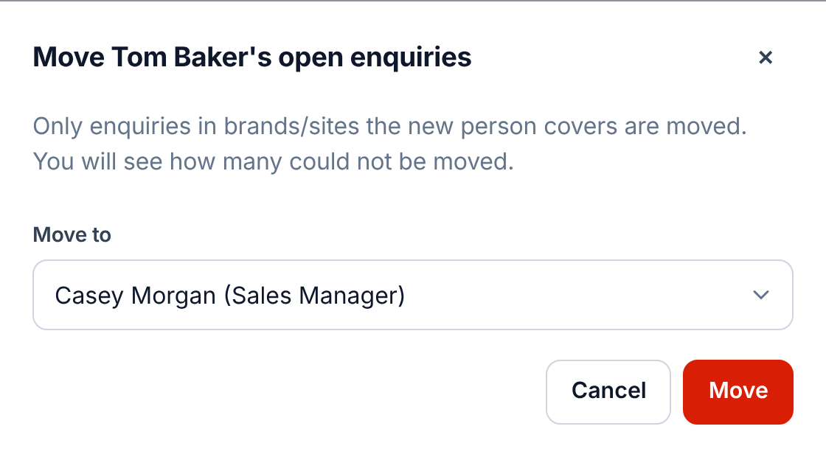

When someone leaves or goes on leave
Tap the person, then More
Move open enquiries
Reset password, Move open enquiries or Disable.
Choose who takes their customers. Then More, Disable.
Notes:
Disabling someone signs them out straight away. Their enquiries and history are kept and still count in the reports for the period they worked. To hand over a single customer, use Reassign on the ··· button of that enquiry.

Slide 19
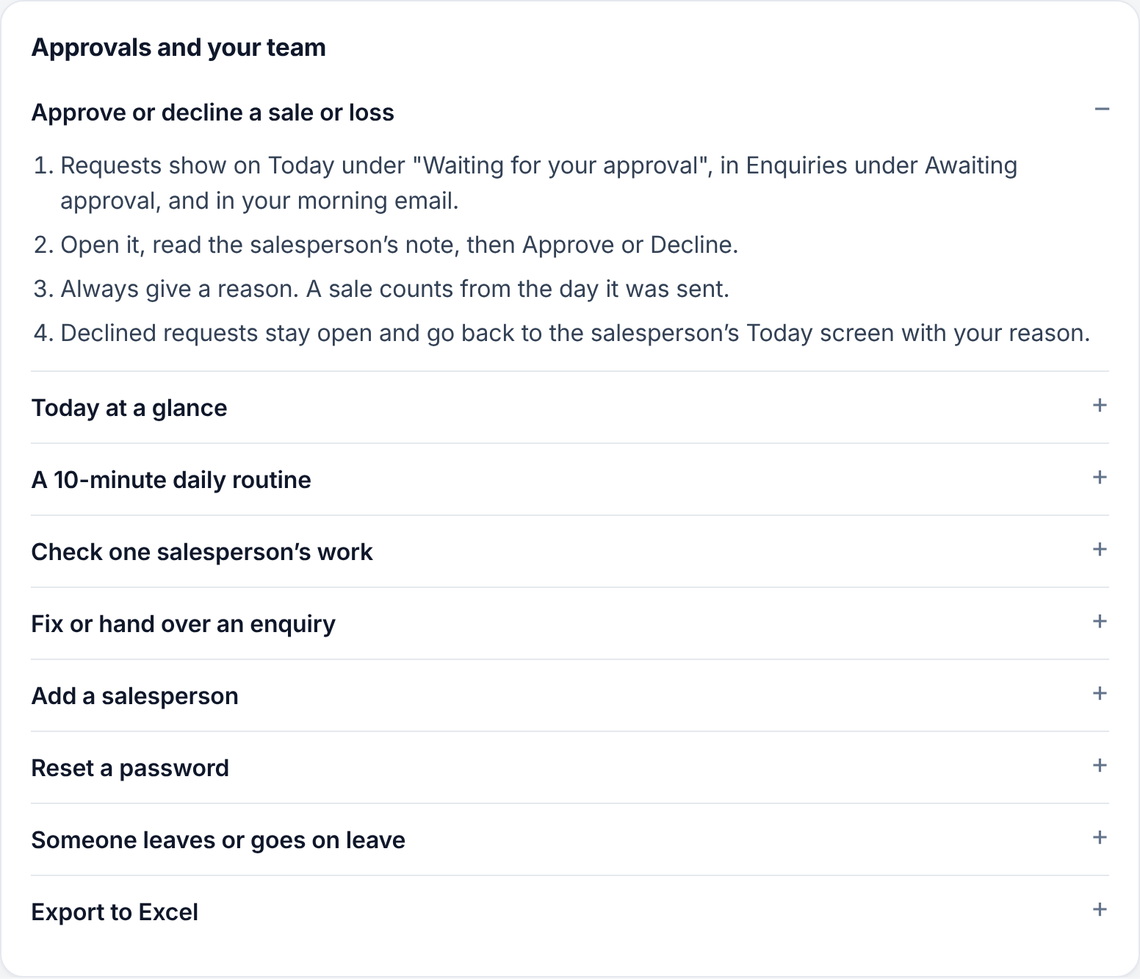

Help for your role
Help in the menu
Every how-to in this guide.
Only your role
Salespeople see their own version.
Search it
Try "approve" or "leaves".
Notes:
Point new salespeople to Help: it shows them only what they can do. Managers also see approvals, the team and the daily routine; the general manager also sees Admin, backups and the sales board.

Slide 20
General manager
The sales board, brand trends and Admin
Notes:
These screens are only for the general manager (and anyone given the admin flag).

Slide 21
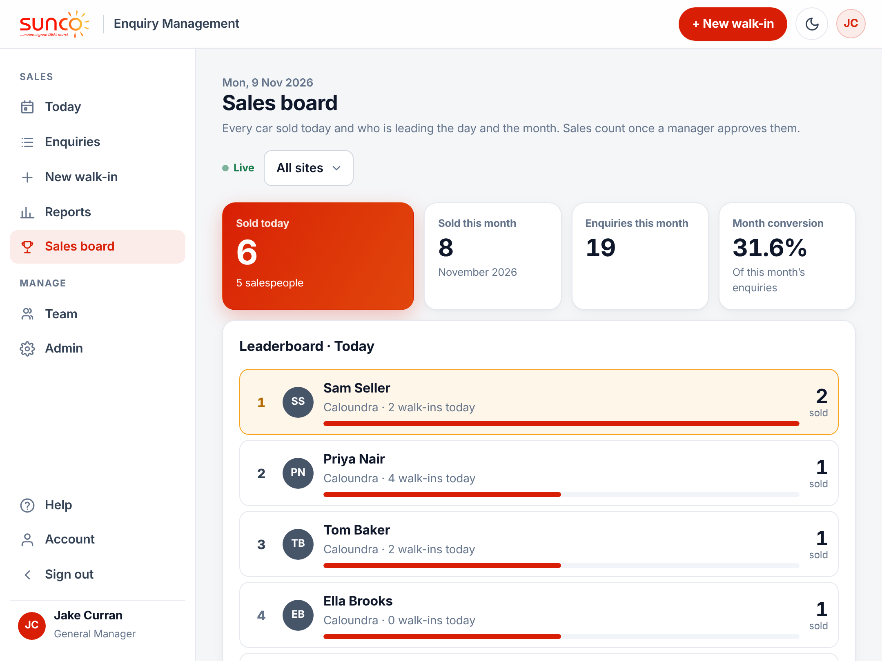




Sales board: who is selling today
Leaderboards
Cars sold today and this month, by salesperson.
The day at the top
Sold today, this month and conversion.
Live
Refreshes itself every minute.
Any site
All sites, or pick one.
Notes:
Sales board is in the menu for the general manager only. A sale appears once a manager approves it, at the time the salesperson marked it sold. It is a good screen to leave open on an office display.

Slide 22
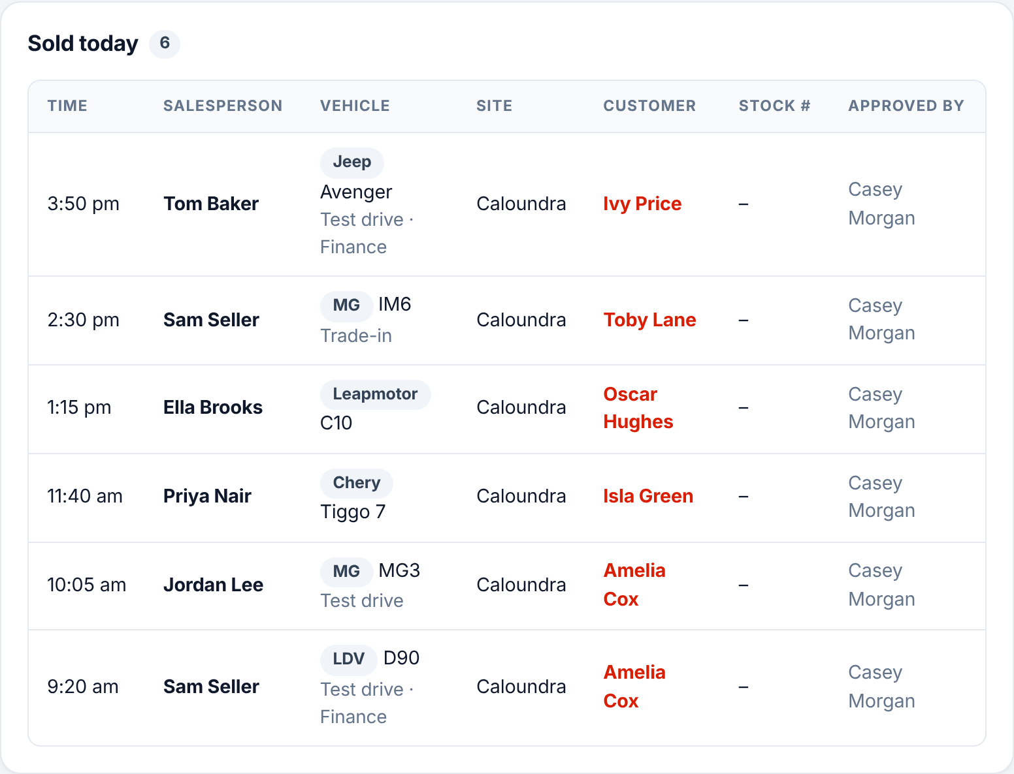

Every car sold today
When
The time it was marked sold.
Who and what
Salesperson, brand, model and site.
Approved by
The manager who signed it off.
Tap a row
Opens the enquiry.
Notes:
Test drive, trade-in and finance show under the vehicle. Below this list the board also shows cars sold this month by brand.

Slide 23
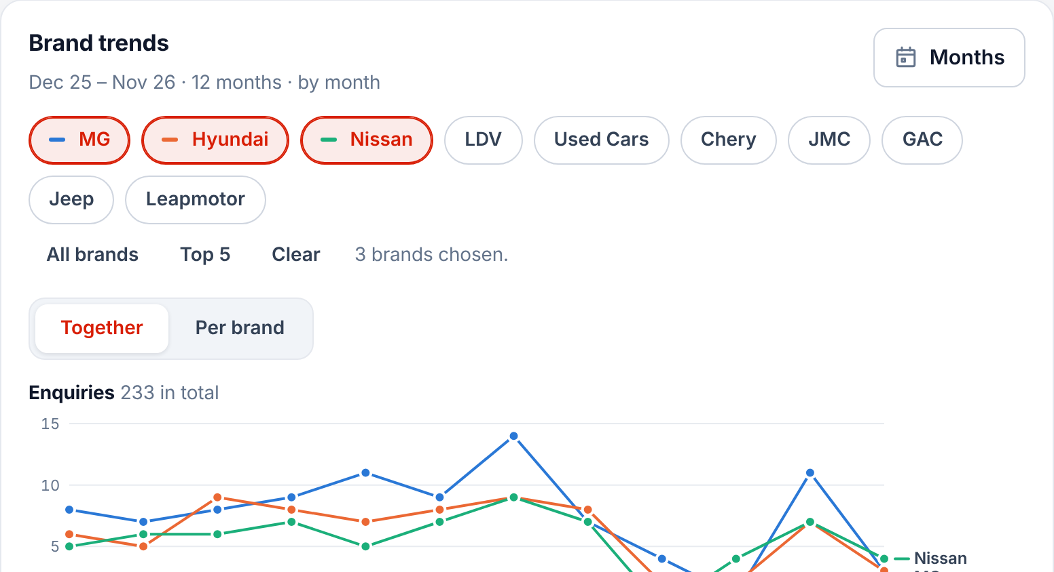
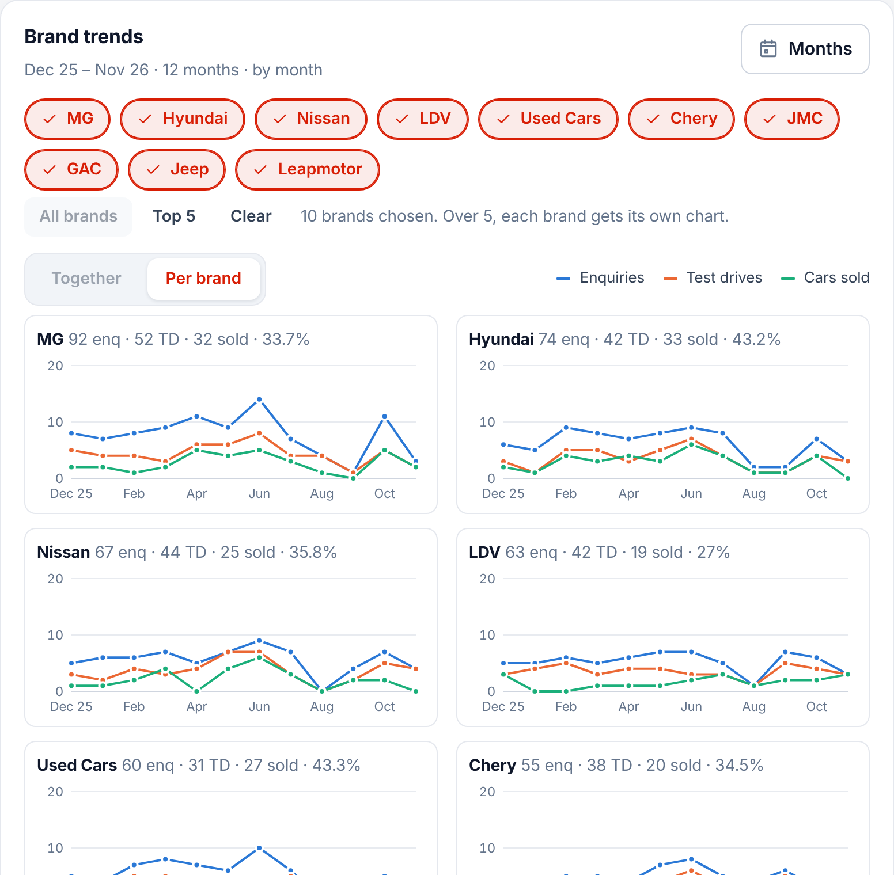

Brand trends in Reports
Together
Per brand
Up to five brands on one chart. The current month shows by day; tap Months for up to a year.
All brands, one chart each, on the same scale: enquiries, test drives and sold.
Notes:
Brand trends is at the top of Reports for the general manager. Tap brands to compare them, or All brands. The bubbles underneath show each brand’s share of enquiries, and the table lists every value.

Slide 24
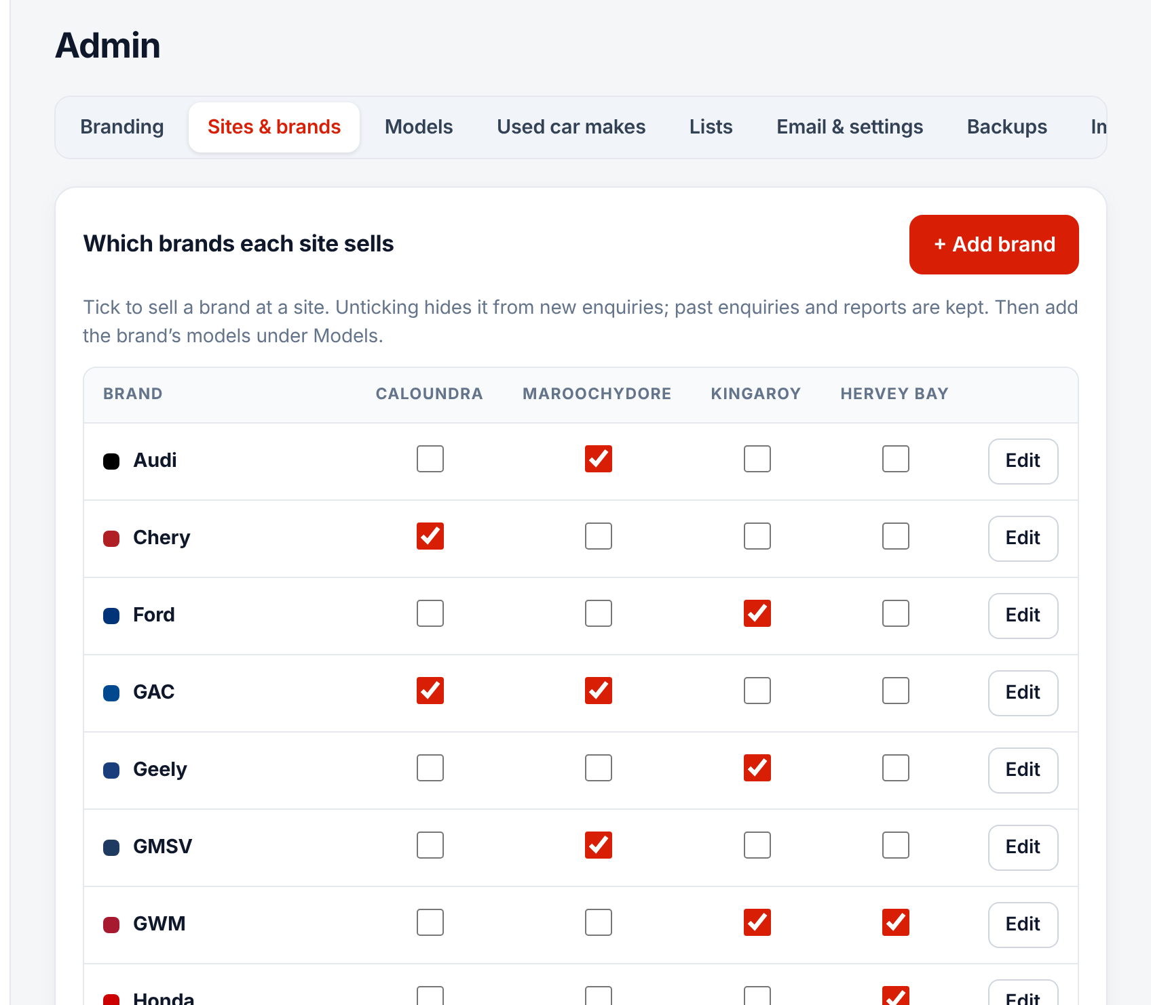
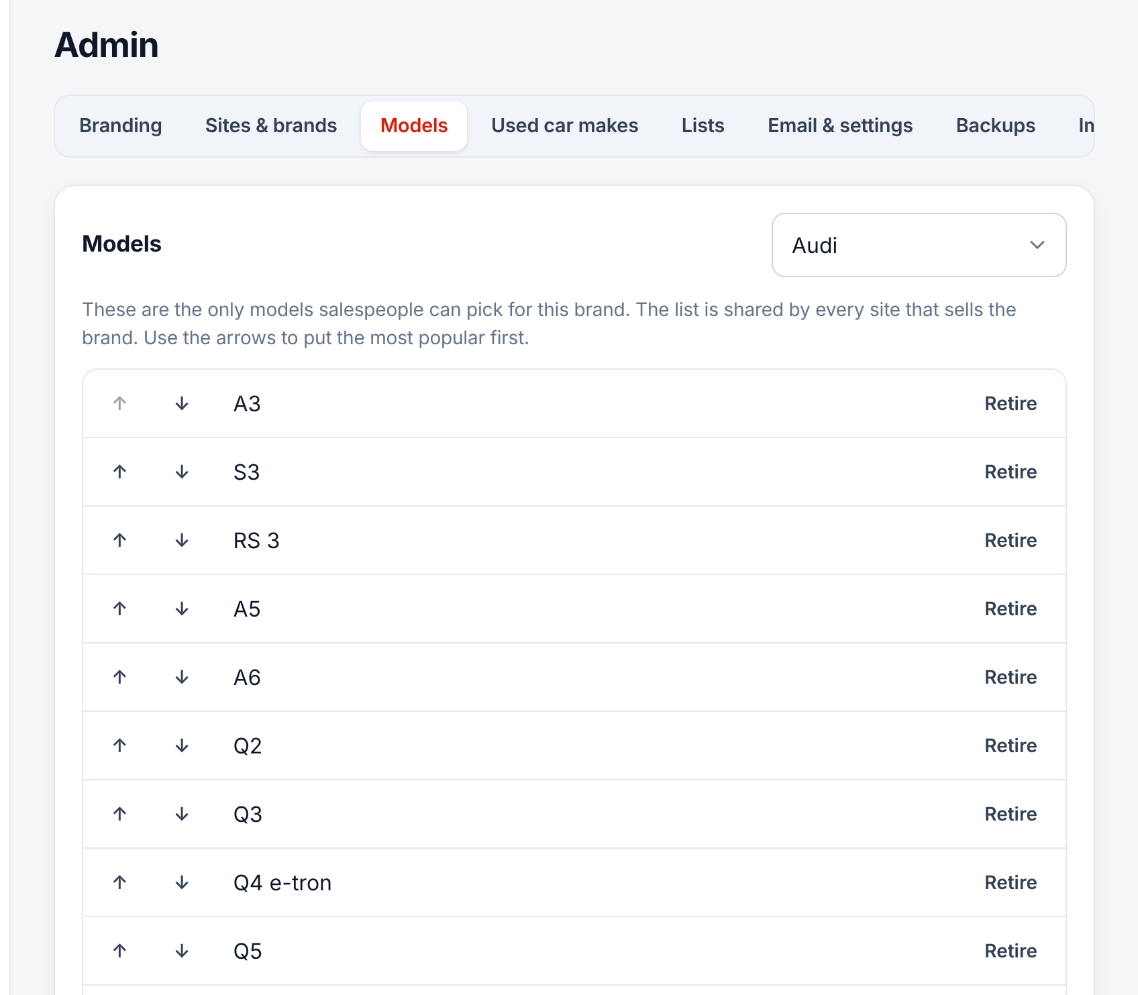


Admin: brands and models
Sites & brands
Models
Admin, Sites & brands. Tick which brands each site sells, or add a new brand.
Add a model the day it launches. Retire old ones; past enquiries keep them.
Notes:
Admin is only for people with the admin flag, normally the general manager. Salespeople can only pick from this model list, which keeps the reports clean. Use the arrows to put the most popular models at the top.

Slide 25
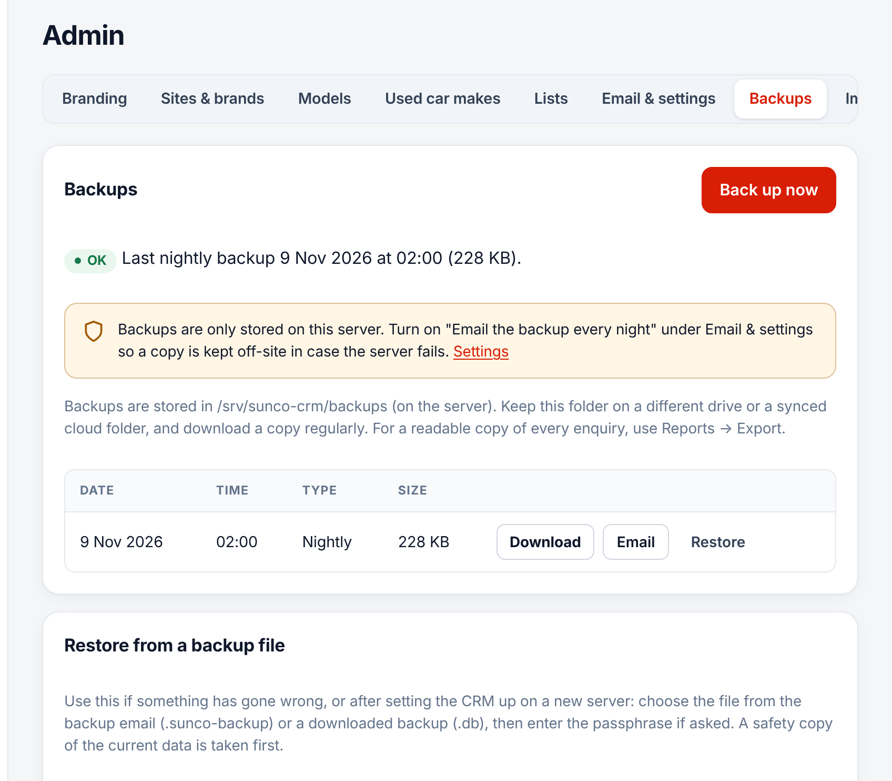
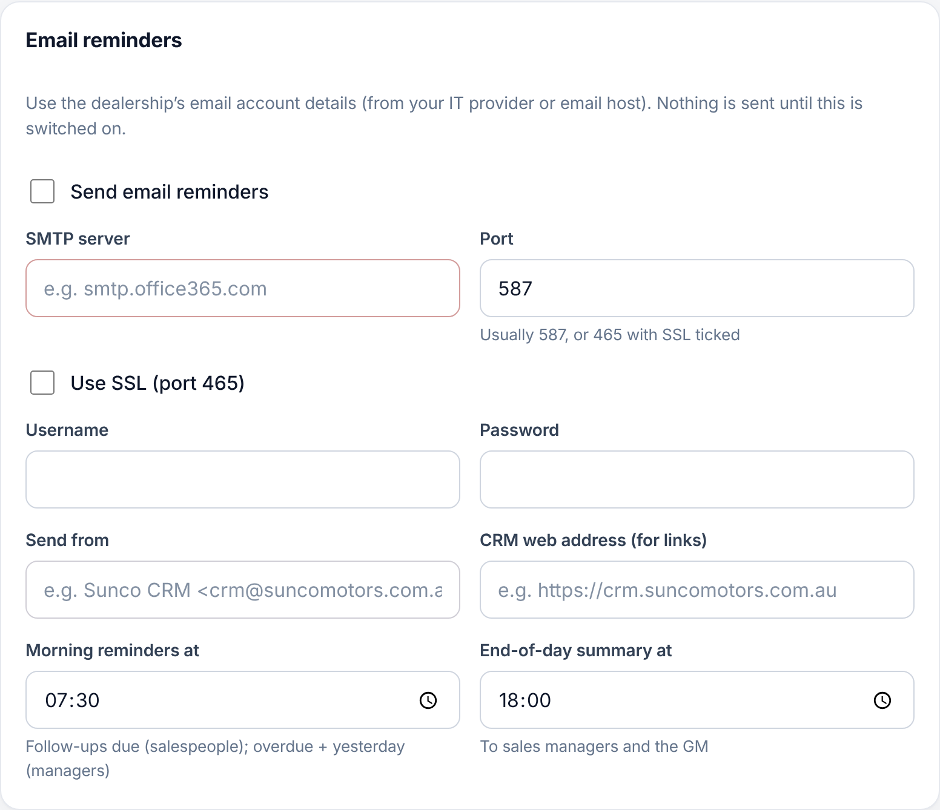


Admin: backups and email
Backups
Email reminders
A backup runs every night. Check the last one is OK, and email a copy off-site.
Turn on the morning reminders and end-of-day summary for the team.
Notes:
If the server ever fails, a backup file can be uploaded on a new server to restore every enquiry. Email settings come from your IT provider; use Send test to check them.

Slide 26

Approve daily.
Coach weekly.
Clear approvals every morning
Keep overdue close to zero
If it is not in the CRM, it did not happen.
Review Reports in your weekly meeting
Notes:
Wrap up by agreeing a daily approval time and a weekly review of the Reports page with each salesperson.

