Slide 1
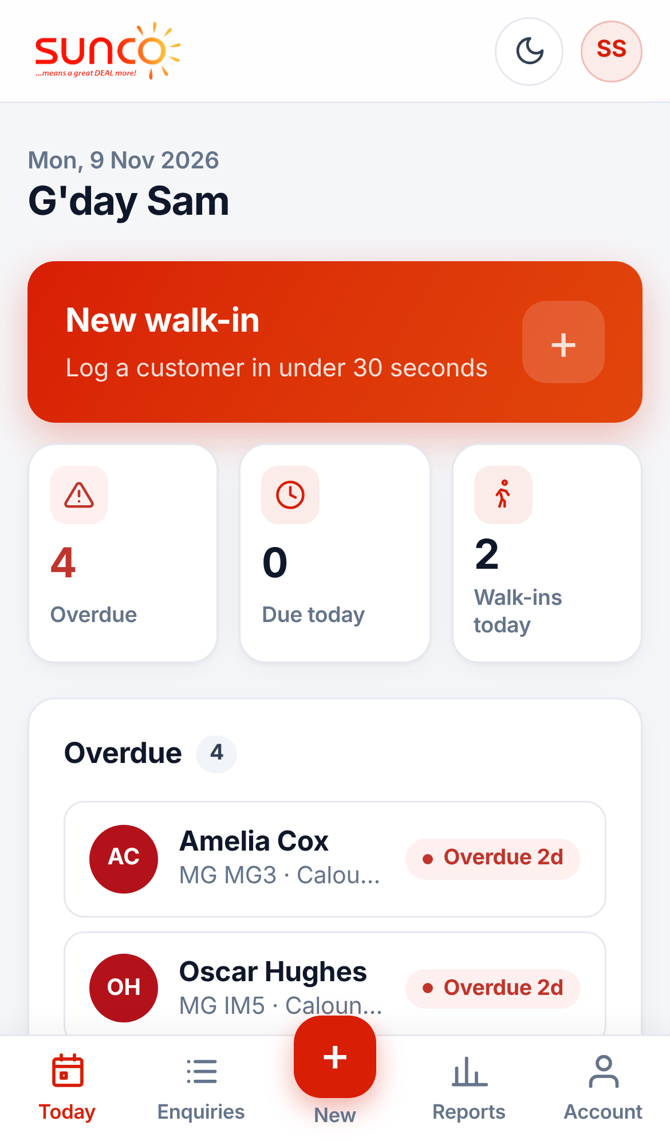
Salesperson guide
Using the CRM well
ENQUIRY MANAGEMENT CRM
Log every walk-in in 30 seconds, follow up on time and see your own numbers.
Notes:
Welcome. This guide shows salespeople how to use the Sunco Motors Enquiry Management CRM, which replaces the walk-in spreadsheet: logging a walk-in, working follow-ups, closing a deal and reading your own numbers. Every screen shown is the real system with demo data.

Slide 2




Why we use the CRM
Log a walk-in in 30 seconds
Never miss a follow-up
Mostly taps. The date, your name and the site fill themselves in.
Every open enquiry has a next date. Overdue ones go to the top.
No more month-end tabs
Your numbers, any time
One list. Enquiries stay open until they are sold or lost.
Enquiries, test drives and conversion for the day, month or year.
Notes:
The spreadsheet made people type the same things over and over, and enquiries got lost between monthly tabs. The CRM fixes both: entry is mostly taps, follow-ups are tracked for you, and there is no month-end carry-over.

Slide 3
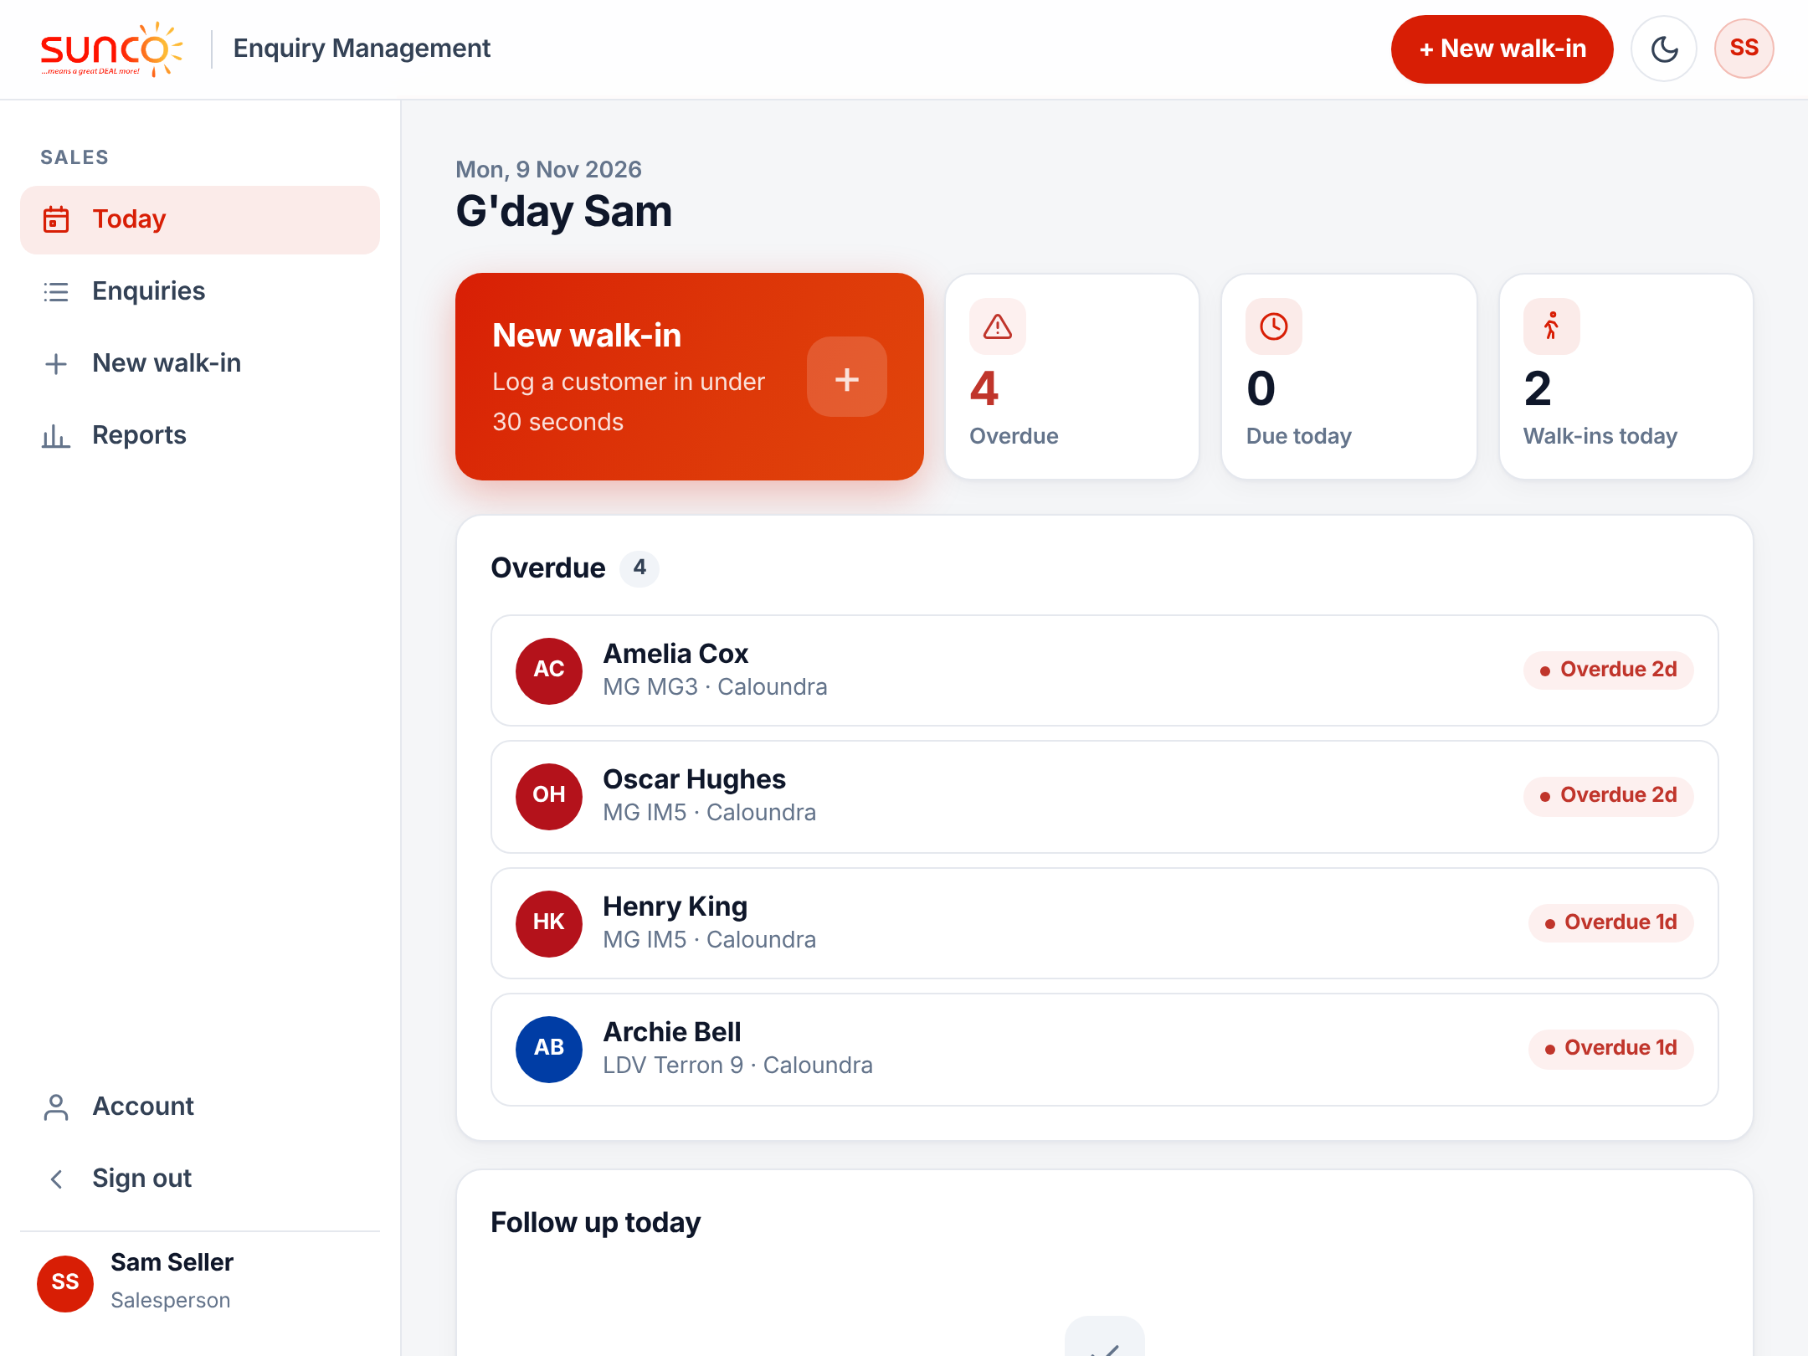
Your day starts on the Today screen
1
New walk-in
Tap it when a customer arrives.
2
Overdue
Follow-ups you missed. Clear these first.
3
Due today
The people to contact today.
4
Walk-ins today
Everyone you have logged today.
Notes:
Sign in with your own username and password. Today is home: work top to bottom, overdue first, then due today. Each list shows the first few, with See all for the rest. The moon button at the top switches between light and dark.

Slide 4
Logging a walk-in
Three steps, about 30 seconds, while the customer is still with you
Notes:
Open the form from New walk-in on Today, the + in the phone menu, or New walk-in at the top of any page. The form has three numbered steps: vehicle, customer and visit.

Slide 5
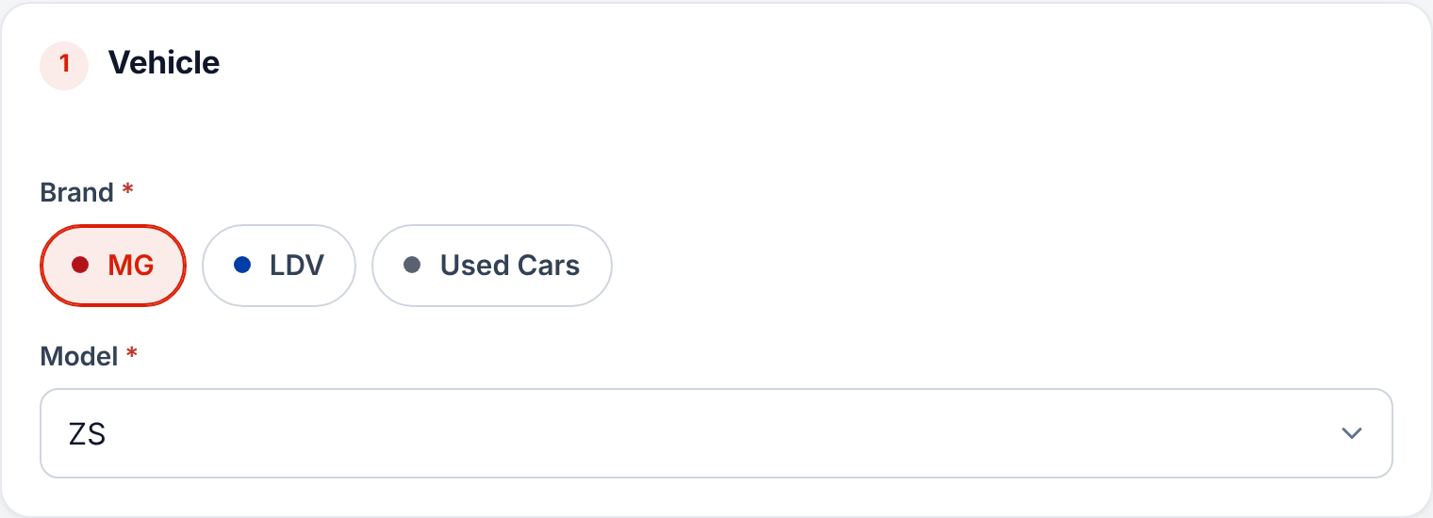



Step 1: pick the brand and model
Tap the brand
Only the brands you sell appear.
Choose the model
From the list, so every model is spelt the same.
Model missing?
Ask your sales manager to add it.
Notes:
Brand buttons only show the brands you are assigned to at your site. Models come from a fixed list per brand, which keeps the reports accurate. New models are added in Admin and appear straight away.

Slide 6
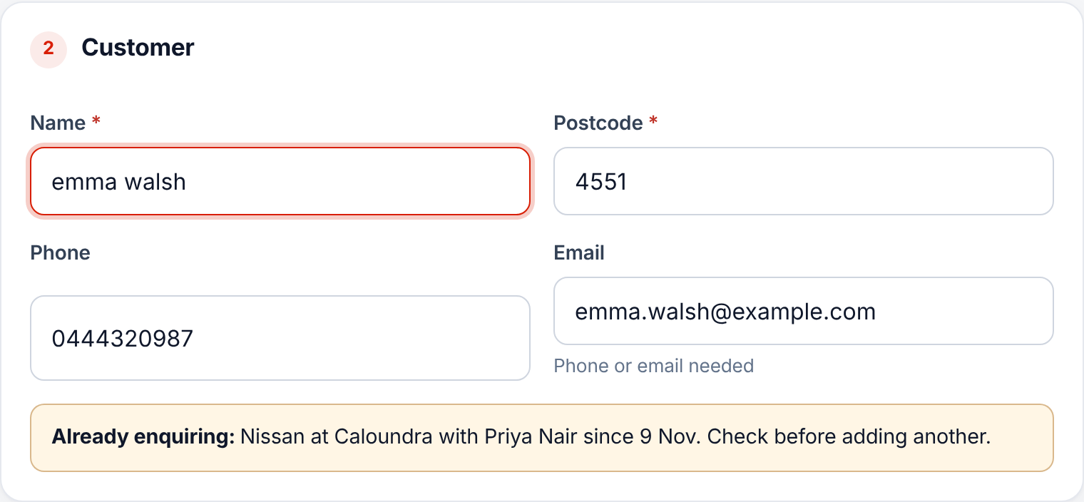

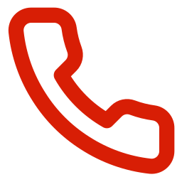

Step 2: who is the customer?
Name and postcode
Both required. Type it any way; it is tidied for you.
Phone or email
At least one, so you can follow up.
Already enquiring?
You are warned if they are open with someone else.
Notes:
"emma walsh" is saved as "Emma Walsh" and phone numbers are formatted for you. The duplicate warning checks every site, so two salespeople do not chase the same customer. If you see it, speak to that colleague or your manager instead of adding a second enquiry.

Slide 7
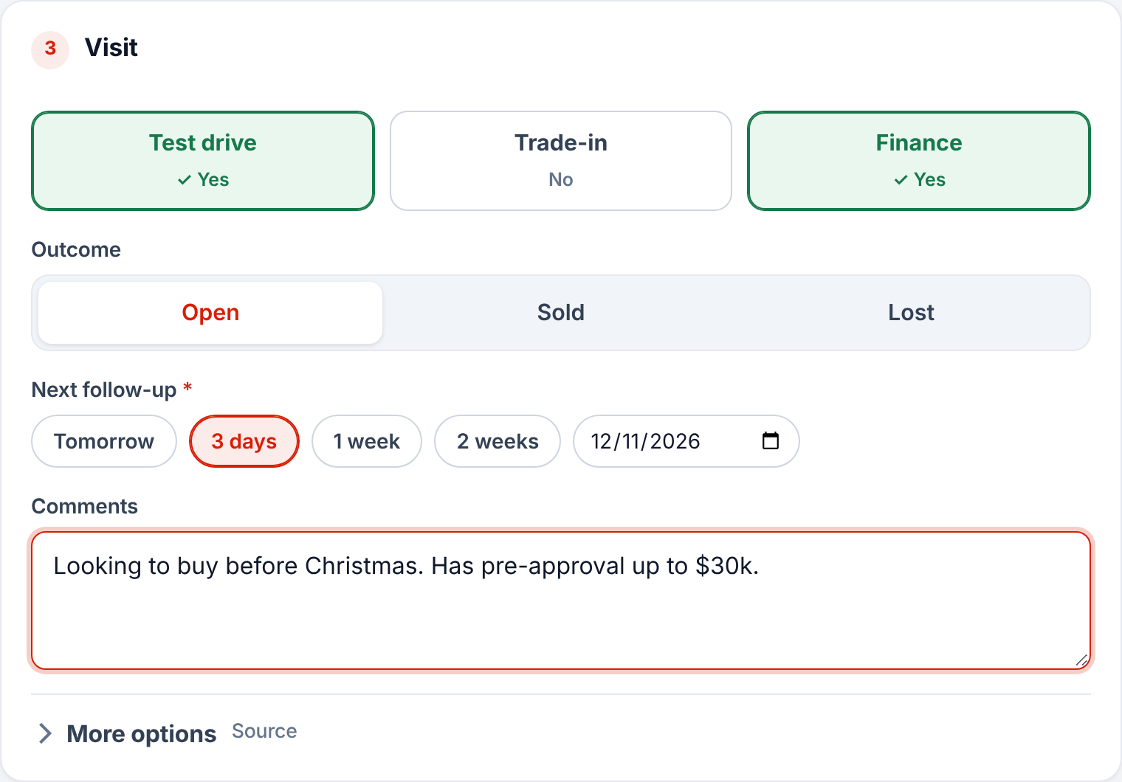
Step 3: the visit and next follow-up
1
Test drive, trade-in, finance
Tap each one that applies. Green means yes.
2
Leave it Open
Unless they bought or walked away today.
3
Pick the next follow-up
Tap a quick date such as 3 days.
4
Add a comment, then Save
One line on budget, timing or trade.
Notes:
Every open enquiry needs a next follow-up date. That date drives the Today screen and the morning reminder email. Saving takes you back to Today.

Slide 8
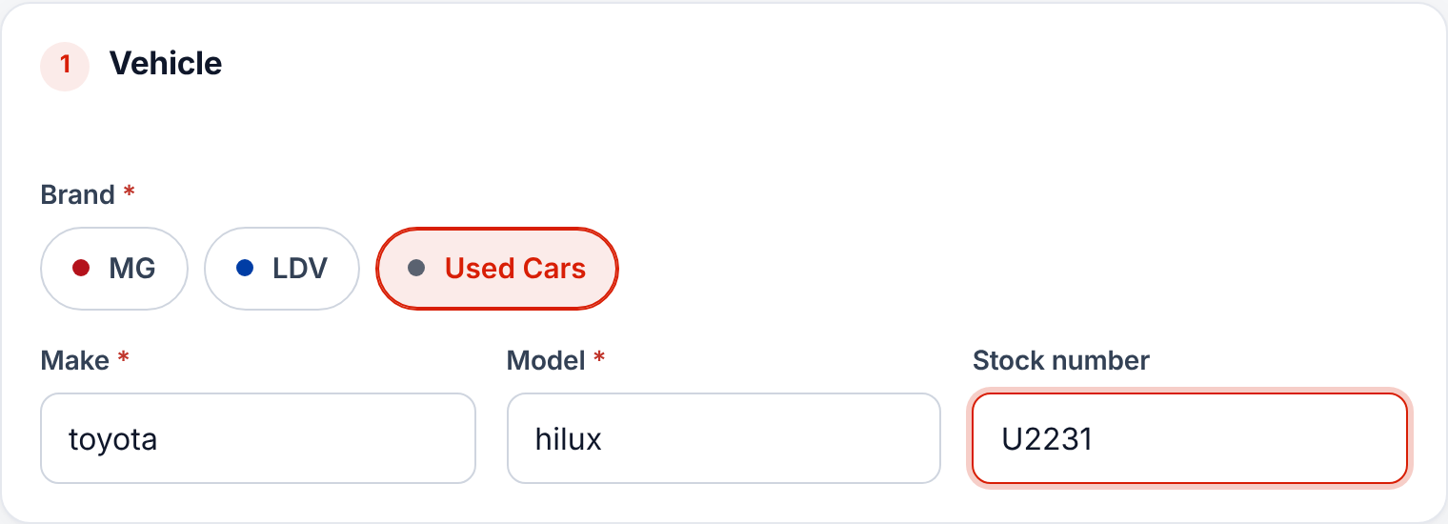



Used cars: type the make and model
Type it as you say it
"toyota hilux" is saved as Toyota HiLux.
Typos are matched
"hodna" is saved as Honda.
Stock number
Optional. You can search by it later.
Notes:
Choose Used Cars as the brand. Suggestions appear as you type. A make that has never been entered before is added for next time. Typing is only for used cars; new-car brands always use the model list.

Slide 9
Working your enquiries
Find a customer, log what happened, close it off
Notes:
This section covers the Enquiries list, the enquiry page, follow-ups, and marking an enquiry sold or lost, which your sales manager then approves.

Slide 10
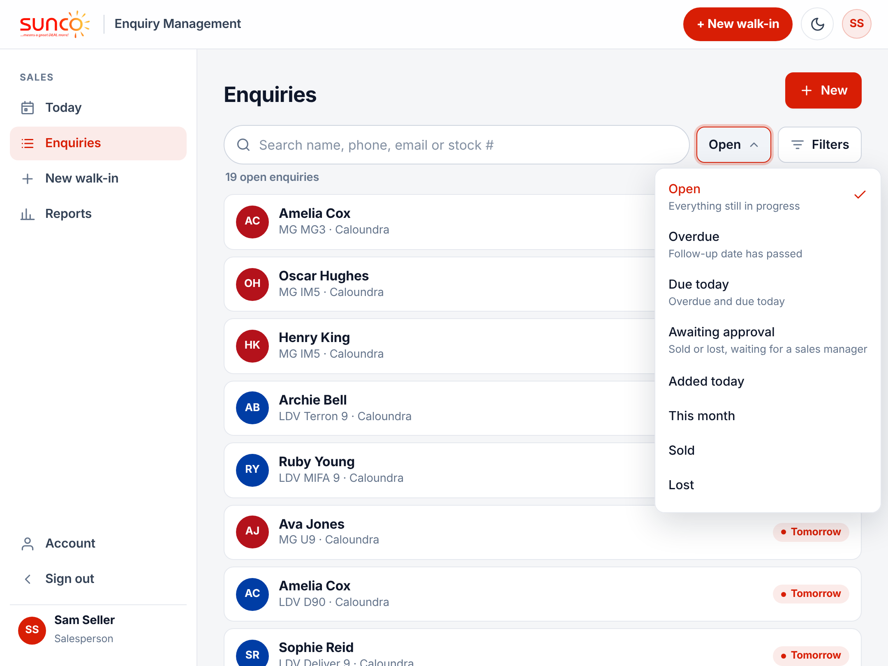



Find any enquiry in seconds
Search
By name, phone, email or stock number.
Show
Open, Overdue, Due today, Awaiting approval and more.
Filters
Narrow by brand or change the order.
Notes:
Open is the default: everything still in progress, soonest follow-up first. You only see your own enquiries; managers see their whole team. On a tablet the enquiry opens beside the list.

Slide 11
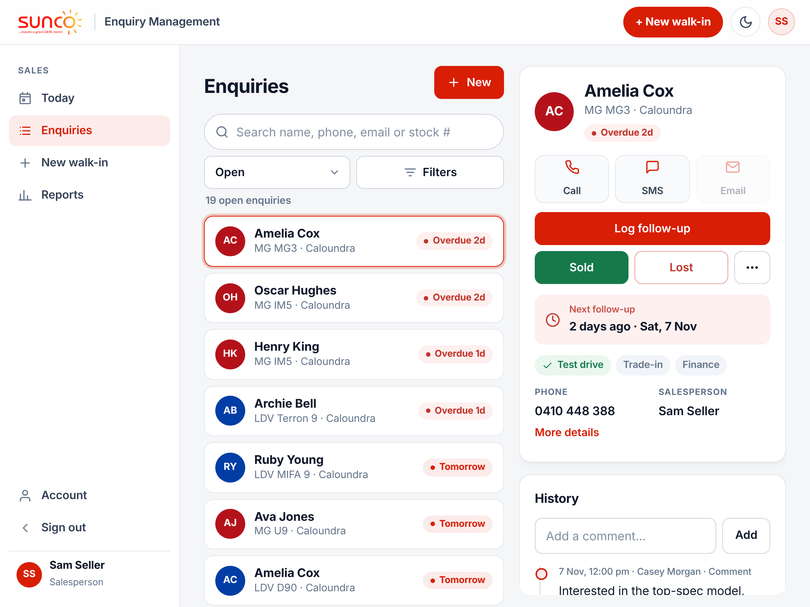
Everything about a customer on one page
1
Call, SMS or Email
One tap from your phone.
2
Log follow-up
Record what happened and the next date.
3
Sold or Lost
Close it when the customer decides.
4
More (···)
Edit the details if something changed.
Notes:
The top of the page shows only what you need to act. More details shows the postcode, source and date of entry. History at the bottom lists every call, comment and change, newest first.

Slide 12
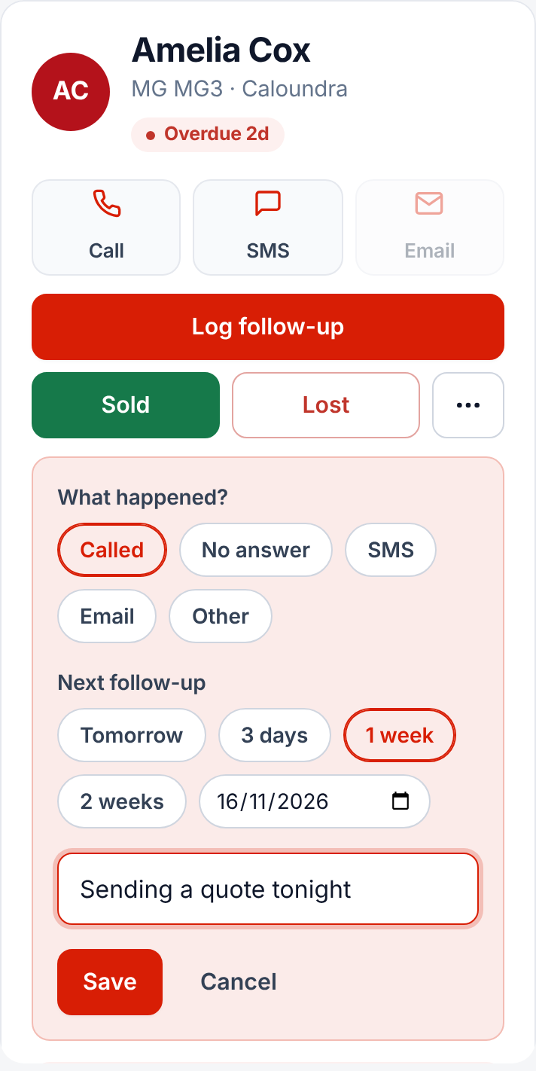
Log a follow-up in one step
1
Tap Log follow-up
On the customer’s page.
2
What happened?
Called, No answer, SMS, Email or Other.
3
Pick the next date
Tomorrow, 3 days, 1 week, 2 weeks or a date.
4
Add a note and Save
It goes into the history with your name.
Notes:
Log every contact, even when there is no answer. It keeps the follow-up date current and shows your manager the work you have put in. Reports count how many follow-ups were done on time.

Slide 13
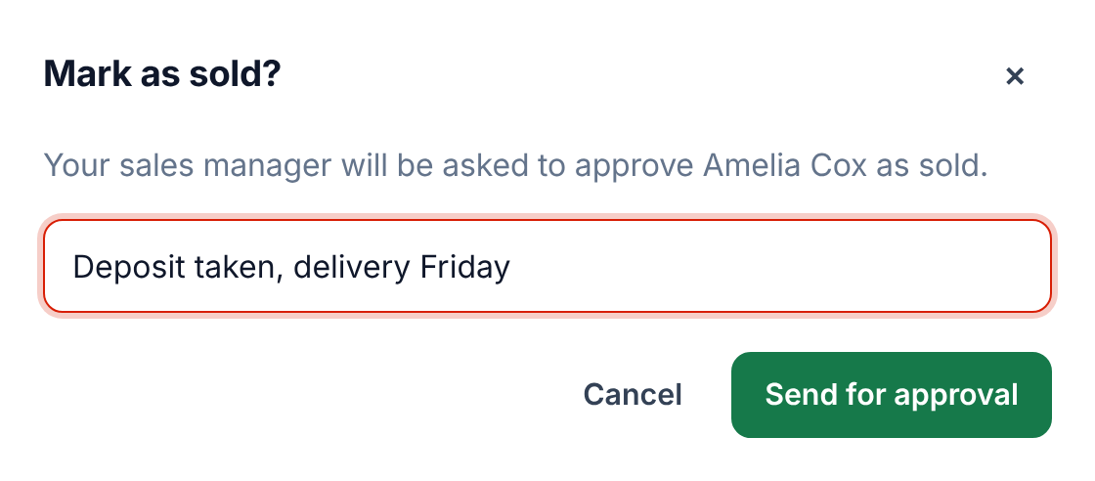
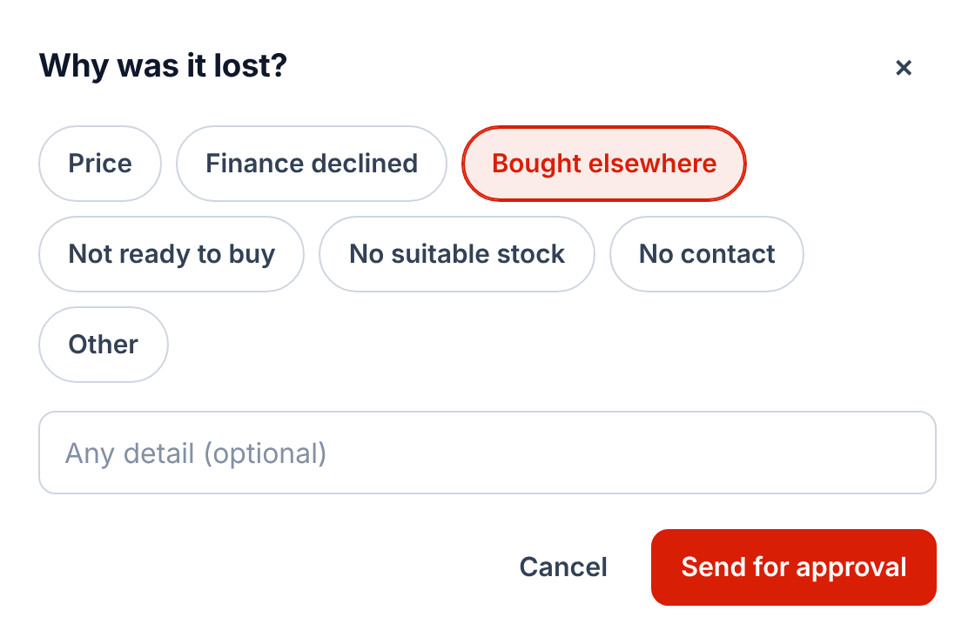


Sold or Lost goes to your manager
Sold
Lost
Tap Sold, add a short note such as "deposit taken", then Send for approval.
Pick the reason, add any detail, then Send for approval.
Notes:
Salespeople do not close enquiries on their own. Sold or Lost is sent to your sales manager, who approves or declines it with a reason. Do it the day it happens so the numbers stay true. A good note gets a quicker approval.

Slide 14
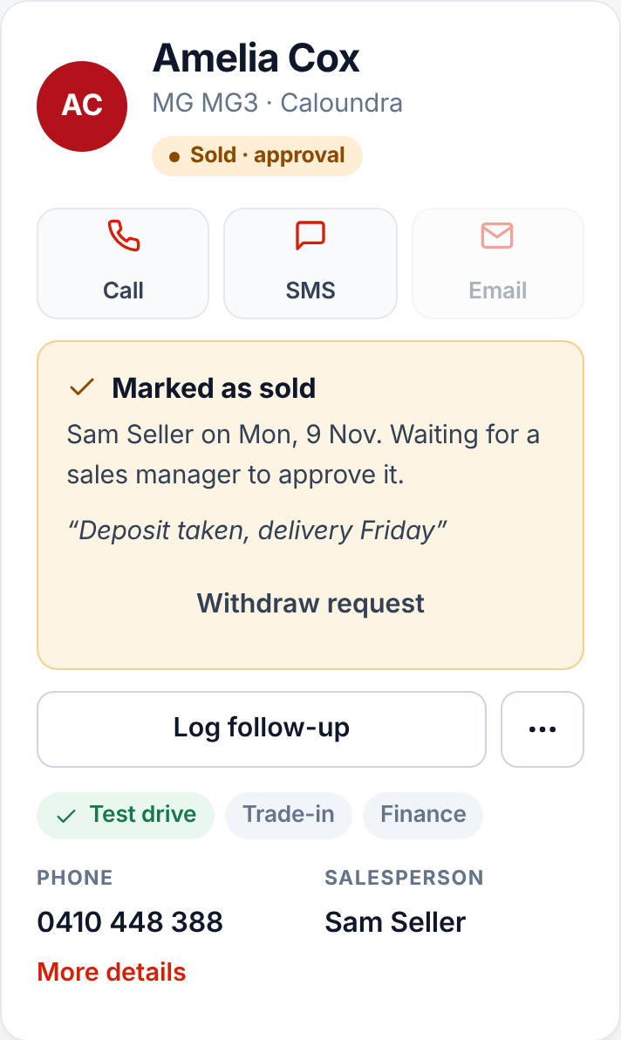




While you wait for approval
Marked "Sold · approval"
It stays open until your manager decides.
Changed your mind?
Tap Withdraw request.
Approved
It closes and counts in your numbers.
Declined
It stays open. Read the reason and follow up.
Notes:
Find everything you have sent with Show, then Awaiting approval. If the manager declines, their reason shows on the enquiry and in the history, and the follow-up date is set to today so it lands on your Today screen.

Slide 15
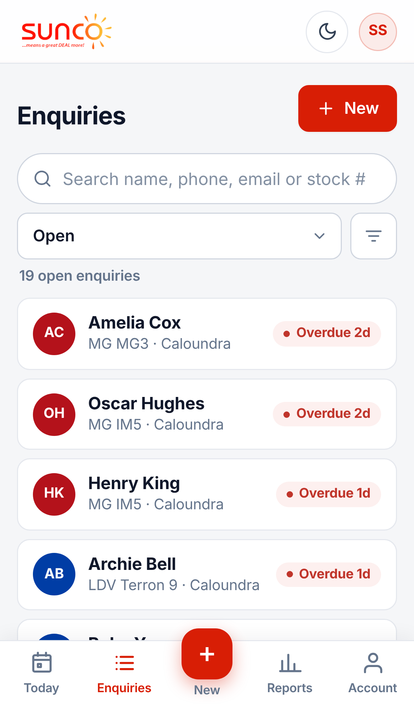
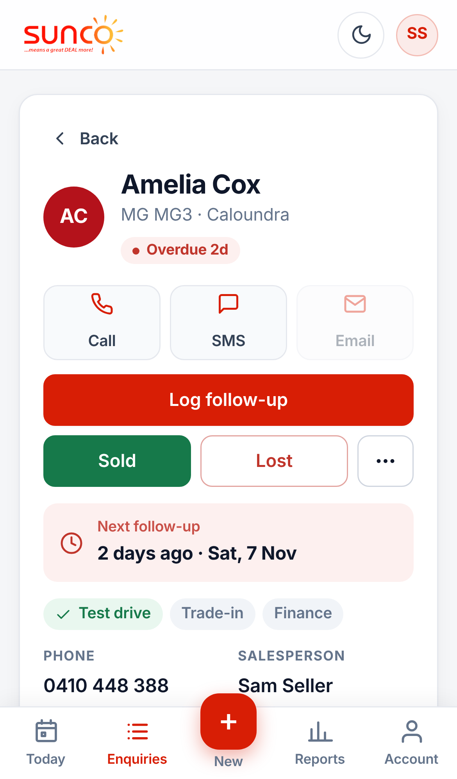
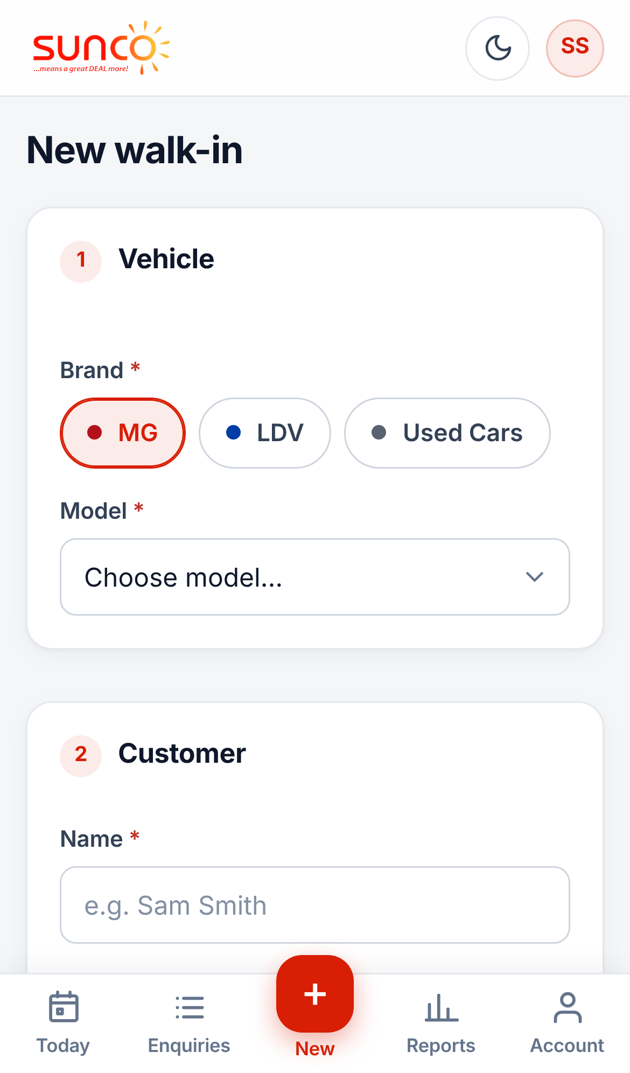
It works the same on your phone
Today
Enquiries
A customer
New walk-in
Notes:
Add it to your home screen so it opens like an app: in Safari tap Share then Add to Home Screen; in Chrome open the menu and tap Add to Home screen. The bottom bar has Today, Enquiries, + for a new walk-in, Reports and Account.

Slide 16
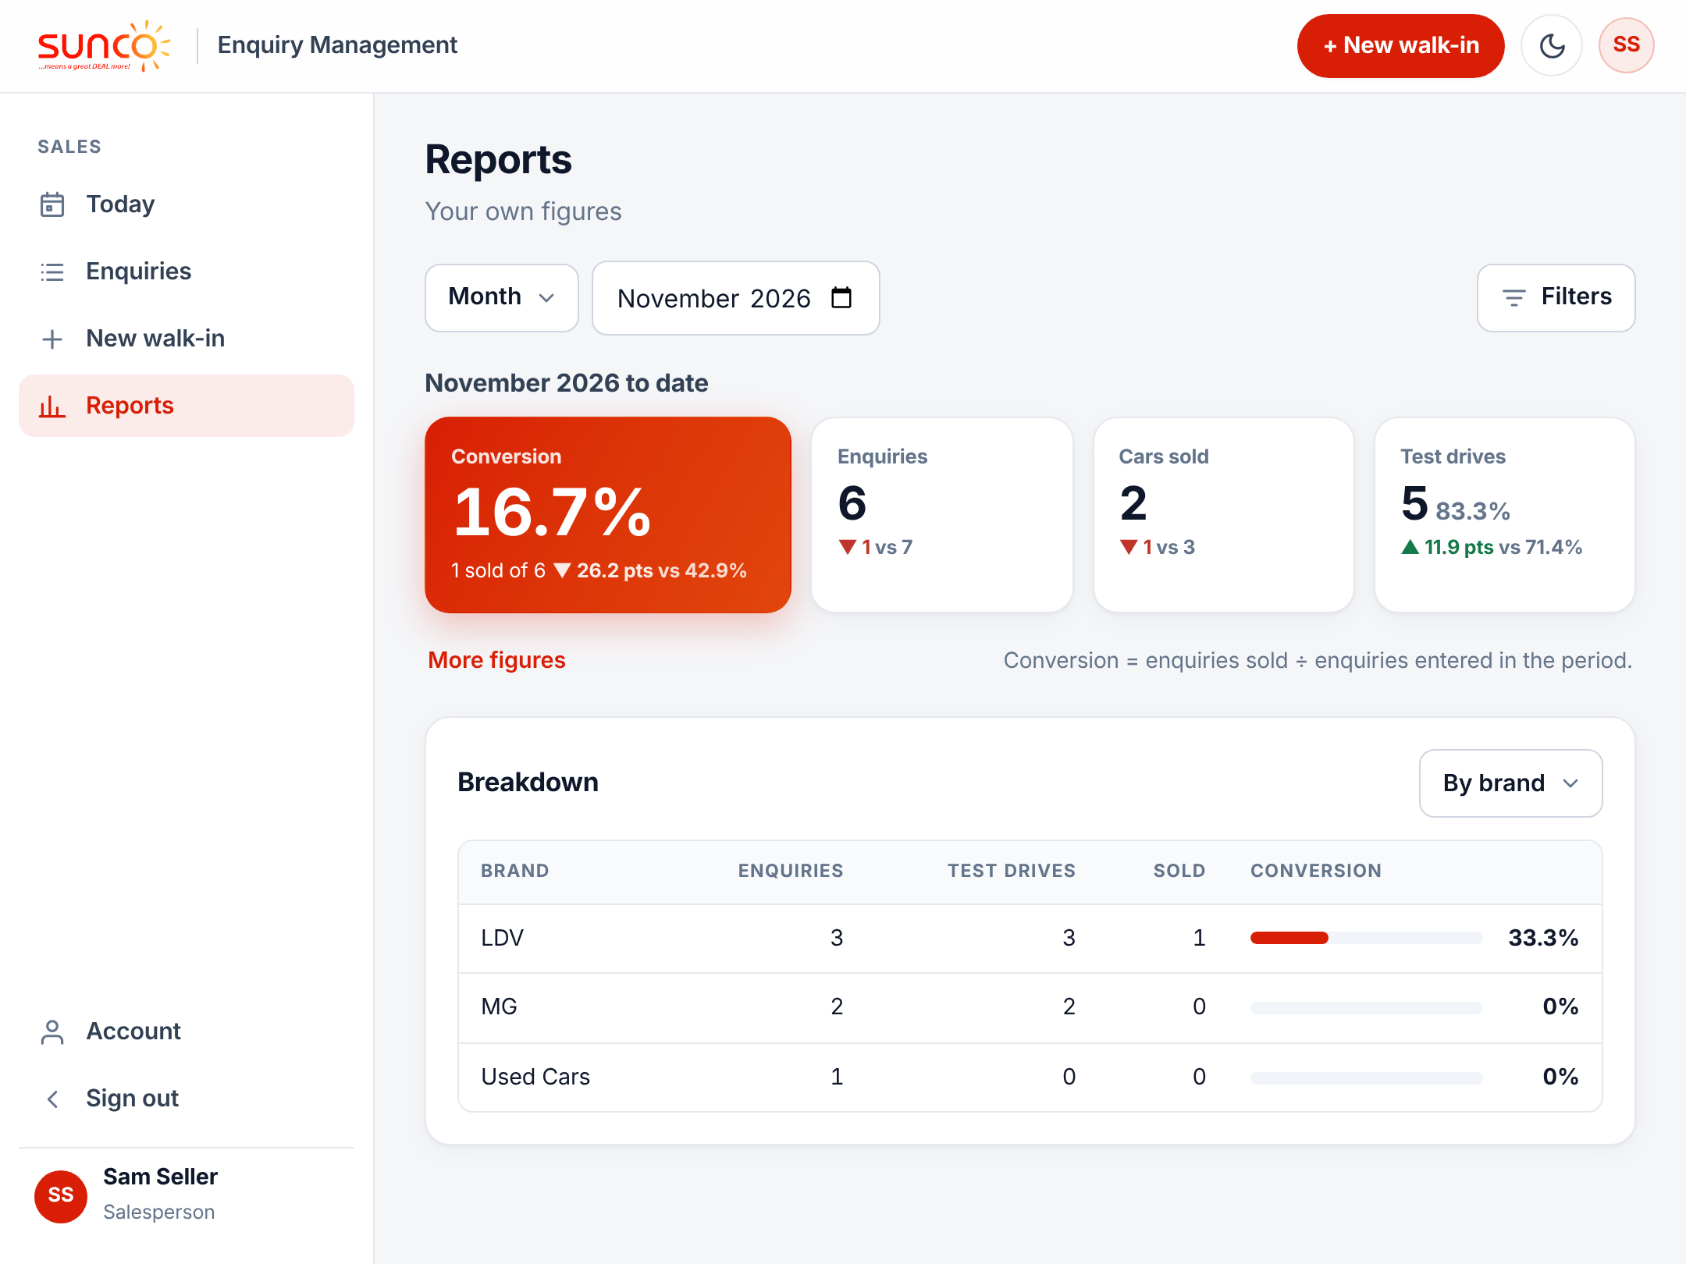


See your own numbers any time
33%
Conversion: 20 sold from 60 enquiries
Day, month or year
Choose the period at the top.
Breakdowns
By brand, model, source or lost reason.
Notes:
Conversion is enquiries sold divided by enquiries entered in the period: 20 sold from 60 enquiries is 33%. A sale only counts once your manager approves it. Salespeople see only their own figures, with the change from the previous period.

Slide 17





Five habits that make it work
Log it on the spot
Always set a follow-up
Clear overdue first
While the customer is still with you.
No date means no reminder.
Open Today each morning and work down.
Log every call
Close it off promptly
Even no answer. It shows the work you put in.
Send Sold or Lost the day it happens.
Notes:
These habits are what make the CRM useful. Your sales manager can see overdue follow-ups and how many walk-ins each person logs, so keeping it current protects you as well as the dealership.

Slide 18



Every walk-in.
Every time.
Sign in with your own login
Add it to your phone
Questions about access, brands or models? Ask your sales manager.
Watch for the morning email
Notes:
Close by asking everyone to sign in today, add the CRM to their phone and log their next walk-in in the CRM instead of the spreadsheet. Forgotten passwords are reset by a sales manager.

