Slide 1
be{er}.smart
A Machine Learning Approach to find the Beer for You
Notes:
Jake

Slide 2
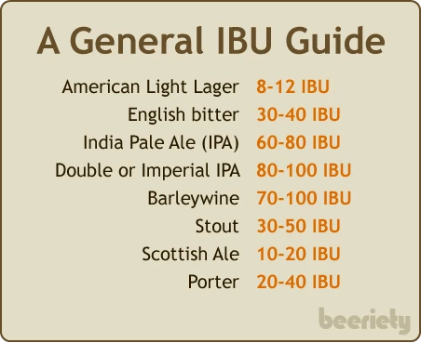
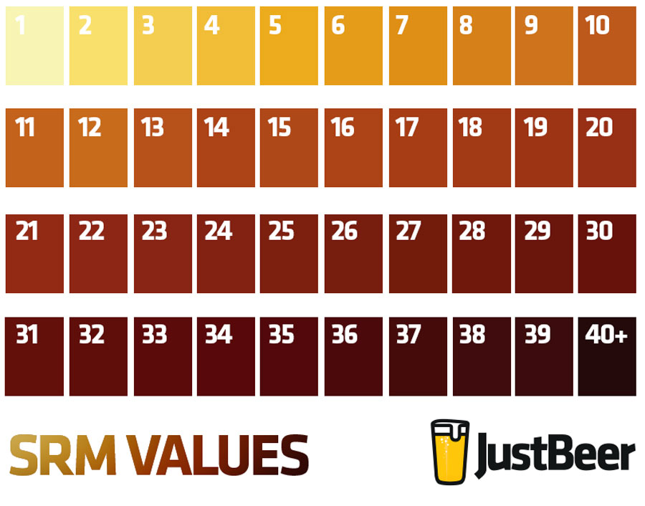
Project Objective & Data Sources
Create a machine learning model to predict a beer review score
This was based on attributes of the beer
IBU level (measure of bitterness)
SRM (Color Scale)
Data pulled from:
Brewerydb.com
Kaggle csv of beer styles
IBU and SRM examples
Notes:
Jake

Slide 3
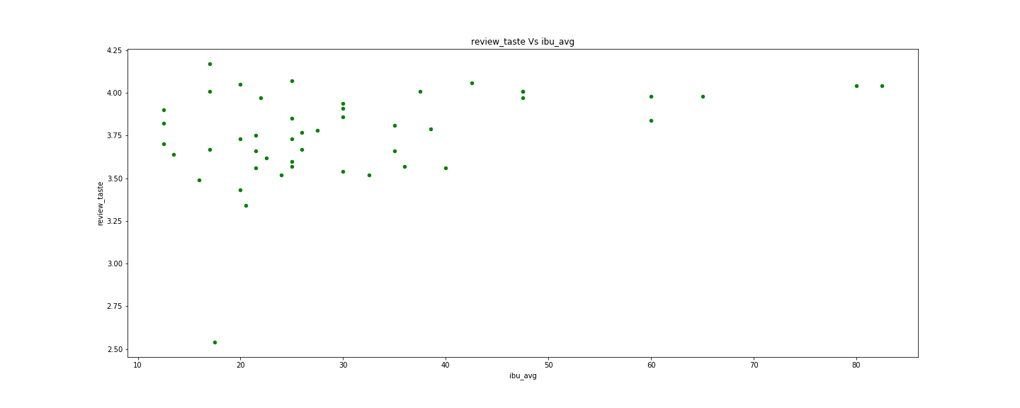
Data Analysis
Notes:
Mythili

Slide 4
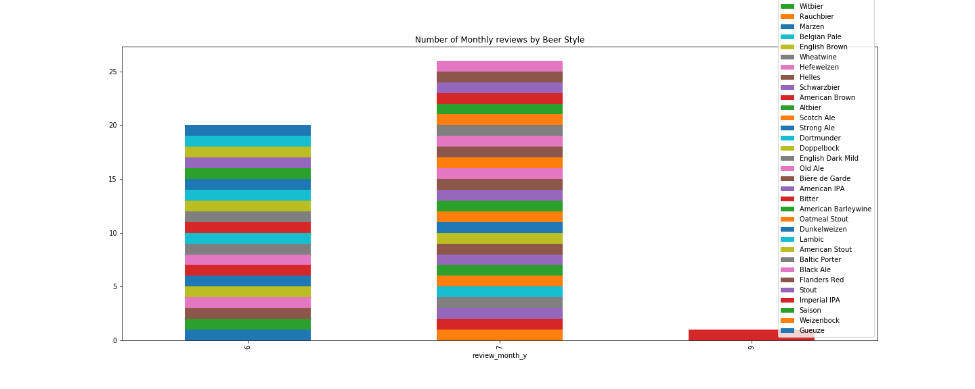
Data Analysis
Notes:
Mythili

Slide 5
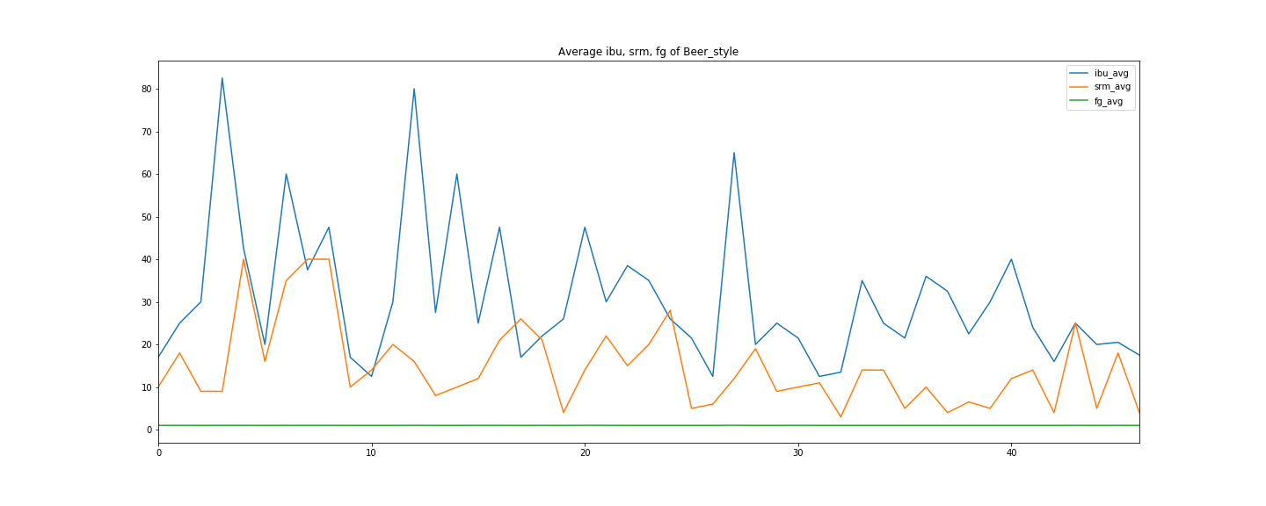
Data Analysis
Notes:
Mythili

Slide 6
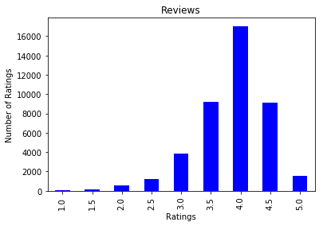
Difficulties in the Data
Ran a variety of machine learning models with data from all review profiles
No model had a score better than guessing that the review would be 4
Most people who submit beer reviews are:
Biased - reviews occur more often when reviewer liked the beer
Bad at reviewing - lots of 4s, little variety in scores
Reviewing similar beers - little variety in IBU, SRM scales
Upon realizing the drastic lack of balance in data:
Decided to model per reviewer
Focused on hero reviewers (balanced data)
Yielded much better performance
Notes:
Edgar

Slide 7
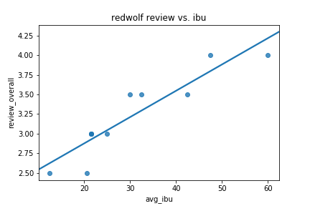

Training Approach
Multiple Linear Regression (Interpretability, equation for web app)
Features (independent variables):
IBU - Measure of Bitterness
SRM - Color Scale
Ran model for each review profile with over 10 reviews (7,000 + models)
Pulled top 20 models based on r-squared values
Used coefficients to drive application predictor
Notes:
Jackson

Slide 8
App Architecture
Web Server
Client
Kaggle:
Beer reviews
Data merge
https://brewerydb.com/
Beer Styles
Python
Flask
Data clean up
Java Script
json container (Beer Styles)
index.html
Web
APP
Java Script
Beer APP
Java Script
json container (Beer AI model)
Machine learning
Manual procedure executed by Admin.
Notes:
Pablo

Slide 9
Moving Forward
Building on the project:
Spend more time exploring models with reviewer-specific data
Allow for users to input reviews directly on app to feed model
Explore patterns in seasonality and location
Combine multiple machine learning models for user separation and to define influencer according to different taste and appearance reviews
Notes:
Pablo

