Slide 1
IEEE 802.1x Standard
Primary goal: to allow for controlled access to the LAN environment
  Authentication of Layer 2 devices
  Before a device is allowed to connect to the physical or logical port of a switch or a wireless access point, it first needs to be authenticated and authorized.
Example Uses: Ethernet, Token Ring, 802.11 WLAN
Additional resource: http://www.networkdictionary.com/protocols/8021x.php

Slide 2
802.1x Entities
Supplicant:
  requests to connect to a LAN
Authenticator:
  responsible for initiating the authentication process
  Acting as a relay btwn the authentication server and the supplicant
Authentication server:
  responsible for doing the actual authentication & authorization

Slide 3
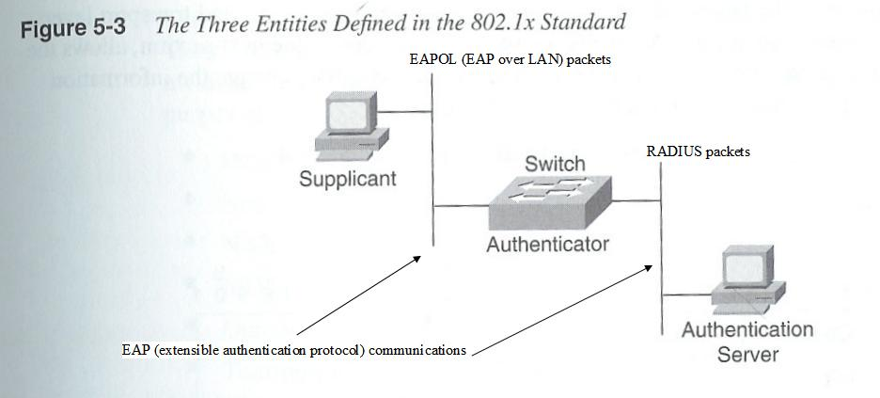
802.1x entities

Slide 4
Port access entity (PAE)
From section 6.2 of the IEEE 802.1x standard (http://standards.ieee.org/getieee802/download/802.1X-2001.pdf)
The Port Access Entity (PAE) operates the algorithms and protocols associated with the authentication mechanisms for a given Port of the System.
In the Supplicant role, the PAE is responsible for responding to requests from an Authenticator for information that will establish its credentials. The PAE that performs the Supplicant role in an authentication exchange is known as the Supplicant PAE.
In the Authenticator role, the PAE is responsible for communication with the Supplicant, and for submitting the information received from the Supplicant to a suitable Authentication Server in order for the credentials to be checked and for the consequent authorization state to be determined. The PAE that performs the Authenticator role in an authentication exchange is known as the Authenticator PAE.
  The Authenticator PAE controls the authorized/unauthorized state of its controlled Port (see 6.3) depending on the outcome of the authentication process.

Slide 5
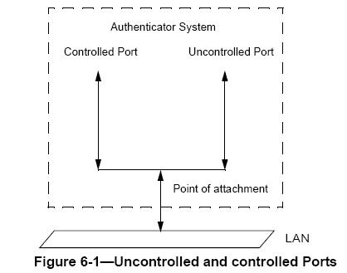
Controlled and uncontrolled access
The operation of Port-based access control has the effect of creating two distinct points of access to the Authenticator System’s point of attachment to the LAN.
The uncontrolled and controlled Ports are considered to be part of the same point of attachment to the LAN; any frame received on the physical Port is made available at both the controlled and uncontrolled Ports, subject to the authorization state associated with the controlled Port.

Slide 6
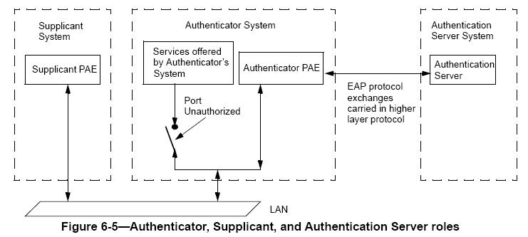
Supplicant – Authenticator - Auth. Server

Slide 7
802.1x communcations
EAP
  Originally developed for PPP
  Allow two entities to exchange authentication data via various authentication mechanisms:
    One-time password, MD5 hashed username and password, etc.
  RFC 2284 PPP Extensible Authentication Protocol (EAP) L. Blunk, J. Vollbrecht. March 1998 (obsoleted)
  RFC3748 Extensible Authentication Protocol (EAP) B. Aboba, L. Blunk, J. Vollbrecht, J. Carlson, H. Levkowetz (Ed.) June 2004 (current edition)
  RFC3579 RADIUS (Remote Authentication Dial In User Service) Support For Extensible Authentication Protocol (EAP) B. Aboba, P. Calhoun. September 2003.

Slide 8
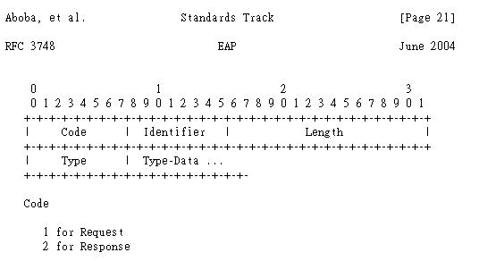
EAP
Aboba, et al. Standards Track [Page 21] RFC 3748 EAP June 2004 (ftp://ftp.rfc-editor.org/in-notes/rfc3748.txt)

Slide 9
EAP
4 types of EAP packets
  Request
  Response
  Success
  Failure
Subtypes of request/response messages:
  Identify: authenticator (“send your identity info”) → supplicant
  Notification: authenticator (“notification/warning, etc.”) → supplicant
  NAK: supplicant (“unacceptable! This is my desired authentication mechanism”) → authenticator
  MD-5 challenge: authenticator (challenge) → supplicant
        supplicant (response) → authenticator

Slide 10
EAP
Subtypes of request/response messages (cont.):
  One-time password
    a password with an expiration time that is about to expire, i.e., an OTP sequence integer which is nearing 0
  EAP-TLS message
    Allows a supplicant and an authentication server to use digital certificates to authenticate each other
    RFC2716 PPP EAP TLS Authentication Protocol B. Aboba, D. Simon. October 1999.
    A mutual authentication method

Slide 11
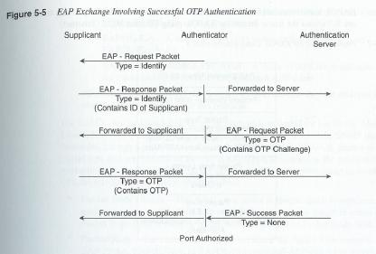
Using EAP in IEEE 802.1x
Question:
Is this protocol secure?
Is ‘replay attack’ possible?

Slide 12
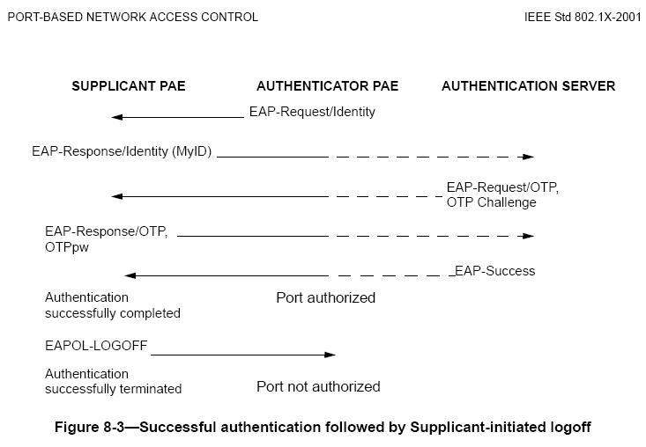
More EAP Scenarios in 802.1x

Slide 13
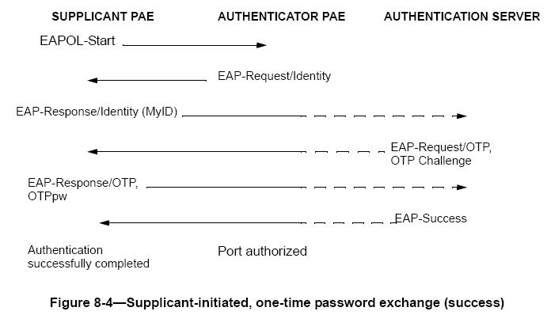
More EAP Scenarios in 802.1x

Slide 14
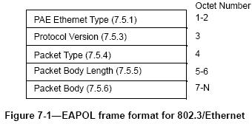
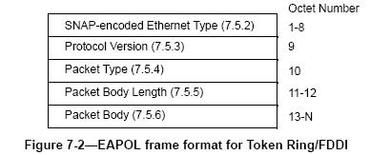
EAPOL
EAP over LANs
  Allows EAP packets to be encapsulated in regular LAN frames (e.g., Ethernet, Token Ring)
  Source: http://standards.ieee.org/getieee802/download/802.1X-2001.pdf

Slide 15
EAPOL Packet type in IEEE 802.3
a) EAP-Packet. A value of 0000 0000 indicates that the frame carries an EAP packet.
b) EAPOL-Start. A value of 0000 0001 indicates that the frame is an EAPOL-Start frame.
c) EAPOL-Logoff. A value of 0000 0010 indicates that the frame is an explicit EAPOL-Logoff request frame.
d) EAPOL-Key. A value of 0000 0011 indicates that the frame is an EAPOL-Key frame.
e) EAPOL-Encapsulated-ASF-Alert. A value of 0000 0100 indicates that the frame carries an EAPOL-Encapsulated-ASF-Alert.
All other possible values of this field shall not be used, as they are reserved for use in potential future extensions to this protocol.

Slide 16
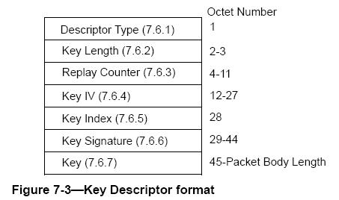
EAPOL-Key frame

Slide 17
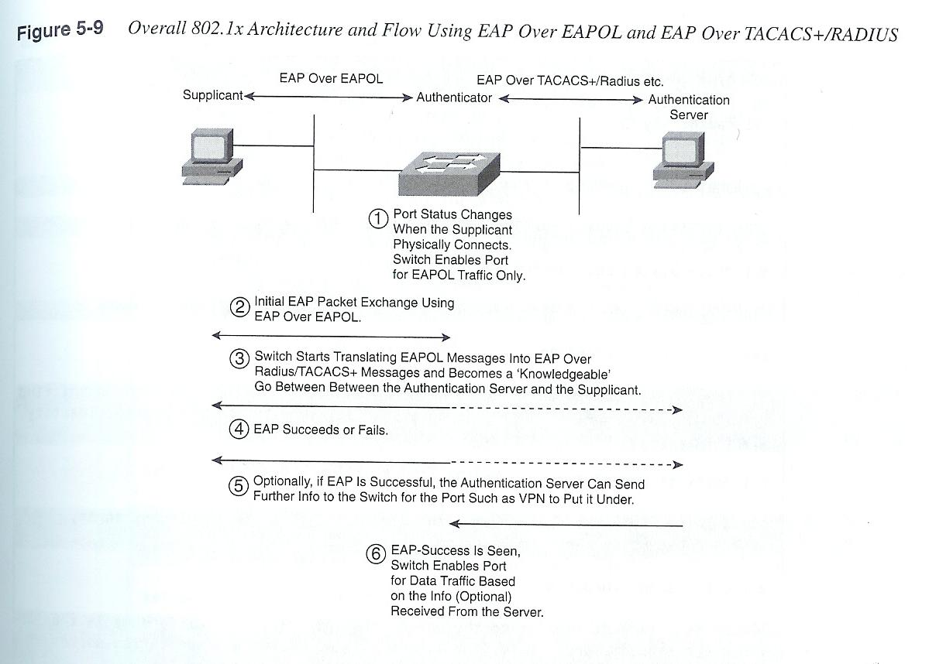
Overall 802.1x Architecture

