Slide 1
Wireless?
A wireless LAN or WLAN is a wireless local area network that uses radio waves as its carrier.
The last link with the users is wireless, to give a network connection to all users in a building or campus.
The backbone network usually uses cables

Slide 2
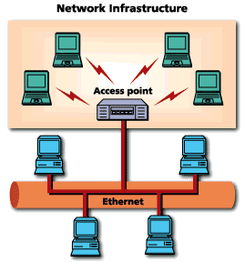
Common Topologies
The wireless LAN connects to a wired LAN
There is a need of an access point that bridges wireless LAN traffic into the wired LAN.
The access point (AP) can also act as a repeater for wireless nodes, effectively doubling the maximum possible distance between nodes.

Slide 3
Integration With Existing Networks
Wireless Access Points (APs) - a small device that bridges wireless traffic to your network.
Most access points bridge wireless LANs into Ethernet networks, but Token-Ring options are available as well.

Slide 4
How are WLANs Different?
They use specialized physical and data link protocols
They integrate into existing networks through access points which provide a bridging function
They let you stay connected as you roam from one coverage area to another
They have unique security considerations
They have specific interoperability requirements
They require different hardware
They offer performance that differs from wired LANs.

Slide 5
Physical and Data Link Layers
Physical Layer:
The wireless NIC takes frames of data from the link layer, scrambles the data in a predetermined way, then uses the modified data stream to modulate a radio carrier signal.
Data Link Layer:
Uses Carriers-Sense-Multiple-Access with Collision Avoidance (CSMA/CA).

Slide 6
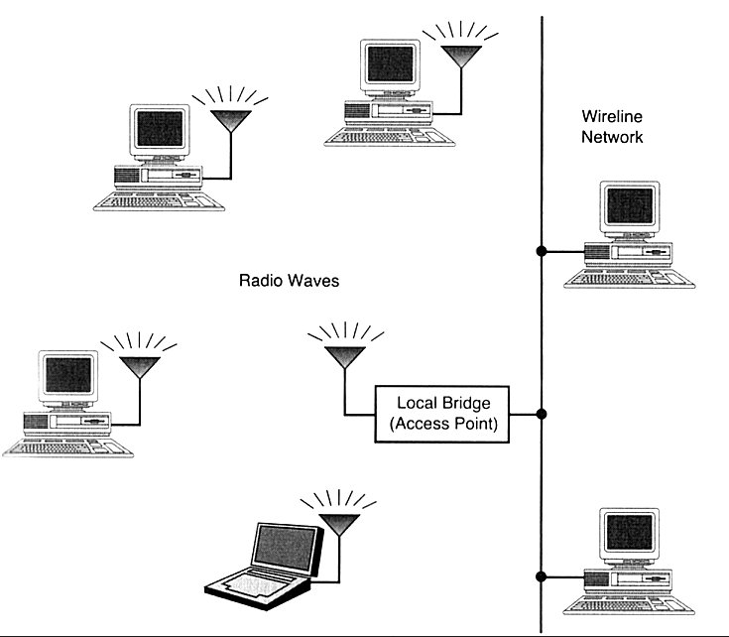
802.11 WLANs - Outline
801.11 bands and layers
Link layer
Media access layer
  frames and headers
  CSMA/CD
Physical layer
  frames
  modulation
    Frequency hopping
    Direct sequence
    Infrared
Security
Implementation
Based on: Jim Geier: Wireless LANs, SAMS publishing and IEEE 802 - standards

Slide 7
802.11 WLAN technologies
IEEE 802.11 standards and rates
  IEEE 802.11 (1997) 1 Mbps and 2 Mbps (2.4 GHz band )
  IEEE 802.11b (1999) 11 Mbps (2.4 GHz band) = Wi-Fi
  IEEE 802.11a (1999) 6, 9, 12, 18, 24, 36, 48, 54 Mbps (5 GHz band)
  IEEE 802.11g (2001 ... 2003) up to 54 Mbps (2.4 GHz) backward compatible to 802.11b
IEEE 802.11 networks work on license free industrial, science, medicine (ISM) bands:
26 MHz
83.5 MHz
200 MHz
255 MHz
902 928 2400 2484 5150 5350 5470 5725 f/MHz
EIRP power
in Finland
100 mW
200 mW
indoors only
1 W
EIRP: Effective Isotropically Radiated Power - radiated power measured immediately after antenna
Equipment technical requirements for radio frequency usage defined in ETS 300 328

Slide 8
Other WLAN technologies
High performance LAN or HiperLAN (ETSI-BRAN EN 300 652) in the 5 GHz ISM
  version 1 up to 24 Mbps
  version 2 up to 54 Mbps
HiperLAN provides also QoS for data, video, voice and images
Bluetooth
  range up to 100 meters only (cable replacement tech.)
  Bluetooth Special Interest Group (SIG)
  Operates at max of 740 kbps at 2.4 GHz ISM band
  Applies fast frequency hopping 1600 hops/second
  Can have serious interference with 802.11 2.4 GHz range network

Slide 9
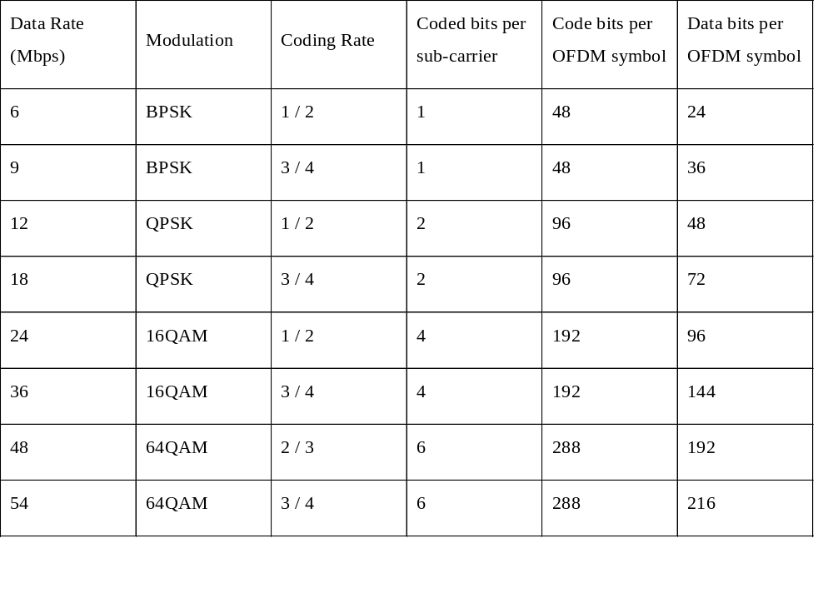
IEEE 802.11a rates and modulation formats

Slide 10

The IEEE 802.11 and
supporting LAN Standards
IEEE 802.2
Logical Link Control (LLC)
OSI Layer 2
(data link)
IEEE 802.3
Carrier
Sense
IEEE 802.4
Token
Bus
IEEE 802.5
Token
Ring
IEEE 802.11
Wireless
MAC
PHY
OSI Layer 1
(physical)
a
b
g
bus
star
ring
See also IEEE LAN/MAN Standards Committee Web site
www.manta.ieee.org/groups/802/

Slide 11
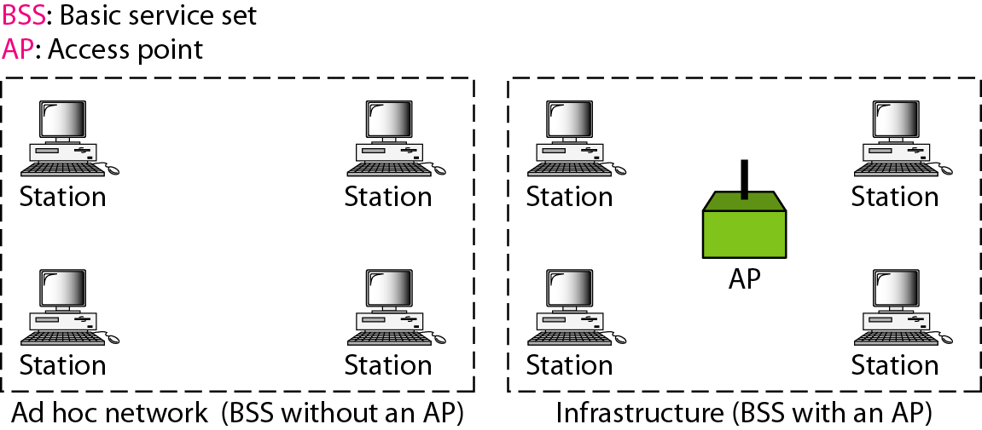
Figure 14.1 Basic service sets (BSSs)
14.<number>

Slide 12
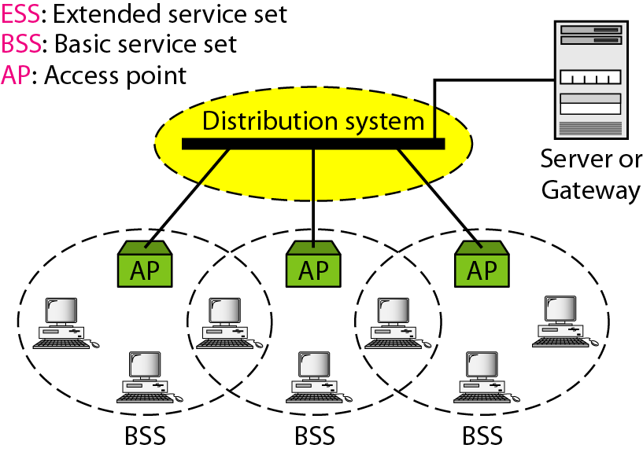
Figure 14.2 Extended service sets (ESSs)
14.<number>

Slide 13
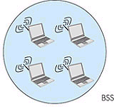
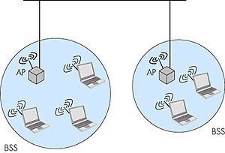
IEEE 802.11 Architecture
IEEE 802.11 defines the physical (PHY), logical link (LLC) and media access control (MAC) layers for a wireless local area network
802.11 networks can work as
  basic service set (BSS)
  extended service set (ESS)
BSS can also be used in ad-hoc
networking
Network
LLC
MAC
802.11
FHSS
PHY
DSSS
IR
LLC: Logical Link Control Layer
MAC: Medium Access Control Layer
PHY: Physical Layer
FHSS: Frequency hopping SS
DSSS: Direct sequence SS
SS: Spread spectrum
IR: Infrared light
BSS: Basic Service Set
ESS: Extended Service Set
AP: Access Point
DS: Distribution System
DS,
ESS
ad-hoc network

Slide 14
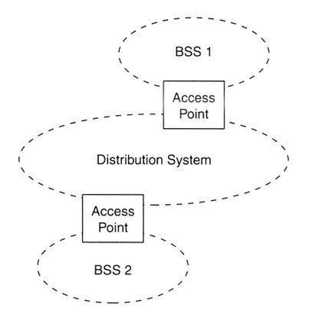
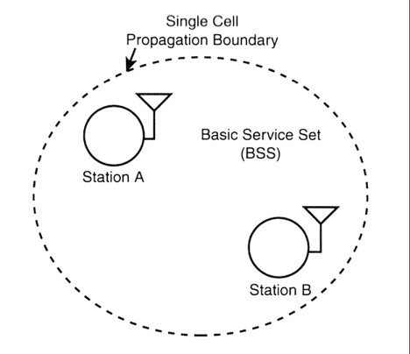
BSS and ESS
Basic (independent) service set (BSS)
Extended service set (ESS)
In ESS multiple access points connected by access points and a distribution system as Ethernet
  BSSs partially overlap
  Physically disjoint BSSs
  Physically collocated BSSs (several antennas)

Slide 15
802.11 Logical architecture
LLC provides addressing and data link control
MAC provides
  access to wireless medium
    CSMA/CA
    Priority based access (802.12)
  joining the network
  authentication & privacy
  Services
    Station service: Authentication, privacy, MSDU* delivery
    Distributed system: Association** and participates to data distribution
Three physical layers (PHY)
  FHSS: Frequency Hopping Spread
  Spectrum (SS)
  DSSS: Direct Sequence SS
  IR: Infrared transmission
LLC: Logical Link Control Layer
MAC: Medium Access Control Layer
PHY: Physical Layer
FH: Frequency hopping
DS: Direct sequence
IR: Infrared light
*MSDU: MAC service data unit
** with an access point in ESS or BSS

Slide 16
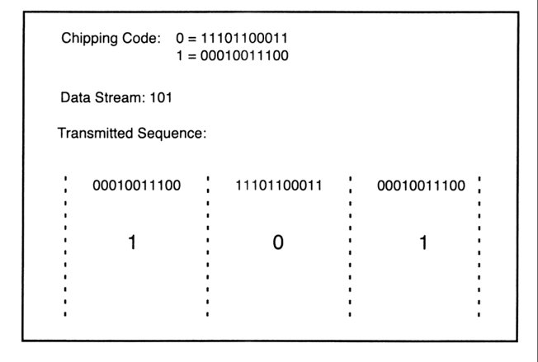
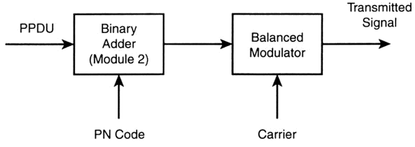
802.11 DSSS
DS-transmitter
Supports 1 and 2 Mbps data transport, uses BPSK and QPSK modulation
Uses 11 chips Barker code for spreading - 10.4 dB processing gain
Defines 14 overlapping channels, each having 22 MHz channel bandwidth, from 2.401 to 2.483 GHz
Power limits 1000mW in US, 100mW in EU, 200mW in Japan
Immune to narrow-band interference, cheaper hardware
PPDU:baseband data frame

Slide 17
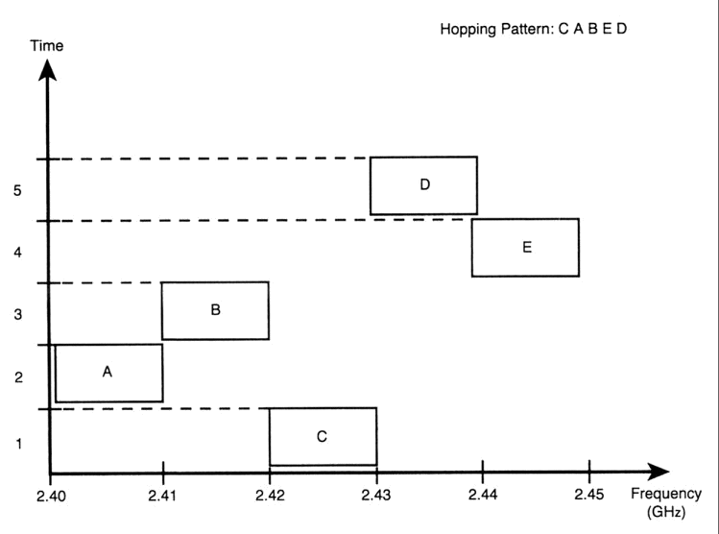

802.11 FHSS
Supports 1 and 2 Mbps data transport and applies two level - GFSK modulation* (Gaussian Frequency Shift Keying)
79 channels from 2.402 to 2.480 GHz ( in U.S. and most of EU countries) with 1 MHz channel space
78 hopping sequences with minimum 6 MHz hopping space, each sequence uses every 79 frequency elements once
Minimum hopping rate
2.5 hops/second
Tolerance to multi-path,
narrow band interference,
security
Low speed, small range
due to FCC TX power
regulation (10mW)

Slide 18
How ring-network works
A node functions as a repeater
only destination copies
frame to it,
all other nodes
have to discarded
the frame
Unidirectional link
A
A
C
A
B
C
A
B
B transmits frame
addressed to A
C ignores frame
A
A
C
A
B
C
B
A
A copies frame
C absorbs
returning frame

Slide 19
Token ring
A ring consists of a single or dual (FDDI) cable in the shape of a loop
Each station is only connected to each of its two nearest neighbors. Data in the form of packets pass around the ring from one station to another in uni-directional way.
Advantages :
  (1) Access method supports heavy load without degradation of performance because the medium is not shared.
  (2) Several packets can simultaneous circulate between different pairs of stations.
Disadvantages:
  (1) Complex management
  (2) Re-initialization of the ring whenever a failure occurs

Slide 20
How bus-network works
In a bus network, one node’s transmission traverses the entire network and is received and examined by every node. The access method can be :
  (1) Contention scheme : multiple nodes attempt to access bus; only one node succeed at a time (e.g. CSMA/CD in Ethernet)
  (2) Round robin scheme : a token is passed between nodes; node holds the token can use the bus (e.g.Token bus)
Advantages:
  (1) Simple access method
  (2) Easy to add or remove
  stations
Disadvantages:
  (1) Poor efficiency with high
  network load
  (2) Relatively insecure, due to
  the shared medium
A
B
C
D
D
term
term
term: terminator impedance

Slide 21


802.11 LAN architecture
wireless host communicates with base station
  base station = access point (AP)
Basic Service Set (BSS) (aka “cell”) in infrastructure mode contains:
  wireless hosts
  access point (AP): base station
  ad hoc mode: hosts only
Internet
hub, switch
or router
AP
BSS 1
AP
BSS 2
6: Wireless and Mobile Networks
6-<number>

Slide 22
802.11: Channels, association
802.11b: 2.4GHz-2.485GHz spectrum divided into 11 channels at different frequencies
  AP admin chooses frequency for AP
  interference possible: channel can be same as that chosen by neighboring AP!
host: must associate with an AP
  scans channels, listening for beacon frames containing AP’s name (SSID) and MAC address
  selects AP to associate with
  may perform authentication
  will typically run DHCP to get IP address in AP’s subnet
6: Wireless and Mobile Networks
6-<number>

Slide 23
802.11: passive/active scanning
BBS 1
BBS 2
BBS 1
BBS 2
AP 1
AP 2
AP 1
1
AP 2
1
1
2
2
2
3
3
4
H1
H1
Passive Scanning:
beacon frames sent from APs
association Request frame sent: H1 to selected AP
association Response frame sent: H1 to selected AP
Active Scanning:
Probe Request frame broadcast from H1
Probes response frame sent from APs
Association Request frame sent: H1 to selected AP
Association Response frame sent: H1 to selected AP
6: Wireless and Mobile Networks
6-<number>

Slide 24
IEEE 802.11: multiple access
avoid collisions: 2⁺ nodes transmitting at same time
802.11: CSMA - sense before transmitting
  don’t collide with ongoing transmission by other node
802.11: no collision detection!
  difficult to receive (sense collisions) when transmitting due to weak received signals (fading)
  can’t sense all collisions in any case: hidden terminal, fading
  goal: avoid collisions: CSMA/C(ollision)A(voidance)
A
B
C
C
A’s signal
strength
C’s signal
strength
B
A
space
6: Wireless and Mobile Networks
6-<number>

Slide 25
IEEE 802.11 MAC Protocol: CSMA/CA
802.11 sender
1 if sense channel idle for DIFS then
  transmit entire frame (no CD)
2 if sense channel busy then
  start random backoff time
  timer counts down while channel idle
  transmit when timer expires
  if no ACK, increase random backoff interval, repeat 2
802.11 receiver
- if frame received OK
return ACK after SIFS (ACK needed due to hidden terminal problem)
sender
receiver
DIFS
data
SIFS
ACK
6: Wireless and Mobile Networks
6-<number>

Slide 26
Avoiding collisions (more)
idea: allow sender to “reserve” channel rather than random access of data frames: avoid collisions of long data frames
sender first transmits small request-to-send (RTS) packets to BS using CSMA
  RTSs may still collide with each other (but they’re short)
BS broadcasts clear-to-send CTS in response to RTS
CTS heard by all nodes
  sender transmits data frame
  other stations defer transmissions
avoid data frame collisions completely
using small reservation packets!
6: Wireless and Mobile Networks
6-<number>

Slide 27
Collision Avoidance: RTS-CTS exchange
A
B
AP
RTS(B)
RTS(A)
reservation collision
RTS(A)
CTS(A)
CTS(A)
DATA (A)
defer
time
ACK(A)
ACK(A)
6: Wireless and Mobile Networks
6-<number>

Slide 28
802.11 frame: addressing
2
2
6
6
6
2
6
0 - 2312
4
frame
control
duration
address
1
address
2
address
3
seq
control
address
4
payload
CRC
Address 4: used only in ad hoc mode
Address 1: MAC address
of wireless host or AP
to receive this frame
Address 3: MAC address
of router interface to which AP is attached
Address 2: MAC address
of wireless host or AP
transmitting this frame
6: Wireless and Mobile Networks
6-<number>

Slide 29
802.11 frame: addressing
Internet
H1
R1
router
AP
R1 MAC addr H1 MAC addr
dest. address
source address
802.3 frame
AP MAC addr H1 MAC addr R1 MAC addr
address 1
address 2
address 3
802.11 frame
6: Wireless and Mobile Networks
6-<number>

Slide 30
802.11 frame: more
frame seq #
(for RDT)
duration of reserved
transmission time (RTS/CTS)
2
2
6
6
6
2
6
0 - 2312
4
frame
control
duration
address
1
address
2
address
3
seq
control
address
4
payload
CRC
2
2
4
1
1
1
1
1
1
1
1
Protocol
version
Type
Subtype
To
AP
From
AP
More
frag
Retry
Power
mgt
More
data
WEP
Rsvd
frame type
(RTS, CTS, ACK, data)
6: Wireless and Mobile Networks
6-<number>

Slide 31
802.11: mobility within same subnet
H1 remains in same IP subnet: IP address can remain same
switch: which AP is associated with H1?
  self-learning (Ch. 5): switch will see frame from H1 and “remember” which switch port can be used to reach H1
router
hub or
switch
BBS 1
AP 1
AP 2
H1
BBS 2
6: Wireless and Mobile Networks
6-<number>

Slide 32
802.11: advanced capabilities
Rate Adaptation
base station, mobile dynamically change transmission rate (physical layer modulation technique) as mobile moves, SNR varies
10⁻¹
10⁻²
10⁻³
BER
10⁻⁴
10⁻⁵
10⁻⁶
10⁻⁷
10
20
30
40
SNR(dB)
1. SNR decreases, BER increase as node moves away from base station
QAM256 (8 Mbps)
QAM16 (4 Mbps)
2. When BER becomes too high, switch to lower transmission rate but with lower BER
BPSK (1 Mbps)
operating point
6: Wireless and Mobile Networks
6-<number>

Slide 33
802.11: advanced capabilities
Power Management
node-to-AP: “I am going to sleep until next beacon frame”
  AP knows not to transmit frames to this node
  node wakes up before next beacon frame
beacon frame: contains list of mobiles with AP-to-mobile frames waiting to be sent
  node will stay awake if AP-to-mobile frames to be sent; otherwise sleep again until next beacon frame
6: Wireless and Mobile Networks
6-<number>

Slide 34
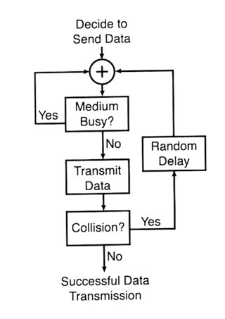
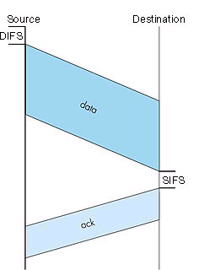
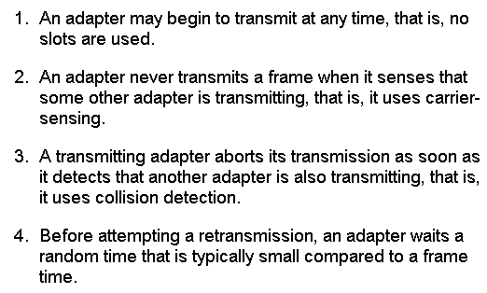
IEEE 802.11 Media
Access Control (MAC)
Carrier-sense multiple access protocol
with collision avoidance (CSMA/CS)
DIFS: Distributed Inter-Frame Spacing
SIFS: Short Inter-Frame Spacing
ack: Acknowledgement

Slide 35

Figure 14.4 CSMA/CA flowchart
14.<number>

Slide 36
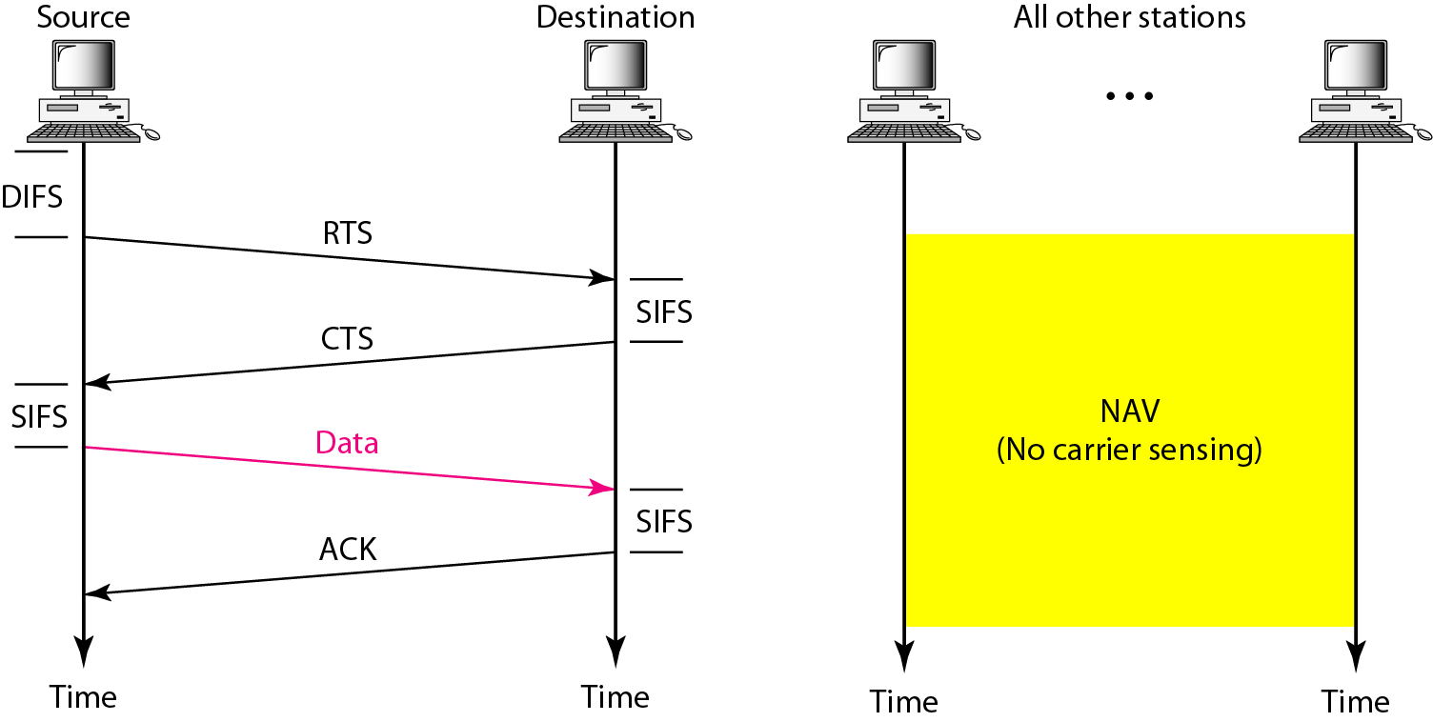
Figure 14.5 CSMA/CA and NAV
14.<number>

Slide 37
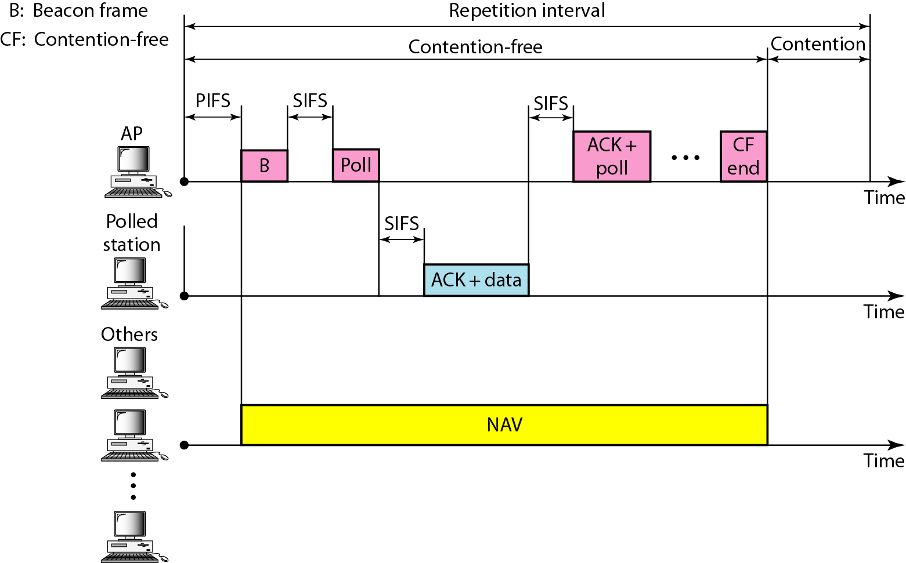
Figure 14.6 Example of repetition interval
14.<number>

Slide 38

Figure 14.7 Frame format
14.<number>

Slide 39
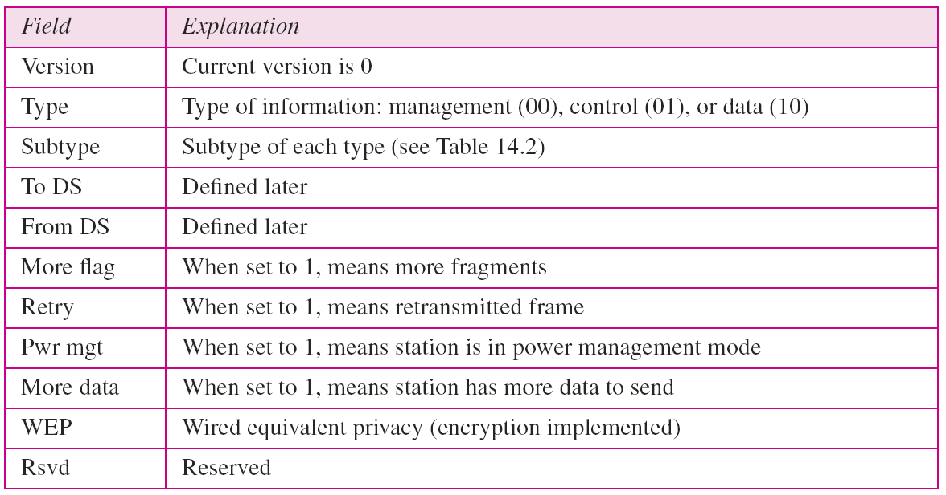
Table 14.1 Subfields in FC field
14.<number>

Slide 40
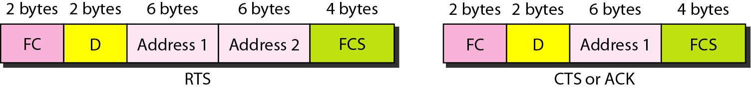
Figure 14.8 Control frames
14.<number>

Slide 41
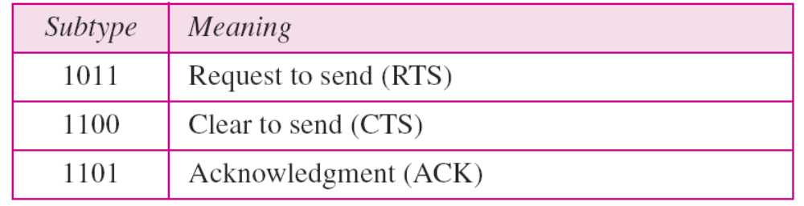
Table 14.2 Values of subfields in control frames
14.<number>

Slide 42
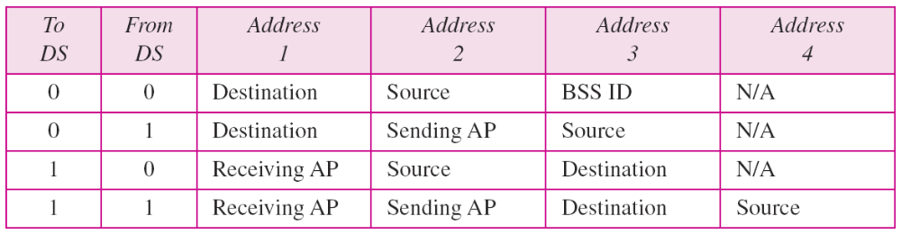
Table 14.3 Addresses
14.<number>

Slide 43
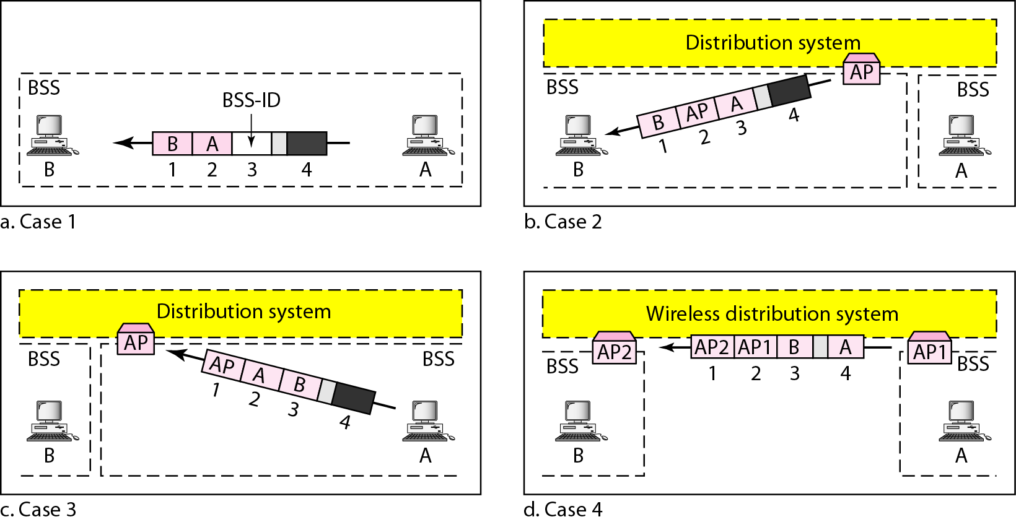
Figure 14.9 Addressing mechanisms
14.<number>

Slide 44
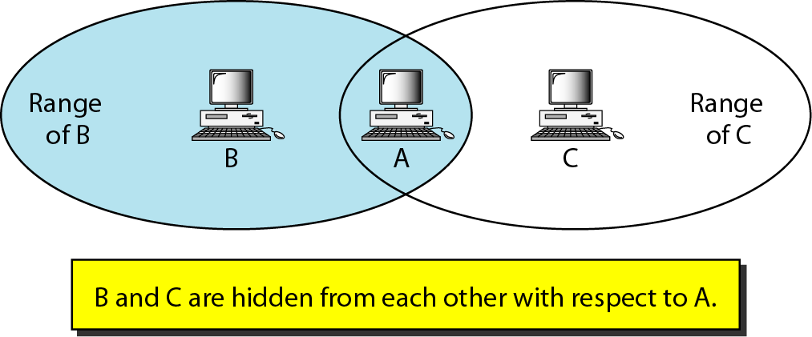
Figure 14.10 Hidden station problem
14.<number>

Slide 45

Note
The CTS frame in CSMA/CA handshake can prevent collision from
a hidden station.
14.<number>

Slide 46
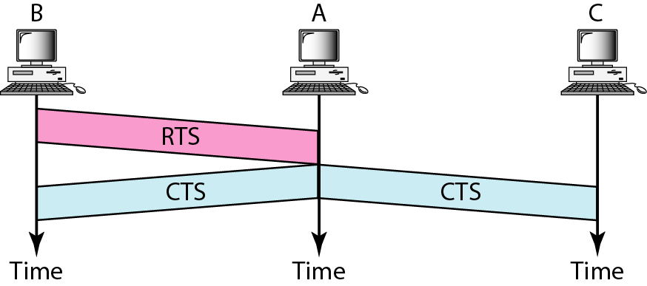
Figure 14.11 Use of handshaking to prevent hidden station problem
14.<number>

Slide 47
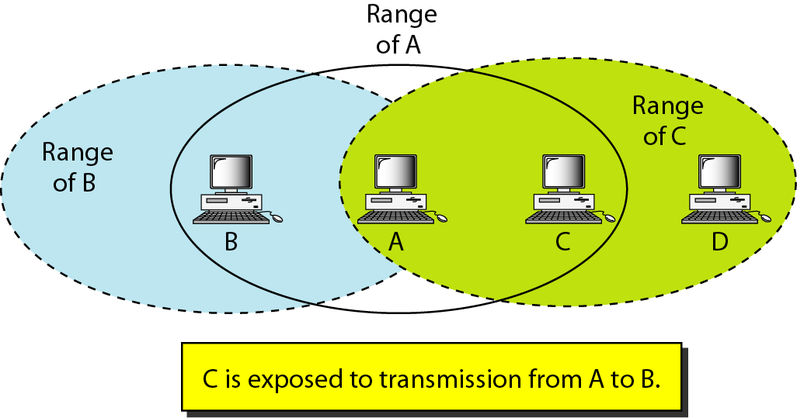
Figure 14.12 Exposed station problem
14.<number>

Slide 48
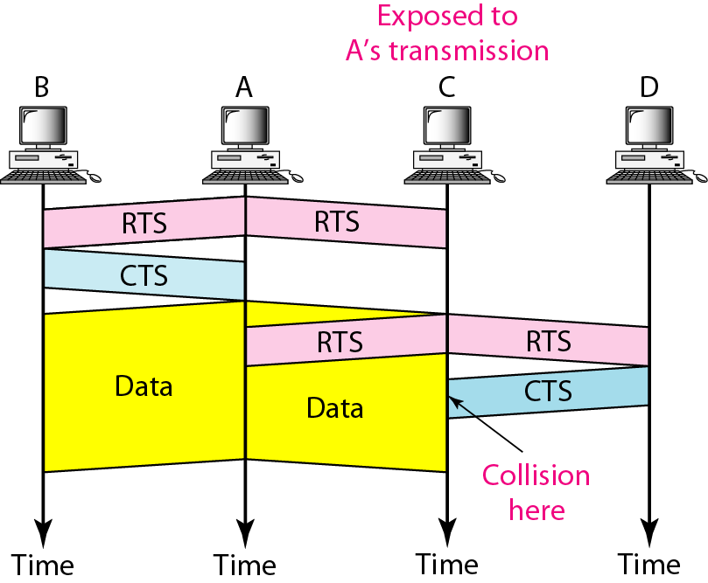
Figure 14.13 Use of handshaking in exposed station problem
14.<number>

Slide 49
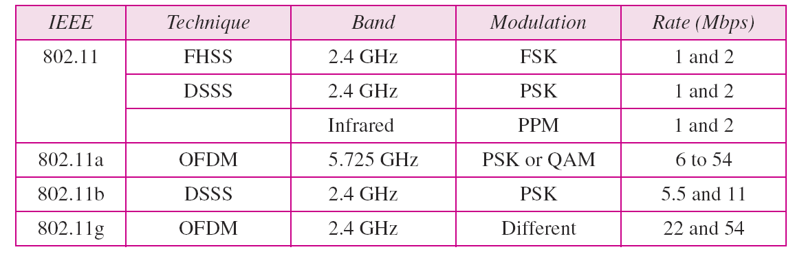
Table 14.4 Physical layers
14.<number>

Slide 50
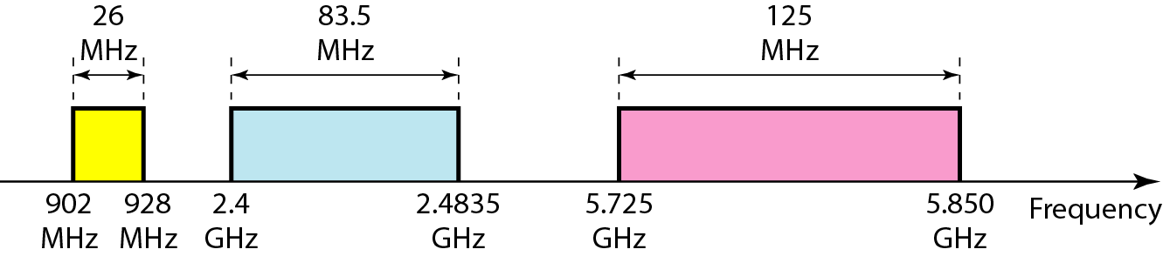
Figure 14.14 Industrial, scientific, and medical (ISM) band
14.<number>

Slide 51
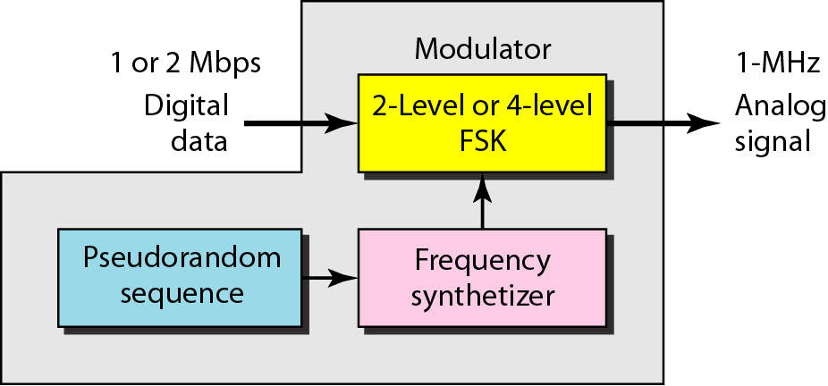
Figure 14.15 Physical layer of IEEE 802.11 FHSS
14.<number>

Slide 52
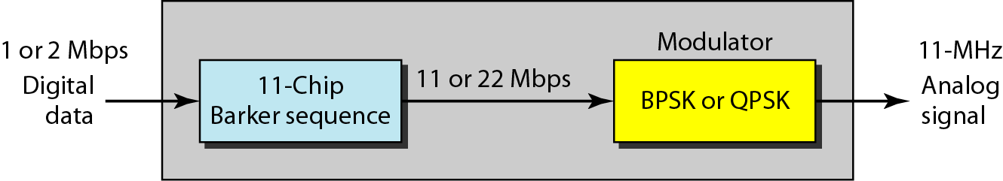
Figure 14.16 Physical layer of IEEE 802.11 DSSS
14.<number>

Slide 53
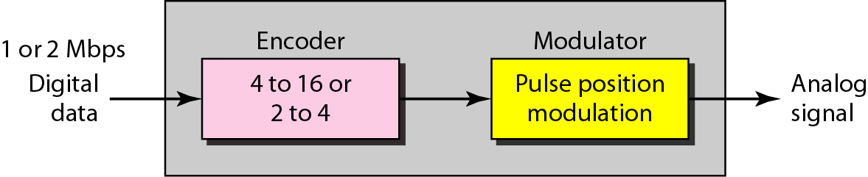
Figure 14.17 Physical layer of IEEE 802.11 infrared
14.<number>

Slide 54
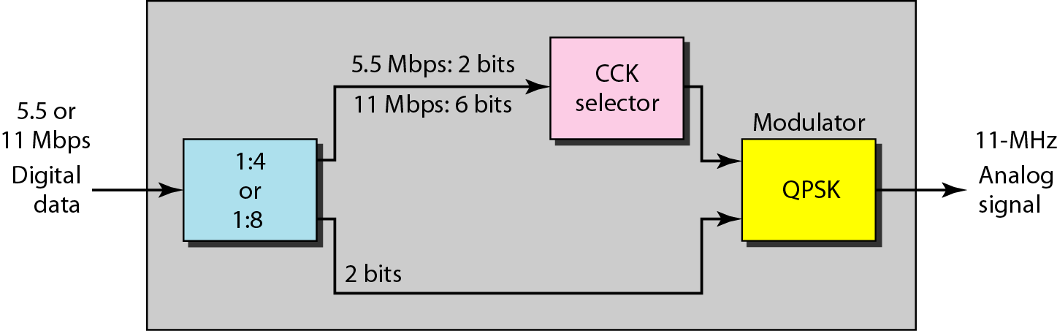
Figure 14.18 Physical layer of IEEE 802.11b
14.<number>

Slide 55
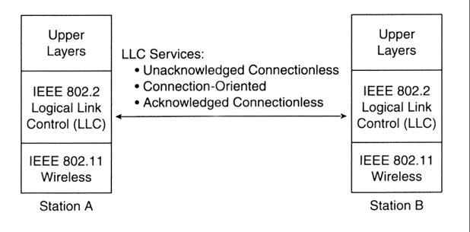
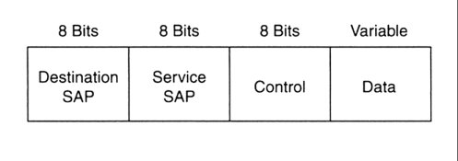
Logical Link Control Layer (LLC)
Specified by ISO/IEC 8802-2 (ANSI/IEEE 802.2)
purpose: exchange data between users across LAN using 802-based MAC controlled link
provides addressing and data link control, independent of topology, medium, and chosen MAC access method
Data to higher level protocols
Info: carries user data
Supervisory: carries
flow/error control
Unnumbered: carries protocol
control data
Source
SAP
LLC’s functionalities
LLC’s protocol data unit (PDU)
SAP: service address point

Slide 56
Logical Link Control Layer Services
A Unacknowledged connectionless service
  no error or flow control - no ack-signal usage
  unicast (individual), multicast, broadcast addressing
  higher levels take care or reliability - thus fast for instance for TCP
B Connection oriented service
  supports unicast only
  error and flow control for lost/damaged data packets by cyclic redundancy check (CRC)
C Acknowledged connectionless service
  ack-signal used
  error and flow control by stop-and-wait ARQ
  faster setup than for B

Slide 57
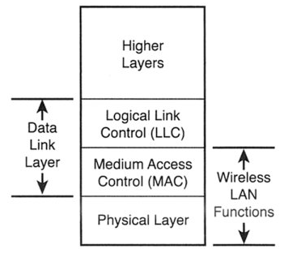
A TCP/IP packet in 802.11
TPC/IP send data packet
Control
header
LLC constructs PDU by
adding a control header
SAP (service access point)
MAC frame with
new control fields
MAC lines up packets using carrier
sense multiple access (CSMA)
PHY layer transmits packet
using a modulation method
(DSSS, OFDM, IR, FHSS)
Traffic to the
target BSS / ESS
*BDU: protocol data unit

Slide 58
IEEE 802.11 Mobility
Standard defines the following mobility types:
  No-transition: no movement or moving within a local BSS
  BSS-transition: station movies from one BSS in one ESS to another BSS within the same ESS
  ESS-transition: station moves from a BSS in one ESS to a BSS in a different ESS (continuos roaming not supported)
Especially: 802.11 don’t support roaming with GSM!
- Address to destination
mapping
- seamless integration
of multiple BSS
ESS 1
ESS 2

Slide 59
Security
In theory, spread spectrum radio signals are inherently difficult to decipher without knowing the exact hopping sequences or direct sequence codes used
The IEEE 802.11 standard specifies optional security called "Wired Equivalent Privacy" whose goal is that a wireless LAN offer privacy equivalent to that offered by a wired LAN. The standard also specifies optional authentication measures.

Slide 60
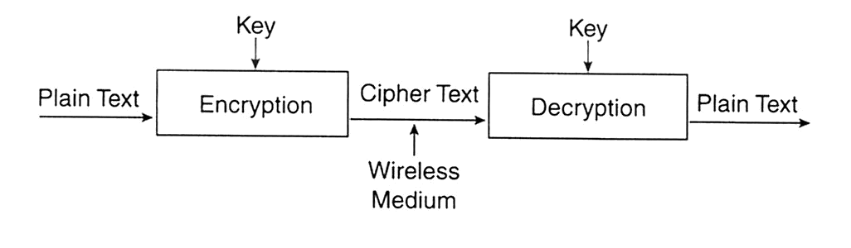
Authentication and privacy
Goal: to prevent unauthorized access & eavesdropping
Realized by authentication service prior access
Open system authentication
  station wanting to authenticate sends authentication management frame - receiving station sends back frame for successful authentication
Shared key authentication (included in WEP*)
  Secret, shared key received by all stations by a separate, 802.11 independent channel
  Stations authenticate by a shared knowledge of the key properties
WEP’s privacy (blocking out eavesdropping) is based on ciphering:
*WEP: Wired Equivalent Privacy

Slide 61
802.11b Security Features
Wired Equivalent Privacy (WEP) – A protocol to protect link-level data during wireless transmission between clients and access points.
Services:
  Authentication: provides access control to the network by denying access to client stations that fail to authenticate properly.
  Confidentiality: intends to prevent information compromise from casual eavesdropping
  Integrity: prevents messages from being modified while in transit between the wireless client and the access point.

Slide 62
Authentication
Means:
Based on cryptography
Non-cryptographic
Both are identity-based verification mechanisms (devices request access based on the SSID – Service Set Identifier of the wireless network).

Slide 63
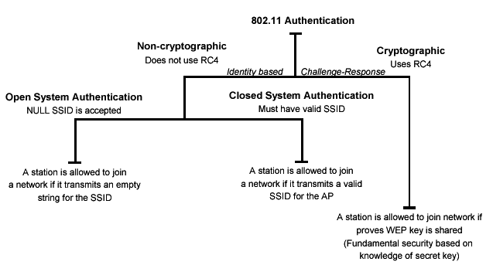
Authentication
Authentication techniques

Slide 64
Privacy
Cryptographic techniques
WEP Uses RC4 symmetric key, stream cipher algorithm to generate a pseudo random data sequence. The stream is XORed with the data to be transmitted
Key sizes: 40bits to 128bits
Unfortunately, recent attacks have shown that the WEP approach for privacy is vulnerable to certain attack regardless of key size

Slide 65
Data Integrity
Data integrity is ensured by a simple encrypted version of CRC (Cyclic Redundant Check)
Also vulnerable to some attacks

Slide 66
Security Problems
Security features in Wireless products are frequently not enabled.
Use of static WEP keys (keys are in use for a very long time). WEP does not provide key management.
Cryptographic keys are short.
No user authentication occurs – only devices are authenticated. A stolen device can access the network.
Identity based systems are vulnerable.
Packet integrity is poor.

Slide 67
Other WLAN Security Mechanisms
3Com Dynamic Security Link
CISCO LEAP - Lightweight Extensible Authentication Protocol
IEEE 802.1x – Port-Based Network Access Control
RADIUS Authentication Support
EAP-MD5
EAP-TLS
EAP-TTLS
PEAP - Protected EAP
TKIP - Temporal Key Integrity Protocol
IEEE 802.11i

Slide 68
WLAN Network Planning
Network planning target
  Maximize system performance with limited resource
  Including
    coverage
    throughput
    capacity
    interference
    roaming
    security, etc.
Planning process
  Requirements for project management personnel
  Site investigation
  Computer-aided planning practice
  Testing and verifying planning

Slide 69

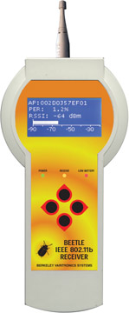
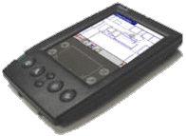
Field measurements
Basic tools: power levels - throughput - error rate
  Laptop or PDA
  Utility come with radio card HW (i.e. Lucent
  client manager)
  Supports channel scan, station search
  Indicate signal level, SNR, transport rate
Advanced tools: detailed protocol data flows
  Special designed for field measurement
  Support PHY and MAC protocol analysis
  Integrated with network planning tools
Examples
  Procycle™ from Softbit, Oulu, Finland
  SitePlaner™ from WirelessValley, American

Slide 70
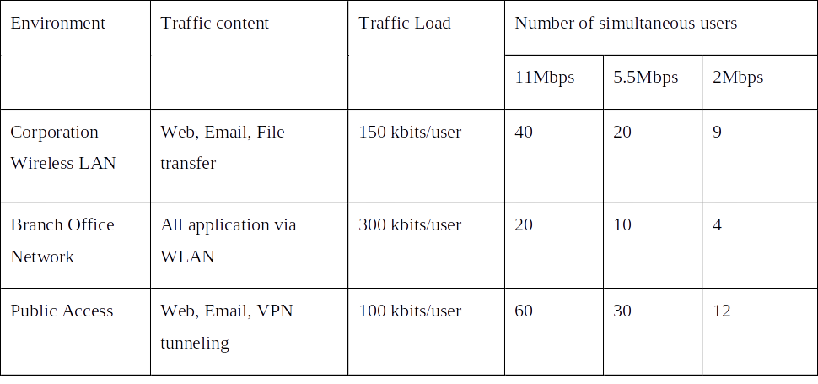
Capacity planning
802.11b can have 6.5 Mbps rate throughput due to
  CSMA/CA MAC protocol
  PHY and MAC management overhead
More user connected, less capacity offered
Example of supported users in different application cases:

Slide 71
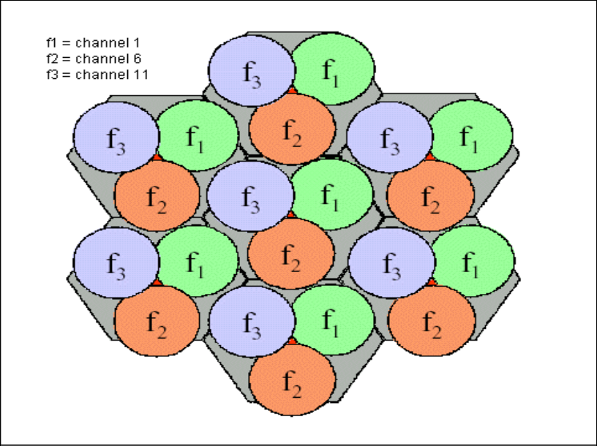
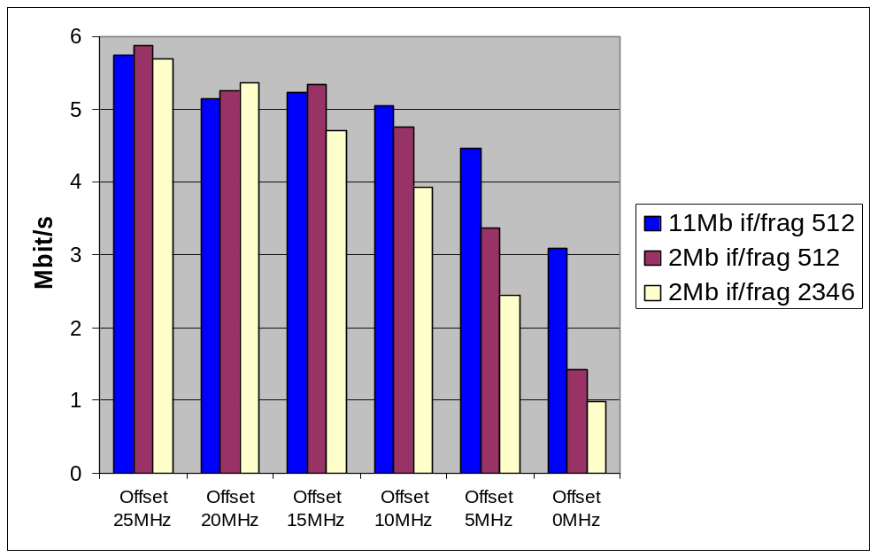
Frequency planning
Interference from other WLAN systems or cells
IEEE 802.11 operates at uncontrolled ISM band
14 channels of 802.11 are overlapping, only 3 channels are disjointed. For example Ch1, 6, 11
Throughput decreases with less channel spacing
A example of frequency allocation in multi-cell network

Slide 72
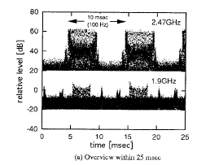
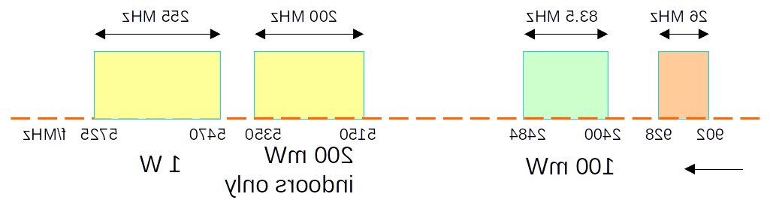
Interference from microwave ovens
Microwave oven magnetrons have central frequency at 2450~2458 MHz
Burst structure of radiated radio signal, one burst will affect several 802.11 symbols
18 dBm level measured from 3 meter away from oven
-> masks all WLAN signals!
Solutions
  Use unaffected channels
  Keep certain distance
  Use RF absorber near
  microwave oven

Slide 73
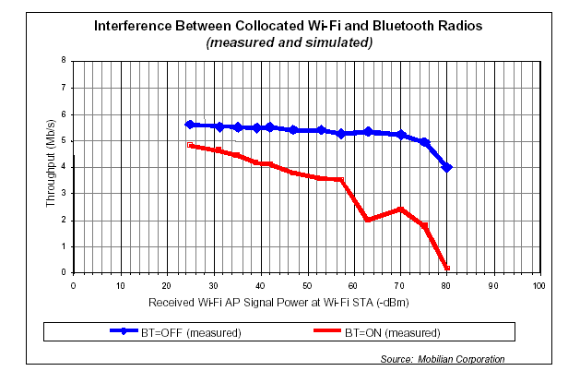
Interference from Bluetooth
  The received signal level from two systems are comparable at mobile side
  In co-existing environment, the probability of frequency collision for one 802.11 frame vary from 48% ~62%
  Deterioration level is relevant to many factors
    relative signal levels
    802.11 frame length
    activity in Bluetooth
    channel
Solution
  Co-existing protocol
  IEEE 802.15 (not ready)
  Limit the usage of BT
  in 802.11 network

Slide 74
WLAN benefits
Mobility
  increases working efficiency and productivity
  extends the On-line period
Installation on difficult-to-wire areas
  inside buildings
  road crossings
Increased reliability
  Note: Pay attention to security!
Reduced installation time
  cabling time and convenient to users and difficult-to-wire cases

Slide 75
WLAN benefits (cont.)
Broadband
  11 Mbps for 802.11b
  54 Mbps for 802.11a/g (GSM:9.6Kbps, HCSCD:~40Kbps, GPRS:~160Kbps, WCDMA:up to 2Mbps)
Long-term cost savings
  O & M cheaper that for wired nets
  Comes from easy maintenance, cabling cost, working efficiency and accuracy
  Network can be established in a new location just by moving the PCs!

Slide 76
WLAN technology problems
Date Speed
  IEEE 802.11b support up to 11 MBps, sometimes this is not enough - far lower than 100 Mbps fast Ethernet
Interference
  Works in ISM band, share same frequency with microwave oven, Bluetooth, and others
Security
  Current WEP algorithm is weak - usually not ON!
Roaming
  No industry standard is available and propriety solution are not interoperable - especially with GSM
Inter-operability
  Only few basic functionality are interoperable, other vendor’s features can’t be used in a mixed network

Slide 77
WLAN implementation problems
Lack of wireless networking experience for most IT engineer
No well-recognized operation process on network implementation
Selecting access points with ‘Best Guess’ method
Unaware of interference from/to other networks
Weak security policy
As a result, your WLAN may have
  Poor performance (coverage, throughput, capacity, security)
  Unstable service
  Customer dissatisfaction

