Slide 1
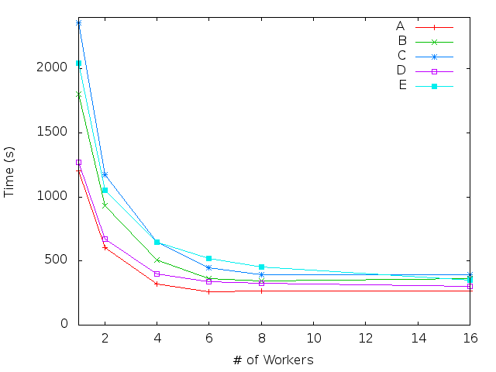
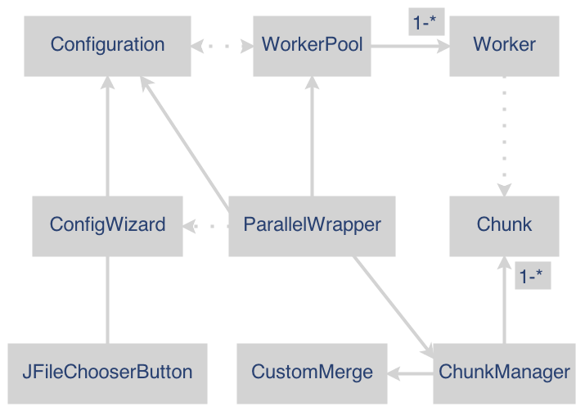
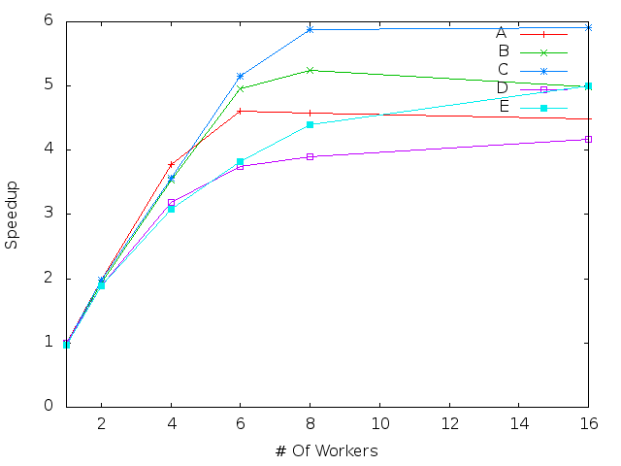
A Java Framework For Embarrassingly Parallel Problems
Problem Description
Programs in the field of Biology and Genetics often analyze long strings of DNA, RNA or protein sequences. In addition to large file sizes, there is a lot of processing that goes into comparing and manipulating these strings. The time adds up when there are hundreds of thousands of strings to process. These sequences often do not relate to each other and could be processed independently.
Abstract
An embarrassingly parallel problem is one that can be easily broken up into identical components that do not need to interact to find the solution. Many programs for the biological sciences are embarrassingly parallel but often their authors do not have the expertise to implement a parallel solution. We have written a framework, implemented in Java, that will execute the serial program in several threads. These threads working together help cut down the total runtime of the program significantly.
Proposed Solution
This paper describes a framework that makes it easy to parallelize a potentially embarrassingly parallel program, providing a ‘wrapper’ for the original program. It calls the serial program on multiple Java threads, such that each thread acts like the serial application: reading a subset of the input and creating the output in the same format. The framework’s goal is to achieve in a significant decrease in overall runtime with very little programmer effort.
Results and Conclusions
The graph on the left shows how the number of worker threads affected the total runtime.
In very simple samples, the times decreased until around 8 threads, then leveled off. One case did not level off because the work that took the longest was toward the end of the file.
The speedup graph compares the time in the graph above to the time it takes to run serially, or with 1 thread.
Just like in the previous graph, the speedup starts to level off at around 8 workers. This shows that the most efficient way to run, in this situation, is to only use 50% of the total CPU, because maxing out does not give a performance boost that warrants crippling the computer for the duration of the execution.
Author: Jacob Schwartz Advisor: Dan Bergeron
Notes:
UML. Embarrassingly parallel diagram, results

