Slide 1
REFURBISHED LAPTOPS!

Slide 2
THE PROBLEM!
Good performance laptops are too expensive
Cheap laptops have low performance

Slide 3
THE SOLUTION!
REFURBISHED LAPTOPS!

Slide 4
WHY SOLVE?!
So people with tighter budgets can afford a laptop that meets the requirements for their jobs / tasks

Slide 5
WIREFRAMES!

Slide 6
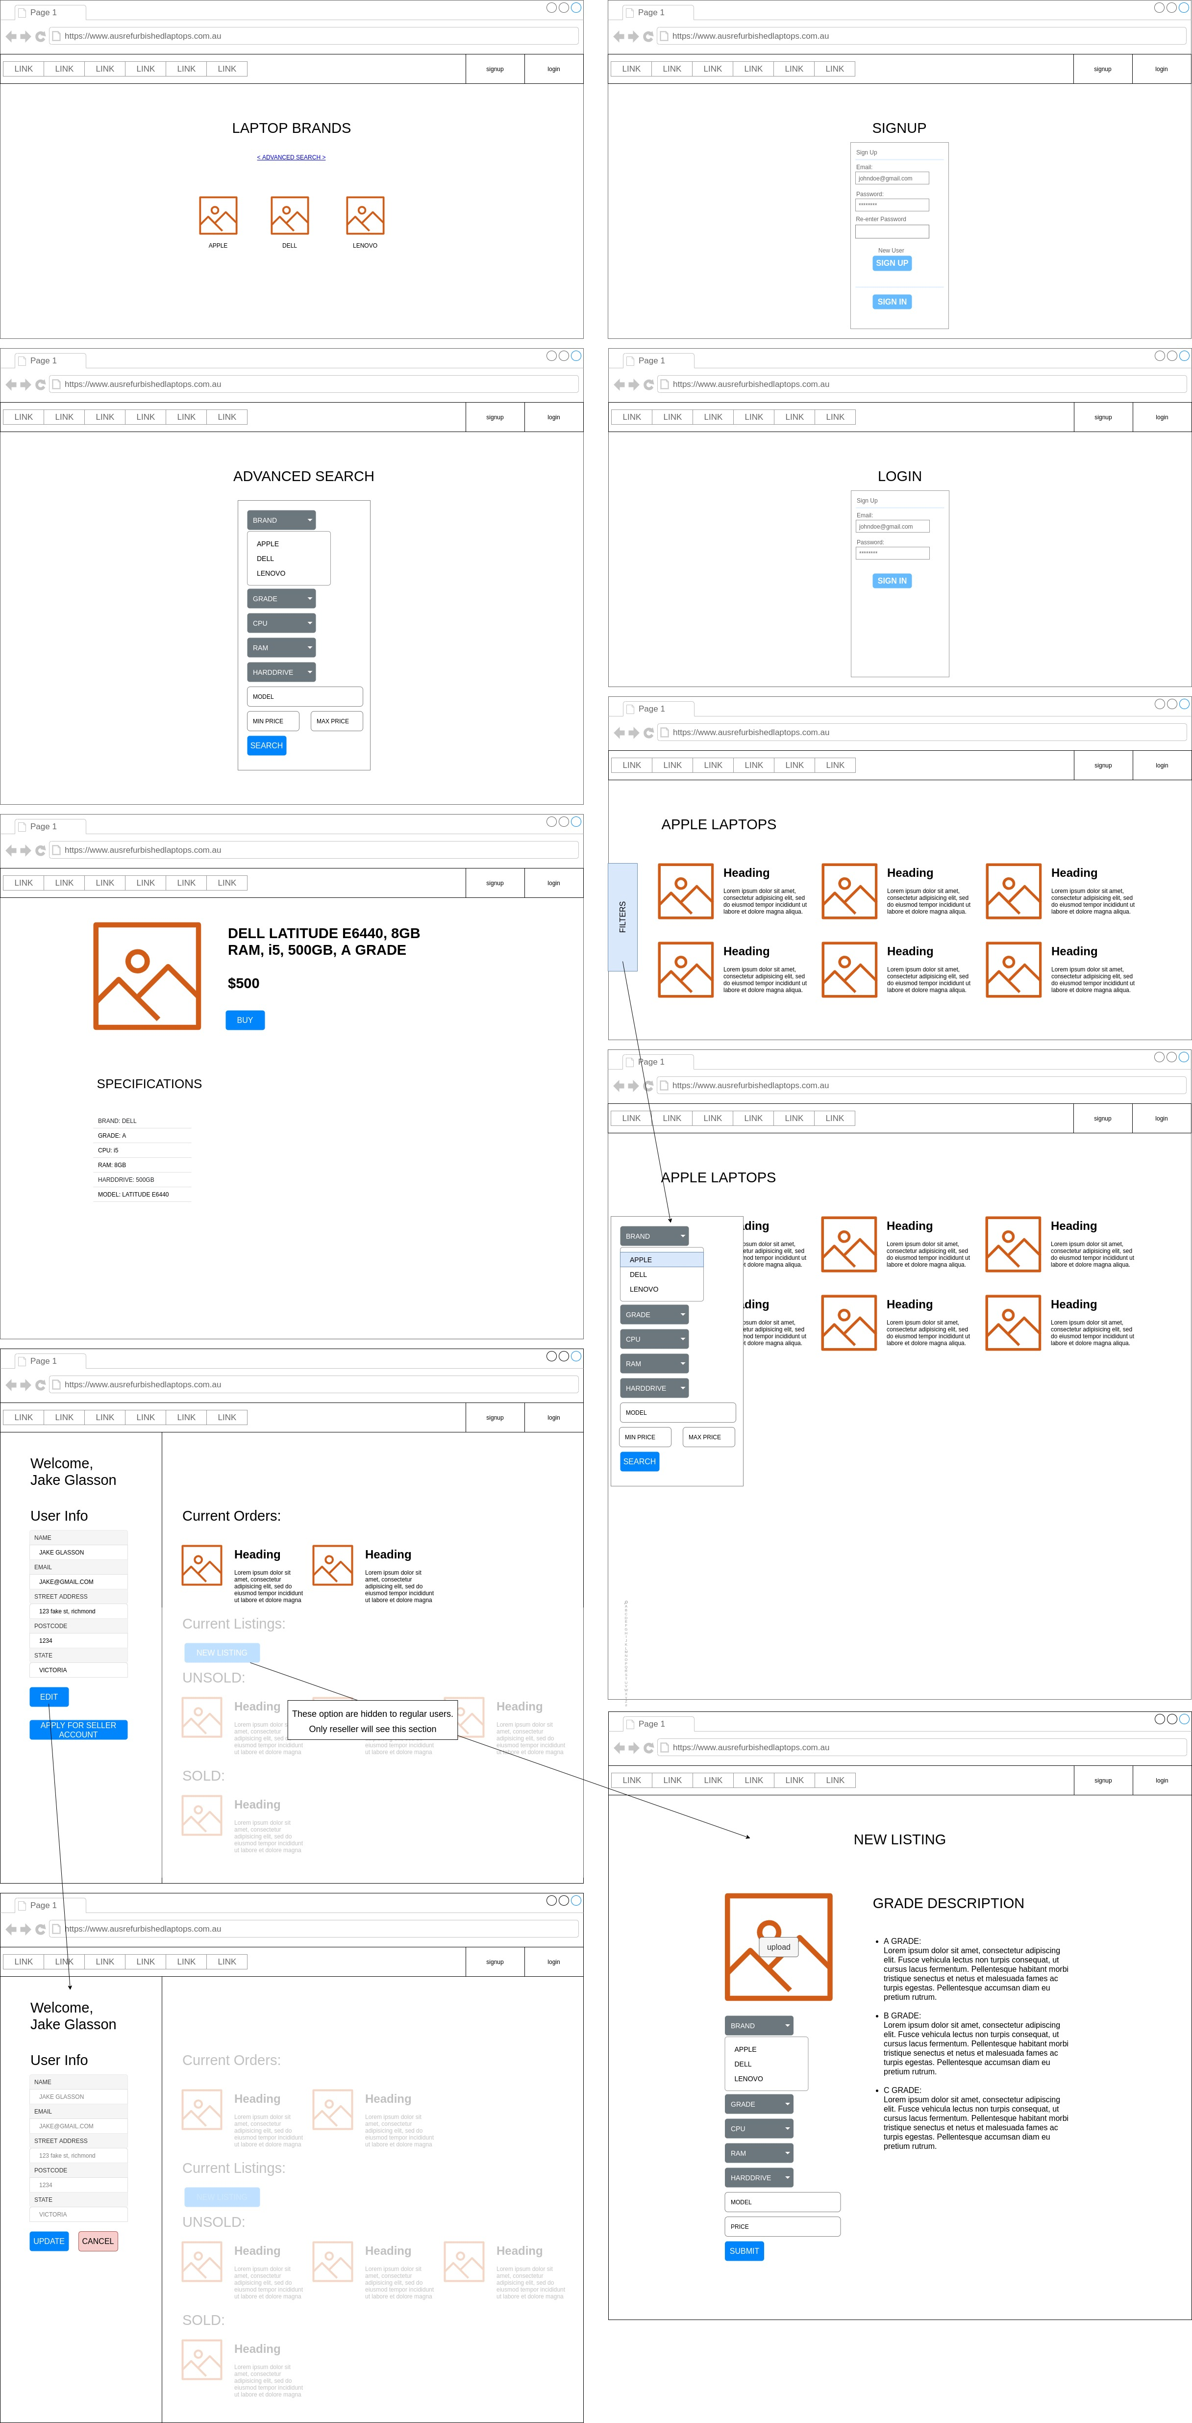

Slide 9
SITEMAP!

Slide 10
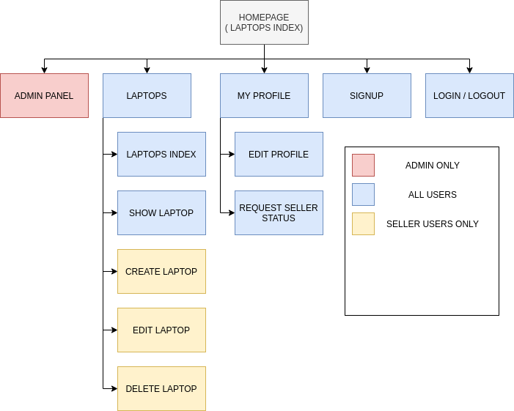

Slide 11
DEMONSTRATION!

