Slide 1
Project 0
By: Jake Ira

Slide 2
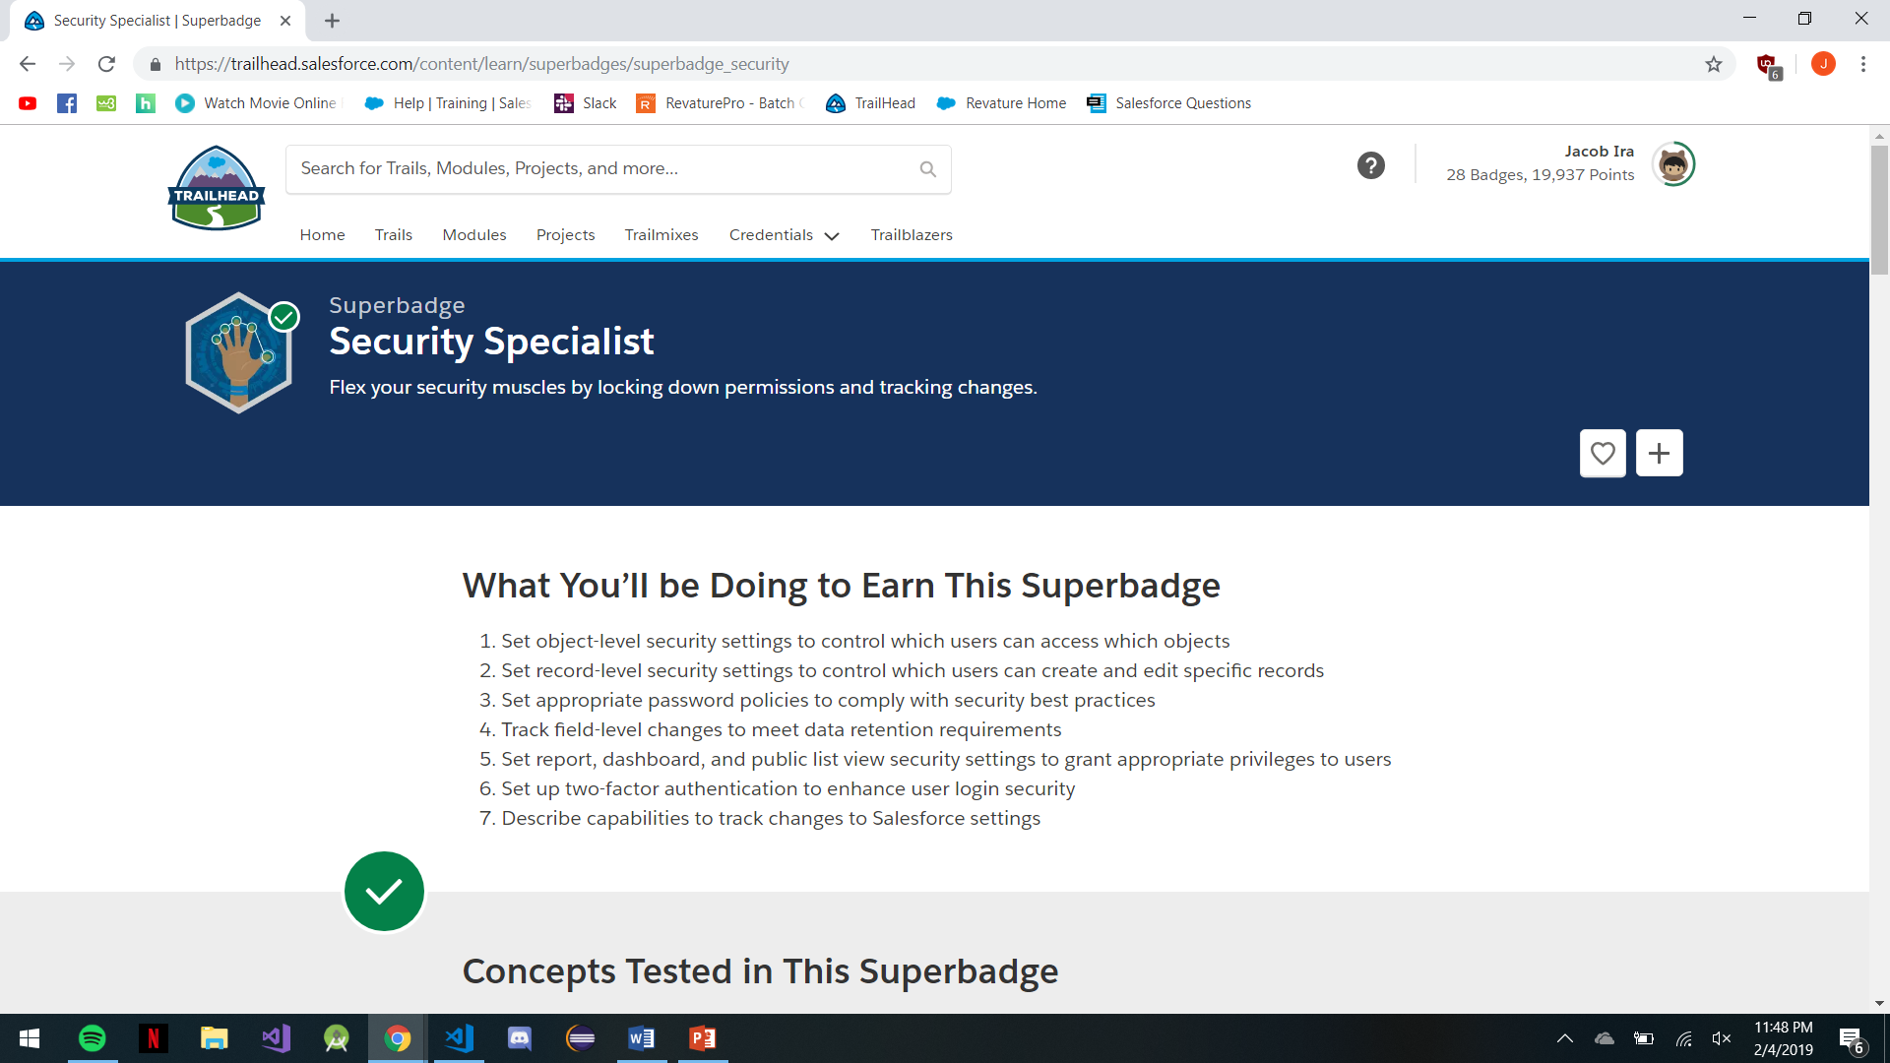
Security specialist

Slide 3
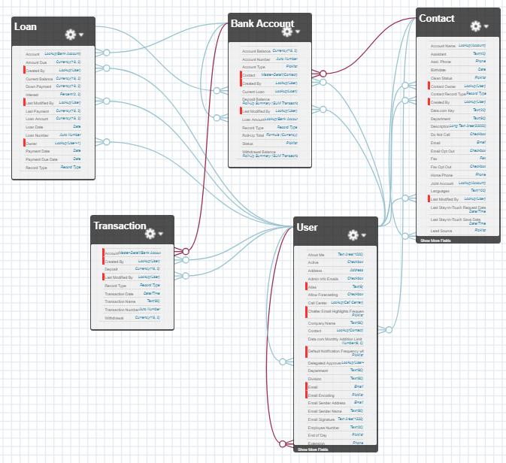
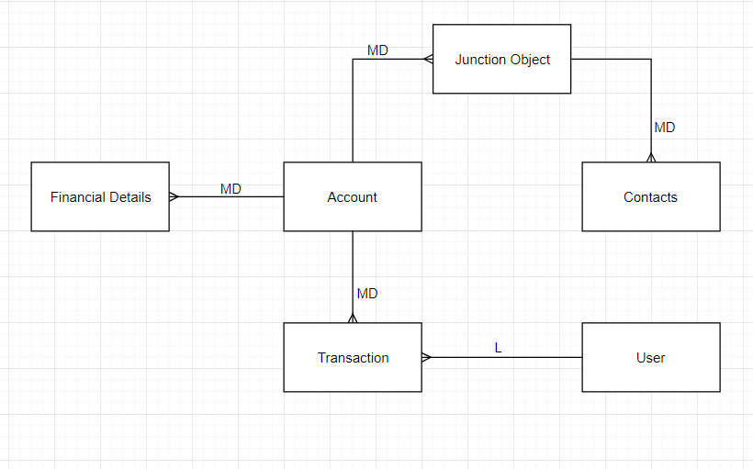
Diagrams

Slide 4
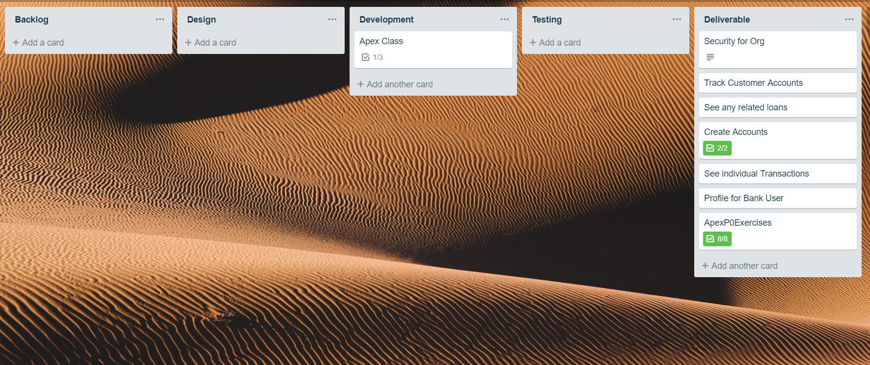
Trello Board

Slide 5
Security Measures
2 Factor Authentication
Login Hours
Tab Settings
OWD

Slide 6
DEMO

