Slide 1

Using Negative Prefixes

Slide 2
Prefixes
Prefix is a letter or group of letters that is added at the beginning of the word. When added, it changes the meaning of the word.

Slide 3
Give some sentences about the picture. .

Slide 4
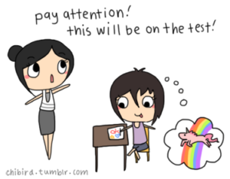

Slide 5
The student is inattentive with her teacher’s advice. .

Slide 6
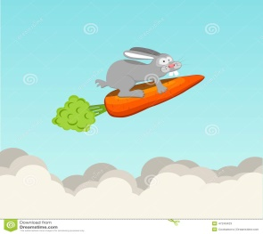

Slide 7
It was impossible for a rabbit to fly. .

Slide 8
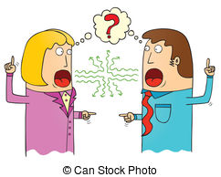

Slide 9
The officers had a misunderstanding. .

Slide 10
Negative Prefixes
Negative prefixes are examples of prefixes which mean not.

Slide 11
What have you noticed to the sentences?

Slide 12
(Prefix) | Meaning of the prefix
de | Not
dis | Not
in | Not
mis | Not
non | Not
un | Not

Slide 13
Examples
de

Slide 14
Examples
Deactivate demagnitize de-emphasize

Slide 15
Examples
dis

Slide 16
Examples
Dishonest disapprove disappear

Slide 17
Give examples of words with prefix dis

Slide 18
Examples
non

Slide 19
Examples
Nonsense nontoxic nonstop

Slide 20
Give examples of words with prefix non

Slide 21
Examples
mis

Slide 22
Examples
Misheard misplaced misinterpret

Slide 23
Give examples of words with prefix mis

Slide 24
Examples
un

Slide 25
Examples
Unfriendly undone unknown

Slide 26
Give examples of words with prefix un

Slide 27
Examples
in

Slide 28
Examples
Inactive inefficient invisible

Slide 29
Give examples of words with prefix in

Slide 30
Decide whether to add the prefix im-, dis-, or -un to the following root words. Make sure the new words are the opposite of the given word.

Slide 31
1. decided 2. partial 3. moral 4. material 5. measurable | 6. able 7. connected 8. tamed 9. continue 10. respect

