Slide 1
Ball and Plate
MECA 482
Group 6: Jesus Hernandez, Jacob Krainock, Joseph Marlowe,
Joseph Marlowe, Joseluis Zamora

Slide 2
Project Definition
A control system for this project was designed to move a ball on a plate using a tilt mechanism with two servo motors
The requirements are that the ball is balanced on the center of the plate and that the it reacts to system disturbances
The assumptions of the system is no slipping between the ball and the plate, negligible friction, and small angle movements from the servo motors

Slide 3
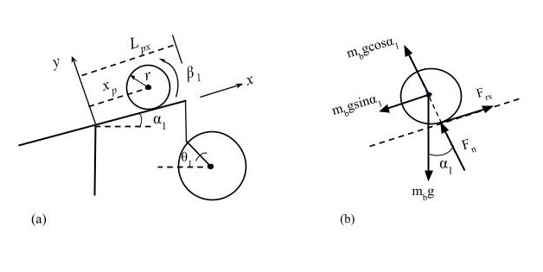
Modeling

Slide 4
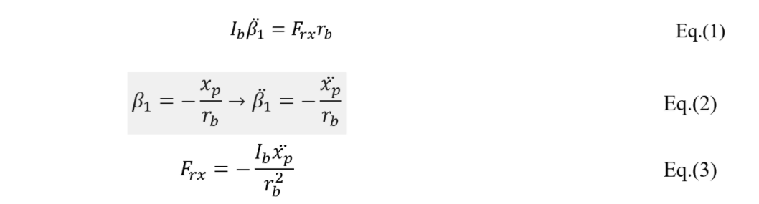
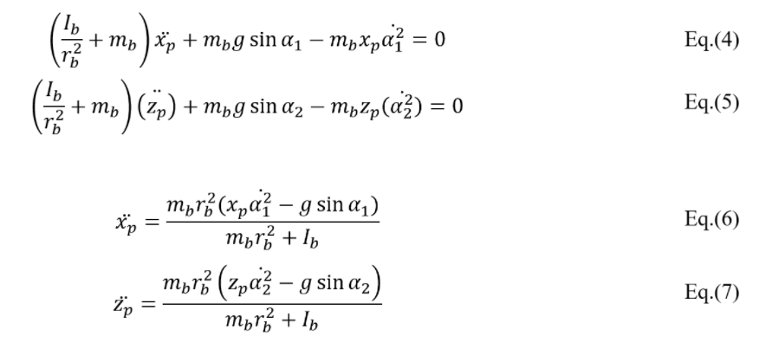
Equations

Slide 5
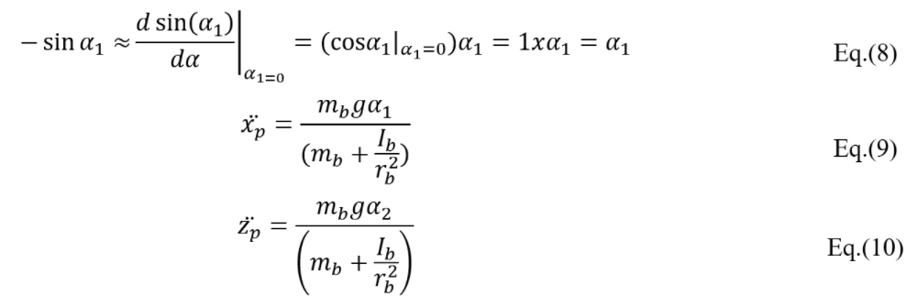
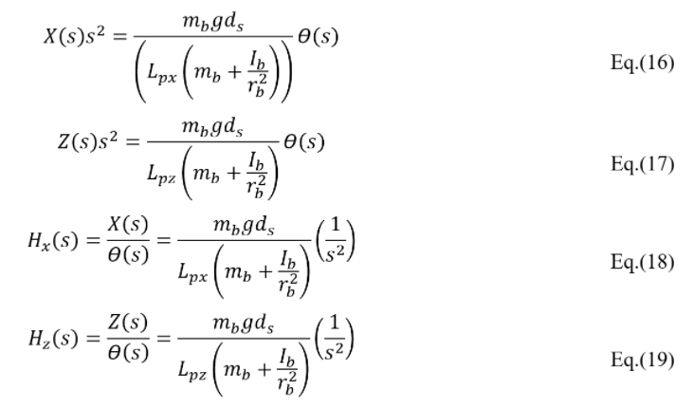
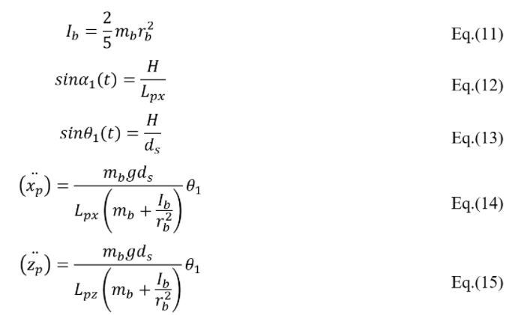
Equations cont…

Slide 6
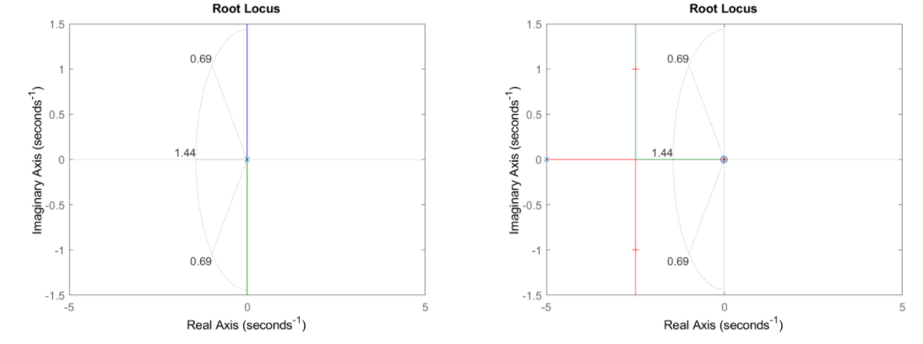
Root Locus
%OS <= 5%
Ts < = 4s
ωn = 1.44
Damping = 0.69

Slide 7
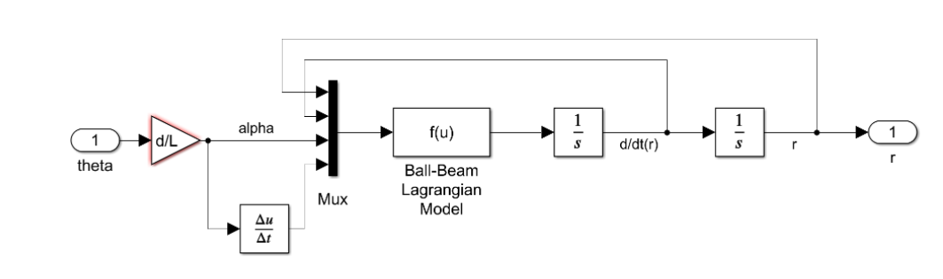
MATLAB Simulink of Ball on Beam

Slide 8
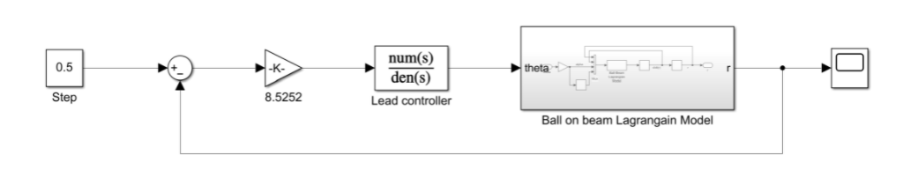
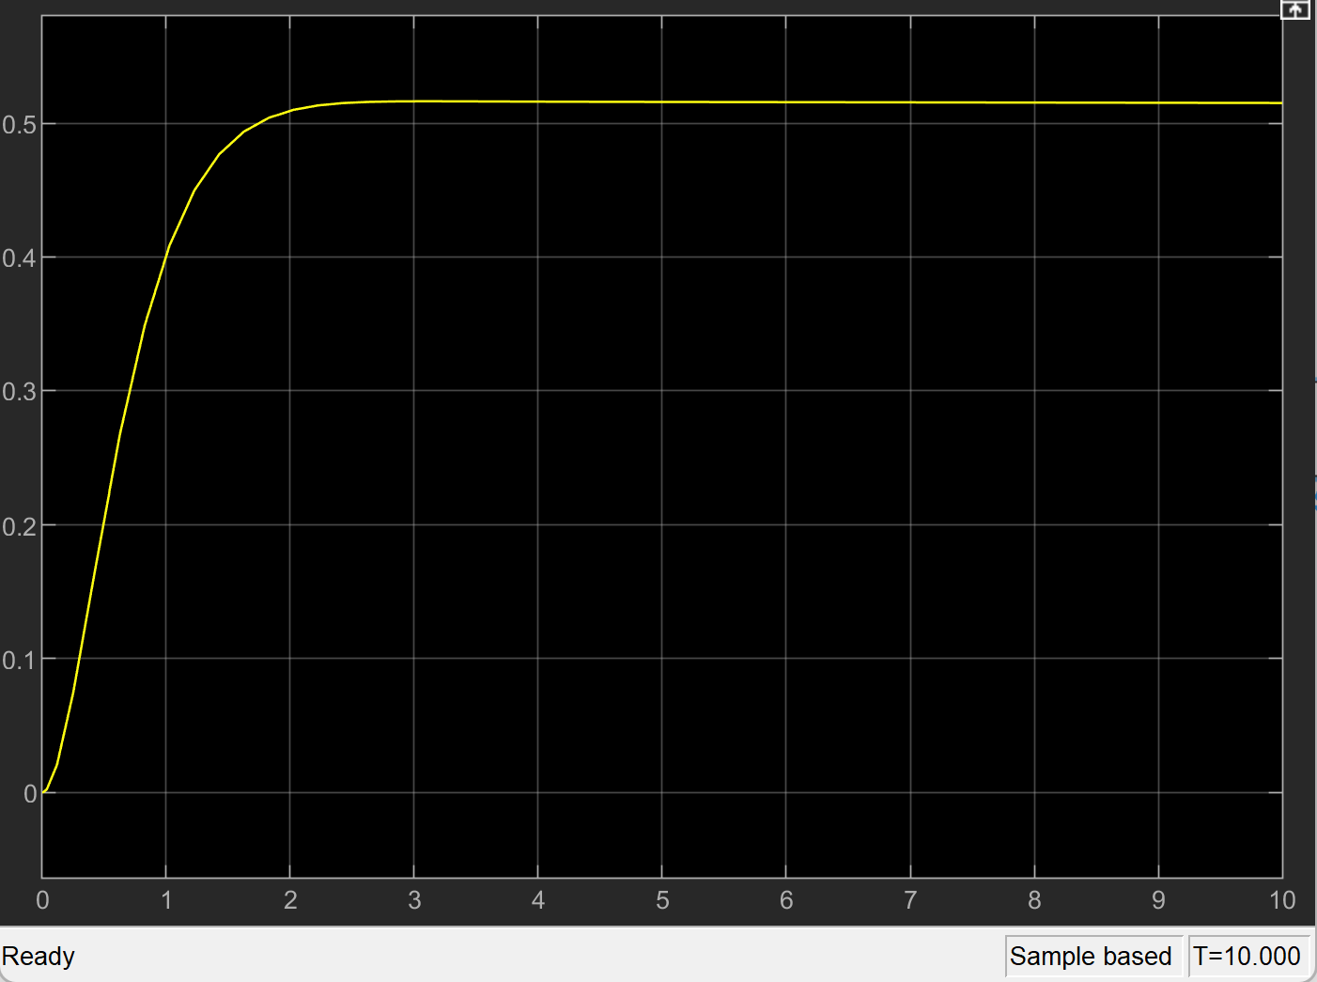
Simulink Ball and Plate Step response

Slide 9
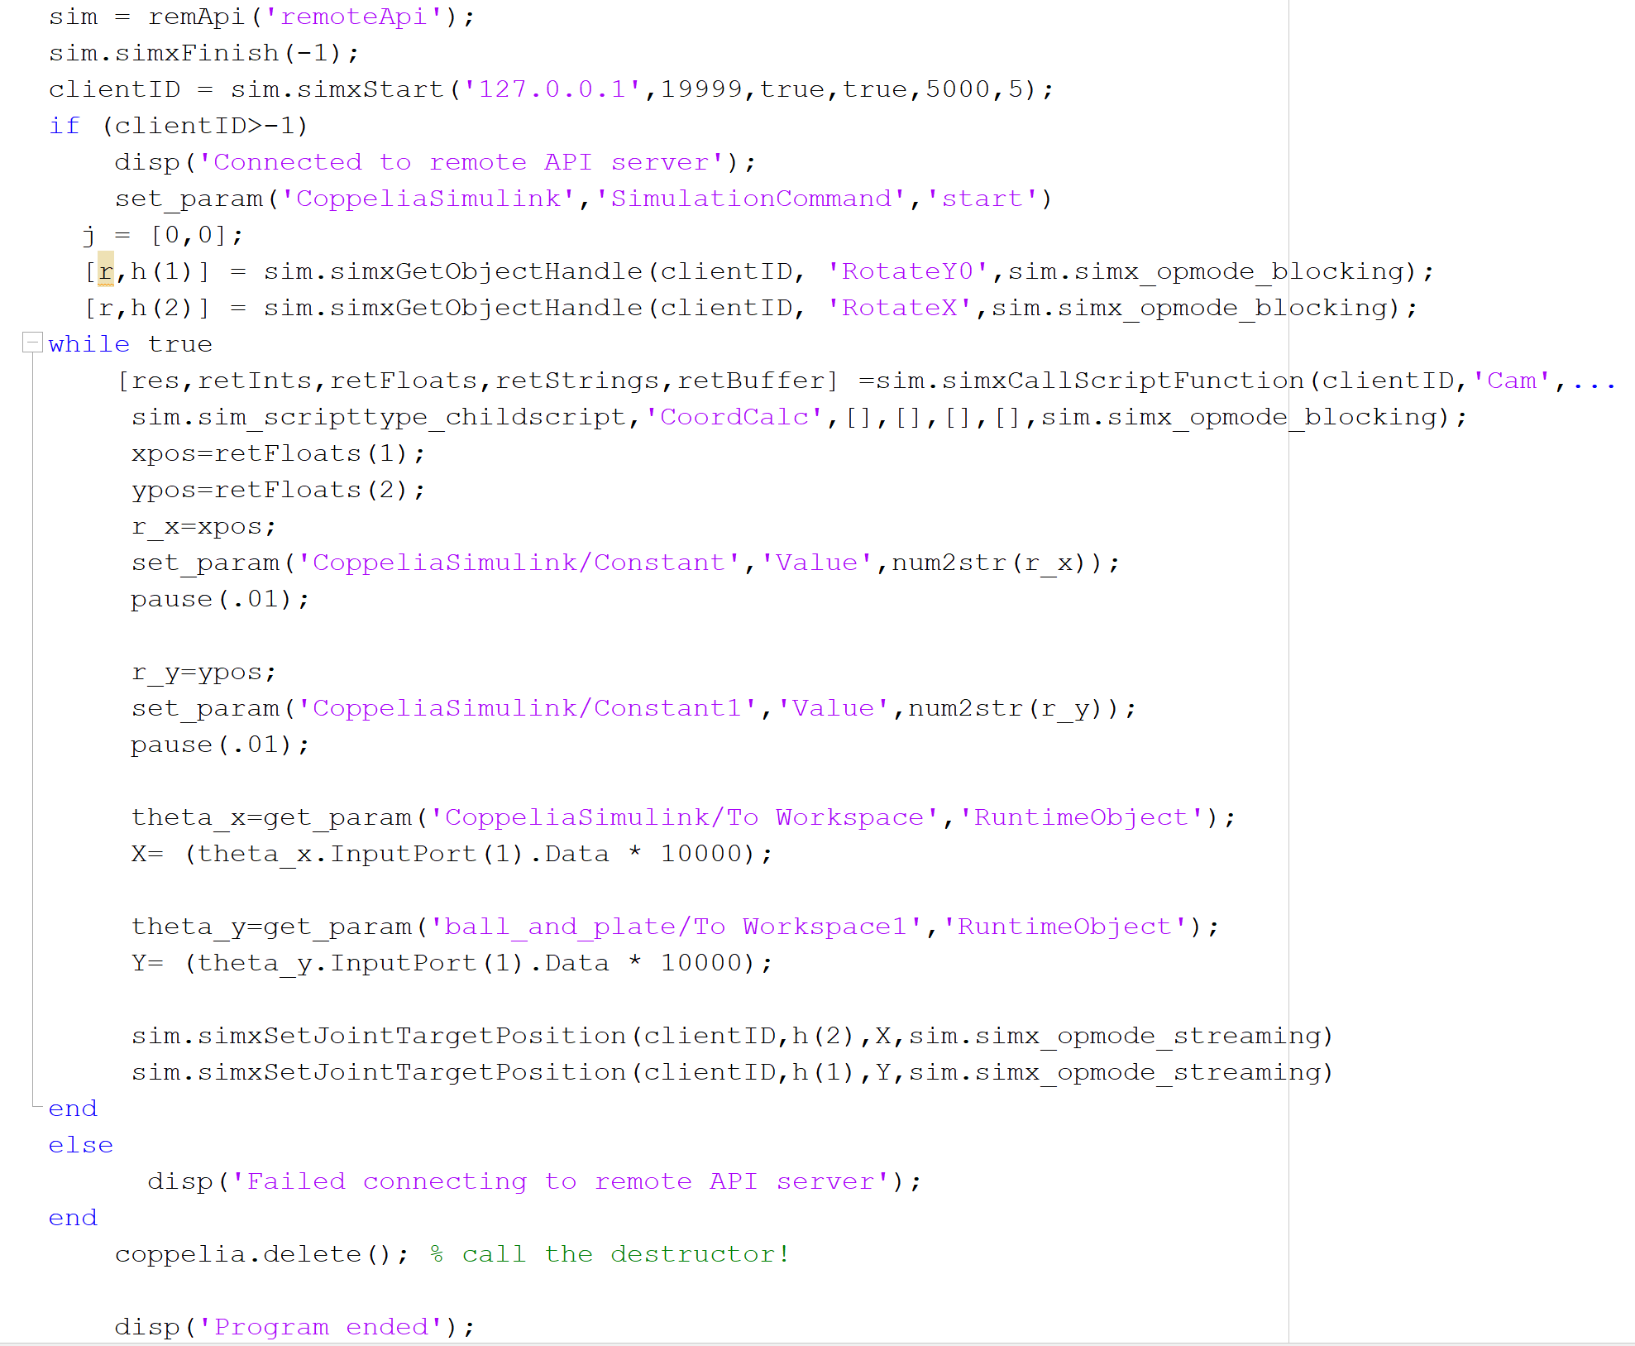
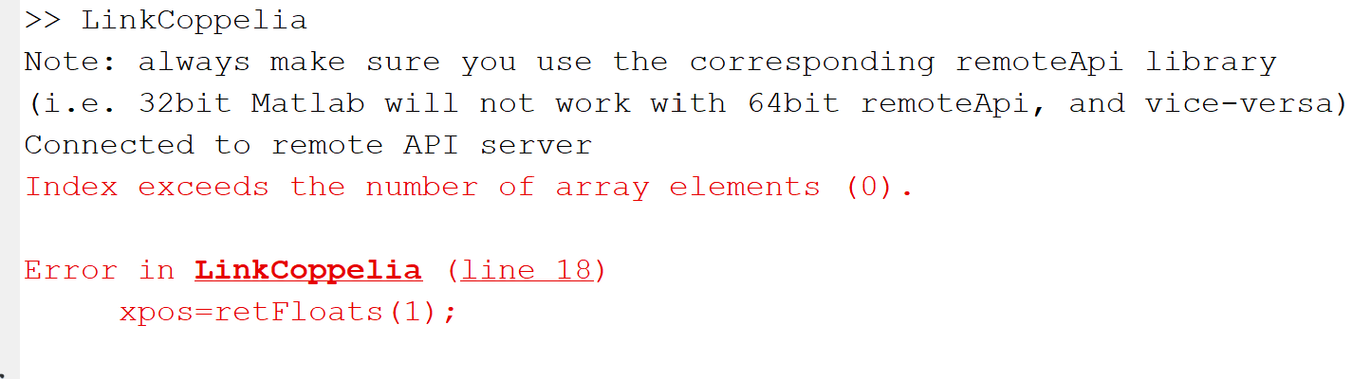
Code

