Slide 1
WordNet Embeddings
CSCI 7000-006 Jake Krol
Notes:
https://aclanthology.org/W18-3016.pdf
Each student should expect to present one research paper during the course. The instructor will ask students to sign up for papers by the end of the first day of class. The instructor will present any unselected papers during the course. Each presentation should take no more than 40 minutes, so that we can have enough time for discussion. The presentation should elaborate on the motivation, related work, research questions, methodology/experimental design, findings, limitations, and future work stated in the paper. To make your presentation more insightful, try to position the paper contribution with respect to the related literature and tell the audience why this work was proposed in the first place, how it advances our understanding about the topic, and how it is different from other related work in the past. You are also encouraged to connect the assigned paper to your own research. You should prepare a set of questions (either written by yourself or based on questions other students post on Canvas) and co-lead an in-class discussion with the instructor after the presentation.
I recommend that you give yourself enough time to read the paper and prepare your presentation. If you encounter any difficulties understanding the technical content of the paper, please attend office hours for help. Due to the increased cap in student enrollment, some presentations will be presented in teams of 2. In these cases, students either have to combine two related papers into their presentation (usually one main and one supporting paper), or present a longer paper (a journal paper). It is important to note that these presentations will also be limited to 40 minutes. So, you and your partner need to coordinate to deliver a joint presentation that fits the time limit.

Slide 2
Motivation & research question

Slide 3
Motivation and research question
Motivation:
There’s minimal existing research which specifically converts semantic networks to embedding spaces (?)
Applications of word embeddings
1. Cognitive science: effectively representing words and their meaning to study thought, reasoning, and actions in humans
2. Machine processing of language: named entity recognition, semantic similarity, discourse analysis, etc
Interoperability between knowledge representations within a field is beneficial to advancing research (?)
Q: How/can semantic networks effectively be embedded and perform well in semantic similarity tasks?

Slide 4
Motivation: personal research
Idea: During NIH summer internship, I had the idea of modeling genomes as text corpora to study biological phenomena; particularly, to discover systems of biological conflict (e.g., the genes involved in viral defense mechanisms)
Logic: gene co-location often implies co-functioning roles. With prior knowledge of bio-conflict genes, the embedding space can reveal new genes and entire systems involved in biological conflict.
Method: Learned gene embeddings with word2vec from large in-house genomics database at NIH
Example document (word2vec input): “gene_{A}+gene_{B}+gene_{C,} …”
Result: Cosine similarity networks are more dense for co-functioning genes.

Slide 5
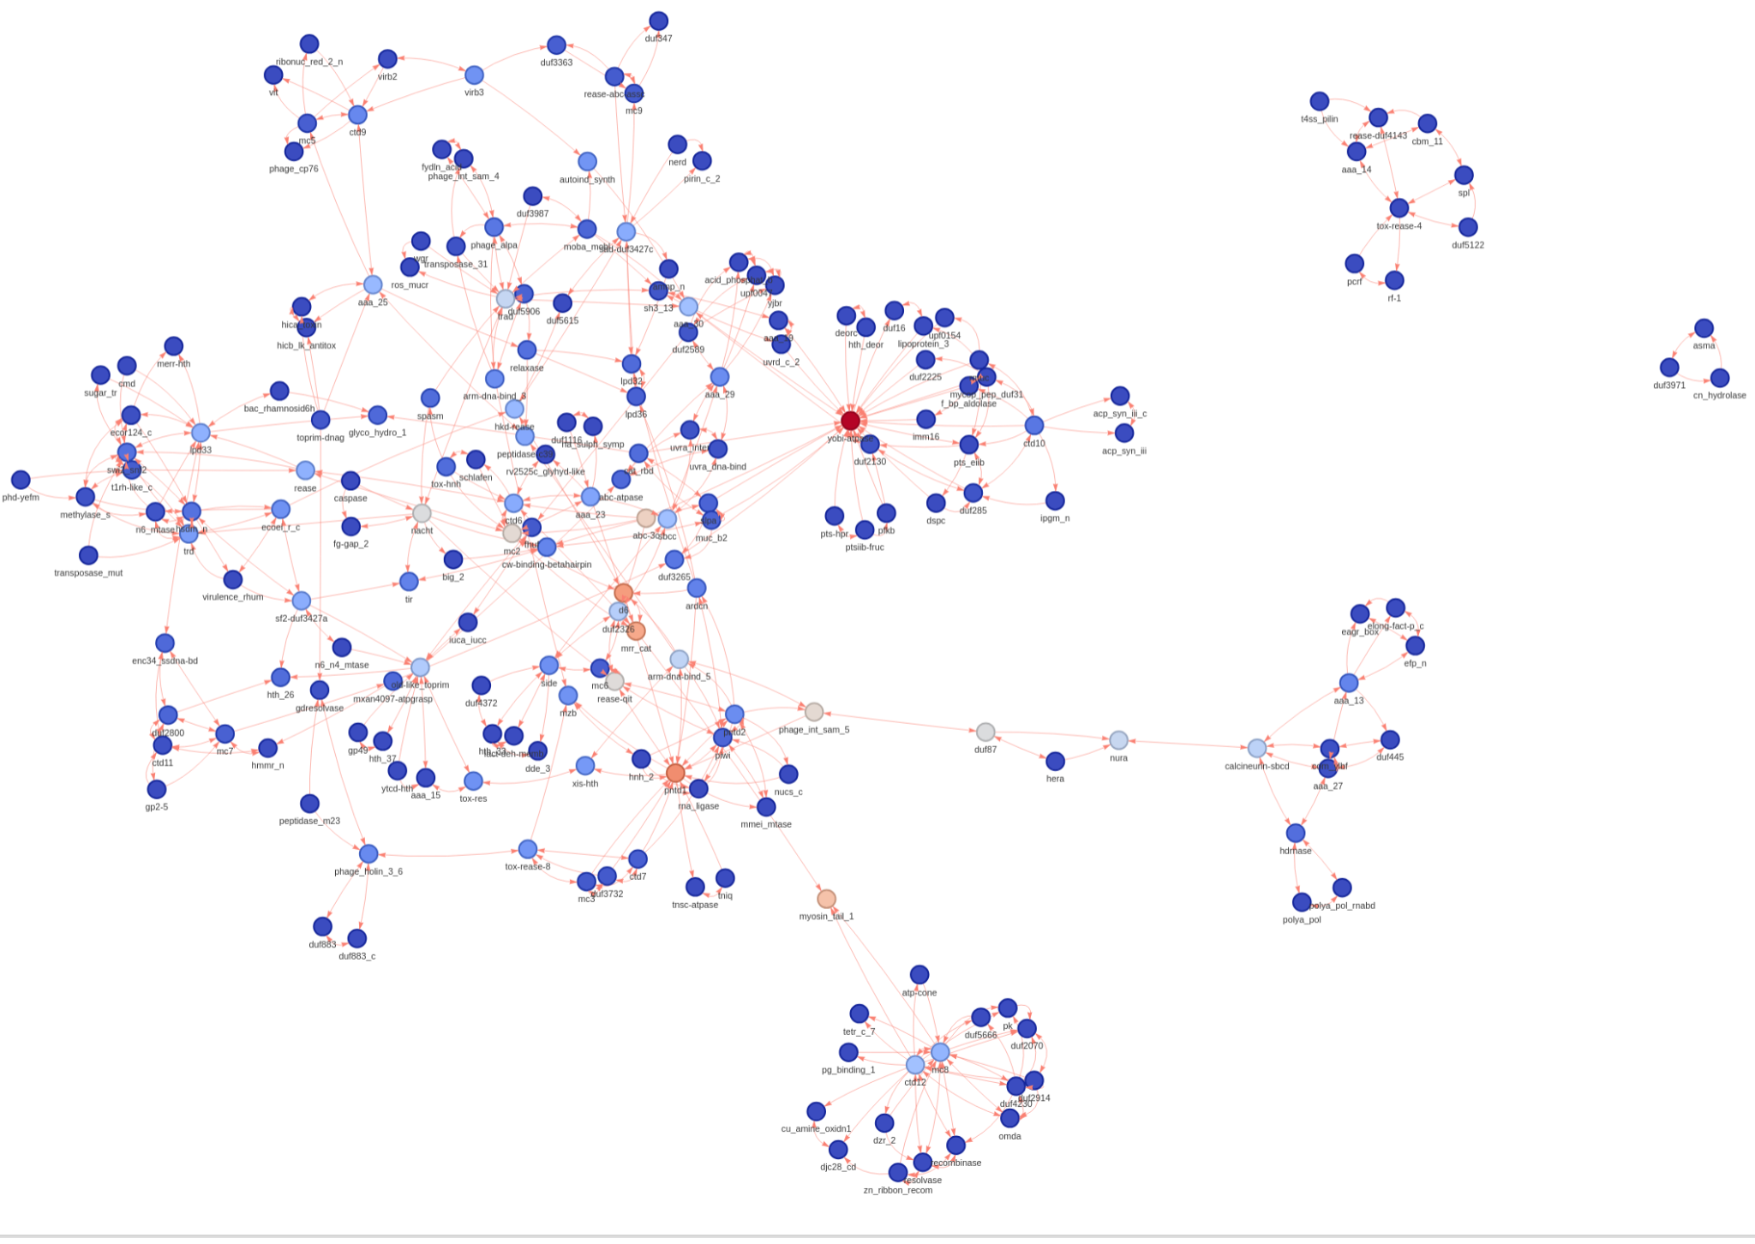
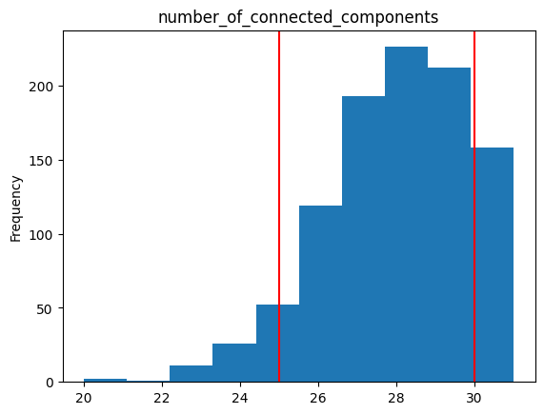
Motivation: personal research
Random gene sample (repeated 1000x), top 5 cossim network (high # of connected components)
Bio-conflict labeled, top 5 cossim network, (3 connected components)

Slide 6
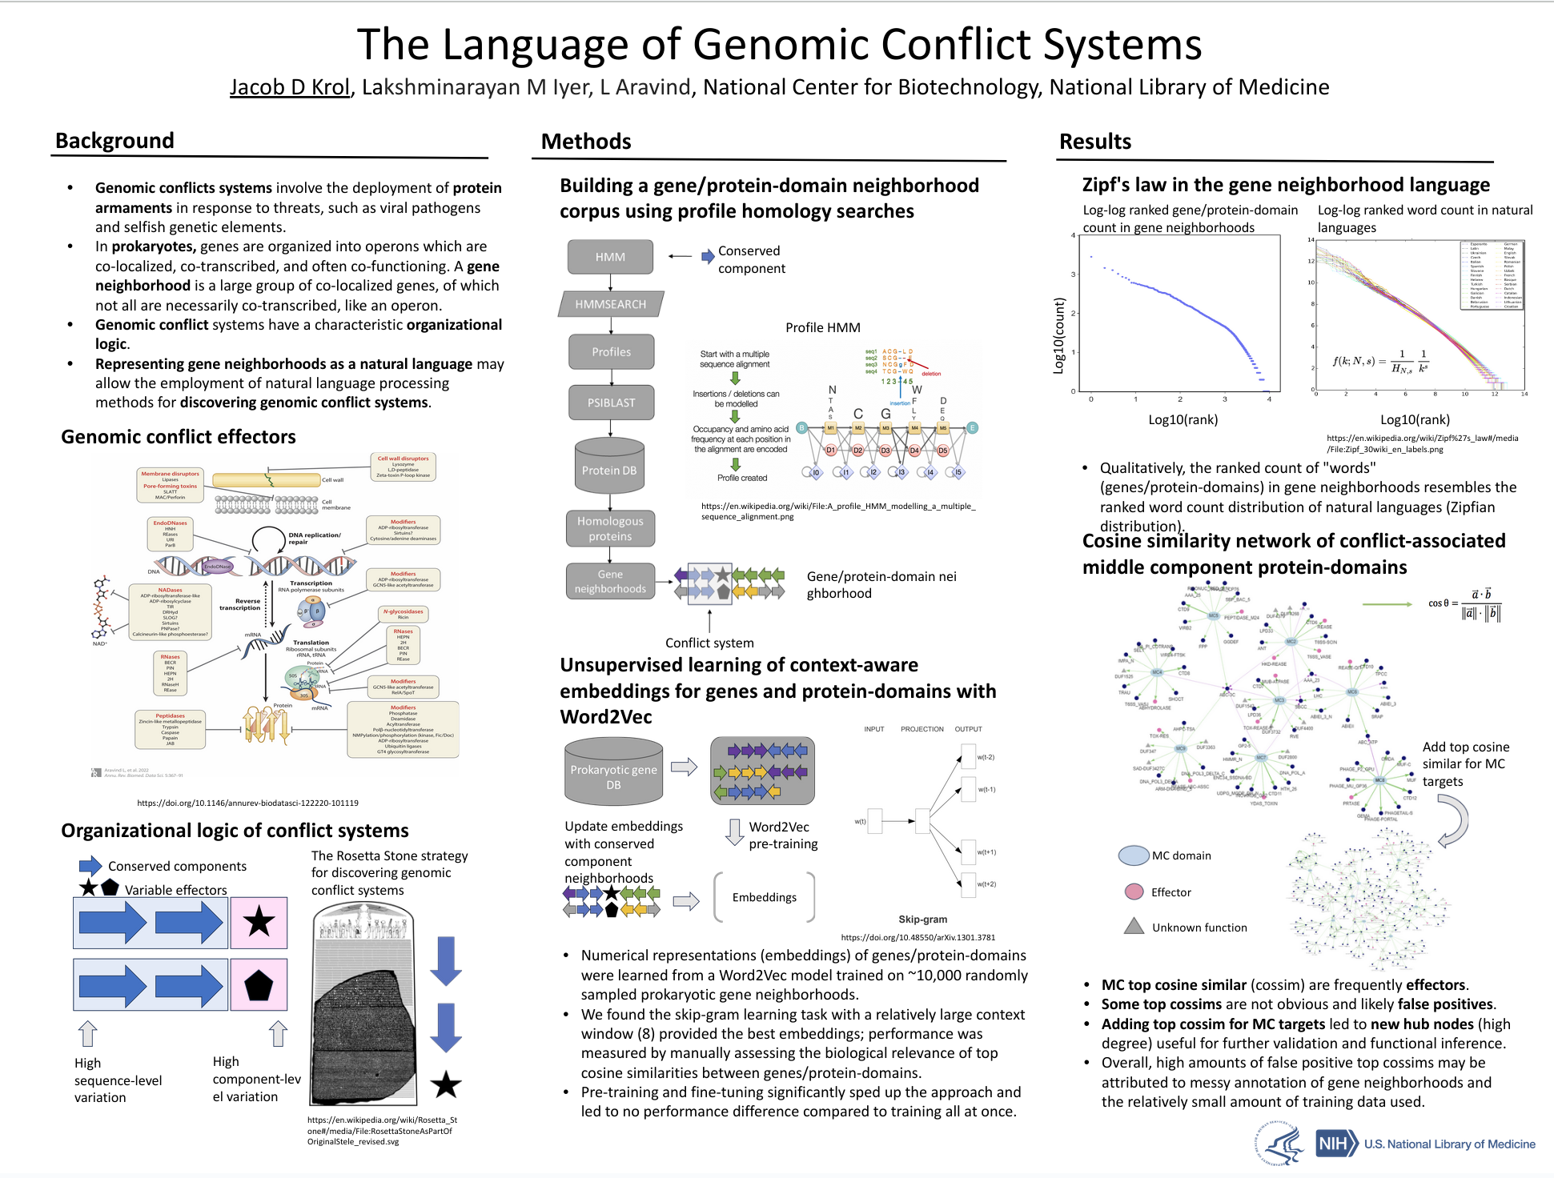

Slide 7
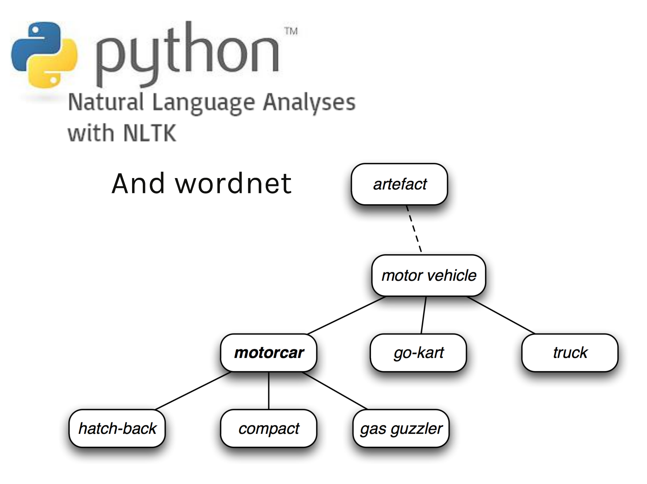
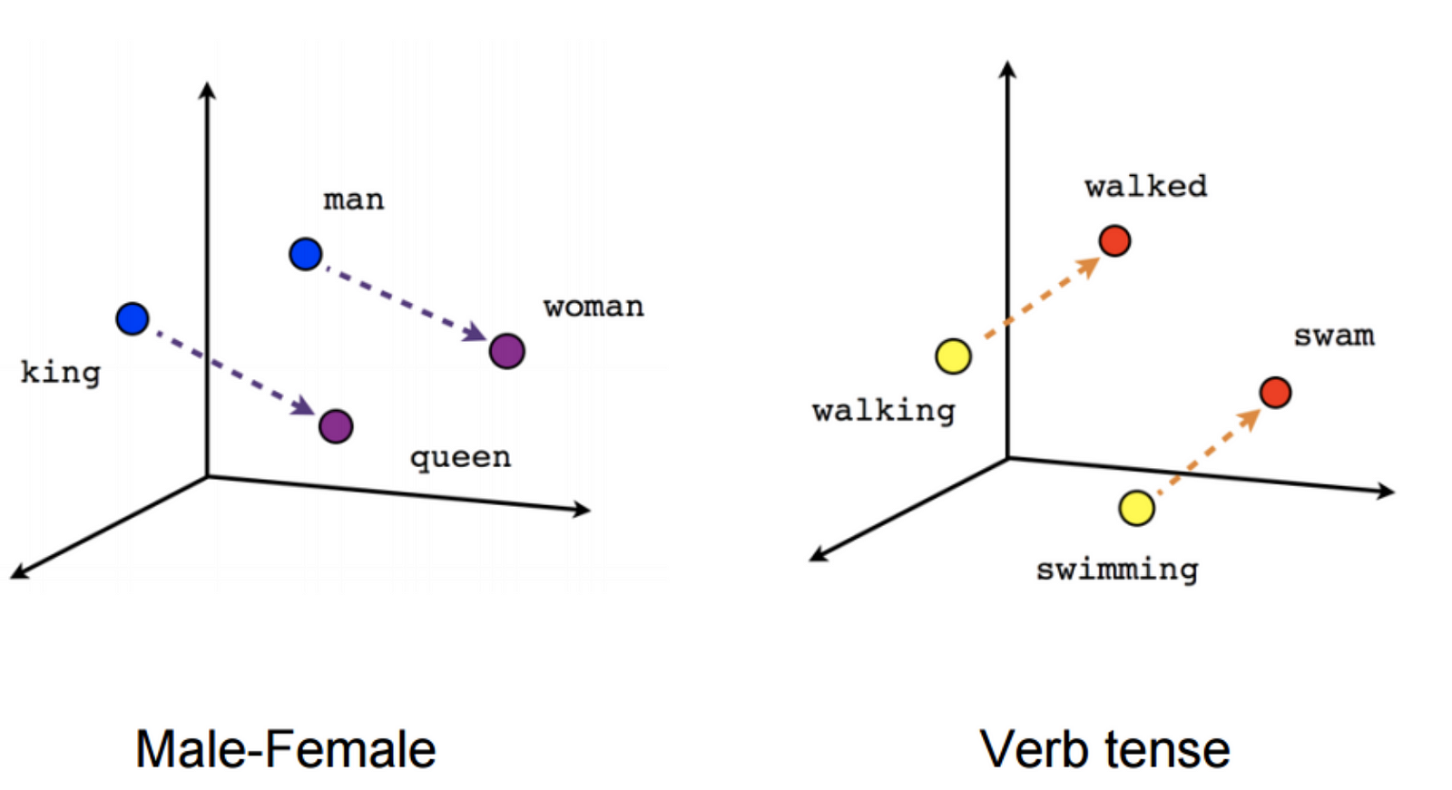
Motivation & related work
3 forms of semantic representation
Network
Feature-based
Embedding space
Convergence

Slide 8
Related work

Slide 9
Related work: forms semantic representations
Networks
Features
Embedding space

Slide 10
Related work: forms semantic representations
Text2network
Semantic networks extracted from text (Herst 1992)
Networks learned from text corpora (Snow 2005)
Task-specific embeddings spaces and networks
Hypernym detection using dependency paths learned from RNNs (Shwartz 2016)
Delineating synonyms and antonyms with syntactic parsers and neural nets (Nguyen 2017)
Classification over distributional word vectors (Baroni 2012, Roller 2014, & Weeds 2014)
Networks2embeddings
Graph-based enhancement of embeddings (Faruqui 2015)
TF-IDF plus semantic networks to embeddings (Camacho-Collados 2015)
Semantic hierarchies plus images to embeddings (Vendrov 2015)
Non-euclidean (hyperbolic) embeddings (Nickel & Kiela 2016)
General knowledge graph embedding methods
TransE, Google (2013): head entity plus relationship = tail entity
TransR (2015): entity and relationship spaces are distinct
HolE (2016): holographic embeddings
Q: How/can semantic networks effectively be embedded and perform well in semantic similarity tasks?

Slide 11
Methods

Slide 12

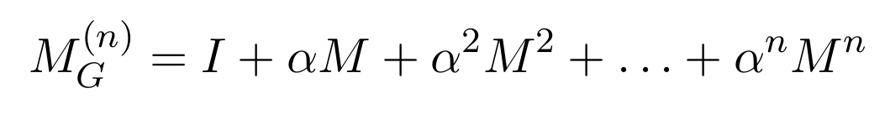
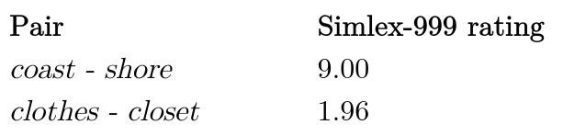
Methods: overview
Objective: from semantic network to embeddings
Data: WordNet
Embeddings: derived from path count and path distance between nodes (words)
Normalization: PMI+ & L2
Dimensionality reduction: PCA
Evaluation:
Data: SimLex-999 (& others)
Metric: Spearman (& Pearson) correlation of SimLex-999 score and semantic similarity (i.e., cosine similarity)
Parameter tuning

Slide 13
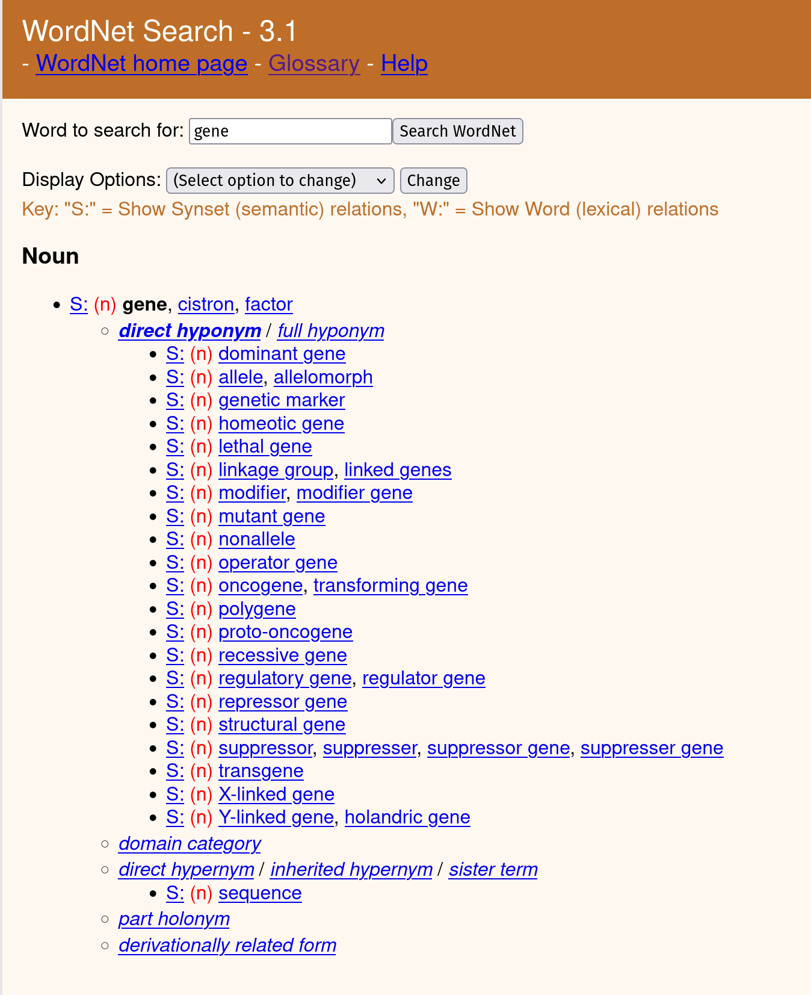
Methods: WordNet
WordNet: Expert curated semantic knowledge graph
Nodes: “synsets” (word sets)
Edges: semantic relationships
25 types
E.g., hyponym
Allele is a hyponym of gene
Unweighted*
~120k total synsets subset to 60k*
Removed more sparse synsets
Adjacency matrix of WordNet is used to derive embeddings
http://wordnetweb.princeton.edu

Slide 14
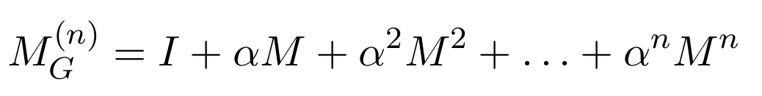
Methods: WordNet to embedding (wnet2vec)
Logic: word pairs with many short paths between them are semantically similar
Implementation: cumulative addition of Me (e = path length) scaled by a decay term ⍺^{e}
Transformation:
Positive pointwise mutual information (PMI+)
Reducing degree bias
L2 normalization
PCA dimensionality reduction (850 PCs)
Result: 850 dimension embedding space

Slide 15
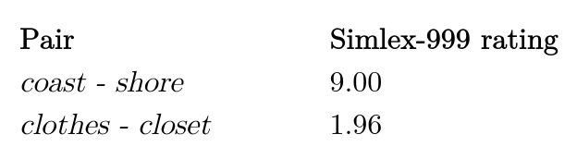
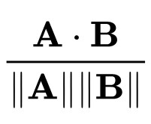
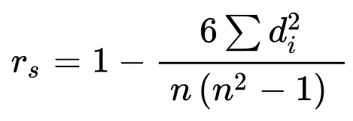
Methods: evaluation
Data: SimLex-999
Other: RG1963, Wordsim-353-similarity, Wordsim-353-relatedness, MEN, MTurk-771
Metric: spearman correlation between SimLex-999 rating and embedding similarity (scaled cosine similarity)

Slide 16
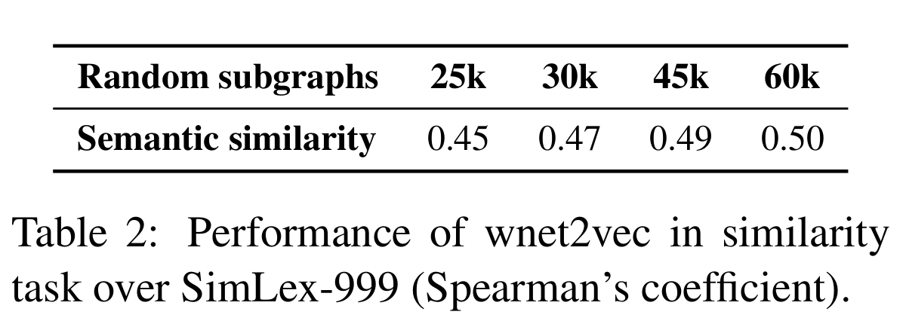
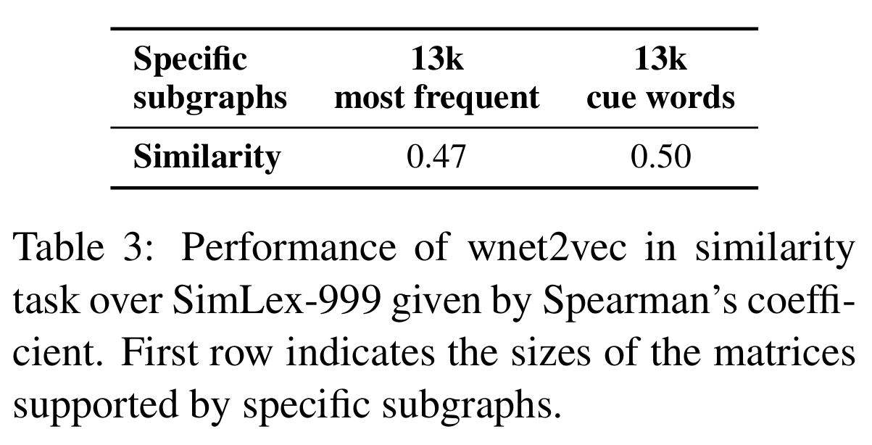
Methods: Parameter tuning, choosing the sub-graph
Motivation: memory issues for full 120k graph
WordNet subsetting
25k, 30k, 45k, & 60k sparsity-based subset
Sort by sparsity and randomly remove
13k most common English words
13k “cue” words from psycholinguistic experiments
Argument: high frequency words are more ambiguous and have more relationships in the graph. Seemingly, using high frequency words and increasing the graphs size improve semantic sim performance.
Note: I’ve found high frequency tokens are problematic when applying Word2Vec to genomics.
Weighing edges by type did not improve performance

Slide 17
Methods: parameter tuning
⍺=0.75 best out of [0.65,0.85] tested
Dimensionality reduction
PCA performed better than encoder-decoder neural network
850 PCs > 100,300, 1000, and 3000 PCs
L2 normalization & PMI+ consistently aided performance (ablation test)
Summary: parameters were tested reasonably, but not reported well

Slide 18
Findings

Slide 19
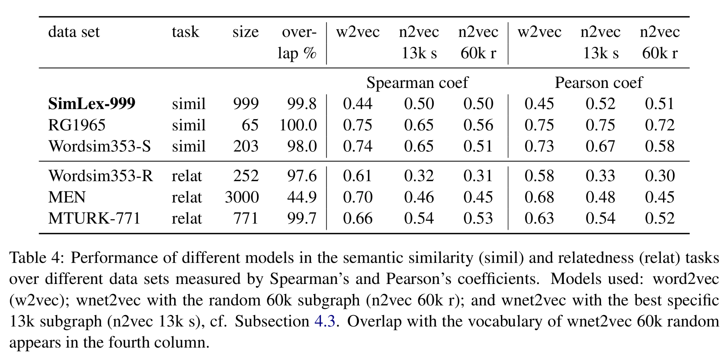
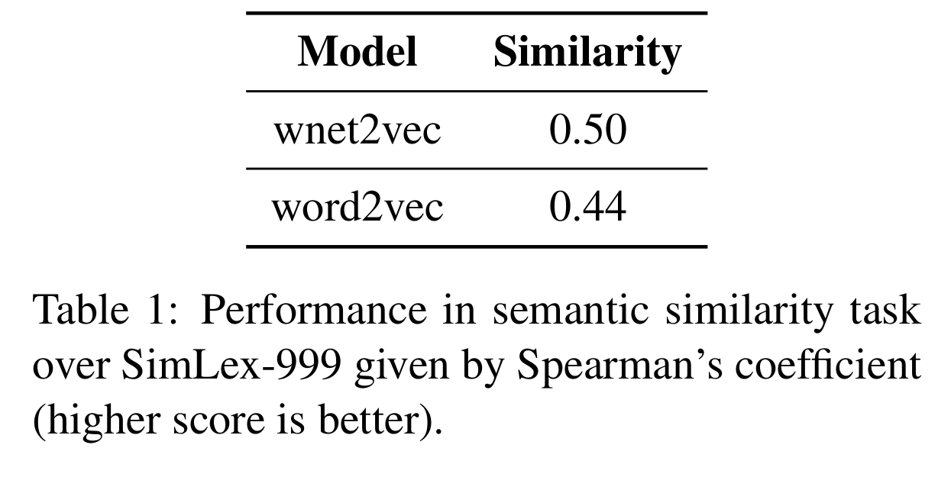
Findings: performance of wnet2vec embeddings
wnet2vec embedding performance is better on SimLex-999 (semantic similarity task), but worse on other datasets and for semantic relation tasks

Slide 20
Findings: conclusions
Developed a method for learning semantic embeddings from a semantic network
Applied method to WordNet semantic network
Achieved comparable performance to word2vec

Slide 21
Future work and limitations (?)

Slide 22
Critiques

Slide 23
Critiques
Why were the following methods not benchmarked against their approach?
General graph embedding methods (e.g., TransE)
What is the impact? Are general knowledge graph embedding frameworks sufficient?
Introductory claims suggest the interoperability between knowledge representations (i.e., graphs, features, and embedding spaces) is beneficial for advancing research, but the results and discussion do not build upon this.

Slide 24
Questions

Slide 25
Discussion questions
Do you expect WordNet would perform better or worse than general knowledge graph embedding methods?
What were the authors’ final conclusions and how does this compare to the results?
How can a research paper discuss future directions and limitations (without painting a target on their back for reviewers)?

