Slide 1
FlyTracker: design and implementation
Master thesis project in engineering in socio-technical systems

Slide 2
Project background
Neuroscience department at BMC
Motion vision
Behavioural studys on flies

Slide 3
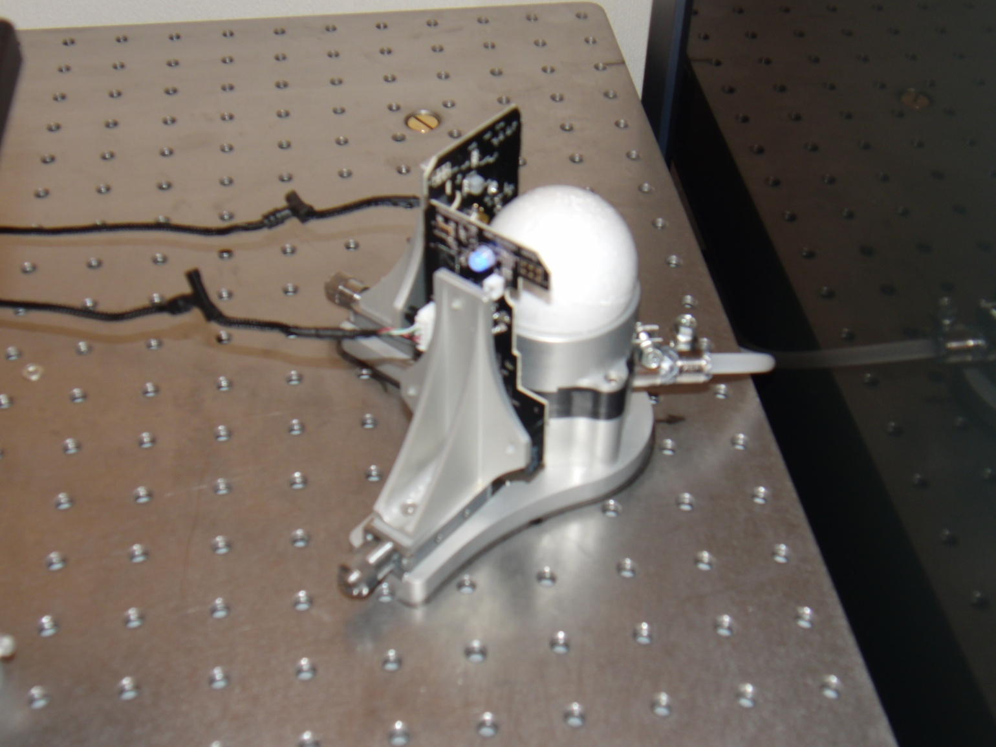
Track ball setup
Experiment aim:
Study fly movement as a function of visual stimulus
Thesis purpose:
Design and implement a new user friendly software system

Slide 4
Project plan
20 weeks
Agile user-centered process
The plan:
Initial phase (3 weeks)
Implementation (10 weeks)
Evaluation (2 weeks)
Finalizing report (5 weeks)

Slide 5
Requirements engineering
Identification
Definition
Prioritization

Slide 6
Requirements engineering cont.
Result:
Raw mouse data → Coordinates in the fly’s coordinate plane
Save and display data in appropriate format
Trigger system
Low latency

Slide 7
Design
Agile manifesto
User focus
Paper prototypes
Result:
Calibration part
Experimental part

Slide 8
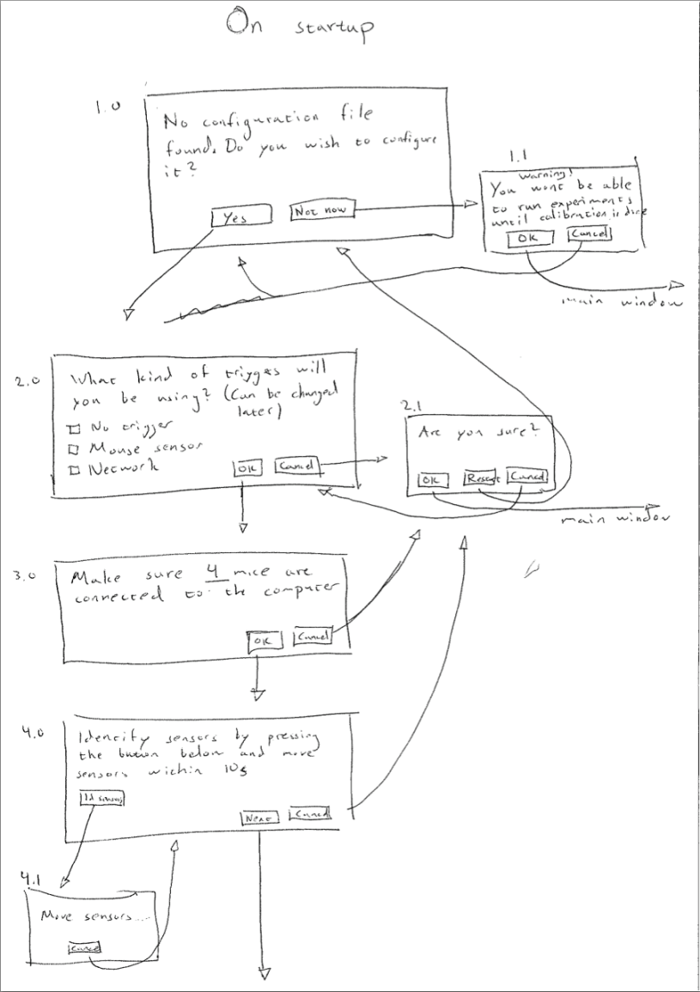
Calibration
Calibrate measurement to coordinates
Tricky!
Physical setup
Design of interactive calibration
Iterative design

Slide 9
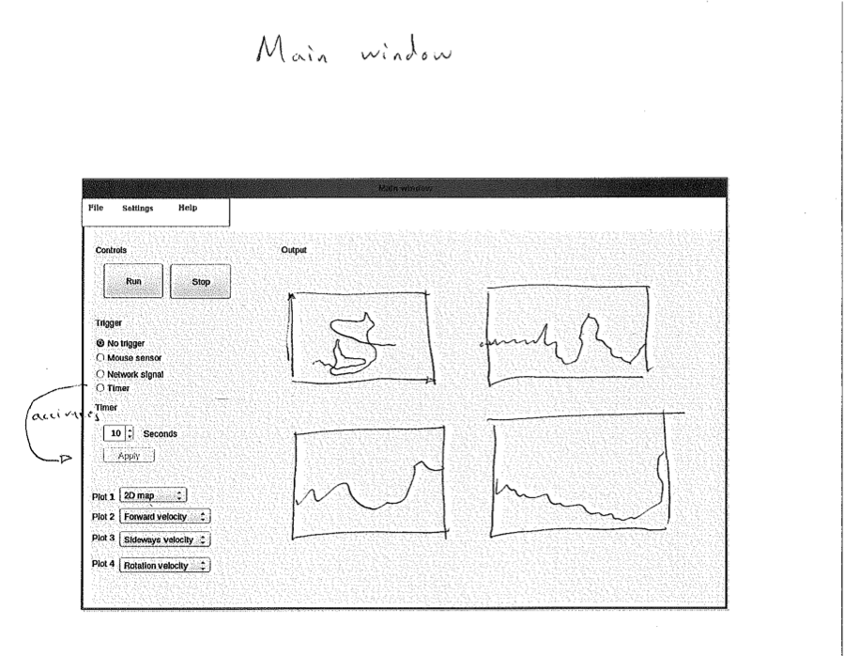
The main view
Straight forward
Following usability heuristics

Slide 10
Implementation
Working in sprints
Platform:
Ubuntu
Matlab
Python
The Python-package
Reads mice
Deals with starting and stopping the recording

Slide 11
Implementation cont.
The Matlab-package
Main application
GUI
Calculating virtual fly movement

Slide 12
The result: FlyTracker
*Video of a fly moving and corresponding plots in real time in FlyTracker*

Slide 13
Evaluation
Interview with the main user
Nielsen’s usability heuristics
Results:
Overall high level of usability
2D-plot, real time plotting and saving best functions
Major issue: Losing control of mouse cursor during experiments
Minor issues: Display more info, change wording

Slide 14
Conclusion
Purpose: User friendly and functional software system
Result: FlyTracker
Issues:
Calibration
Trigger
Shorter sprints
Future directions
Naive user evaluation
Closed-loop system

