Slide 1
FlyTracker: design and implementation
Master thesis project in engineering in socio-technical systems

Slide 2
Project background
Motion vision
Behavioural studys on flies

Slide 3
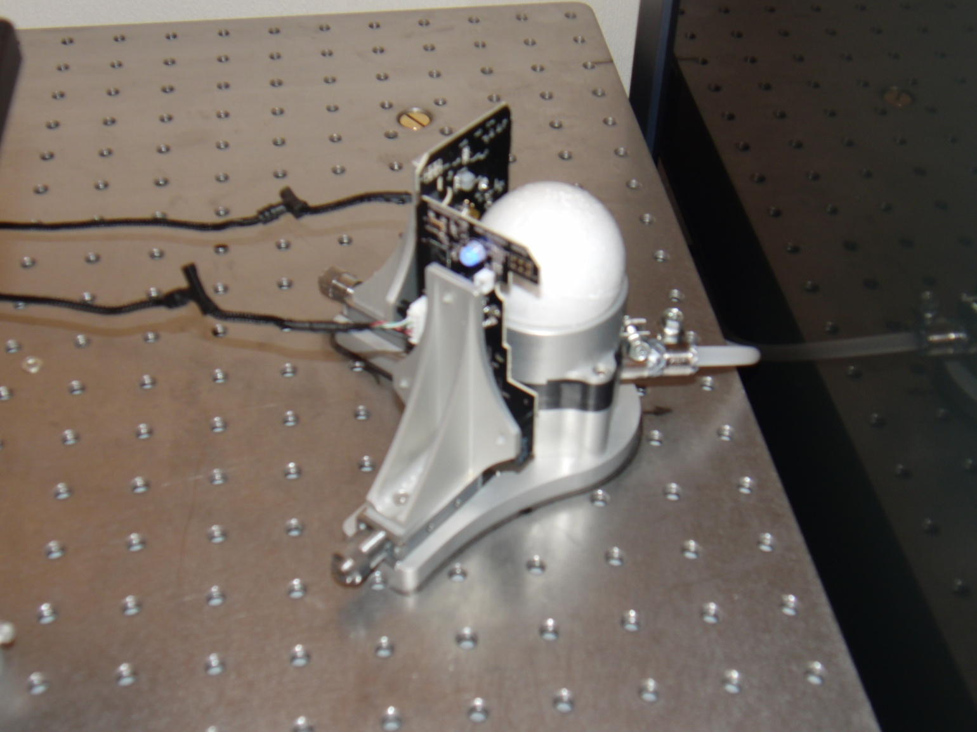
Track ball setup

Slide 4
Purpose
Develop an user-friendly and functional software system

Slide 5
Project plan
Analysis and design
Implementation
Evaluation
Finalizing report

Slide 6
Analysis
Work modeling
User analysis
Scenarios
Contextual design
Model → design

Slide 7
Design
Requirements engineering
Identification
Definition
Prioritization
Paper prototype

Slide 8
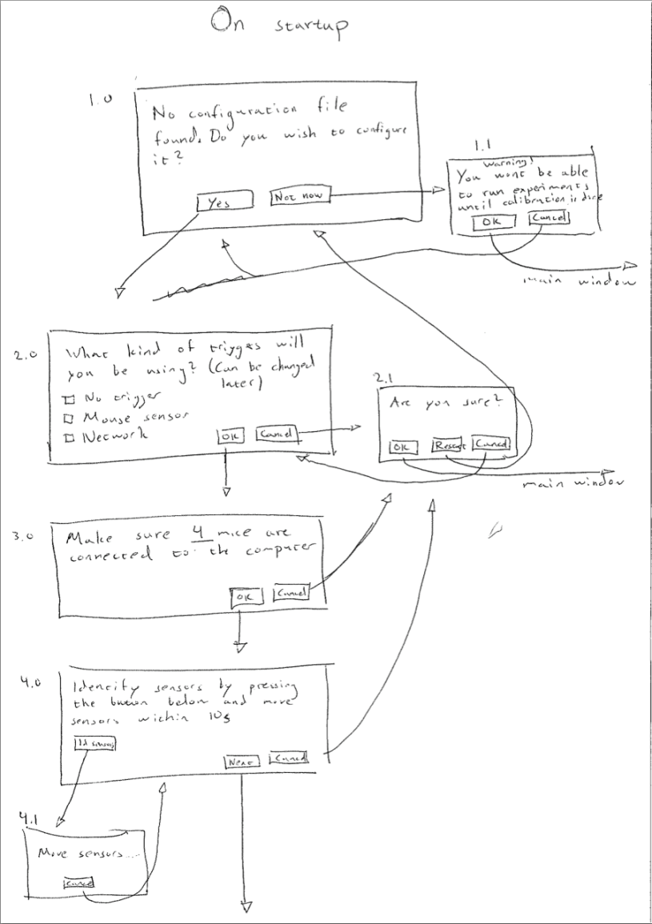
Paper prototype

Slide 9
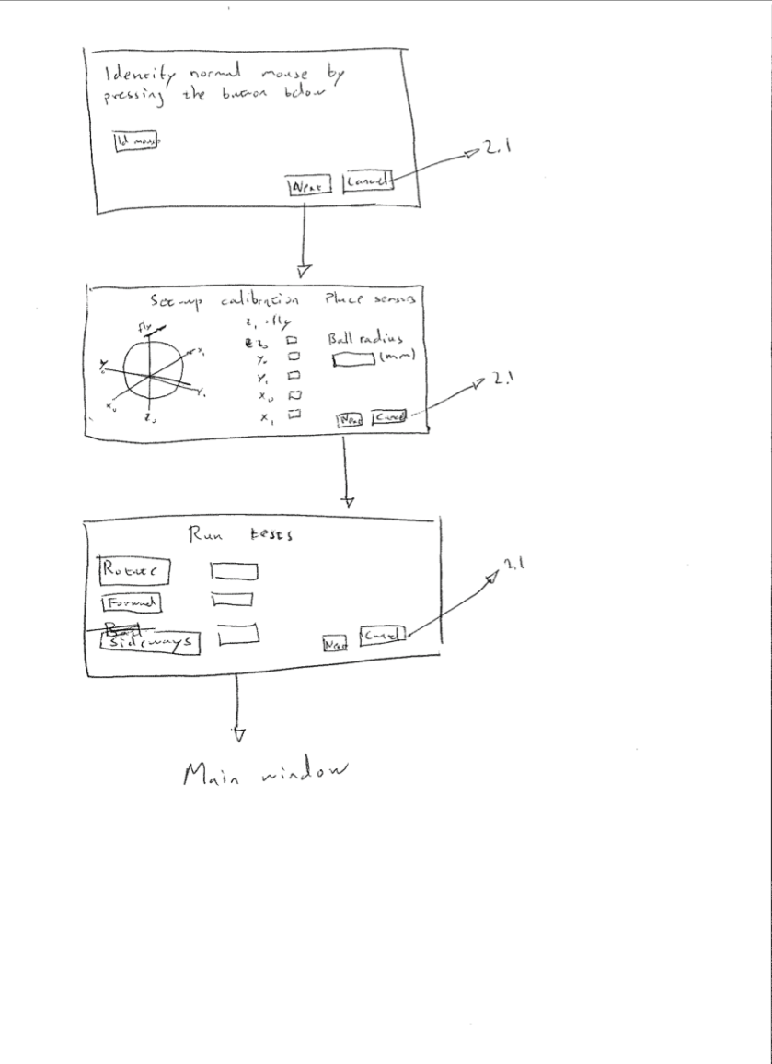
Paper prototype

Slide 10
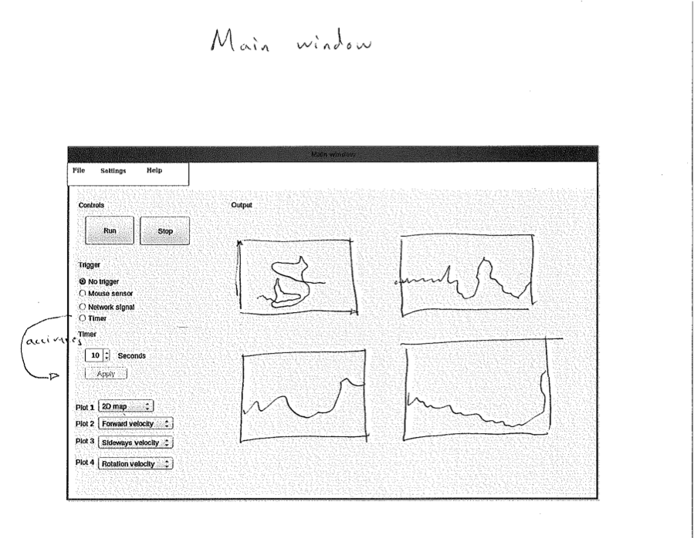
Paper prototype

Slide 11
Implementation
Platform:
Ubuntu
Matlab
Python
The Python-package
Reads mice
Deals with starting and stopping the recording

Slide 12
Implementation cont.
The Matlab-package
Main application
GUI
Data processing

Slide 13
The result: FlyTracker
*Video of a fly moving and corresponding plots in real time in FlyTracker*

Slide 14
Evaluation
Coming later...

Slide 15
Conclusion
...

