Slide 1
FlyTracker: design and implementation
Master thesis project in engineering in socio-technical systems

Slide 2
Project background
Neuroscience department at BMC
Motion vision
Behavioural studys on flies

Slide 3
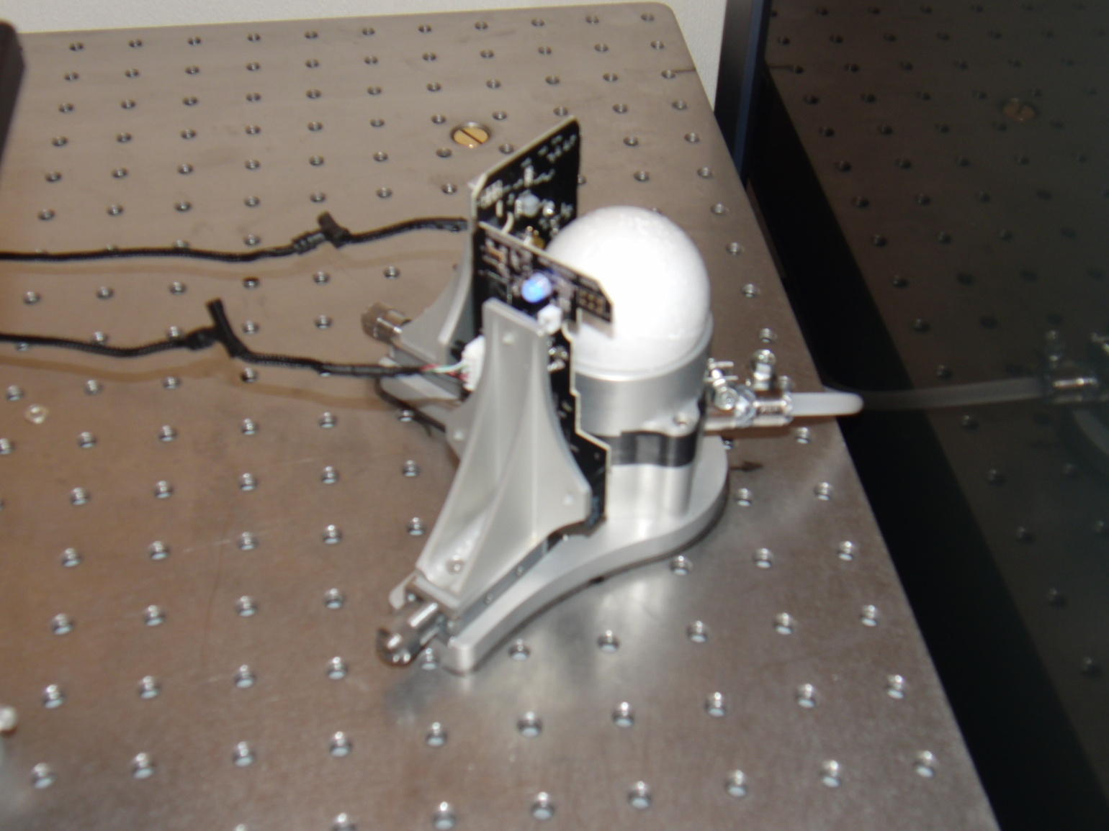
Track ball setup

Slide 4
Purpose
Develop a new software system:
Reads and process mouse data
Saves and display output
User friendly!

Slide 5
Project plan
Analysis and design
Implementation
Evaluation
Finalizing report

Slide 6
Analysis
Requirements engineering
Identification
Definition
Prioritization
User analyis
System has two main parts
Calibration
Experiments
Model → design

Slide 7
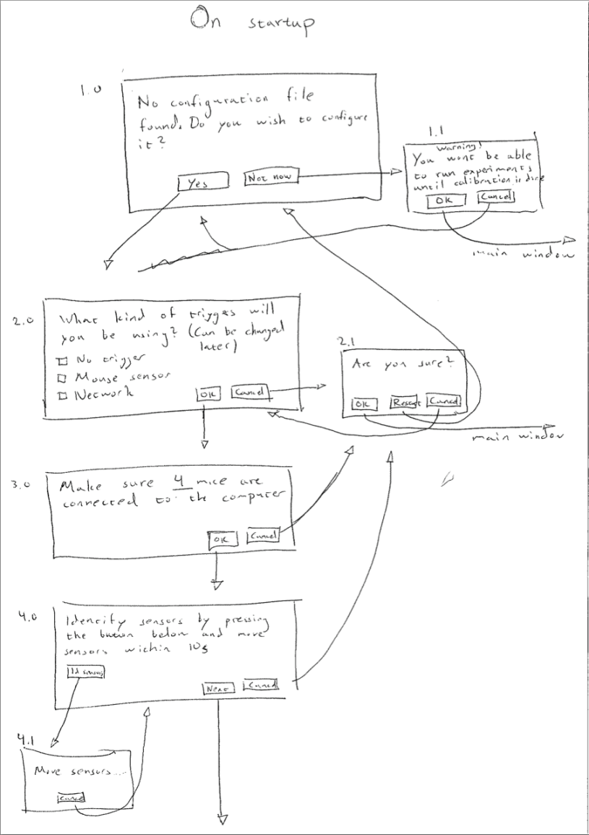
Paper prototype

Slide 8
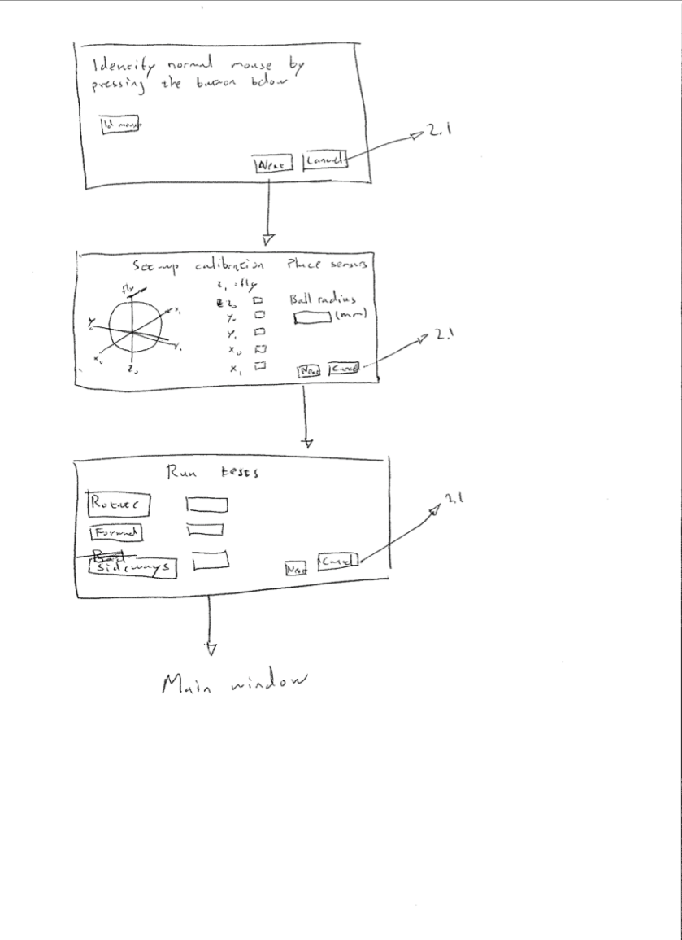
Paper prototype

Slide 9
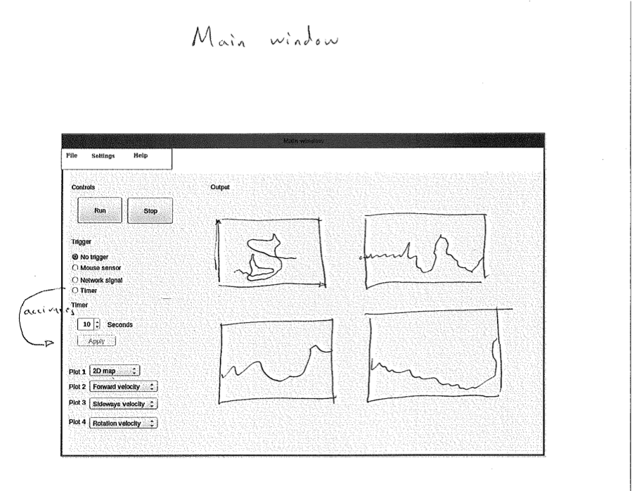
Paper prototype

Slide 10
Implementation
Working in sprints
Platform:
Ubuntu
Matlab
Python
The Python-package
Reads mice
Deals with starting and stopping the recording

Slide 11
Implementation cont.
The Matlab-package
Main application
GUI
Data processing

Slide 12
The result: FlyTracker
*Video of a fly moving and corresponding plots in real time in FlyTracker*

Slide 13
Evaluation
Coming later...

Slide 14
Conclusion
Purpose: User friendly and functional software system
Result: FlyTracker
Issues:
Trigger
Calibration
Future research
Naive user evaluation
Closed-loop system

