Slide 1
FlyTracker: design and implementation
Master thesis project in engineering in socio-technical systems

Slide 2
Project background
Neuroscience department at BMC
Motion vision
Behavioural studys on flies

Slide 3
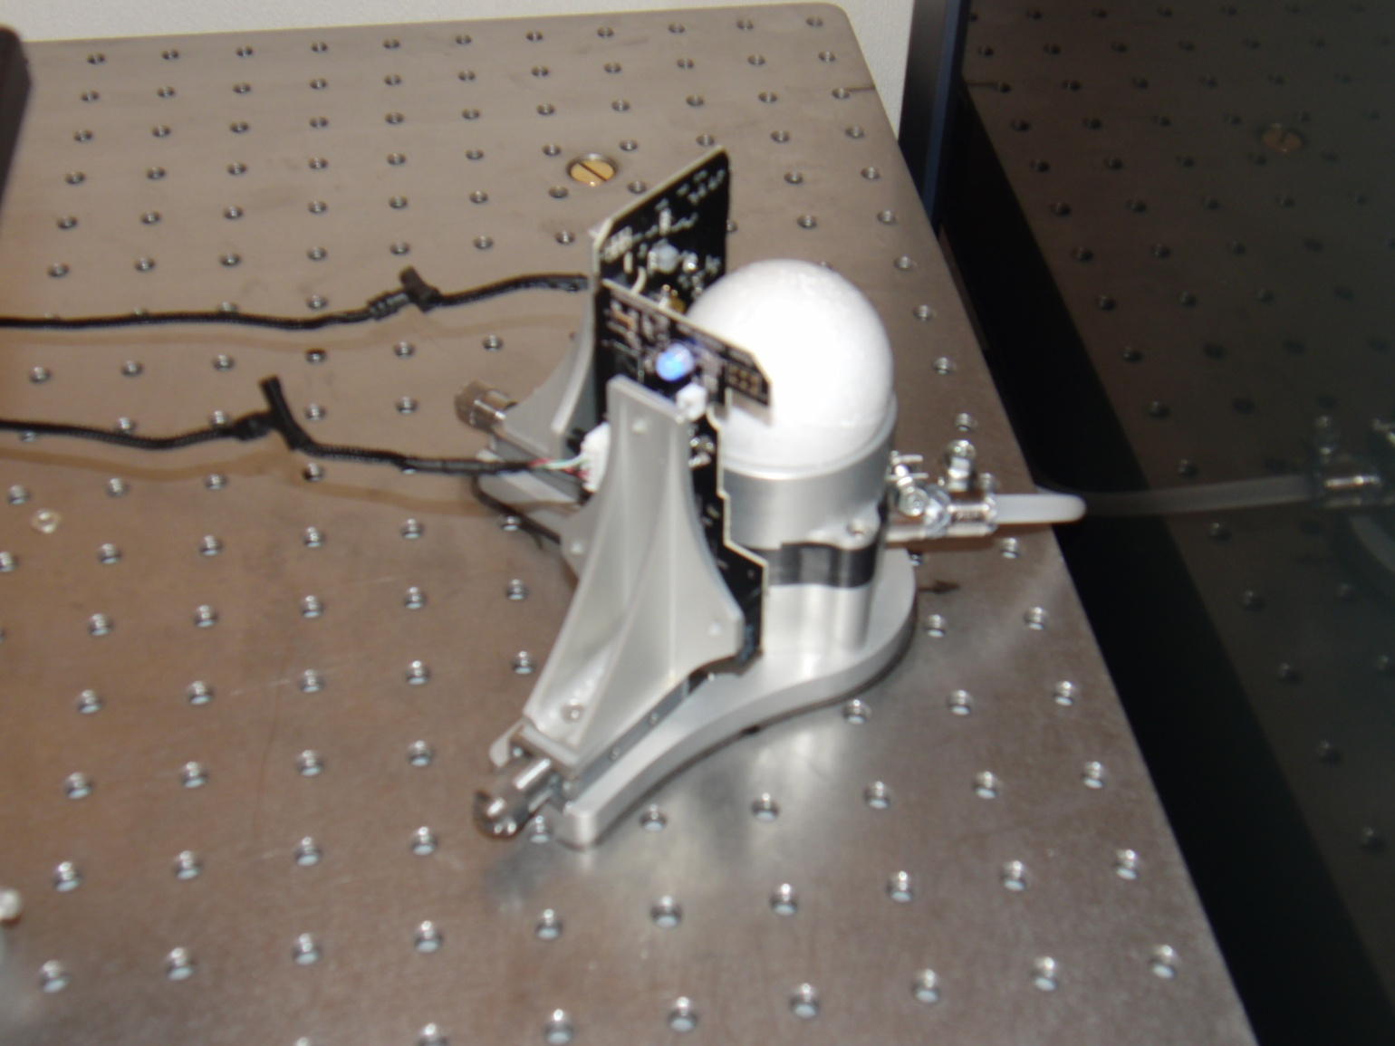
Track ball setup
Experiment aim:
Study fly movement as a function of visual stimulus

Slide 4
Purpose
Develop a new software system:
Reads and process mouse data
Saves and display output
User friendly!

Slide 5
Project plan
20 weeks
Agile user-centered process
The plan:
Initial phase (3 weeks)
Implementation (10 weeks)
Evaluation (2 weeks)
Finalizing report (5 weeks)

Slide 6
Analysis
Requirements engineering
Identification
Definition
Prioritization
Design
Agile manifesto
User focus
Two main parts

Slide 7
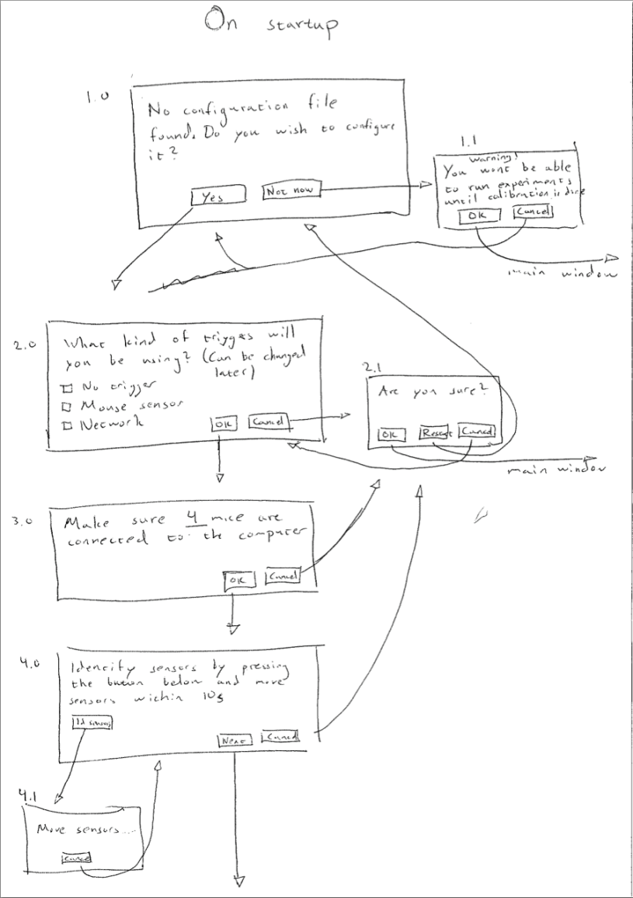
Calibration
Tricky!
Iterative design

Slide 8
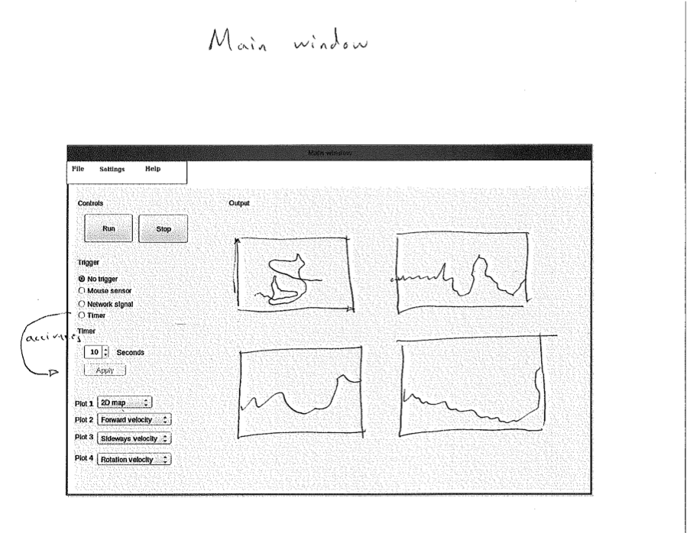
The main view
Straight forward
Following usability heuristics

Slide 9
Implementation
Working in sprints
Platform:
Ubuntu
Matlab
Python
The Python-package
Reads mice
Deals with starting and stopping the recording

Slide 10
Implementation cont.
The Matlab-package
Main application
GUI
Calculating virtual fly movement

Slide 11
The result: FlyTracker
*Video of a fly moving and corresponding plots in real time in FlyTracker*

Slide 12
Evaluation
....

Slide 13
Conclusion
Purpose: User friendly and functional software system
Result: FlyTracker
Issues:
Trigger
Calibration
Shorter sprints
Future directions
Naive user evaluation
Closed-loop system

